Slide 1






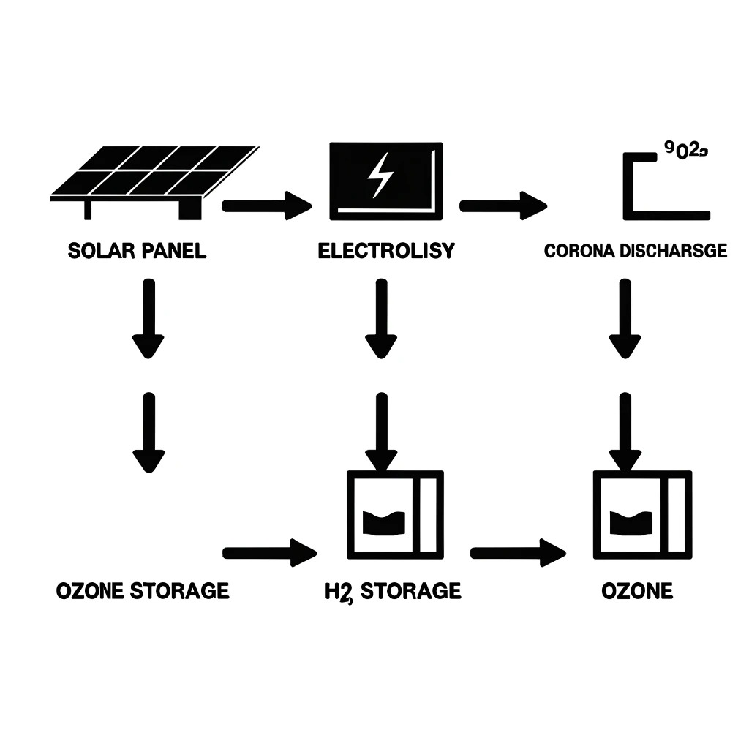
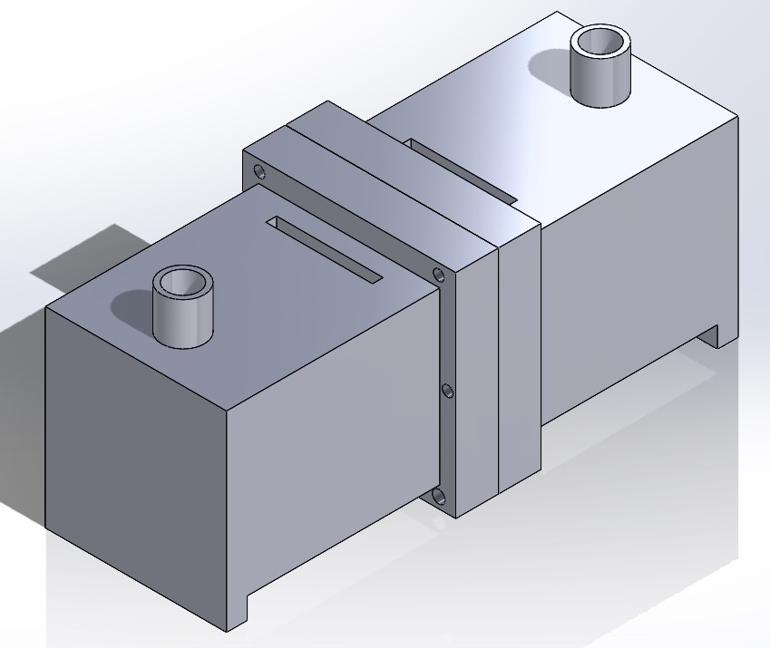
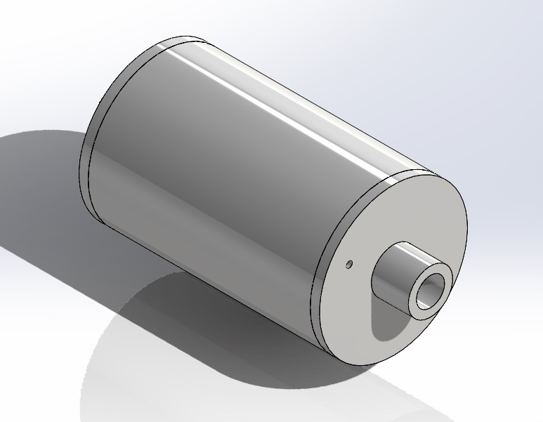
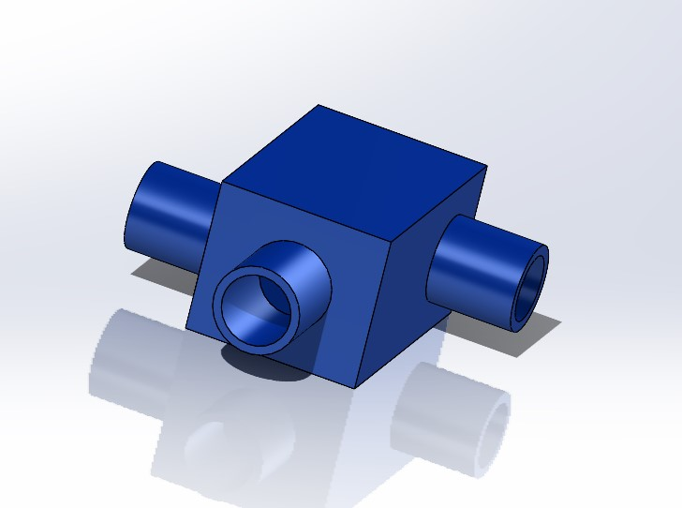
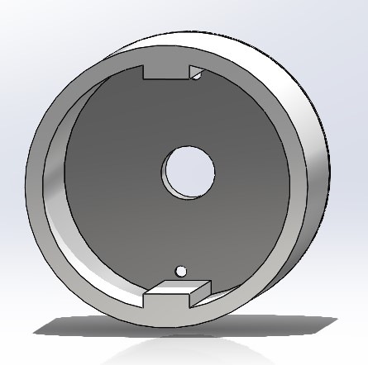
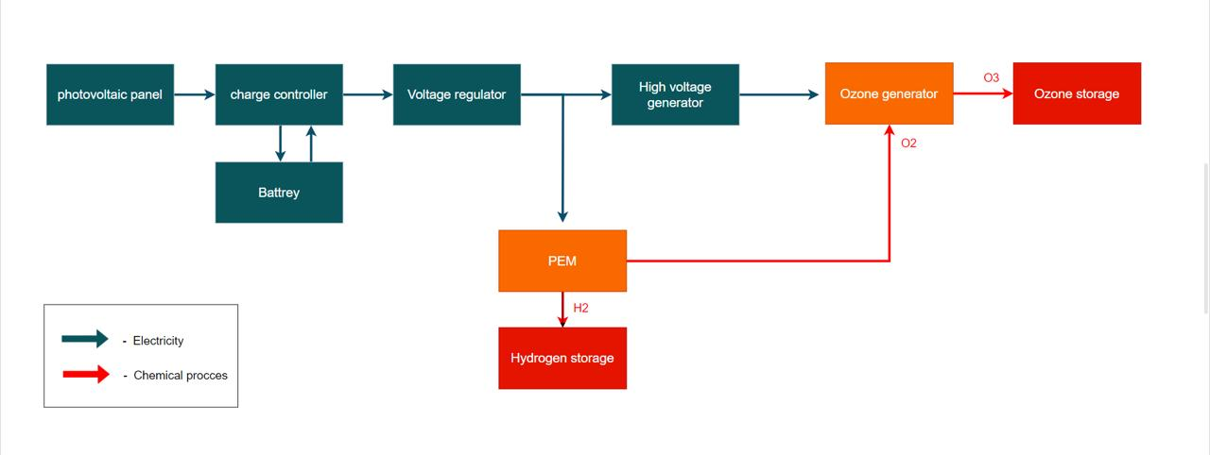
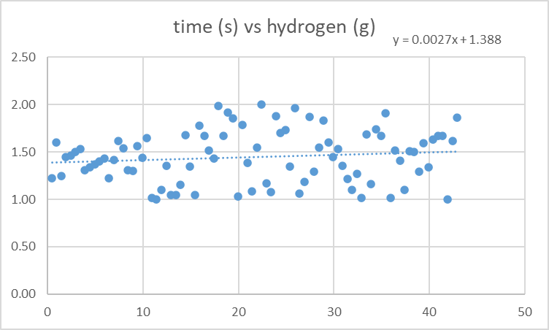
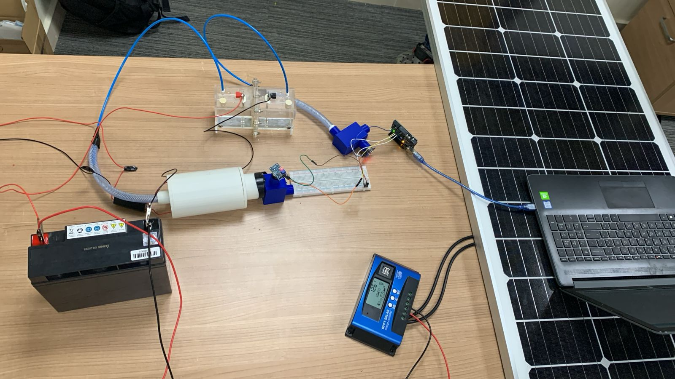
We express our heartfelt gratitude to our project advisor, Dr. Naveed Iqbal, for his invaluable guidance and support throughout our dual-generation hydrogen and ozone project. We also extend our thanks to the Team Design Department for providing essential resources and a conducive environment. Special thanks to all team members for their dedication and collaboration, and to Dr. Tawfik for his practical insights.
Dual generation of hydrogen and ozone
Team 128
CHE :Bandar Alshubiki CHE:Amjad Hlway ISE:Khalid Asiri ME:Omar Otaibi EE:Jawad AlNasser EE:Qassem Alwabari
Introduction & Objective
Constraints
The project aims to address the environmental challenge of CO2 emissions by developing a dual-generation system that simultaneously produces green hydrogen (H2) and ozone (O3). Utilizing solar-powered electrolysis for hydrogen and corona discharge for ozone, the system seeks to offer a sustainable alternative to conventional methods, leveraging non-toxic materials to enhance environmental sustainability and economic potential.
Hydrogen Pressure
Should be between 200-700 bar
Temperature should be up to 54C
Avoid contaminants for O3
Specifications
Purity of H2
Amount of O3
H2 Production prototype
Volume of water
Hydrogen purity
Should be more
Than 99%
Should be more than 200g/h, and less than 500g/h
Should be more than 140g/h , and less than 200g/h
Should be around 1liter
Prototype
Components Of The Prototype
Solar Panel
12V Charge Controller
12V Gel Battery
12V Voltage Regulator
3kV to 20kV High Voltage Generator
Electrolyzer (PEM)
Pt Electrode (10 mm – 15 mm – 0.2 mm)
Graphite Electrode (10 mm – 100 mm)
Tanks (200 to 700 bar)
Corona Discharge Unit:
Teflon/Stainless Steel Tank
Introduction & Objective
System Diagram
The dual-generation system has a significant environmental impact by reducing CO2 emissions through green hydrogen production and utilizing ozone for pollution control in purification processes, thereby enhancing sustainability by using non-toxic materials and renewable energy. Economically, the system offers cost efficiency due to its reliance on solar energy, expands market opportunities in renewable energy and environmental sectors, and boosts profitability with the production of high-purity hydrogen and ozone. Socially, it creates jobs in the renewable energy industry, improves public health by enhancing air and water quality, and encourages community engagement in sustainable practices. Technologically, the system drives innovation in renewable energy and environmental technologies, integrates seamlessly with existing infrastructure, and is scalable, making it adaptable for various applications and promoting widespread adoption.
Testing & Results
Conclusion
the dual-generation system for green hydrogen (H2) and ozone (O3) leverages solar-powered electrolysis and corona discharge, offering a sustainable solution to reduce greenhouse gas emissions and reliance on fossil fuels. By producing high-purity hydrogen and substantial ozone, the system supports clean energy initiatives and meets industry standards. This innovative approach promotes environmental sustainability, economic viability, and aligns with Saudi Arabia's net-zero carbon goals, enhancing the adoption of green technologies for a sustainable future
Acknowledgement
We express our heartfelt gratitude to our project advisor, Dr. Naveed Iqbal, for his invaluable guidance and support throughout our dual-generation hydrogen and ozone project. We also extend our thanks to the Team Design Department for providing essential resources and a conducive environment. Special thanks to all team members for their dedication and collaboration, and to Dr. Tawfik for his practical insights

