Slide 1

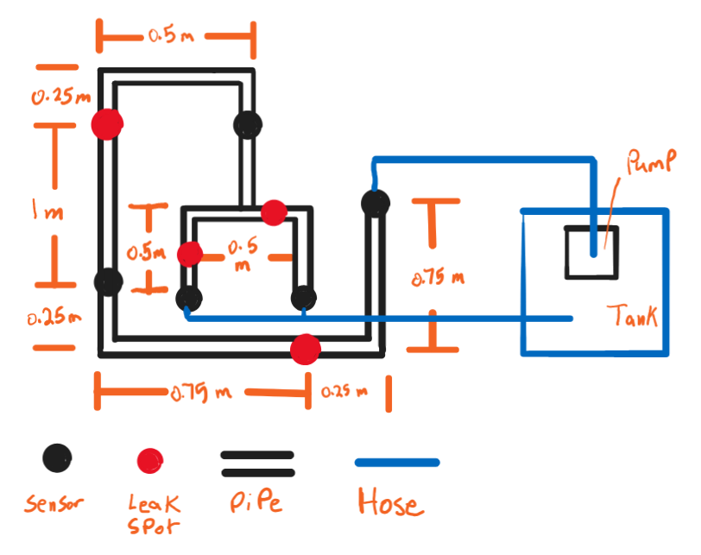
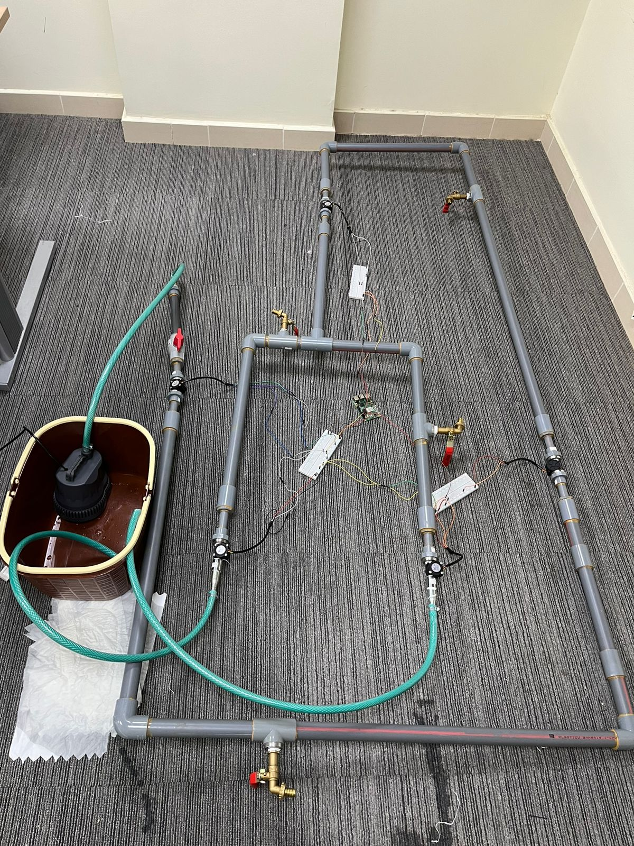
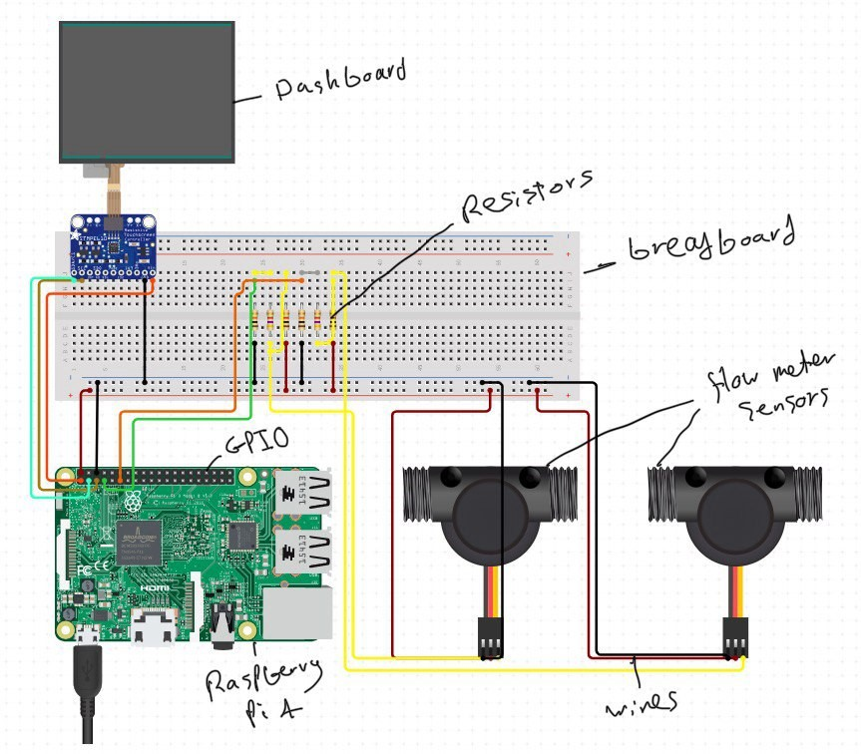
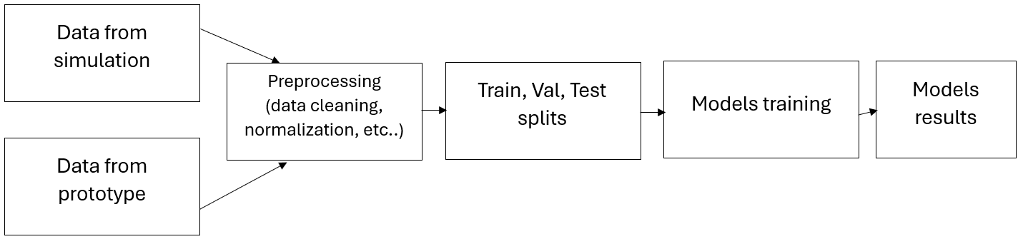




Automated Leak Detection System Using AI
Maan Alateeq-CHE, Meshari Alfuraydi-CHE, Abdulmajeed Aleissa-ISE, Mohammed Alnajjar-ISE, Omar Alandijani-ICS, Shehab Shehab-CE
Coach: Ismail Almaraj
Introduction
Water Network & Simulation
Sensor Placement Optimization Model
Problem Statement
According to engineers from NWC (national water company) in Saudi Arabia, 50% of the water transported in Saudi is lost along the transportation process, mainly due to leaks. This poses a large economic loss, and material loss with many collateral consequences that follow due to leakage of water in unwanted areas. This project aims to detect leaks in cutting edge speed, using flowmeters and an AI algorithm, and has a optimization model to place flowmeters at positions that maximize distance between flowmeters in order to reduce their number, and as a result reduce cost.
Constraints
Final Target Specifications
Impact
After implementing our project in a pipeline network the following is guaranteed:
Leaks would be detected with great accuracy
Leak detection time is set to be faster than ever
The percentage of 50% of water transported being lost is set to reduce to less than 10%
As a result of the previous point, in a country that has little natural water sources, this reduces the water consumed and transported, as losses in that process is being greatly reduced.
As the leak detection time is being reduced, collateral damage from water being present at unwanted places (rust, for example) will also greatly reduce, thus improving the overall infrastructure of the pipeline
Due to water being leaked less, the process becomes far more sustainable and eco-friendly.
E PANET software was used to stimulate the leaks in the designed WDN.
The inputs for the simulation were, pump power, emitter coefficient, and outlet flow rates.
The total flow rate:
$$Q=\frac{V}{t}$$
Pressure After the pump (Derived from Bernoulli equation):
$$P_{o}​=\frac{QP_{atm}−\frac{1}{2}ρv^{2}}{Q}$$
Pressure Drop:
$$ΔP_{major}=f∙\left(\frac{L}{D}\right)∙\left(\frac{{ρv}^{2}}{2}\right)$$
$$ΔP_{minor}​=K_{L}⋅\frac{ρv^{2}}{2}​$$
Parameters:
c: Cost of purchasing a sensor
l: Cost of having one cubic centimeter of water leakage
t: Expected number of leakages that could happen per square centimeter per day
e: Expected value of cubic centimeters wasted if a leakage happened
f: Lifetime of a sensor in days
r: Radius of the pipe
L: Length of pipes network
Sets:
I: Set of Available Sensors
Decision Variables:
d: The distance between two sensors
a: The total area that could have the leakage (Auxiliary Variable)
x_{i}: Location of sensor i from the origin (The beginning of the pipe network) ∀ i ∈ I
s: The number of needed sensors
Figure 1. Demo WDN drawing
Model I (number of sensors unspecified): $$maximize d \\ Subject to: \\ a=2 ∗π ∗r ∗d \\ f ∗l ∗e ∗a ∗t ≤ c \\ s ≤ \frac{L}{d} \\ s ≥ \frac{L}{d}−0.999999 \\ s ∈ z^{+}$$
Model II (number of sensors predetermined)
$$Maximize d \\ Subject to: \\ a=2 ∗π ∗r ∗ d \\ f ∗l ∗e ∗a ∗t ≤ c \\ x_{i+1} = x_{i}+d ∀ i ∈ I \\ x_{1}= d \\ x_{i}≤ L ∀ i ∈ I \\ d ≥ 0 \\ x_{i}≥0 ∀ i ∈ I$$
Constraint | Value
Accuracy of flowmeters | ±5%
Pipe diameter | <3 inches
Fluid Pressure | <0.5 MPa
Fluid Temperature | <50 C
Pressure at leak 1:
${P_{L1}=P}_{o}$- $ΔP_{major}$- $ΔP_{minor}$
Emitter coefficient:
$$C=\frac{{\left.Q\right|}_{L1}}{P_{L}^{0.5}}$$
Figure 2. The physical prototype
Specification | Value
Uptime | 100%
Portion of leak detected (Recall) | 85%
Accuracy of AI model | 85%
1 Sensor coverage | 1 m
Detection Time | 3 min
Electric Circuit & AI Algorithms
 | Q1 (L/s) | Q2 (L/s) | Q3 (L/s) | Q4 (L/s) | Q5 (L/s) | Status | Location
1 | 3.06 | 3.05 | 3.02 | 1.54 | 1.50 | 0 | 0
2 | 3.06 | 3.06 | 2.53 | 1.24 | 1.26 | 1 | 2
. | . | . | . | . | . | . | .
16384 | 2.02 | 2.05 | 2.02 | 1.08 | 0.99 | 0 | 0
Validation & Verification
Uptime: The prototype was run for 6 hours strait without any interruption, and there so no indication of it being shutdown.
Accuracy: After training the data with different training models, it was found LTSM model resulted in the best model with an accuracy of 92.27%, exceeding the targeted specification of 85%.
Portion of leak detected: This specification is measured by the recall. With LTSM model resulted in 90.35% recall.
Detection time: The model collect data every 5 seconds. If one reading result in leak statues in the model, the system can activate immediately
Coverage of 1 Sensor: The system was tested on a demo WDS with coverage of 2 meters per sensor. Moreover, the sensor placement optimization model has shown that each sensor can cover up to 12 meters
Table 1. Training data obtained from EPANER software
Electrical Circuit & AI Model
Figure 3. Electric circuit scheme
e as follows:
Figure 4. Data collection scheme
Conclusion
Model | Accuracy | Precision | Recall | F1-Score
LSTM | 92.27% | 88.60% | 90.35% | 89.47%
XGBoost | 90.18% | 85.36% | 87.58% | 86.46%
Autoencoders | 85.14% | 80.71% | 84.34% | 82.49%
One-Class SVM | 88.00% | 83.73% | 86.59% | 85.14%
This project successfully integrated AI and OR to optimize leak detection in water pipelines, showcasing an advanced prototype with 92.27% accuracy and 90.35% recall. Key components included simulations for design validation, an optimization model for sensor placement, and robust AI models employing LTSM and One-Class SVM. Notably, the system's effectiveness was confirmed through extensive validation, significantly reducing water loss by up to 50% and minimizing environmental impact. Future enhancements will focus on model precision and broader application across varied pipeline networks
Figure 3. Electric circuit scheme
The training model techniques implemented here were LTSM, XGBoost, Autoencoders, and One-Class SVM.
Table 2. Results of different training models

