Slide 1



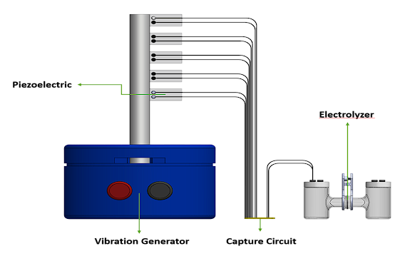
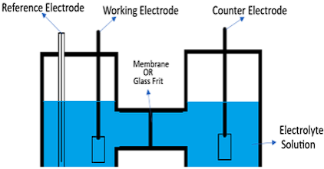
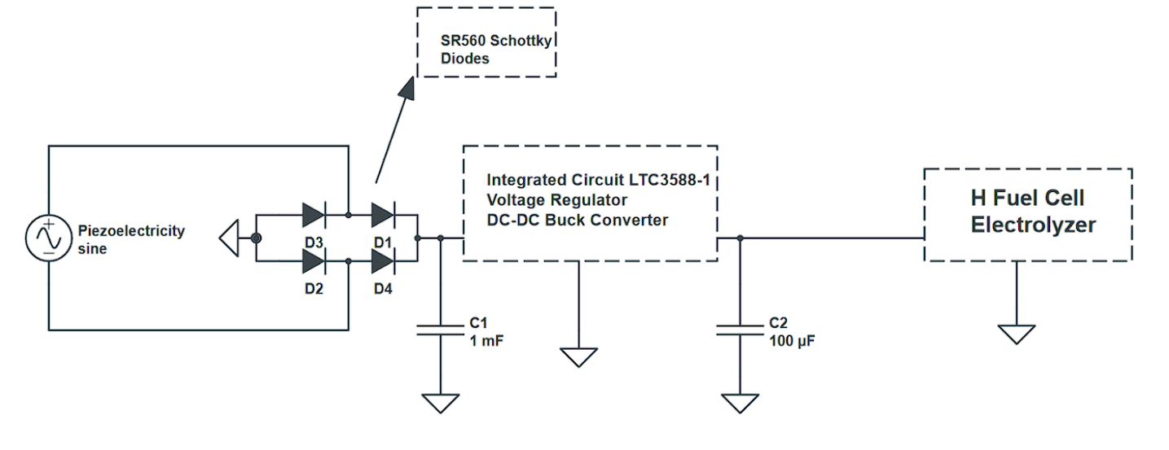
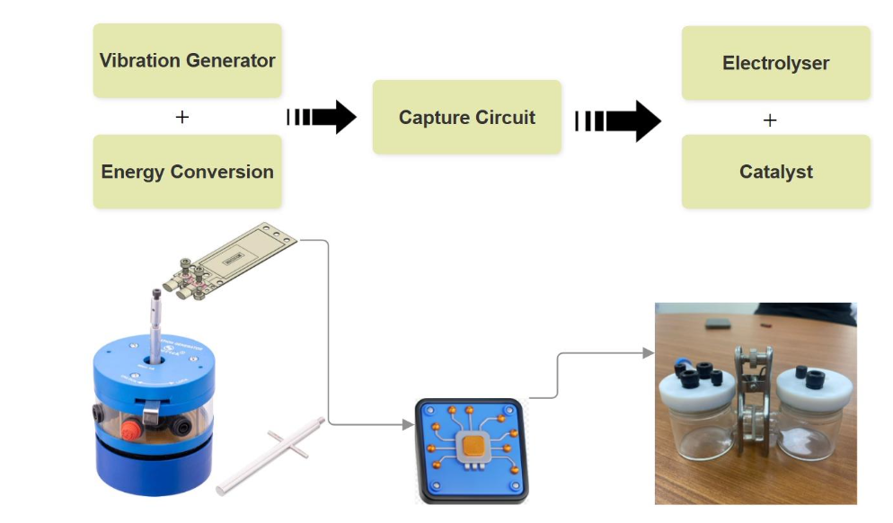
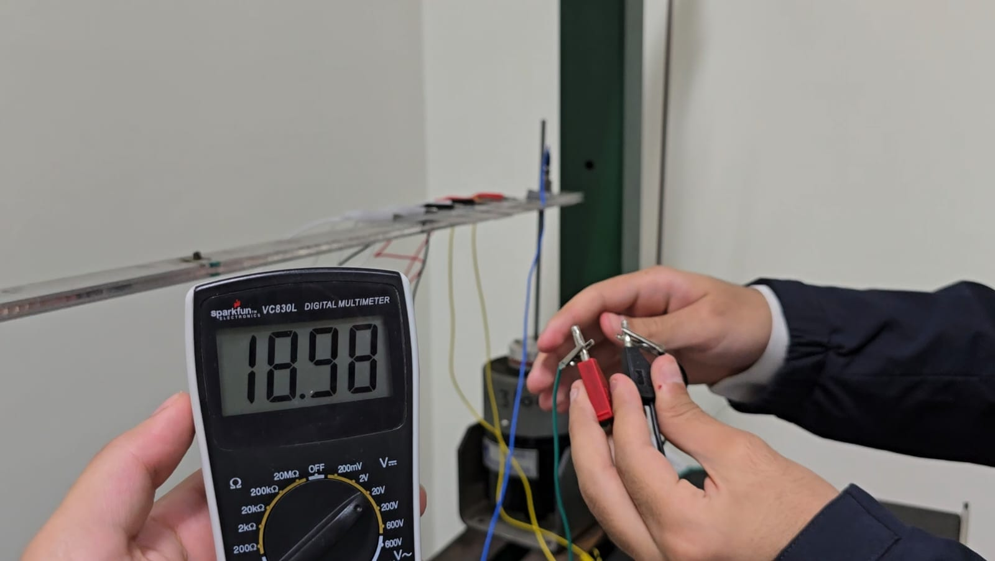
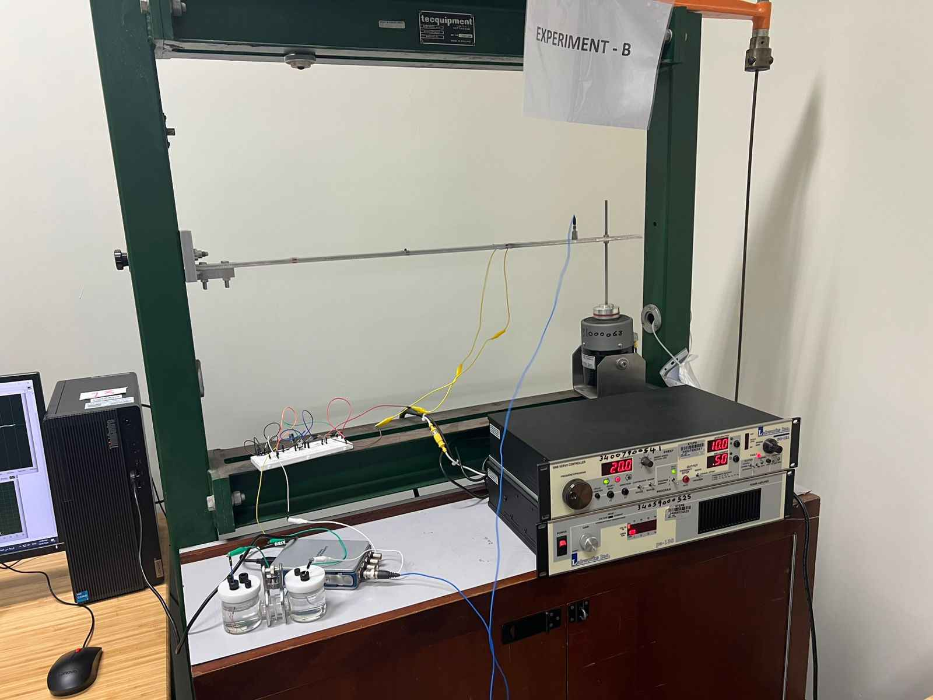
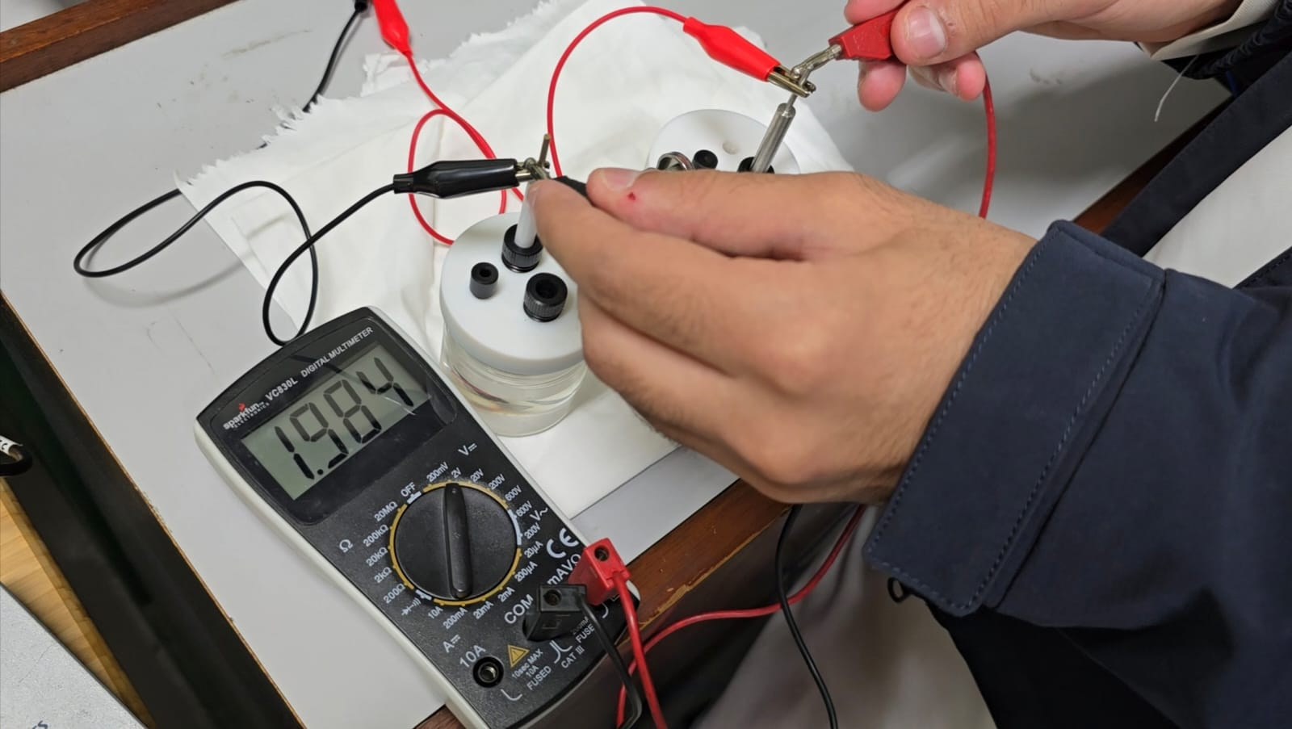
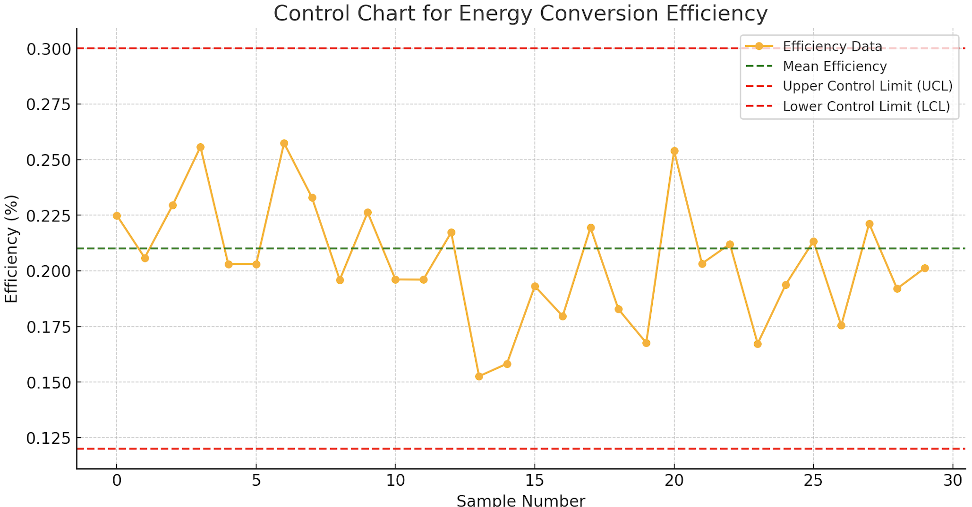
Optimized Piezoelectric Hydrogen Harvesting System
MESHAL ALSHABANI - CHE | ABDULAZIZ ALQASEM - CHE | NAWAF SHAHRANI – ME | KHALID ALKAHTANI – ISE | ABDULRAHMAN ALRUQI - EE
Team 12
Introduction
Design and Methodology
Results
Importance of Hydrogen Production: Essential for a sustainable energy future, reducing reliance on fossil fuels.
Challenges: Conventional methods are costly, inefficient, and carbon-intensive.
Project Goal: Convert ambient mechanical vibrations into electricity for hydrogen production.
Significance: Promotes clean energy through self-sustaining, eco-friendly systems.
1. Input Voltage and Current:
- From the piezoelectric strip specifications:
Input Current = Voltage / Resistance = 18.8 / 3000 = 6.2 mA
- Calculated input power:
Input Power = Voltage × Current = 18.8 V × 6.2 mA = 116.56 mW
2. Output Power:
- Considering an 85% circuit efficiency from the integrated circuit:
Output Power = Input Power × Efficiency = 116.56 mW × 0.85 = 98.9 mW
- This output power fits the specification range of 30 mW to 100 mW.
3. Output Current:
- Calculated using an output voltage of 2V:
Output Current = Power / Voltage = 98.9 mW / 2 V = 49.45 mA
- For a system using 5 piezoelectric strips:
Total Current = 49.45 mA × 5 = 247.25 mA
Conclusion:
- The calculated output current (247.25 mA) is sufficient for operating the small-scale electrolyzer for water splitting, achieving the required performance specifications.
Figure : Prototype Design
Constraints
The system is designed under the following operational constraints to ensure safety, efficiency, and feasibility:
1. Power Consumption: Must not exceed 180mW.
2. Voltage Operation: Limited to a maximum of 2.5V to avoid damaging the electrolyzer.
3. Temperature Range: Operates between 20°C and 40°C, with an upper limit of 60°C.
4. Operating Pressure: Limited to a maximum of 3 atm to ensure safe hydrogen production.
5. Mechanical to Electrical Conversion Efficiency: Ranges between 25% and 35%.
Figure : Electrolyzer Design
Environmental Impact
Reduction in Carbon Emissions:
Eliminates the use of fossil fuels for hydrogen production, reducing CO₂ emissions by approximately 50% compared to traditional methods.
Energy Efficiency:
Converts wasted vibrational energy into usable power with a system efficiency of 85%, minimizing energy losses.
Sustainable Hydrogen Production:
Produces clean hydrogen with zero greenhouse gas emissions during operation, contributing to global decarbonization goals.
Real-World Scalability:
Adaptable for industries such as transportation and manufacturing, potentially reducing industrial emissions by up to 20%.
Figure : Electrical Circuit Design
Target Specifications
Prototype Development
The project adheres to the following measurable targets to achieve its goals:
1. Piezoelectric Power Generation: The system generates electrical power in the range of 30 mW to 100 mW using piezoelectric materials under optimal vibration conditions.
2. Hydrogen Production Efficiency: Achieves a conversion efficiency improvement of 5% over conventional systems.
3. PEM Electrolyzer Operation: Ensures a stable operational voltage range of 1.8V to 2.2V.
4. Durability and Scalability: Designed for long-term operation under real-world conditions with scalability for larger systems.
5. Environmental Compliance: Fully aligns with clean energy principles, utilizing non-toxic materials and reducing carbon footprints.
Future Work
Scaling Up: Expand the system for industrial-scale hydrogen production.
Efficiency Boost: Integrate advanced piezoelectric materials for higher energy conversion rates.
Automation: Develop smart control systems for real-time optimization.
Applications: Explore deployment in renewable energy plants and remote locations.
Testing & Validation
Figure : Integrated Design
References
- Piezo.com. (n.d.). Piezoelectric Energy Harvesting Basics. Retrieved from https://piezo.com.
Wang, Z. (2022).Overview of Piezoelectric Applications in Energy. Springer. DOI: 10.1007/978-3-030-98578-3.
- Hydrogen Europe. (n.d.). Hydrogen Production Technologies. Retrieved from https://hydrogeneurope.eu.
- Lefèvre, M., Chenitz, R., Dodelet, J. (2020). Catalysis in PEM Electrolyzers. Journal of Electrochemical Science, 7(4), 430–446. DOI: 10.1016/jes.2020.09.127.
- Learn Engineering. (n.d.). PEM Electrolyzer Operation Explained. Retrieved from https://learnengineering.org.
Figure : Voltage Input
Figure : Voltage Output
Figure : Physical Prototype
Figure : Control Chart for Efficency

