Slide 1
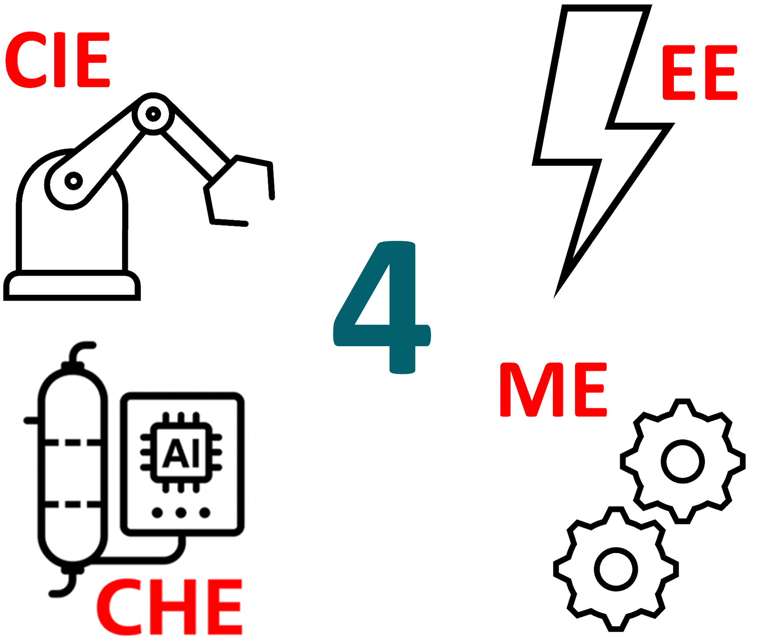


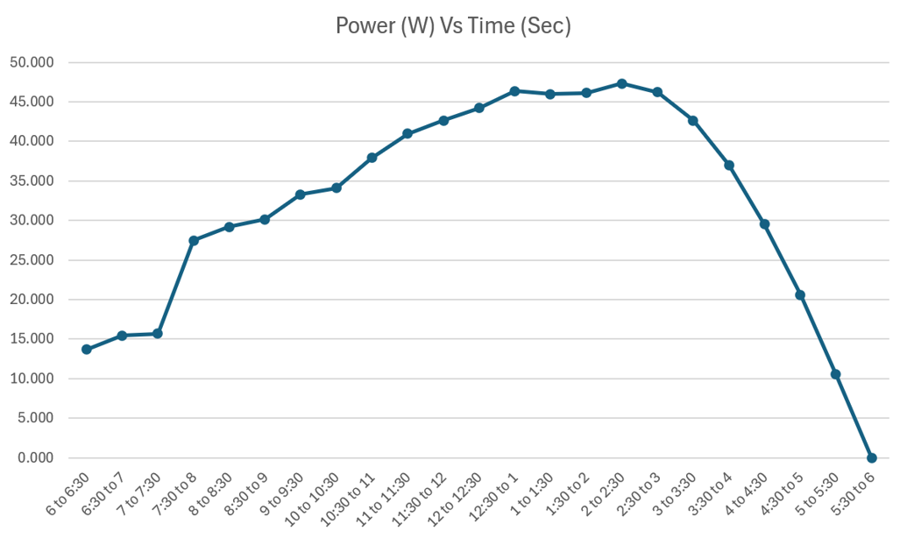
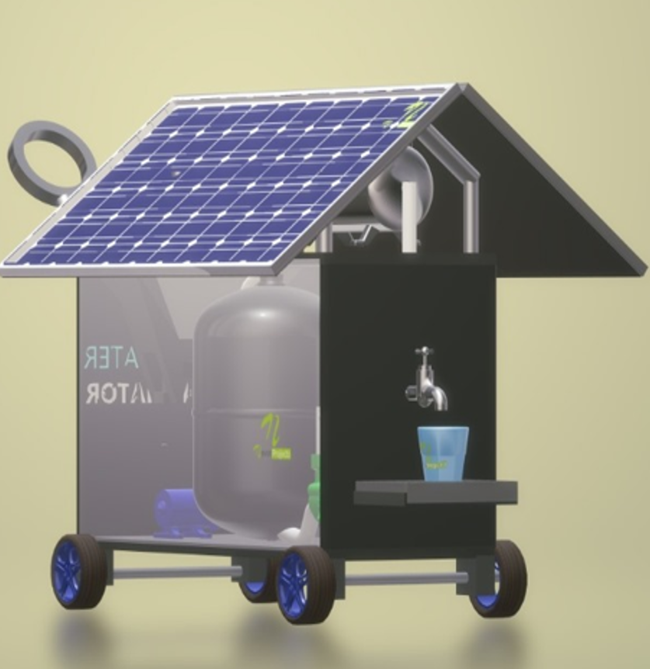
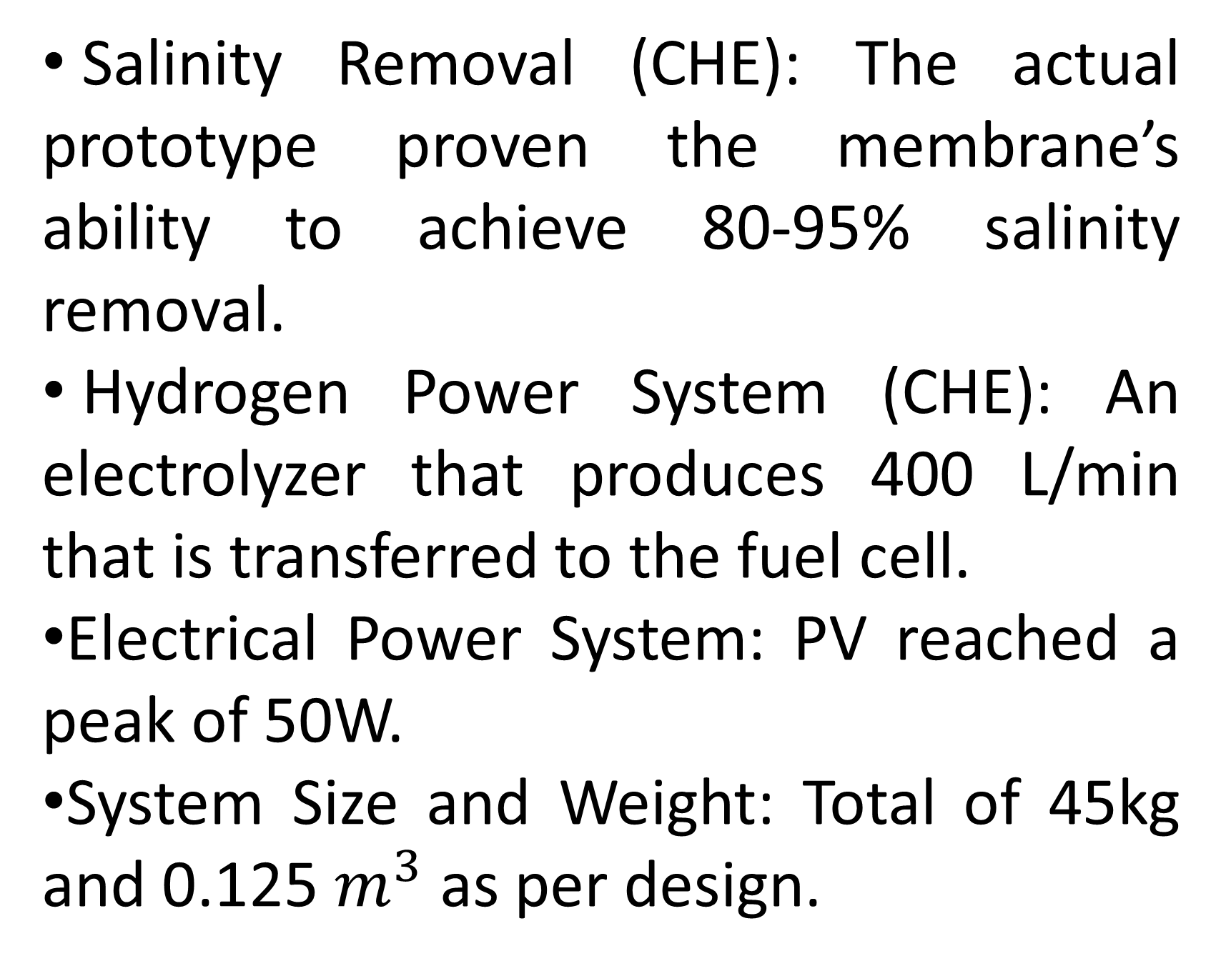

INTEGRATION OF HYBRID SOLAR AND HYDROGEN FUEL CELL UNITS
FOR PORTABLE AND SUSTAINABLE REVERSE OSMOSIS DESALINATION
TEAM
114
Azzam Alsayed , Mshary Alahmdy, Husni Anbarkhan, Abdullah Alqatar, Fawaz Alshammar, Mohammed Saud Coach: Abdullah Al-Sharafi
Problem Statement
Objectives
Validation and Verification
Results
This project aims to develop a portable, off-grid water treatment unit that integrates solar energy, battery storage, and a proton exchange membrane fuel cell (PEMFC) to power reverse osmosis (RO) desalination system, ensuring sustainable and reliable clean water production in remote and off-grid locations.
The objective of this project is to minimize the number of stationery desalination systems in remote areas through providing an effective solution that is transferable, easy to use, and operate completely on green energy, while desalinating low-brackish water to drinkable water ranges.
Salinity Removal (CHE): The actual prototype proven the membrane’s ability to achieve 80-95% salinity removal.
Hydrogen Power System (CHE): An electrolyzer that produces 400 L/min that is transferred to the fuel cell.
Electrical Power System: PV reached a peak of 50W.
System Size and Weight: Total of 45kg and 0.125 $m^{3}$ as per design.
Portable, modular, off-grid system with weight of 45kg.
Suitable for desalinating wide range of TDS levels.
Excess electricity is converted to hydrogen at a rate of 400 L/min.
The photovoltaic panel achieved a peak output of 50 watts.
Project Constraints
Source Salinity Level (<3000 TDS)
System Size (0.125 $m^{3}$)
Testing
Inlet TDS (ppm) | Outlet TDS (ppm)
493 | 93
2860 | 230
PV Efficiency (21%)
Membrane Lifetime (3 Years)
RO Entering Pressure (2 bar)
Prefiltration (up to 5 micron)
Prototype Development
Conclusion
System Overview
Chemical Engineering: Designing all filtration stages, in addition to the hydrogen power system.
Electrical Engineering: Complete power system design and circuits
Mechanical Engineering: Pump selection, and Frame design.
Civil Engineering: Frame build, weight distribution.
The prototype offers a compact, off-grid desalination solution powered by solar and hydrogen energy. It achieves up to 80-95% salinity removal, generates 50W via PV, and produces 400 L/min of hydrogen, making it ideal for remote clean water access.
The frame is built from iron and aluminum for least weight possible
PV is installed with tilting hinges for perfect incident angle.
Four stages filtration that are designed to treat low-brackish water.
Excess electricity is converted to hydrogen for later use at night times.

