Slide 1

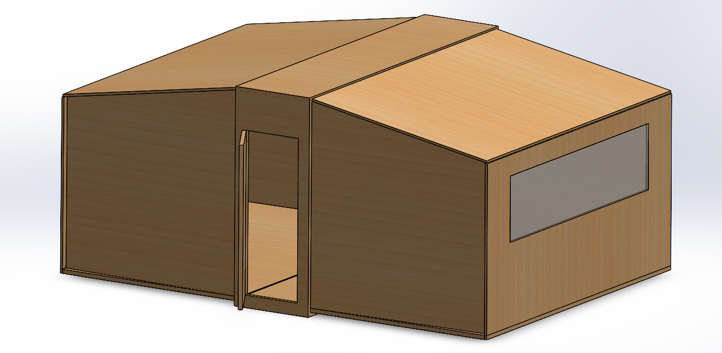
Rapid Deployment Refugee Housing
Senior Project 2 – T232 – Team 113
Introduction/Background
Elevator Pitch
Prototype
Our mission is to design and build innovative refugee housing solutions that are not only cost-effective and efficient but also prioritize the safety and well-being of occupants. Our unique compact design ensures easy storage and mobility, making rapid deployment possible wherever it's needed most.
Constraints
Internal Team Constraints:
Budget
Time
Resources availability
Product Constraints:
1.Maximum assembly team of 5 members
2.Packiging size fit 5 houses per shipping container
3.Eco-Friendly material
4.Dimensions of the house
Target Specifications
Deployment within 20 minutes
Space area of 5m²
1 L/h potable water production
Power system
Insulation, and withstanding wind speeds
Validation
Assembly Time: Achieved an assembly time of 20 minutes for handling and setup, ensuring rapid deployment.
Space Utilization: Offers 7.5 m² of living space, closely aligning with the target specification of 5 m².
Water System: Integrated a water purifying system capable of producing 1 liter of potable water per hour.
Power System: Equipped with solar panels that deliver:
250W (220VAC) during daylight hours
150W (220VAC) during nighttime
Insulation Efficiency: Utilized latte wood in construction, meeting the Wall/Roof/Floor R-value of 5.5, with IzoTeck paints.
Durability: Designed to withstand wind speeds of up to 10 m/s, ensuring stability and safety under common weather conditions.
Project Objective
Our project aims to design a refugee housing solution that is both expandable and foldable, allowing for quick assembly within 20 minutes by a team of four. This system will comfortably accommodate up to six individuals, providing them with a private, secure, and comfortable living space. It will incorporate sustainable energy solutions, utilizing solar panels and renewable energy storage to minimize environmental impact and reduce reliance on traditional energy sources. Additionally, the design will include a comprehensive potable water system to support essential daily activities such as drinking, cooking, washing, and sanitation.
Conclusion
our project not only provides a practical and rapid solution for refugee housing, but also pioneers environmental responsibility in emergency accommodation. By integrating innovative foldable design, renewable energy sources, and a reliable water system, we are setting a new standard for sustainable living in crisis situations. This initiative promises to deliver dignity and comfort to those who need it most, underscoring our commitment to making a positive impact on human lives and the environment.
Team members: Abey Jastaneyah (ISE) Ahmad Alzahrani (ISE) Fahad Alghamdi (ME), Hussein Alalshakihamad (COE) Khalid Alrogy (ME)

