Slide 1

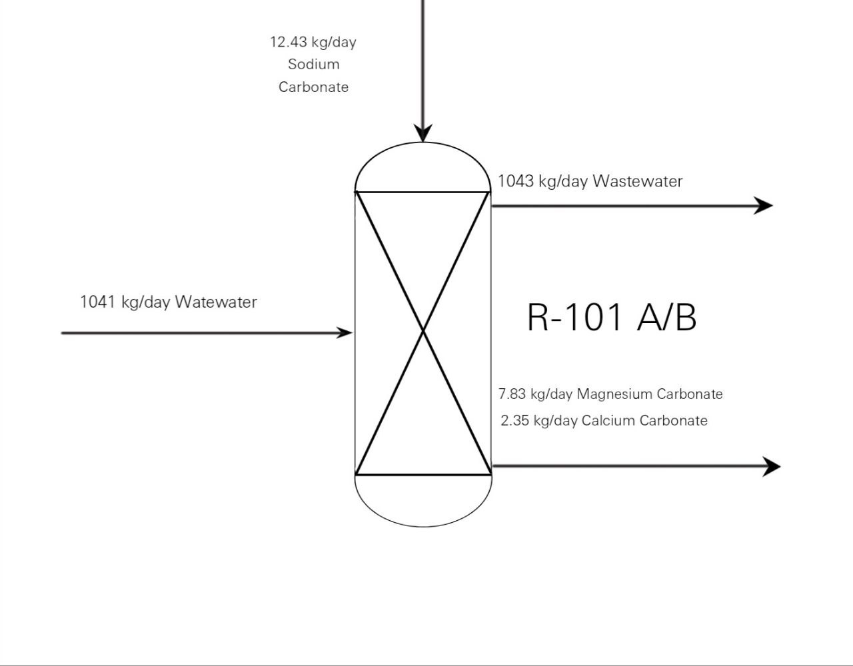
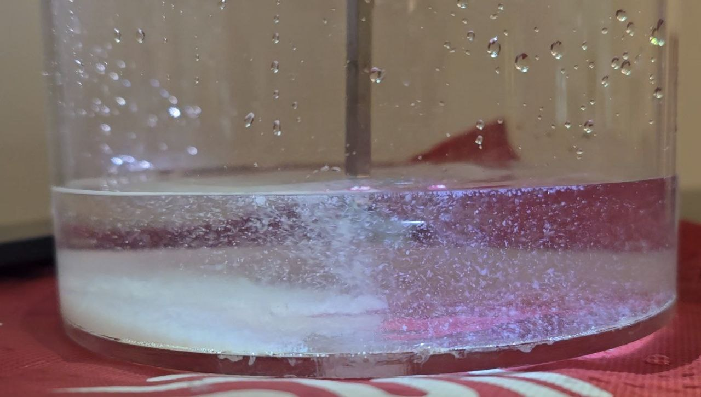
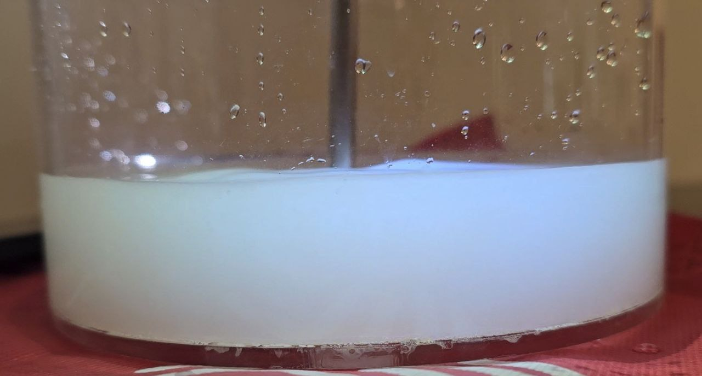
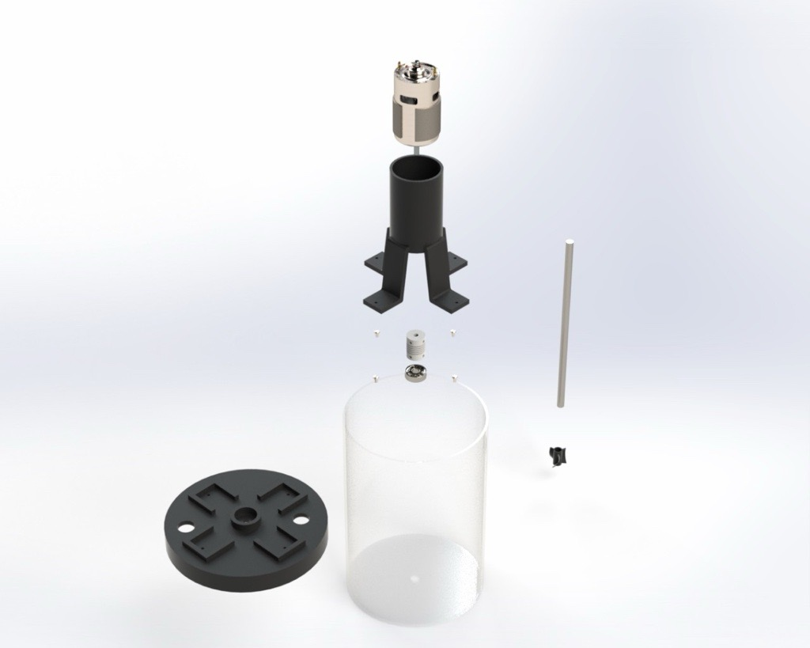
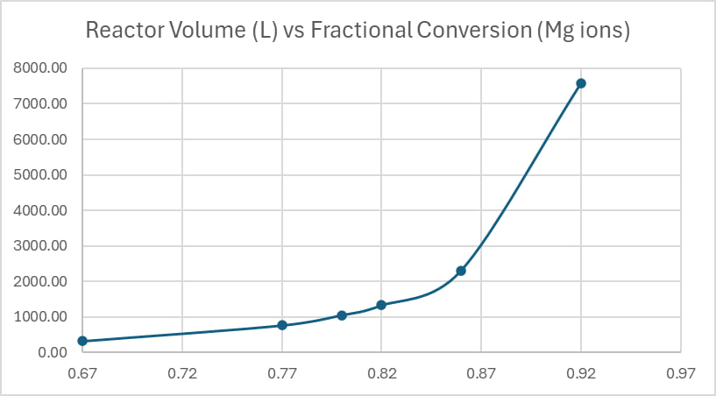
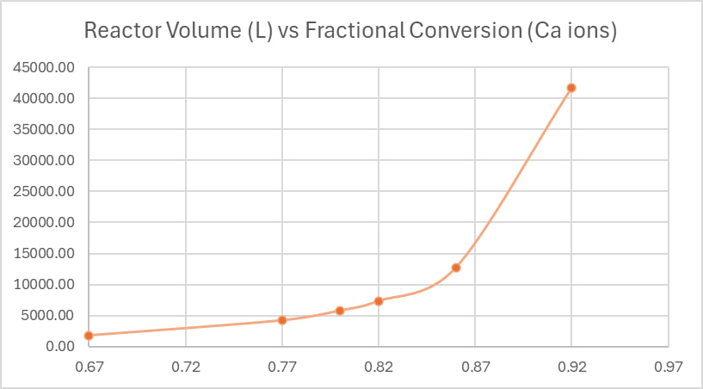
Extraction of Calcium & Magnesium Ions from Brine
TEAM 109
Introduction/Background
Desalination produces brine rich in magnesium and calcium ions, which can disrupt marine ecosystems by altering salinity and hindering vital processes in organisms. While these ions are undesirable, their removal from brine is challenging due to their high solubility, making treatment expensive and complex.
Constraints
TDS concentration of 65,000 mg/L.
Material for reactor should stand pH between 10.5 to 11.
The reactor should withstand a temperatures (around 60°C)
Problem Statement
Desalination brine with high magnesium and calcium content (Mg²⁺, Ca²⁺) harms the environment. This project seeks a cost-effective chemical precipitation method to remove over 80% of both ions from the brine, making desalination more sustainable.
Project Impact
Conclusion
This project reduces Mg²⁺ & Ca²⁺ in desalination brine by 80%+ via an economically feasible chemical precipitation process, for a more environmentally friendly desalination process.
in conclusion, desalination creates brine high in magnesium and calcium, harming marine life. However, removing these problematic ions for safe disposal is difficult and costly due to their inherent properties. This challenge highlights the need for innovative and sustainable brine management strategies.
Testing / Validation
Prototype Design
The reaction was performed in the assembled prototype, and the reaction almost reached completion within 1 minute, emphasizing the fast kinetics of this reaction. However, due to limitations related to the difficulty of characterization of the products, the conversion percentage was not verified.
Theoretical prototype:
Target Specifications
Reduce brine calcium by 86% and magnesium by 90%.
The reactor should function efficiently at room temperature (around 25°C).
Use rotating equipment with at least a 75% efficiency rating.
The reactor should have a volume of 13700 litres.
Time < 1 minute
Proof that Specifications Were Met
3D model of the reactor in the physical prototype:
Through proper mass balance equations and kinetic studies, it was proven that obtaining such high conversions is possible if sufficient reactor volume is provided
.
TEAM 109
Name | ID | Department
Saleh Alhumaid | 201953310 | CHE
Faisal Almansoub | 201922910 | CHE
Omar Alsaiari | 201817680 | ME
Mohammed Alali | 201766810 | EE
Abdulrahman Hussain | 201969510 | ISE
Mohammed Alqahtani | 201728830 | ISE

