Slide 1

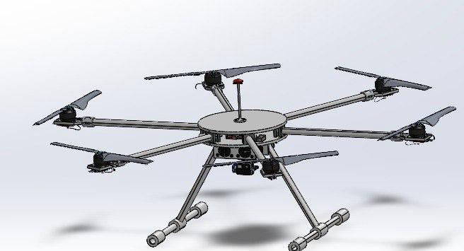
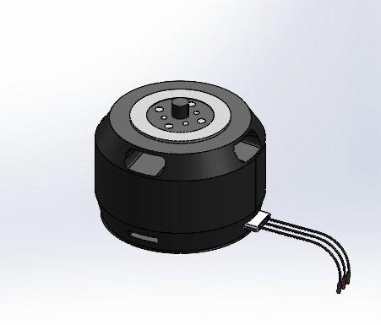
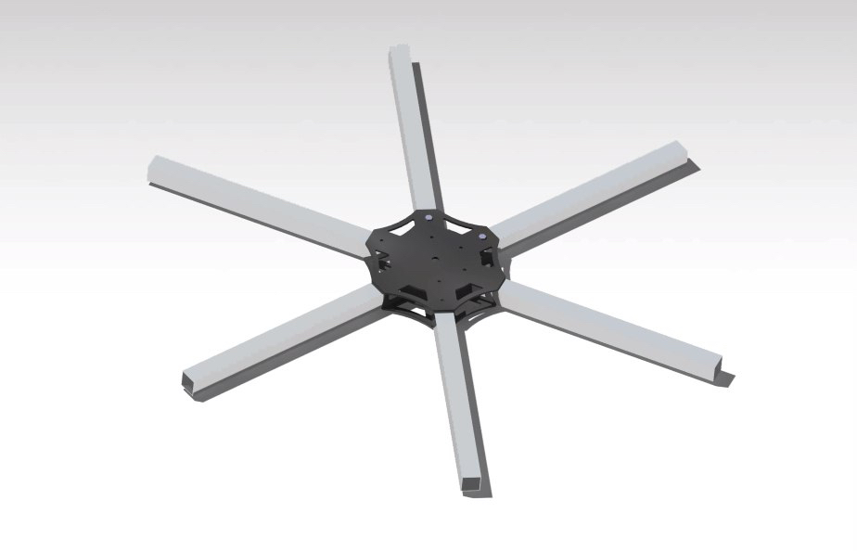
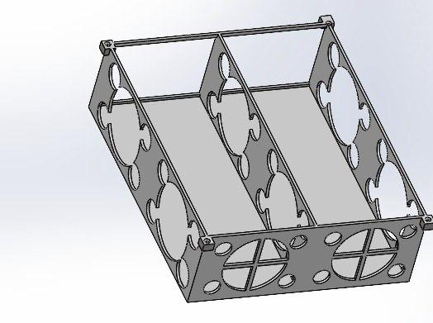
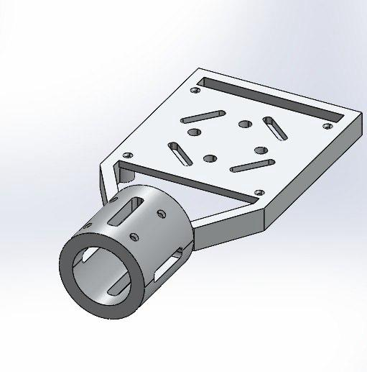
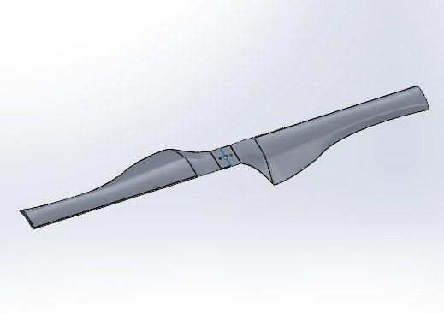
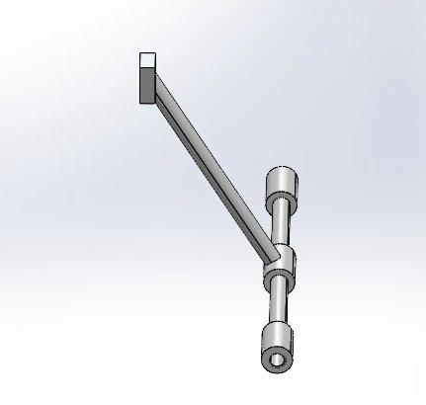
Student Names:
Opti-Spray Drone
NAWAF SHAKER (AAE), AHMAD REHAILI (AAE)
OMAR ALOTAIBY (ACHE), FAHAD ALDOSSARY (CHE)
MOHAMMED ALBAZZAZ (ME), OMAR ALSHETHRI (ME)
Team: 106
Senior Design Project
Coach:
Dr. Ammar Al-Zaydi
INTRODUCTION
PROTOTYPE DESIGN
PROJECT IMPACT
The agriculture industry has seen significant advancements in recent years, particularly in the areas of spraying systems and soil testing sensors. These technologies play a crucial role in optimizing agricultural practices, enhancing crop yields, and promoting sustainable farming methods.
The project will enhance the agricultural industry by providing
real-time crop monitoring for health and growth data.
Also, Processing data with integrated software for informed farming decisions. and Precise spraying system for optimized resource use and reduced waste in order to achieve: Higher yields, lower costs, reduced environmental impact.
PROBLEM STATEMENT
Farmers face challenges with inefficient water, pesticide use and labor-intensive crop monitoring. Our product aims to streamline these tasks.
Offering precise water spraying and automated monitoring for more sustainable and efficient farming
Motor
Frame
Battery holder
CONSTRAINTS
Budget: Limited to 8000 SAR
Range: The drone must operate within a 1km range
Payload Capacity: The drone must carry a payload of up to 13kg
Regulatory Compliance
Flight Time: A maximum flight time of 15 minutes
Environmental Conditions
Motor holder
Propeller
Landing pad
TARGET SPECIFICATIONS
13Kg Payload Capacity
15 Minutes Flight Time
54-72 km/h Maximum Speed
4 Liters Spraying System Capacity
CONCLUSION
In summary, Opti-Spray Drone Transform farming through improved precision and optimized resource use. It will Boost yields, lower expenses, and heighten efficiency for farmers. Also, it will Support sustainable farming goals, lessening environmental footprint.

