Slide 1
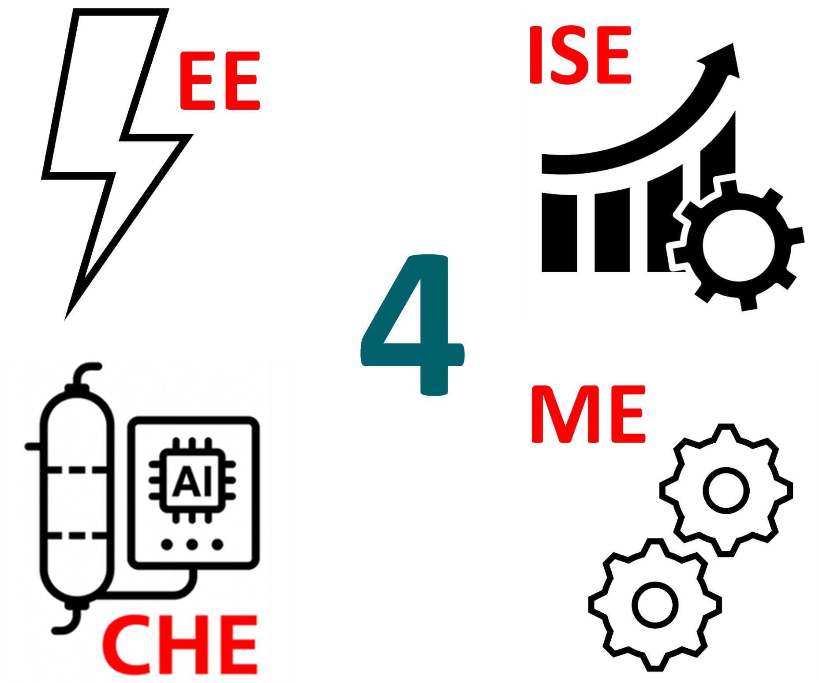
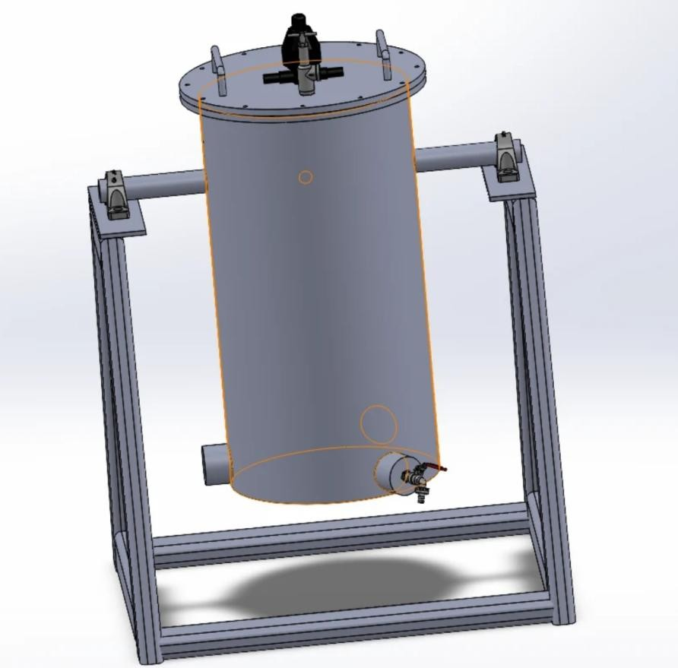
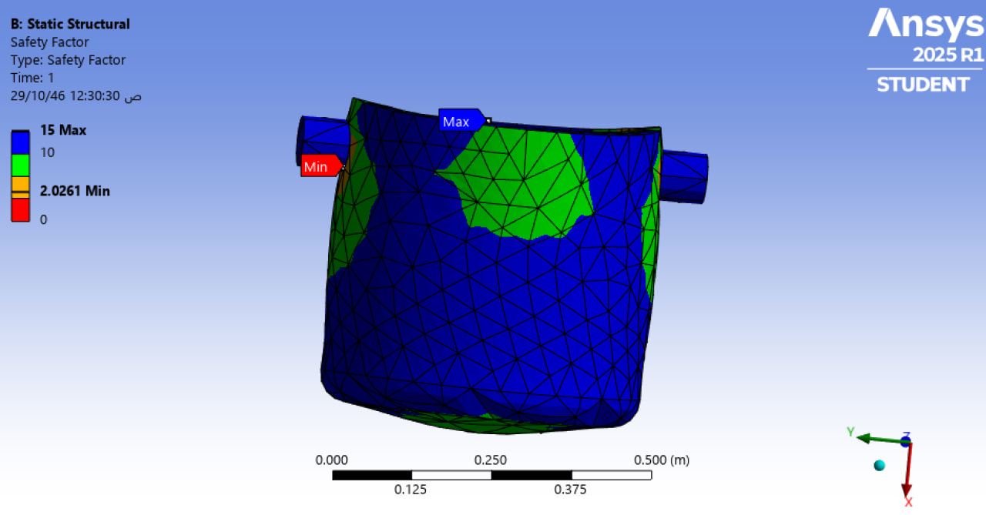
Design and Validation of a Farm-Scale HTC Reactor for Efficient Biochar Production
TEAM
101
Fares Alahmadi ,Sultan Al musaad, Ahmed Albulayhishi, Anas Aljohani, Amer Rifi, Albaraa Alrefai Coach: Wasif Hussain
Subheading
Use font size 46 or above
Problem Statement
Objectives
Validation and Verification
System Overview
Farms in Saudi Arabia produce large quantities of organic waste, much of which is underutilized. This project addresses the lack of affordable, small-scale waste-to-resource systems by designing a compact HTC reactor to convert agricultural biomass into valuable hydrochar, with minimal energy use and emissions
To design, fabricate, and verify a batch-operated Hydrothermal Carbonization (HTC) reactor capable of converting agricultural waste into hydrochar for small- to medium-sized farms. The project aims to ensure environmental sustainability, cost efficiency, and consistent product quality using multidisciplinary engineering solutions.
FEA (ME): Finite Element Analysis confirmed a safety factor of 2.03 under maximum pressure and thermal load.
SPC (ISE): X̄ control chart revealed energy instability, indicating special cause variation.
Process Capability (Cp/Cpk): Low values suggest the need for improved control over energy performance.
Forecasting (ISE): Exponential smoothing projected hydrochar demand growth from 7.5 to 10.5 tonnes/year by 2028.
Testing (EE): Sensor-triggered servo system successfully tested for accurate flow and temperature control.
Batch HTC reactor operating at 180–225°C and up to 35 bar.
Arduino-controlled automation for water input, heating cycles, and safety features.
Compact, modular design optimized for small to medium-sized farms
Project Constraints
180–225°Operating Temp: C
C/N ratio= 20%-30%,
Sulfur content < 0.5%,
Reactor Volume: 60 L
Max Pressure: 35 bar
Budget capped: SAR 7,400
Safety factor > 2.0 (verified via FEA)
Prototype Development
Results
Mechanical Engineering: CAD design, structural support, and pressure vessel fabrication.
Electrical Engineering: Arduino-based automation for water flow, heating, and safety.
Chemical Engineering: Optimized HTC conditions based on biomass type and carbon yield.
ISE: Applied quality control, demand forecasting, and cost-benefit analysis.
Hydrochar production validated with early successful trials.
Quality control revealed process instability, confirming areas for improvement.
Forecasting confirmed strong demand potential among small-scale farmers.
Economic analysis showed a payback period of ~1.03 years and a B/C ratio of 1.5.
Conclusion
The HTC prototype offers a scalable, sustainable solution for converting agricultural waste into biochar. Multidisciplinary testing confirmed its structural, automation, and economic viability. Future work will focus on field testing and supporting multiple feedstock types.

