Slide 1

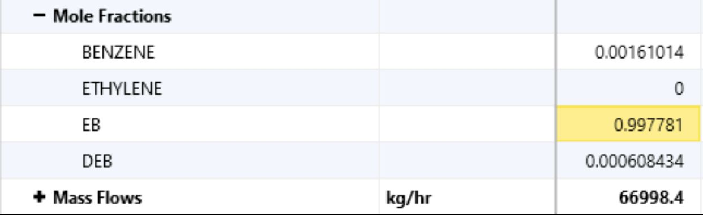
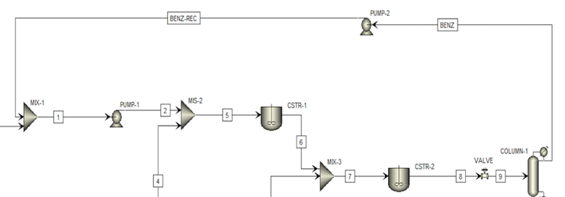
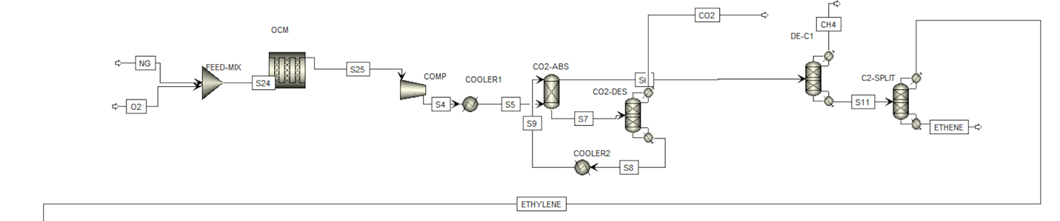
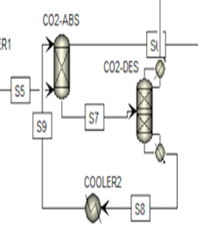
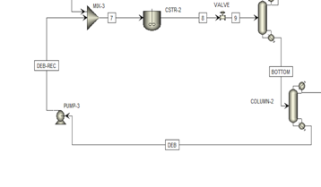
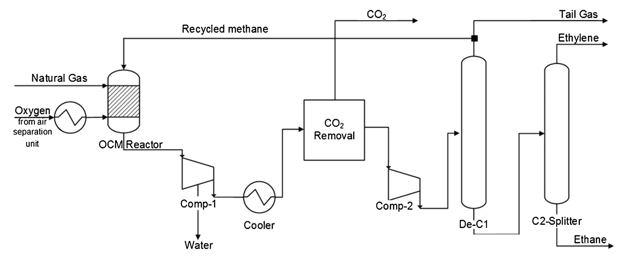
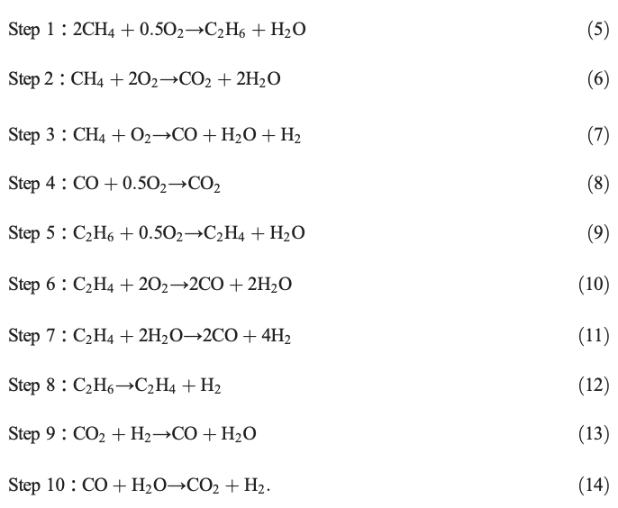
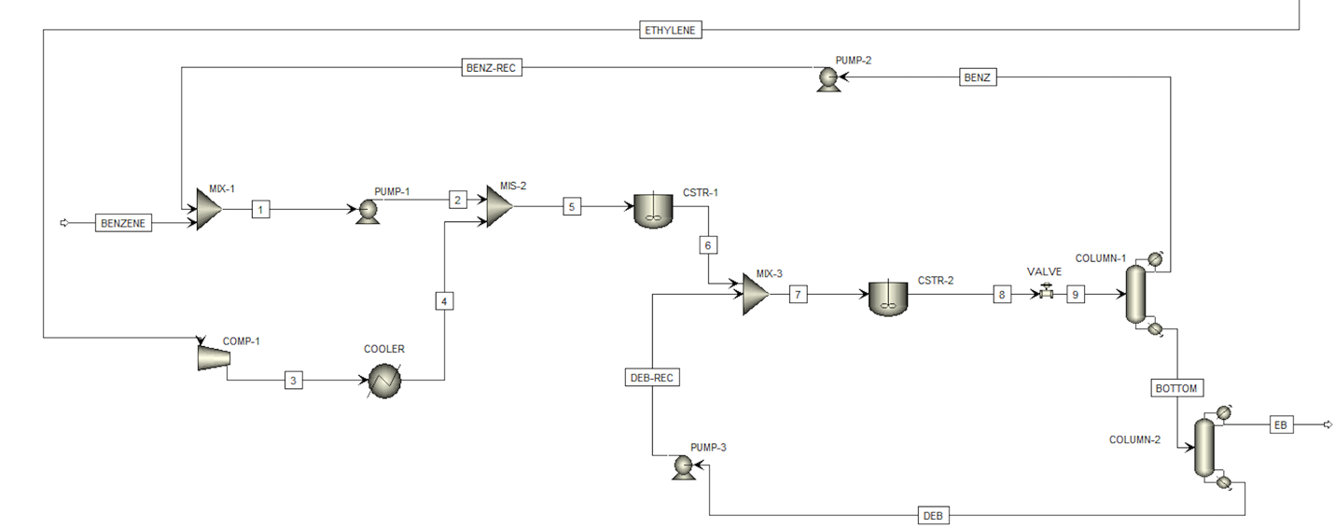
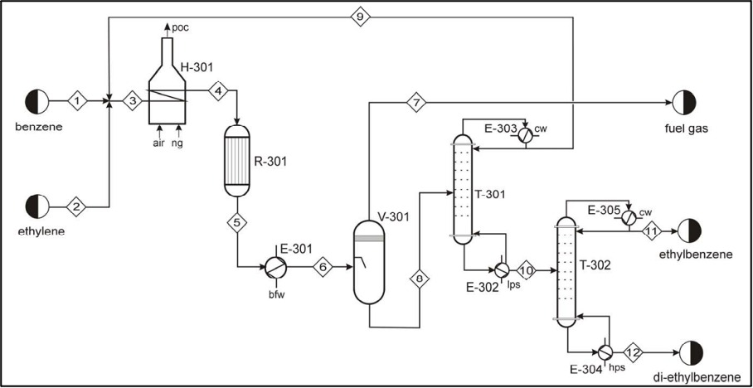
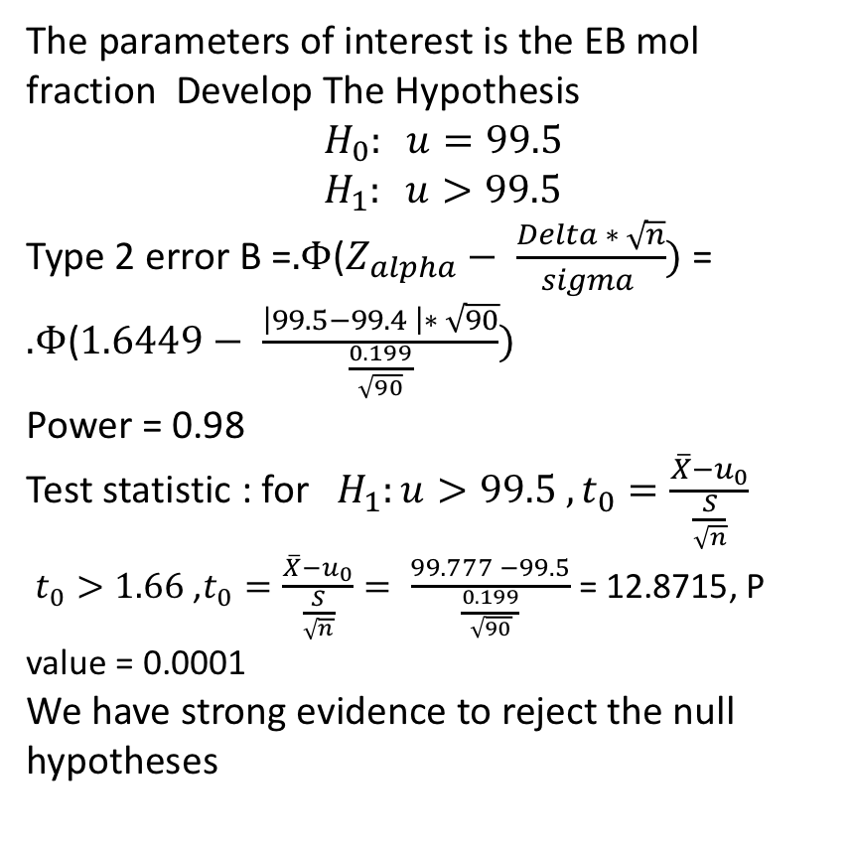
Ethylbenzene Production Process
Team 88
Omar Abed (ISE) Mohammed Al-Shahir (ISE) Saleh Al-Sharari (CHE) Faisal Al-Sowayan (CHE)
Introduction
Validation
Result
Redesign and Develop a process that produces high-purity of ethylbenzene with low manufacturing cost and environmental impact.
Constraints
High Operating Temperature (100– 200 °C)
High Operating Pressure (1000-2000 kPa)
Reduce costs during challenging operations
1. Product Flow Rate Discrepancy
- Design Target: 5000 kg/h - Simulation Outcome: 16000 kg/hr - Deviation: Prompts a detailed examination
2. EB Mol Fraction Achievement:
- Target: >99.5% - Simulation Result: ~99.97% - Noteworthy Alignment: Surpassing the specified purity threshold.
3. Recycling Mechanism Configuration:
- Original Design: Two units in initial prototypes.
- Unanticipated Configuration: Prompts a closer look at the design.
4. Benzene and Ethylene Conversion:
- OCM Reaction: Yields a methane conversion of ~66%. - Post-reaction: 30,000 kg/hr of unreacted methane from the initial 108,000 kg/hr feed.
The parameters of interest is the EB mol fraction Develop The Hypothesis
$$H_{0}: u=99.5$$
$$H_{1}: u>99.5$$
Type 2 error B =$Φ\text{(}Z_{alpha}− \frac{Delta ∗ \sqrt{n}}{sigma })$ = $Φ\text{(}1.6449− \frac{\left|99.5−99.4 \right|∗ \sqrt{90}}{\frac{0.199}{\sqrt{90}}})$
Power = 0.98
Test statistic : for $H_{1}:u>99.5 , t_{0}=\frac{\overline{X}−u_{0}}{\frac{S}{\sqrt{n}}}$
$t_{0}>1.66$ ,$t_{0}=\frac{\overline{X}−u_{0}}{\frac{S}{\sqrt{n}}}= \frac{99.777 −99.5}{\frac{0.199}{\sqrt{90}}}$ = 12.8715, P value = 0.0001
We have strong evidence to reject the null hypotheses
This is the result from the Aspen Hysys Software simulation : The EB Mol Fraction has been met with 99.77%
3 Recycling Unit Has been implemented to the process
Target Specifications
EB mol fraction: 99.8% Product flow rate: 5000 kg/h Recycling Mechanism: 2 Conversion of Benzene and Ethylene <90%
Benzene and Ethylene Conversion:
- OCM Reaction: Yields a methane conversion of ~66%.
- Post-reaction: 30,000 kg/hr of unreacted methane from the initial 108,000 kg/hr feed.
Reactions
Simulation
Natural gas and oxygen are mixed and introduced to a plug flow reactor at 830°C and 10.1 bar, undergoing ten simultaneous chain reactions. The processed feed is compressed, cooled, and enters a CO2 extraction section with recycling. The desorber's bottom CO2 is recycled, and the top portion goes to the demethenizer for methane removal.
Conclusions
The objective of the project is to develop an efficient and cost-effective process to produce high-purity ethylbenzene while minimizing environmental impact.
With similar projects as ours, investing in the future will make our plant more sustainable.
These investments will benefit our business and other businesses by making the process more cost-efficient and effective.
Additionally, by adopting sustainable practices, we aim to set industry benchmarks, fostering a positive environmental impact.
This strategic approach not only aligns with our commitment to responsible production but also positions us as a leader in promoting eco-friendly solutions within the sector.
Project aims
In the second phase, two feed lines are utilized. The first, pure benzene, enters mixer 1 and is pressurized. Simultaneously, ethylene from the previous stage is cooled and blended with benzene in mixer 2. The mixture is directed to a continuous stirred-tank reactor (CSTR), transforming into ethylbenzene with a byproduct, diethylbenzene.

