Slide 1


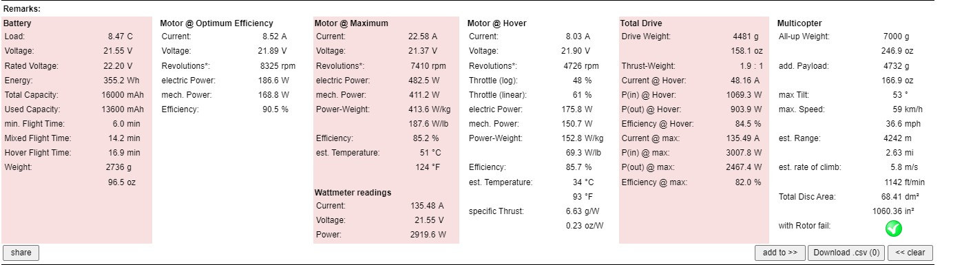
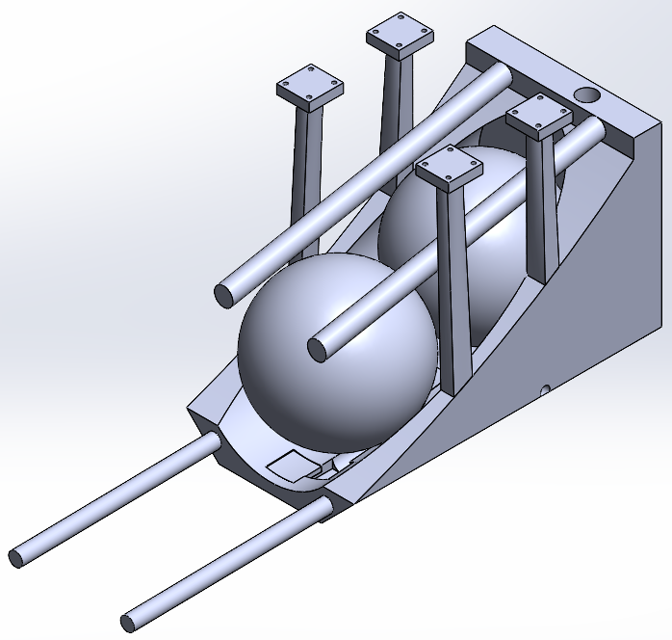
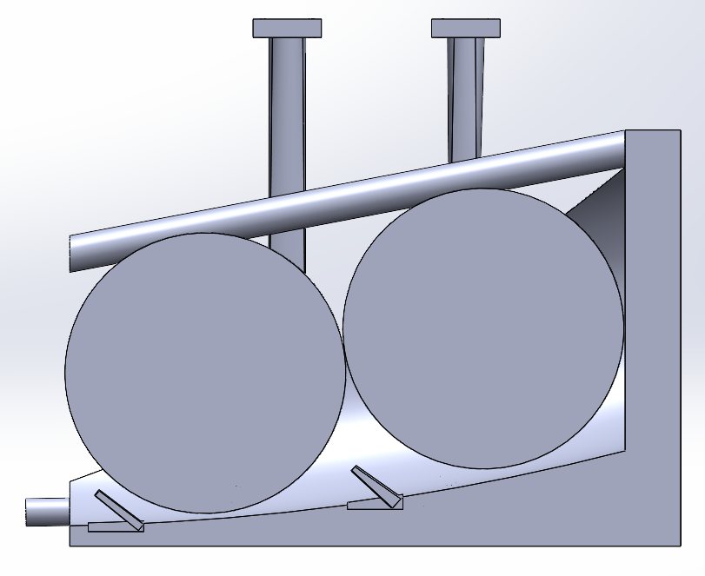

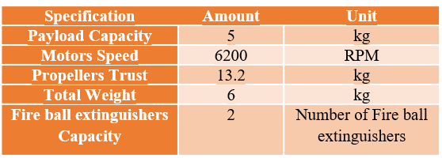
Fire Extinguishing Drone
Problem statement
our drone represents a breakthrough in emergency response, enhancing firefighting efficiency and safety through innovative technology, and paving the way for the future of urban public safety.
Project impact
Validation
Our drone project boosts fire safety by cutting response times and reducing risks for firefighters, enhancing effectiveness and safety in high-rise emergencies.
In busy cities, where rush hour traffic and frequent road closures delay emergency responses, our innovative drone offers a swift solution. Equipped with fireball extinguishers and a glass-breaking mechanism, it flies directly to high-rise fires, bypasses traffic, breaks through windows, and quickly deploys its extinguishing agent
Constraints | Amount | Unit
Weight | 7 | Kg
Altitude | 122 | Meters
Communication range | 10 | Km
Propellers Speed Limit | 340 | m/s
Drone Diameter | 850 | mm
temperature Operation Range | <45 | Celsius
Navigation Precision | ± 0.5 | m
Prototype Design
Conclusion
Team 88 Members
Abdullah Alharbi | AAE
Khalid Almohammadi | AAE
Majed Alsolami | EE
Saad Binsaleh | EE
Khalid Alahmari | ISE
Jamal Mojaled | ISE

