Slide 1

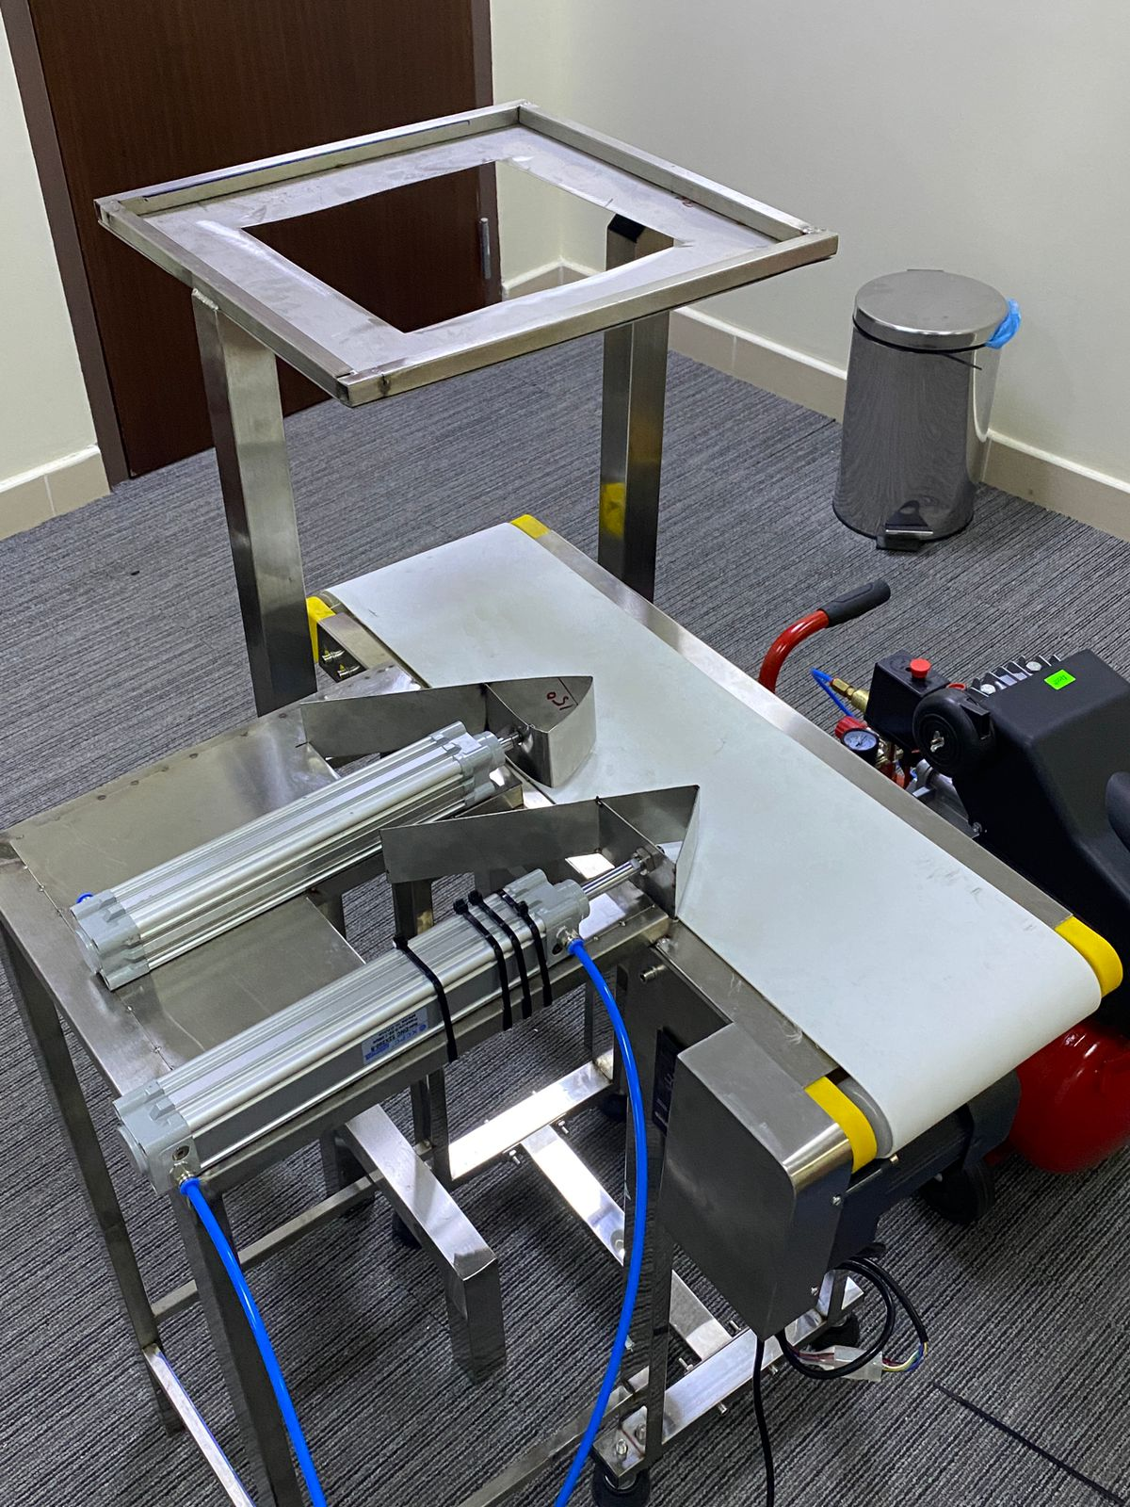
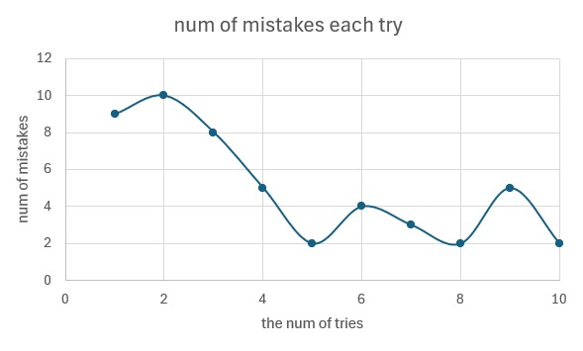
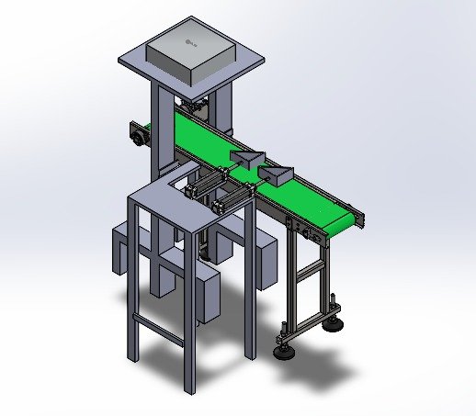
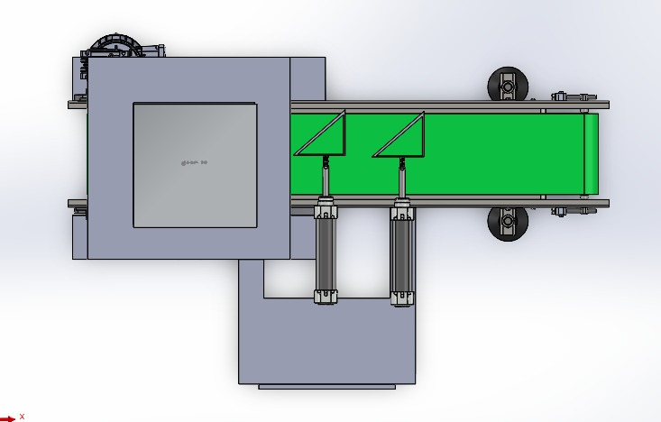
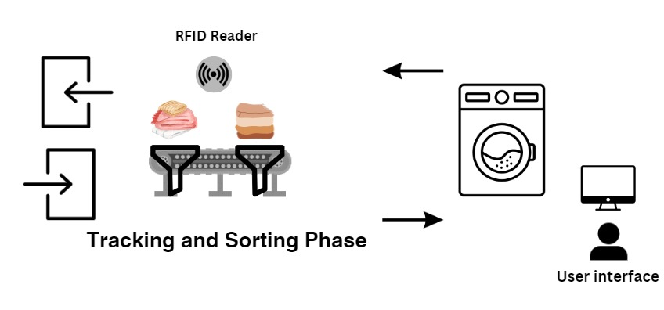
Sorting and Tracking System Based on RFID Technology
Team83 | ICS : Yousef Jamjoom - Abdulrahman AlSuwais | ME : Osama Alshamrani – Abdullah Al shammari | EE : Saud Aldousari - Loai Andijani |
Introduction
Project Impact:
Testing and Validation
Industrial laundries face tracking and sorting challenges, affecting efficiency and customer satisfaction. An RFID-based system promises to revolutionize operations, aligning with automation trends and enhancing service quality.
Energy and Resource Savings:
Implementing RFID-based systems in industrial laundries improves operational efficiency, resulting in energy and resource savings. This aligns with eco-friendly practices and potential energy efficiency incentives.
Functional Testing: Checked for correct operation of the RFID reader, conveyor belt, and pneumatic cylinders.
Load Testing: Evaluated the system under maximum expected operational loads to ensure it could handle high volumes without performance degradation.
User Experience Testing: Assessed the ease of use of the user interface and system responsiveness.
Problem Statement:
Cost Reduction:
RFID technology in industrial laundries reduces costs by minimizing lost items and the need for replacements. Efficient sorting processes also decrease labor expenses by reducing time and personnel required.
Industrial laundries experience significant inefficiencies in item tracking and sorting, leading to resource wastage and reduced customer satisfaction. The proposed RFID system aims to enhance accuracy and operational efficiency by automating tracking and sorting processes, aligning with current market trends favoring intelligent solutions
The Physical Prototype
Prototype Design
Constraints:
Our project requires these following disciplinaries
Sewing the RFID Tag
Verifying Each Tag Individually
Single-Item Sorting
Computer Science:
Software and Interface Development: Develop real-time tracking software for laundry items using RFID and design a user-friendly interface for workers to effectively monitor and interact with the system.
As you can see from the graph, we were optimizing our process after each try so, we can reach the best accuracy we can get.
Target Specifications:
The system is designed to efficiently sort a minimum of 30 tags per minute.
The RFID system will have a robust scanning capability with a minimum range of 2 meters.
The 3D Model
Electrical Engineering:
System Integration: Integrate the RFID system with a conveyor belt and pneumatic cylinders using a Raspberry Pi to control and process RFID data for precise item sorting and handling.
Conclusion
In conclusion, RFID-based systems improve efficiency in industrial laundries by enhancing monitoring, sorting, and operational processes. This technology aligns with automation trends, offering reliability and efficiency. Adopting RFID helps laundries improve service quality, reduce waste, and establish leadership in a competitive, data-driven environment.
Mechanical Engineering:
Conveyor Belt and Pneumatic Cylinder Integration: Design an integrated conveyor belt system with RFID technology and pneumatic cylinders for efficient and precise laundry item management.
The Top View

