Slide 1
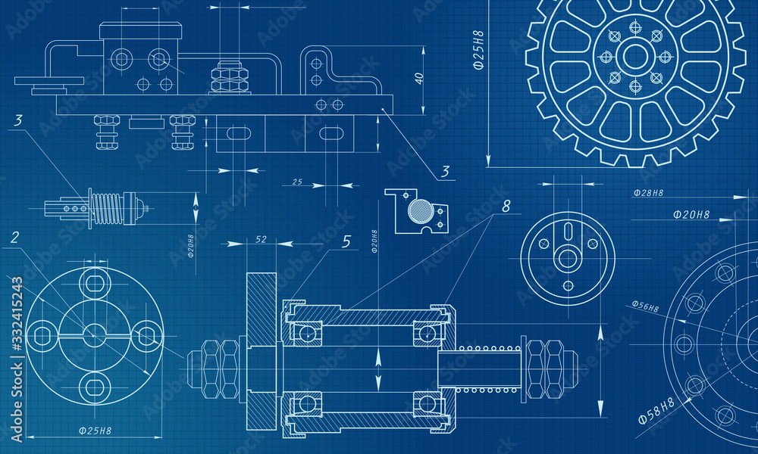

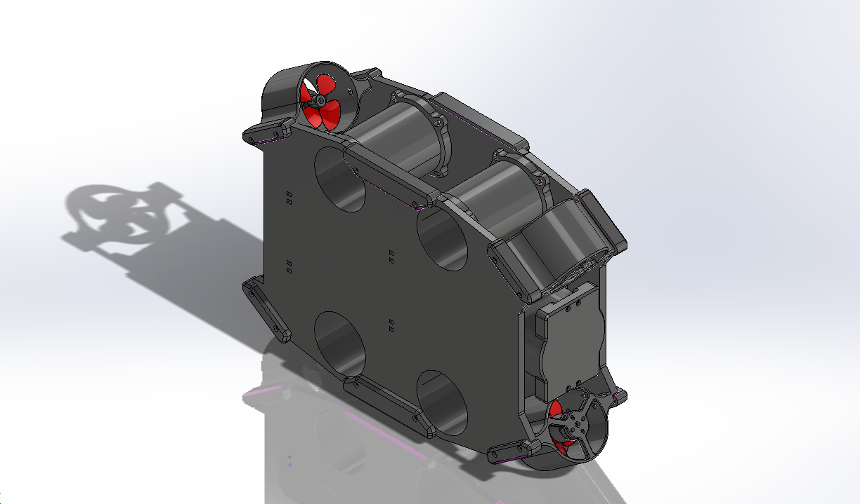
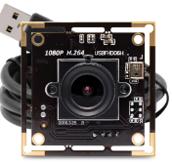

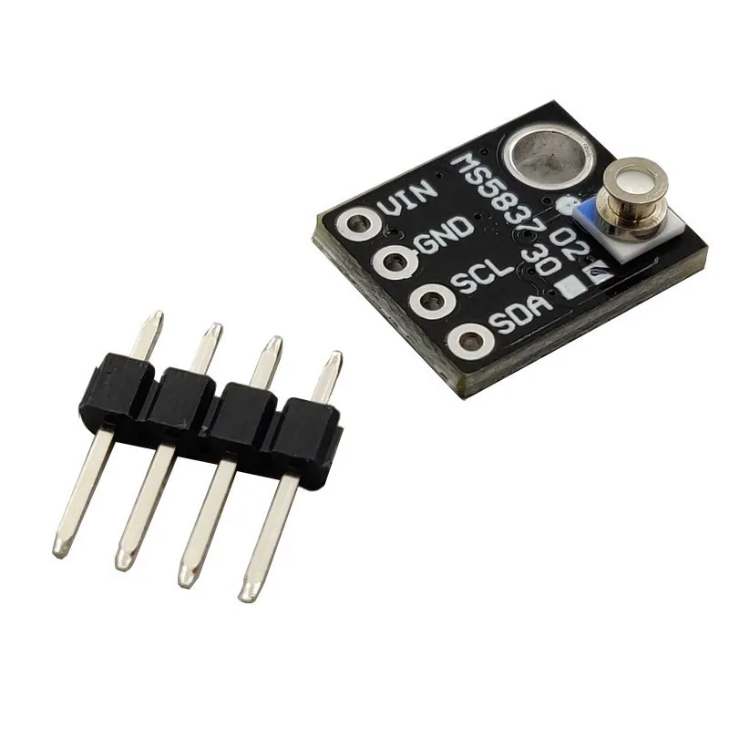
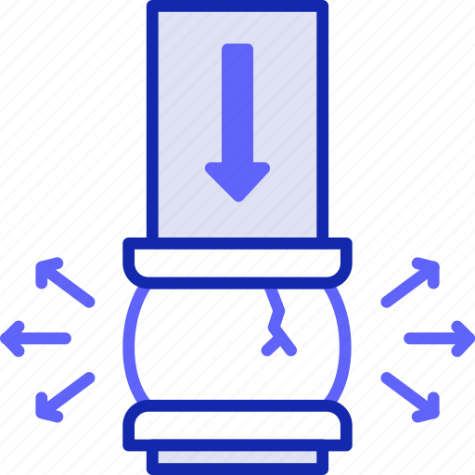

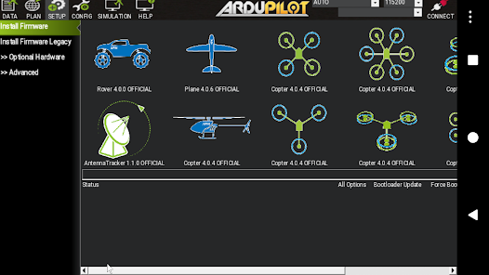

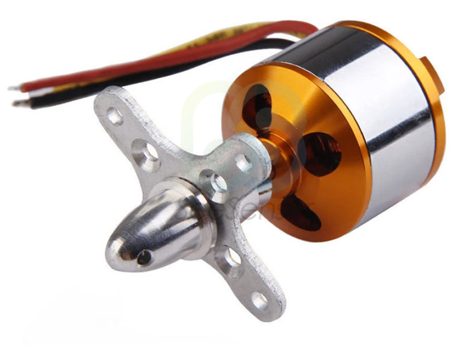


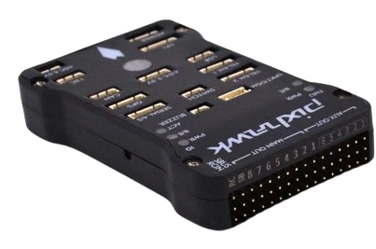
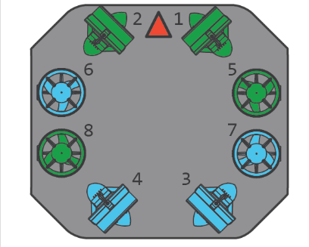
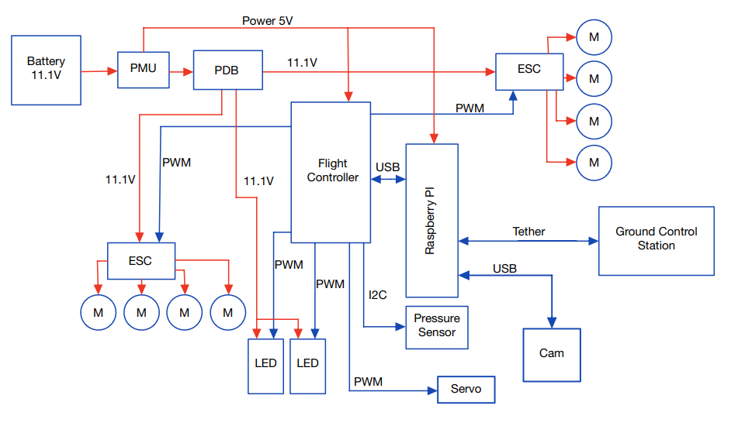


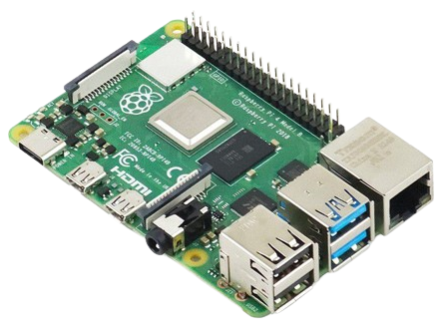
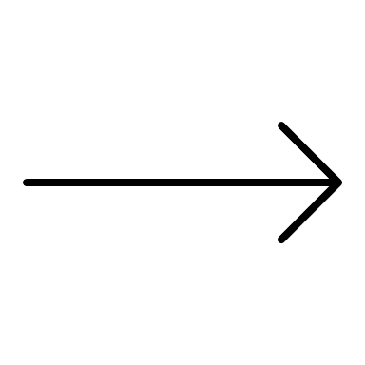




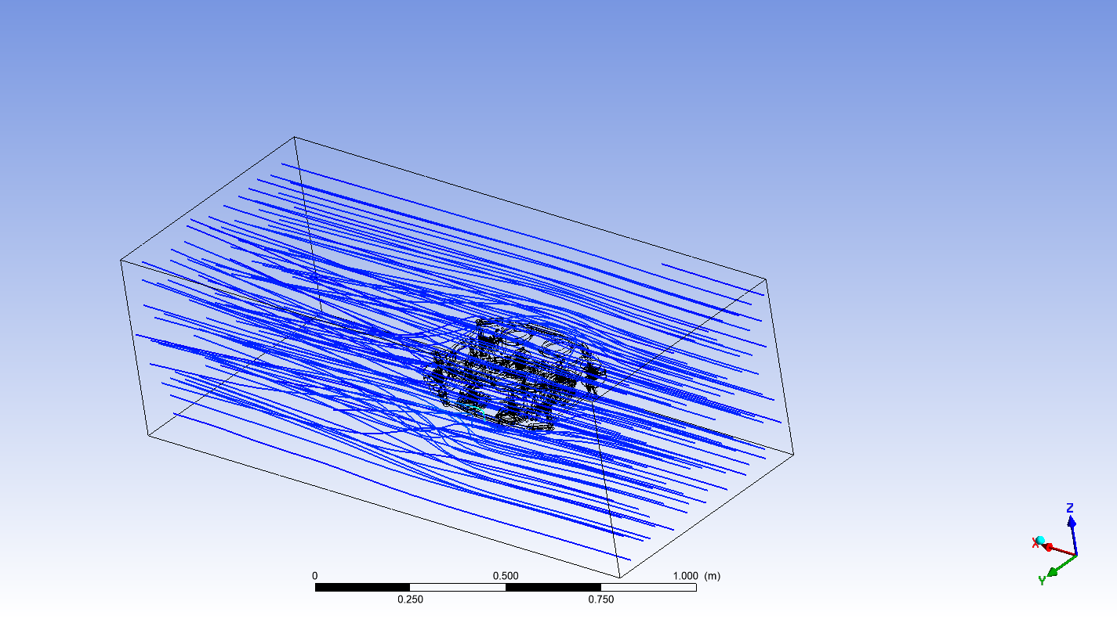
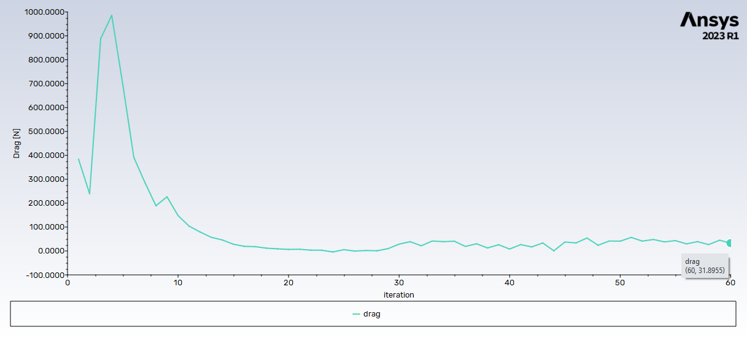
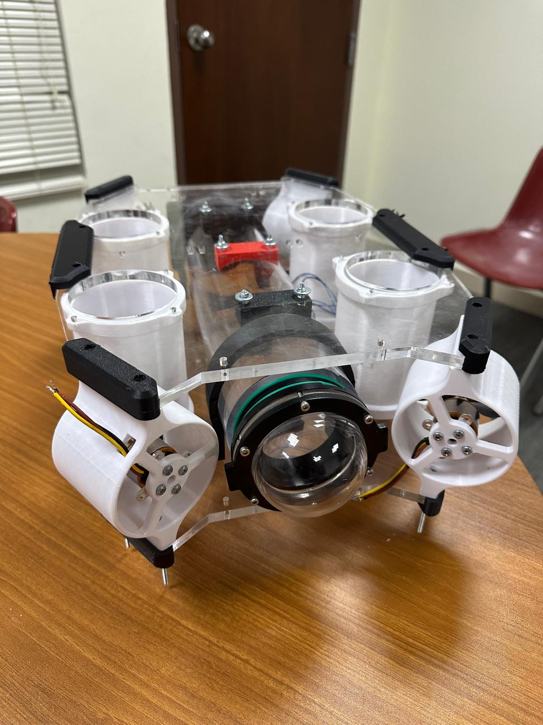
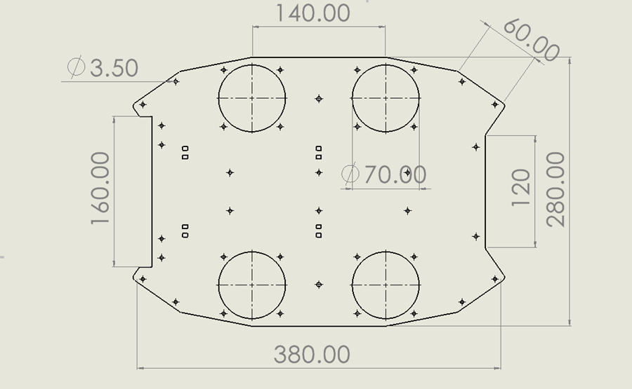
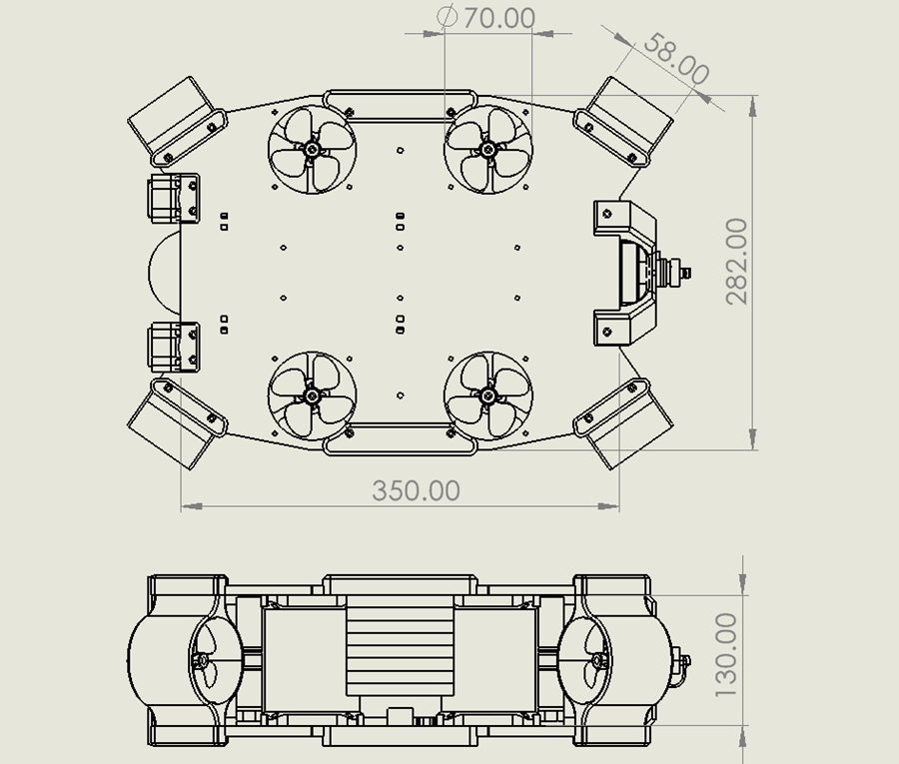

Water Tank Cracks Inspection Submarine
Ahmed ALJaber 201867880 AE
Mohammed Almuhisin 201913190 AE
Abdullah Algubaisi 201950090 ME
Abdulmalik Aljutaily 201865120 ME
Mohammed Alhammadi 201851980 EE
Abdullah AlAhmri 201724650 EE
TEAM Design | Term 232
Objective statement:
Essential Parts
Final Assembly
Elevator Pitch
We are developing an innovative submarine, designed to precisely detect cracks in water tanks, clever propulsion system ensuring efficient maintenance.
Camera
National Water Company faces a problem with detecting cracks in tanks. Our submarine, offers easy and accurate detection for the tank’s cracks, ensuring efficient maintenance actions.
Resolution: 1080P Full-HD
View Angle: 90° viewing angle
Frame Rate: 30 frames per second
Power Consumption: DC 5V
Constraints
Size and Weight: The submarine should be with a size fits easily inside regular tanks of 3*3*6m and move smoothly.
Pressure Resistance: Hold the water pressure of 65 kPa while the inspection process.
Operating Environment: The submarine is detecting the cracks by camera so water should be clean.
Environmental Impact: Employing recyclable materials.
Pressure sensor: GY-MS5837
Pressure Resolution: 0.2 mbar
Temperature Range: -20 to +85C
Conversion Speed: Up to 0.5 ms
Mission Planner
Motors: A2212
Target Specifications
KV Rating: 930KV
Current Capacity: 12A for 60s
E.Current Range: 4-10A
Operating time >= 30 min
Operating Max Speed: S = 0.7m/s.
Weight: W = 3.5 kg
Camera: Frame rate = 30fps, Resolution = 1080P (Full-HD)
Movement: Six Degree Of Freedom
Flight controller
Power Schematics
Propulsion System
Manufacturer: Readytosky
Model: Pixhawk 2.4.8
Main sensors:
MPU6000 as main accel and gyro
ST Micro 16-bit gyroscope
ST Micro 14-bit accelerometer/compass
MEAS barometer
Computer
Manufacturer: Raspberry Pi
Model: Raspberry Pi 5 (4GB)
software : Linux
Main features:
8GB Ram
Video Core VI 3D Graphics
H.265 (HEVC) hardware decode (4K fps60)
Acknowledgment
System Process
We extend our deepest gratitude to the design team, coached by Dr. Othman Ali, and the support from KFUPM for their invaluable contributions to Water Tank Cracks Inspection Submarine project.
Testing and Validations
Drawing & Dimensions
Streamline Simulation
Drag Simulation
Actual Assembly

