Slide 1

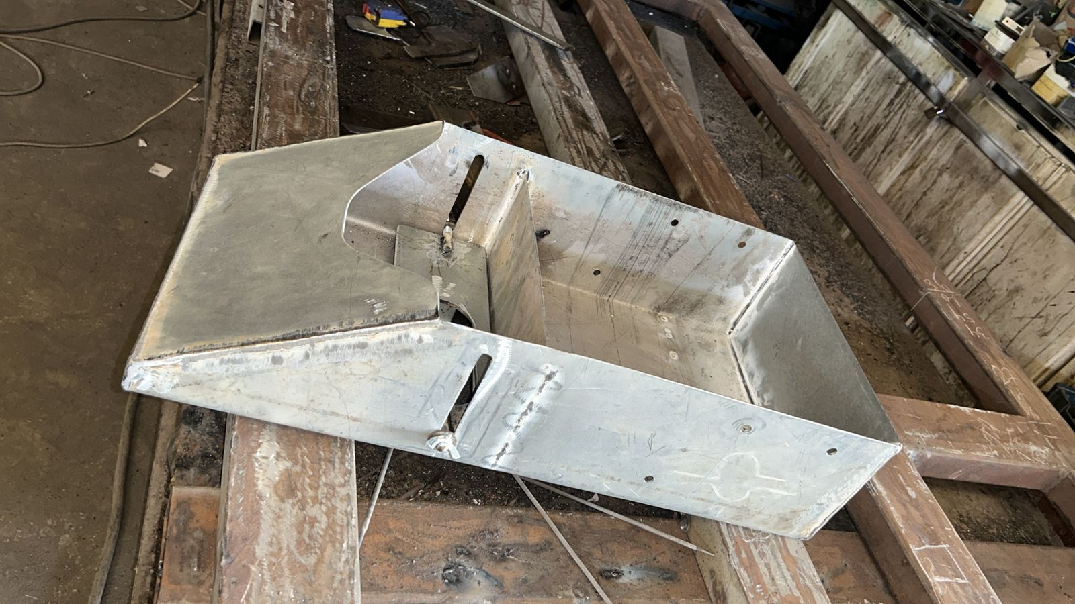
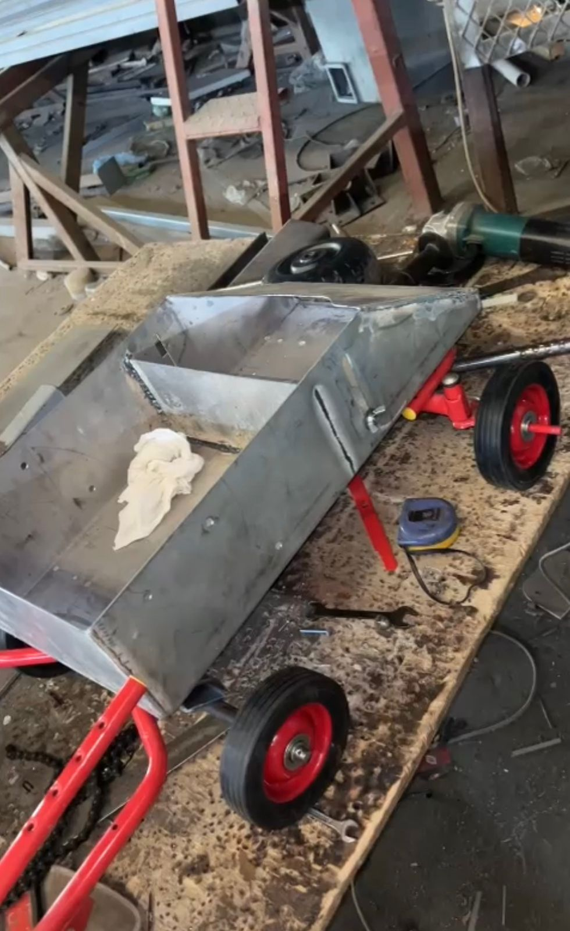
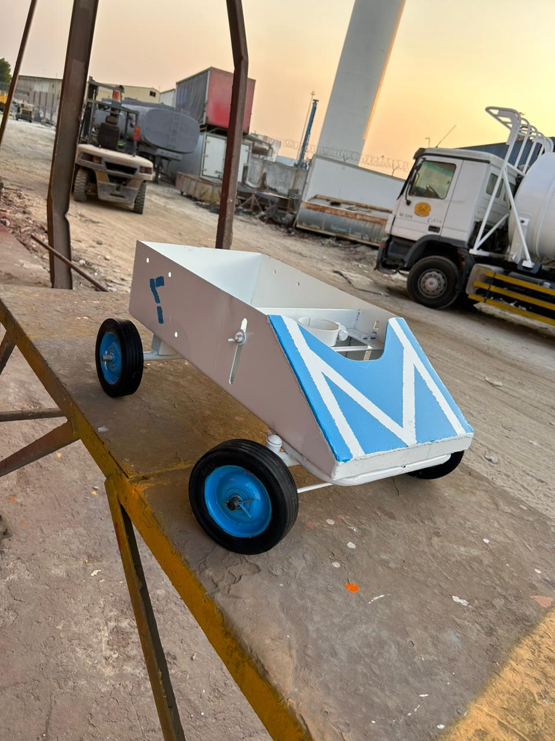
Autonomous Street Painting Robot
Students Name:
Khaleel Alkhalifa, Mutheeb Alsubaie, Ahmed Almutawa, Ali Al-Yousef, and Ammar Al-Mazni.
Senior Design Project
Supervised by:
Dr. Hammad Khalid
INTRODUCTION
SPECIFICATIONS
TESTING
Road infrastructure and road painting have a parallel relationship. As the human population increases, the need to build roads grows and of course painting the road will follow as well as maintenance. The machines and tools used nowadays are all operated manually which leads to the need for more labor to paint and ensure safety. Furthermore, the time it takes to finish the painting process, including the maintenance, raises the demand for a solution that improves the efficiency of the operation. Also, the cost of the process is high. The machines and labor that are required for every road increase the expenses exponentially considering how slow the process is. In addition, there are two types of trucks used during operation, one for marking the road and the other for painting. When working on tight roads and small areas, those trucks won’t be able to operate as intended. Also, the CO2 emissions caused by using heavy trucks will have a negative impact on the environment.
Each specification is important to the performance and user experience of the robotic system. It's a comprehensive list that should provide a clear framework for evaluating or designing such a robot:
Weight between 20-30 kg.
At most 5000-Watt battery.
Battery lasts for 2 h.
550 ml Spray capacity.
UNDER TEASTING
PROTOTYPE DESIGN
Stage1 Design and Planning: At the initial stage of creating our robot body, meticulous design and planning take place. We collaborate to conceptualize the robot's physical structure, considering its intended purpose, functionality, and aesthetics.
Stage 2 Material Selection and Fabrication : After finalized the design we select the appropriate materials for constructing the robot body. Depending on the requirements iron material had be chosen. These materials offer strength, durability, and ease of manufacturing.
Stage 3 Assembly and Integration: In this stage, the fabricated components are carefully assembled to form the robot's body. We follow assembly instructions, to ensure proper alignment and integration of each part. This includes attaching joints, tire axles and other essential components to facilitate movement, perception, and interaction.
RESULTS
WILL BE POVIDED AFTER WE FINALIZED THE TEASTING
PROBLEM STATEMENT
A smart robot automates the road painting process with precision, efficiency, and enhanced safety, ensuring clear and standardized lines for improved traffic flow.
DELIVERABLES AND CONSTRAINTS
In this project, our main deliverable is a remarkable smart robot that takes over the task of painting road traffic lines. Imagine a robot that moves gracefully along the roads, equipped with sensors and a smart software system. We will create a functioning prototype of this robot, complete with all the necessary hardware components. Our goal is to ensure that the lines it paints are clear, standardized, and perfectly aligned, resulting in improved traffic flow and enhanced safety for everyone on the road.
CONCLUSION
Figures: Stages of design development
The Autonomous Painting Robot Project represents a significant leap forward in the field of road infrastructure maintenance, offering an innovative and efficient solution designed to enhance road marking precision while reducing human labor and intervention. This groundbreaking technology introduces a self-contained robot with a suite of features and capabilities that ensure safe, reliable, and adaptable performance

