Slide 1

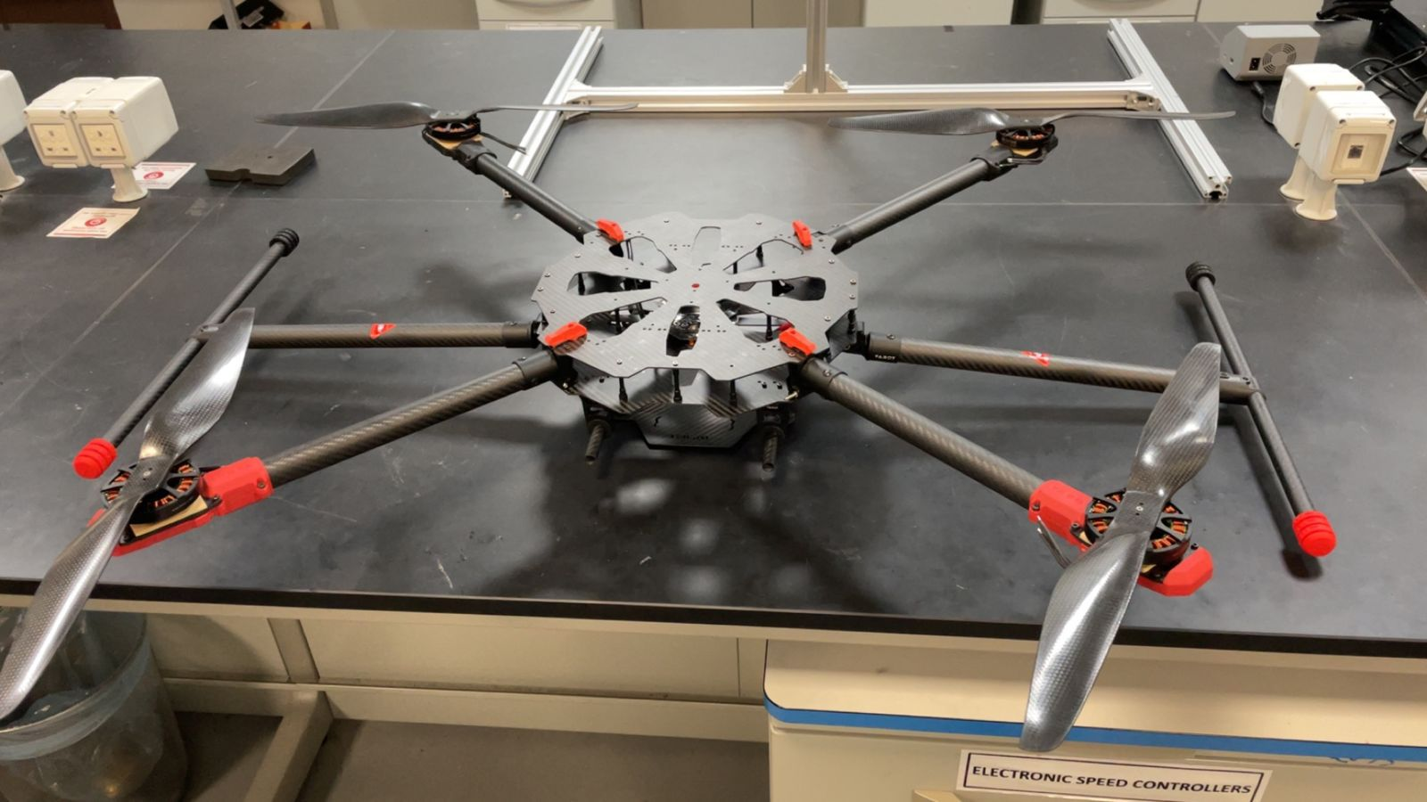
King Fahd University of Petroleum and Minerals
College of Computing and Mathematics & College of Engineering and Physics
Smart Inspection Drone
Bader Alqahtani | Abdulrahman Alwatban | Jamaan Alqattan | Fahad Alotaibi | Muhtadi Alfilfil | Naif Alotaibi
AE | ISE | COE | ME | EE | AE
201971870 | 201920130 | 201860080 | 201867420 | 201812760 | 201971830
Introduction
Constraint & Specifications
Prototype Design
,
Gas refineries face a problem of Providing high safety for workers from toxic emissions. So, for Gas refineries, Who want to reduce the risk to their employees and losses and benefit from modern technologies, Inspection drone is A vehicle equipped with sensors and cameras that Controlled remotely. Unlike human factor, Inspection Drone can reach difficult places and deliver information to the workers.
Constraints
Regulatory Compliance: Adheres to aviation laws for sensor usage.
Cost Optimization: Selects materials and technologies based on budget.
Weather Adaptability: Functions effectively in varied climates.
Security Focus: Addresses operational security concerns.
Full Finished Design:
Specifications
Drone Weight | 8 kg
Flight Range | 18-25 Km
Altitude | 15-30 m
Flight Duration | 25-35 Min
Velocity | 18-30 km/h
Computing and Camera Specifications
Image resolution | 1920x1080 pixels (Full HD)
Data processing speed | 700-1000 ms
Testing & Validation
Problem statement
Test outcomes highlight successful sensor integration and real-time data acquisition, with occasional software glitches promptly addressed through updates. Data analysis underscores the drone's reliability and efficiency in refinery inspections.
Project Impact
The project centers on developing an Intelligent Refineries Inspection Drone,
seamlessly integrating visual and thermal imaging technologies. This innovation aims to transform oil and gas refineries surveillance, ensuring heightened efficiency and reliability in structural integrity assessments.
Advanced Technology: Utilizes the Intelligent Inspection Drone to optimize oil and gas refinery inspections.
Efficiency and Safety: Lightweight design with extended flight capabilities reduces manual inspection needs, enhancing safety.
Economic and Environmental Impact: Lowers operational costs and minimizes environmental pollution.
Societal Benefits: Improves workplace safety and fosters industry innovation, setting a standard for future technological advancements.
Conclusion
In conclusion, the Intelligent Inspection Drone revolutionizes refinery operations by enhancing safety and efficiency. With advanced AI and autonomous capabilities, it minimizes manual risks and speeds up inspections, leading to significant cost savings and operational improvements.

