Slide 1

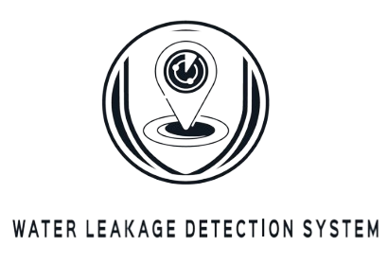
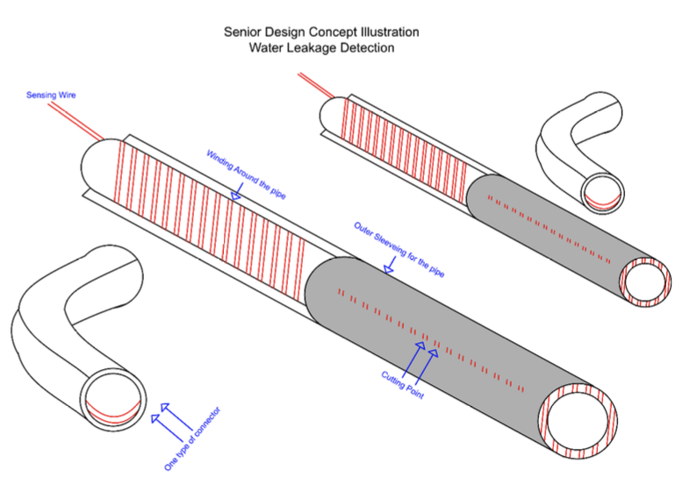
Water Leakage Detection System
· Group(73) – Abdullah Almutairi, Mohammed Al-Towairgi, Osama Al-Asiri, Rayan Al-Amoudi and Assim Al-Dhebaib
· Coach: Dr. Ibraheem Al-Naib
Problem Statement
Design
Specifications
This project aims to prevent financial and environmental damage caused by delayed water leak detection. By implementing an advanced detection system, it aims to eliminate delays, locate leaks accurately, and optimize water flow. This initiative reduces costs and addresses environmental challenges.
Easy Installation: Connect wires to power source and ground, wrap around pipe, and test connections for quick setup.
Corrosion Proof: Choose corrosion-resistant materials for durability in moist or corrosive environments.
Distance Measurement: Analyze voltage drops and resistance per meter to estimate leakage distance.
Pinpoint Pipe for Repair: Compare voltage drops to identify specific pipe requiring attention.
Immediate Leak Alarm: Program Arduino to activate buzzer for instant leakage notification.
Deliverables
1- Instant Water Leakage Detection
2- Pinpointing the Exact Location of the Leakage
3- Determining the amount of Leakage in the System
4- Optimizing After a Leakage has occurred.
  Impact
Method
Conclusion
The implementation of the Water Leakage Detection System showcases a leap in resource management and efficiency, particularly in high-stakes industries. It's projected to yield significant financial benefits for a prominent petrochemical sector client, with an annual cost saving of around 29.82 million SAR in the initial year — traditionally the lowest savings period — against an additional system cost of just 180,000 SR. These savings are largely due to reduced operational downtimes and a decrease in extensive maintenance requirements. By prioritizing the conservation of water resources, the system not only achieves substantial economic advantages but also upholds environmental integrity, demonstrating a commitment to sustainable industry advancements.
- Connect a water tank to a valve and a pipe.
- Twist together two resistive wires along the pipe.
- Leave one end of the first wire open and connect the other end to an Arduino as a power source.
- Ground the other end of the second wire.
- When a leakage occurs, it creates a short circuit between the wires.
- Utilize the voltage divider equation to measure the output voltage across the leakage point.
- Determine the resistance per meter of the wire material.
- Calculate the distance to the leakage point using the resistance per meter.
- Pinpoint the precise location of the leakage along the pipe.
The project concludes with a highly efficient Water Leakage Detection System designed to deliver immediate detection and precise location tracking of water leaks. It significantly reduces the typical industry response time from days or even months to a matter of seconds, effectively curtailing water loss and facility shutdowns. The system's impact on maintenance efficiency is profound, offering a 95% reduction in shutdown costs, which translates to an average of $30 million in savings for a petrochemical factory. This technological advancement represents a crucial step forward in operational efficiency and cost management within the industry.

