Slide 1


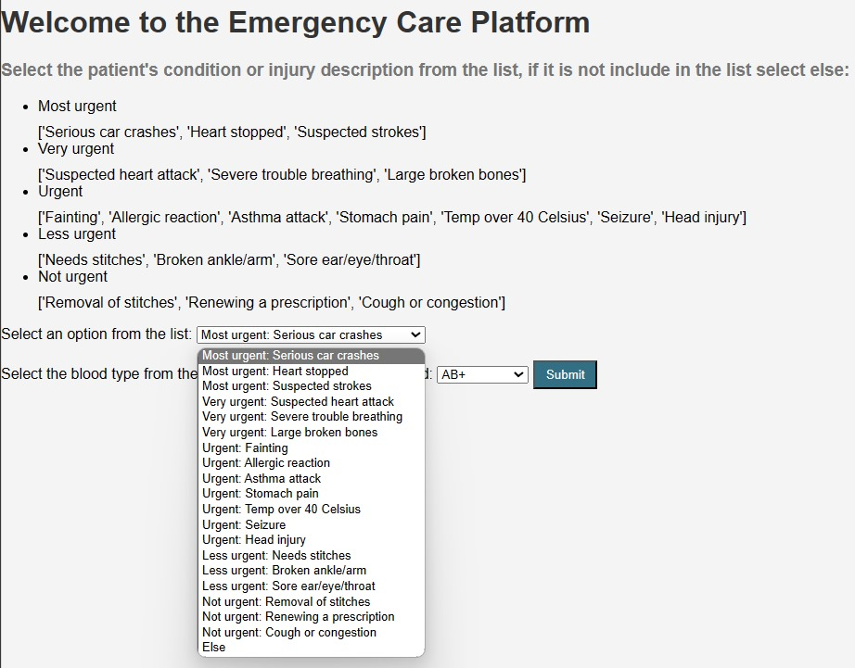
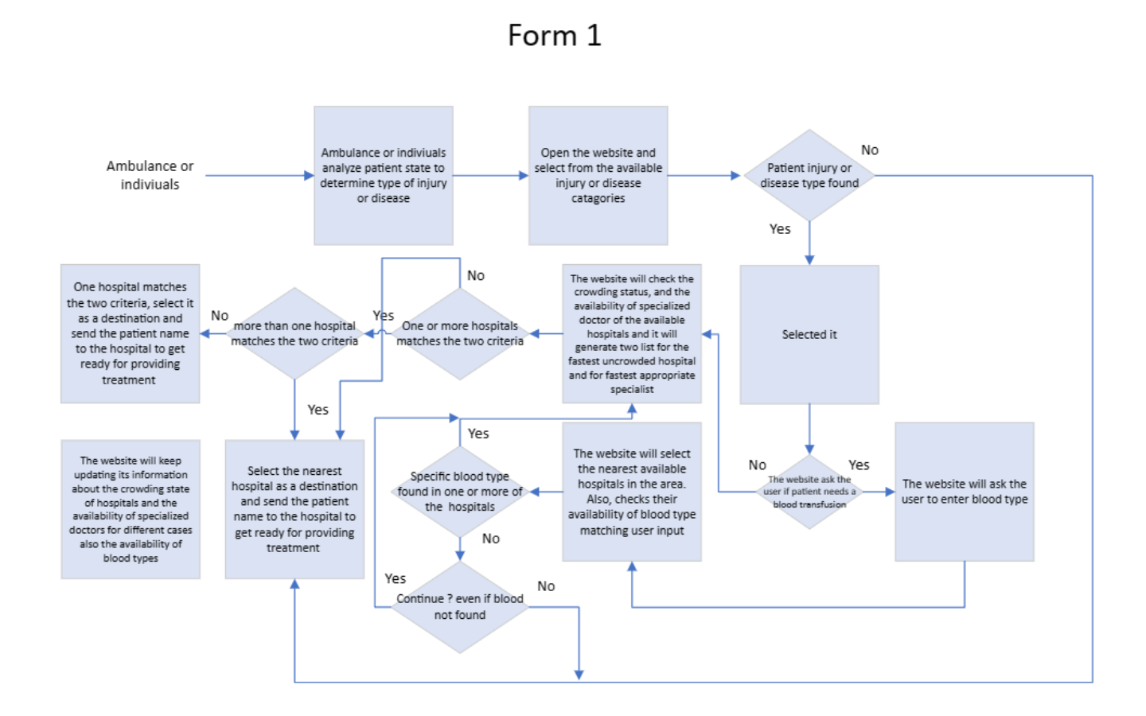
King Fahd University of Petrolium and Minerals “KFUPM”
Emergency Care Platform
Group 67:
Abdulmohsen Alqahtani, Hamad Alqahtani, Hassan Zaini, Abdulaziz Alsdossary, Rayan Alkarry
Coach: Dr. Yasser Almoghathawi
Problem Statement
Prototpe Design
Prototype Design
“Cont.”
Validation
The project aims to develop an Emergency Care website platform suited for healthcare professionals and emergency responders. This platform will provide real-time information on nearby hospitals, including their current capacity, specialization, and availability. The goal is to significantly reduce the time it takes to transport patients to the most suitable hospital.​​
Mathematical Model:
- Parametes:
i=patient, j=hospital
Dij: The distances or travel times between i & j.
Cj: Patient capacity for each j.
1, if Specialists available in hospital j.
SPj:
0, otherwise.
1, if Blood type for i is available in j.
Bij:
0 , otherwise.
- Decision Variables:
1, if patient i is assigned to hospital j.
Xij:
0 , otherwise.
- Objective Function:
Minimize the total transportation time while considering the specified criteria.
This can be represented as:
Minimize Z = Σ(i, j) Xij * Dij
- Constraints:
Hospital Capacity:
Ensure that the number of patients assigned to each hospital does not exceed its capacity.
Σ(i) Xij ≤ Cj, For each hospital j
Patient Assignment:
Ensure that each patient is assigned to one hospital.
Σ(j) Xij = 1, For each patient i
Availability of Specialist Doctors:
Consider the availability of specialist doctors when making assignments.
Σ(i) Xij * SPj ≥ 1, For each hospital j
Blood Type Compatibility:
Ensure that patients are assigned to hospitals with suitable blood types.
Bij ≥ Xij, For each patient and hospital
2. Programming Model:
In this part, we are implying the mathematical model into a language of programming to link up the mathematical model into the website based on the user's choices “decisions”.
3. Operation the Website:
Maintain a 24/7 availability of the system:
Met: The system doesn't seem to have specific features indicating non-availability during certain hours and using Google API is an accessible for 24/7.
Use the Triage coding system on our website:
Met: The code incorporates a Triage coding system for patient conditions and urgency levels.
Increasing the number of options shown in the system to include 70% or more of the common cases of patients transported to the hospital by ambulance:
Meets the specification.
Specifications
Decrease the time to print the output to 3 seconds or less.
Minimize the number of steps/clicks to 5 or less to reach the result.
The system shall be 24/7 available.
Support 2 languages. “Arabic & English”
Provide regular updates every 10 minutes.
Extended scalability of users.
Increase the number of symptoms and injuries options shown in the system to include 70% or more of the common cases of patients.
Utilizing the Triage coding system on our website.
Using HTTPS protocol. “The primary way to securely send data from a web browser to a website”.
Step | Action
1 | Identifying the location of the patient.
2 | Identifying the nearest hospital of patient's location.
3 | Ranking these hospitals based on the 4 factors score.
4 | Assign the patient to the most suitable hospital based on his situation and give a notice to the hospital that a patient is coming.
Conclusion
Constraints
The "Emergency Care Platform" project aims to develop a web-based solution for healthcare professionals and emergency responders. It provides real-time information on nearby hospitals, including capacity, specialization, and availability, to reduce patient transport times. This is achieved by considering factors like crowding, specialist doctor availability, blood type compatibility, and transportation duration. The project improves emergency healthcare services by optimizing hospital selection, benefiting both patients and providers.
Hospitals Agreement to cooperate with our project idea.
Ambulances Agreement to cooperate with our project idea.
Users' trust in using the website.
Initial testing on non-critical cases.
Regulatory and legal compliance.
Technical infrastructure and compatibility.
Funding and financial sustainability.

