Slide 1

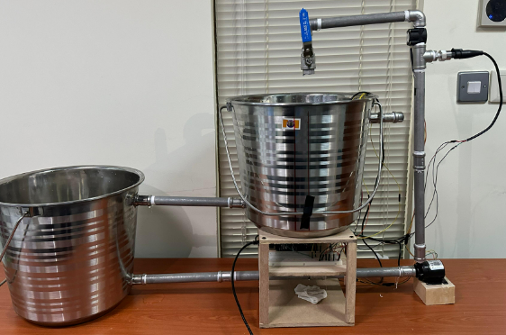
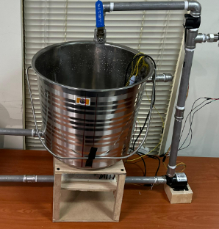


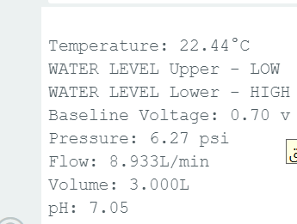
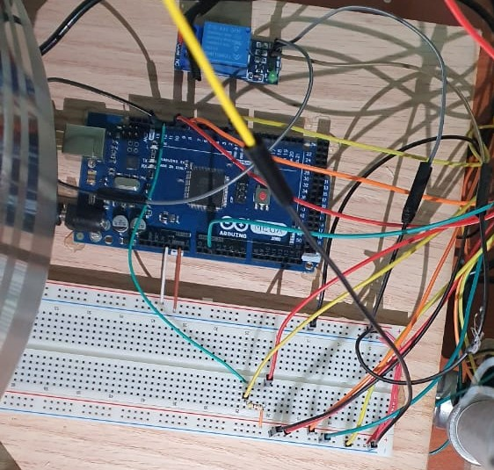
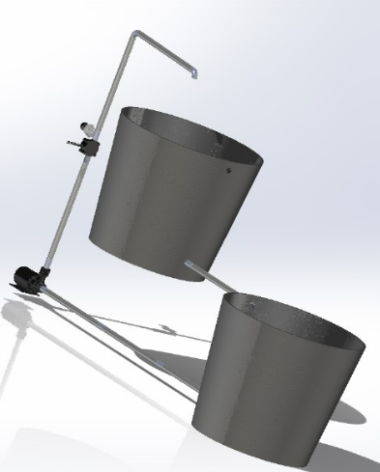
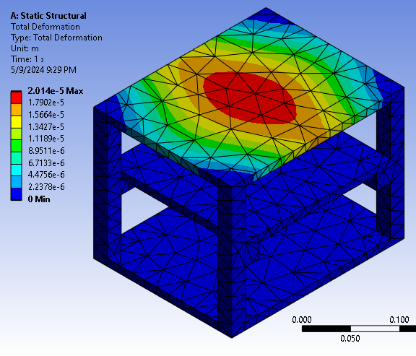
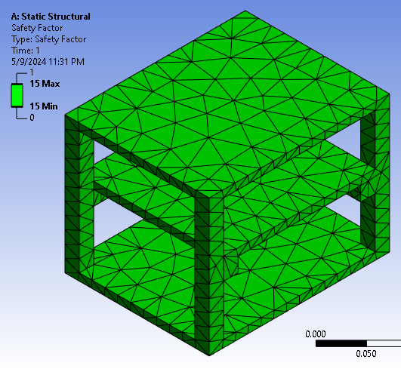


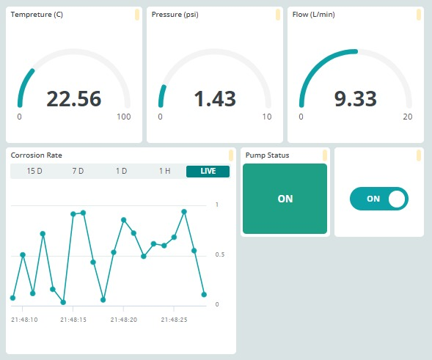
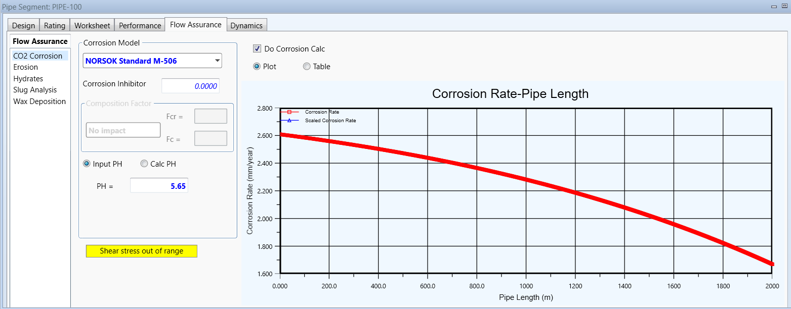
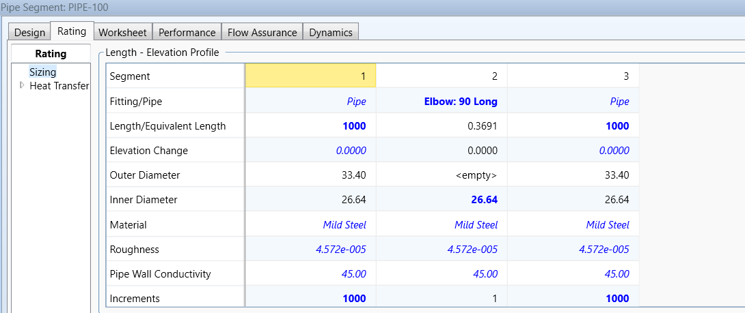
Students Names:
Real-time Monitoring System for Pipe Corrosion
Hussain Alsalem(CIE), Ammar Asiri (CIE)
Fawaz Alotaibi (ME), Mohammed Alghamdi (ME)
Mohammed Alabdrabalnabi(CHE), Khalid Almajed(CHE).
Coach:
Dr. Muhammed Emzir
  INTRODUCTION
PROJECT IMPACT
Our senior design project aims to create a system that integrates with existing pipeline sensors to gather data on pressure, temperature, flow rate. This data feeds into a mathematical model to calculate corrosion rates in real-time, providing oil and gas companies with essential insights to enhance pipeline integrity and safety.
Preventing pipe corrosion saves infrastructure costs, boosts economic viability, and fosters innovation. Job creation benefits local economies, especially in Saudi Arabia.
Sensor systems ensure infrastructure reliability, enhancing community safety and cohesion. They prevent environmental contamination, promoting sustainable infrastructure management and adhering to regional laws.
PROBLEM STATEMENT
PROTOTYPE DESIGN
Figure 2: Physical prototype
Oil and gas companies encounter costly downtime and maintenance from pipeline corrosion. Our Real-time Monitoring System for Pipe Corrosion predicts corrosion rates using MATLAB module. Unlike traditional systems, it leverages existing temperature, pressure, and flow sensors for precise, non-invasive corrosion monitoring, eliminating the need for dedicated sensors.
TESTING
CONSTRAINTS
- Water Pump:
Hmax: 4-6 M, Qmax: 600 -800 L\h.
Water Flow Sensor:
Range: 1-30 L\min, Water Pressure: <= 1.75MPa, Max temperature: 80 C.
Pressure Sensor:
Range: 0 -100 psi, Accuracy: within 2%.
Temperature Sensor:
Type: RTD, Range: -20 C - 80 C.
- Pipe Material: Mild Steel.
Figure 1: SOLIDWORKS Prototype Design.
The prototype is divided into three main parts:
1. Mechanical Part (Structure): Comprising two tanks connected by a loop of pipes and elbow pipes made of mild steel, this structure handles the water cycling process.
2. Automated Control System: Utilizing a Mega Arduino to control flow by monitoring the upper tank’s water level linked to a pump. The Arduino also connects to sensors measuring temperature, pressure, pH, and flow rate, feeding real-time data to a MATLAB model and displaying it on a monitoring dashboard.
3. Real-time Dashboard Monitoring: An interface that provides real-time monitoring of process parameters and displays the corrosion rate based on MATLAB model results.
TARGET SPECIFICATIONS
Data acquisition Time: 100 ms
Corrosion Detection Range: 0 to 5 mm/year
Data Accuracy Error: < 0.5%
The Testing adheres to ASTM E691-15 - 8
Structure Dimensions: 105x35x65 cm
All specifications have been met.
Figure 3: Dashboard
Figure 4: ASPEN HYSYS simulation work
CONCLUSION
The senior design project aims to develop a mathematical model to calculate corrosion rates using real-time data from sensors monitoring pressure, temperature, flow rate, and pH levels in pipelines. This system will integrate with existing oil and gas pipeline sensors to provide corrosion rates in millimeters per year, enhancing proactive monitoring and safety for these companies.

