Slide 1

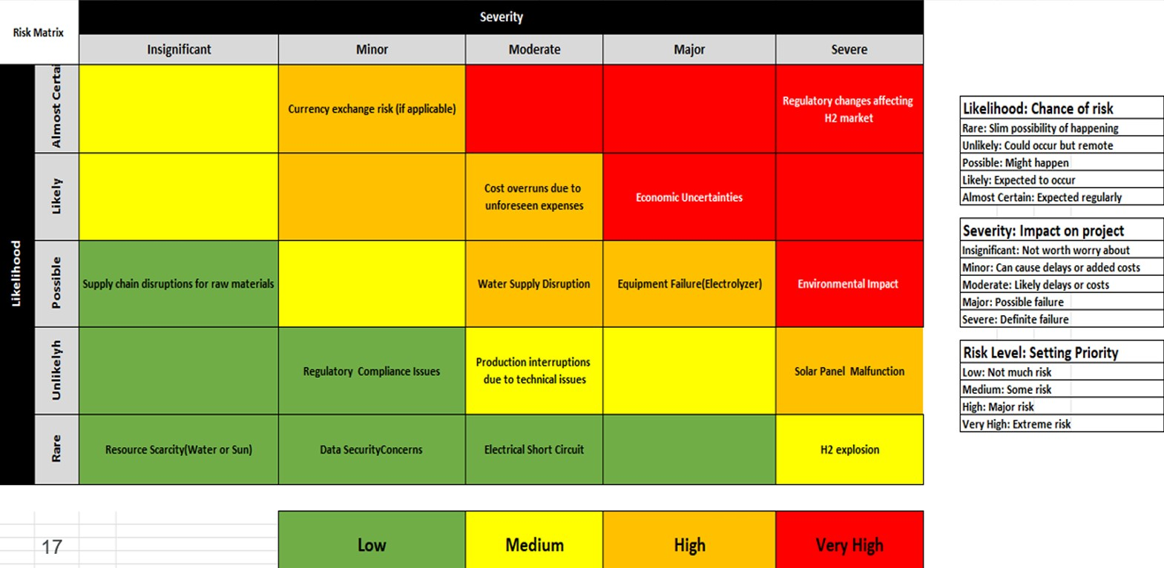
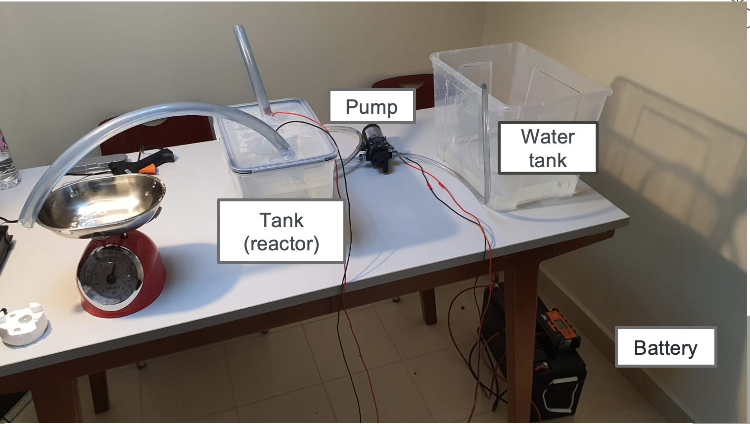

Produce Green Hydrogen and use it as Cooking fuel
Team 62
CHE : Abduallah Alsobhi CHE: Omar Alharbi ISE: Faisal Alqahtani ISE: Mohmmed Alshahrani EE: Hussain Al Radhwan
Introduction
In response to the pressing challenges faced by households reliant on liquefied petroleum gas (LPG) for cooking, our innovative solution seeks to revolutionize the cooking fuel industry. The existing use of LPG has given rise to significant concerns, including greenhouse gas emissions during combustion, the inherent explosiveness of LPG cylinders if not stored properly, and the logistical challenges posed by the heavyweights of the cylinders. In order to address these issues and pave the way for a more sustainable and user-friendly alternative, we propose a pioneering, self-sufficient system. This system harnesses renewable energy to produce green hydrogen, which is then stored for use as a clean and efficient cooking fuel. Our product is designed to be environmentally friendly, boasting not only a reduction in greenhouse gas emissions but also addressing safety concerns associated with traditional LPG usage. Furthermore, our solution offers the advantages of minimal installation time, low operational costs, and reduced maintenance expenses. We firmly believe that our approach represents a transformative shift in the cooking fuel industry. By introducing a sustainable and innovative system, we aspire to not only alleviate the challenges faced by consumers but also contribute to an enhanced quality of life for our customers. Our vision is rooted in environmental responsibility and a commitment to creating a positive impact on both communities and the broader ecosystem.
.
Testing &Results
Will be filled completely before Final presentation
Risk Analysis
A risk matrix is a visual tool for assessing and prioritizing risks by evaluating their likelihood and potential impact. It utilizes a grid, with one axis representing the probability of an event and the other axis depicting the consequences. This matrix categorizes risks into different levels, like low, medium, and high risk, aiding in effective risk management. By highlighting critical areas, it helps organizations allocate resources for mitigation strategies. Whether in project management or safety planning, the risk matrix is a valuable tool for decision-making and prioritizing actions to address potential threats.
Compnent of the prototype
3x Tanks
12V Pump
12V Battery
Pt electrode (10 mm – 15 mm – 0.2 mm )
Greaphite electrode ( 10 mm – 100 mm )
Float switch
Gas stove
2xSolar panels
KOH
Prototype Desgin
The solar panels will fill the baterh first in order to produce the electricity for the entire system,
The water tank will provide the system with the water supply.However, the added pump is to make sure that the electrodes are imarged into water throughout the process, Moreover the second tank which will have electrolysis of water to produce Hydrogen gas
$\text{2}\text{H}\text{2}\text{O}\text{→}\text{2}\text{H}\text{2}\text{+}\text{O}\text{2}$ (1)
After hydrogen being produced it enters third tank filled with water to deliute some of the hydrogen and to make to sure that the hydrogen gas don’t reverse back to the cell and then it will be connected to the gas stove.
Conclusion
In conclusion, our innovative solution stands as a beacon of change in the realm of cooking fuel, addressing the critical challenges associated with conventional LPG usage. The inherent concerns of greenhouse gas emissions, safety risks, and logistical difficulties posed by heavy cylinders have prompted us to pioneer a self-sufficient system driven by renewable energy. By harnessing green hydrogen as a clean and efficient cooking fuel, our product not only mitigates environmental impact but also prioritizes safety and operational ease. Moreover, In the broader context, our vision extends beyond mere product innovation. It encompasses a dedication to environmental responsibility and a sincere effort to create positive ripple effects within communities and the ecosystem at large. By taking these strides towards a cleaner, safer, and more efficient cooking fuel solution, we aspire to set a precedent for sustainable practices that resonate across industries, ushering in a new era of responsible energy consumption.
Acknowledgement
We express our sincere thanks to our project advisors dr.Muhammad Siddiquee & Zayd Leseman for their invaluable guidance and support throughout our senior design project. Special appreciation to Team design department for providing the necessary resources and conducive environment. Our gratitude extends to our team members for their collaboration and commitment. Thanks to dr. Tawfik for his real-world insights. Lastly, we appreciate the understanding and support from friends and family during this journey. This project's success is a collective effort, and we are thankful for everyone who played a role in shaping our academic and professional growth.

