Slide 1
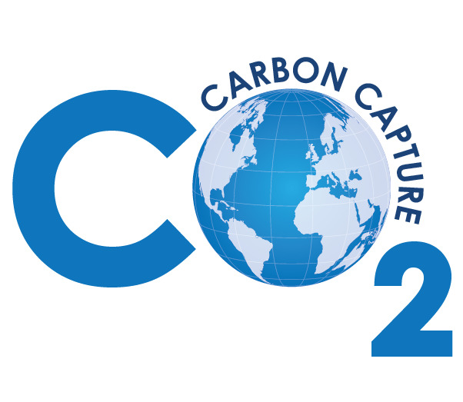

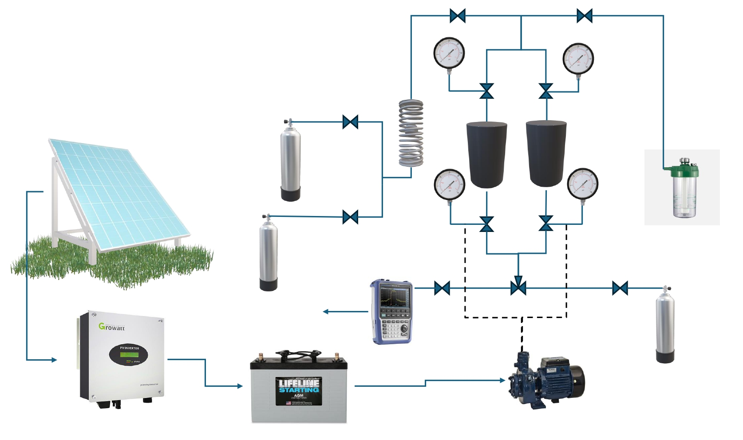
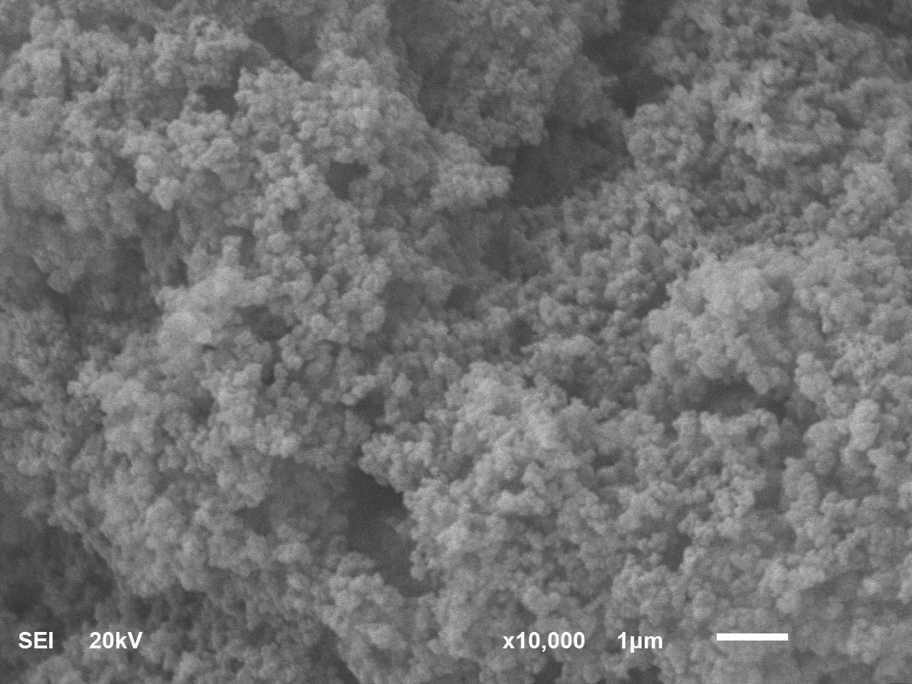




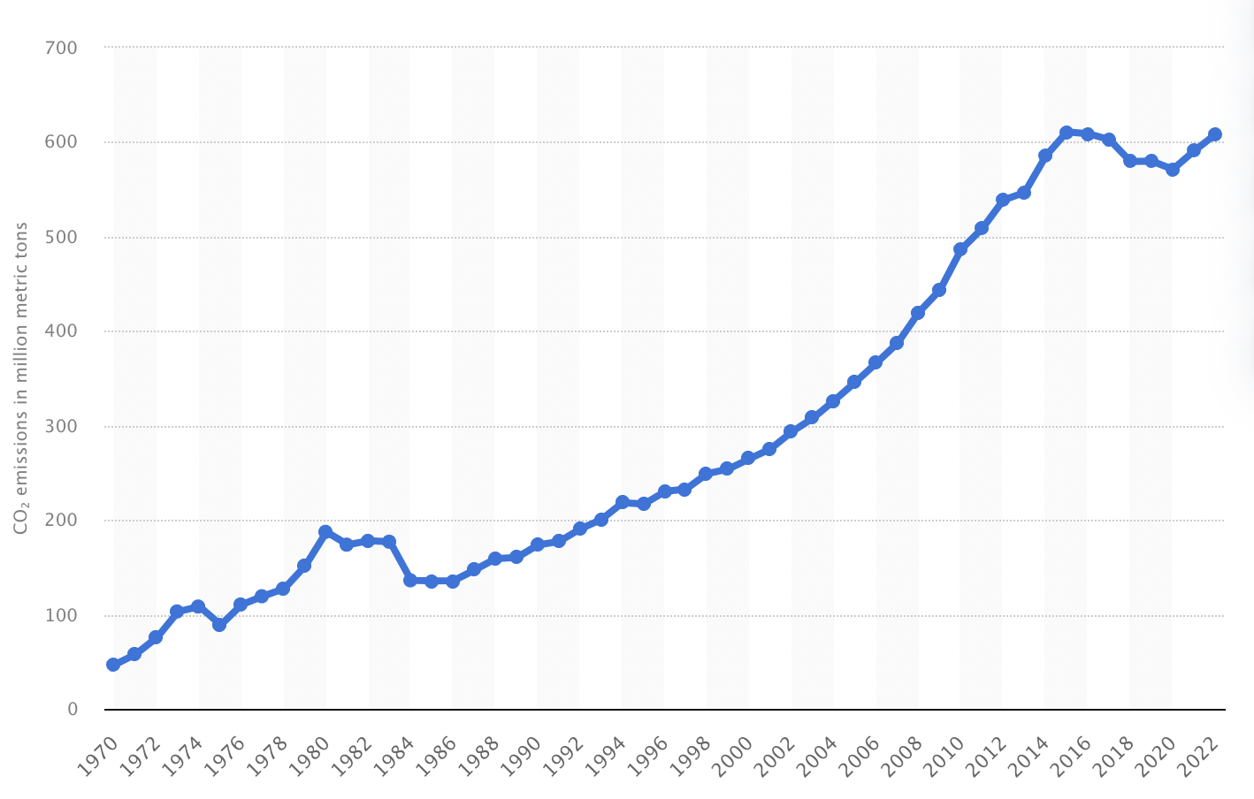



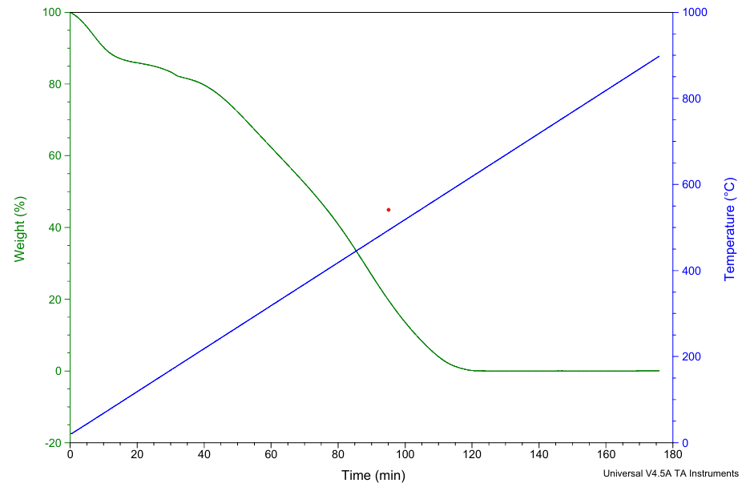



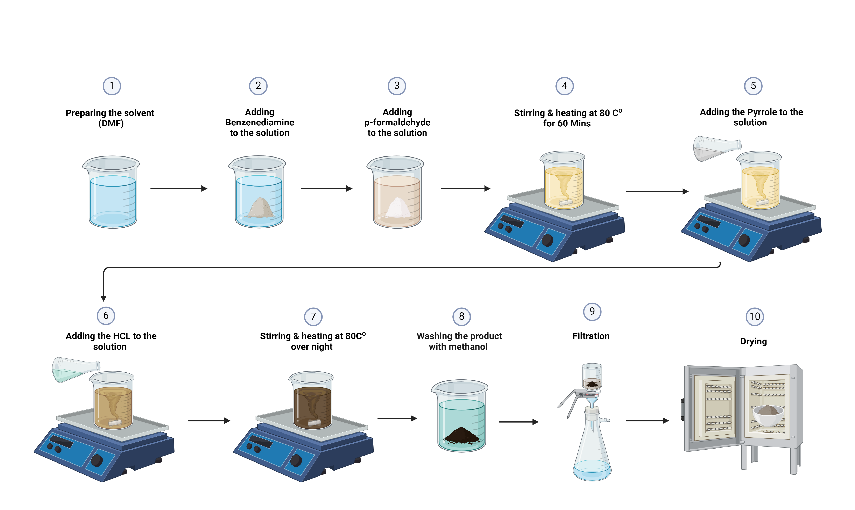

Capturing carbon: Innovative solid adsorbent TVS system for sustainable environmental solutions
Team: Nawaf Alharbi, Ahmed Alghamdi, Nahar Alfehaid, Nawaf Alissa, Abdullah alsayari, Abdullah alnuzha
Introduction
Prototype Design
Results & Discussion
Problem statement
Saudi Arabia faces a critical challenge with escalating ${CO}_{2}$emissions primarily from fossil fuel combustion, leading to environmental harm and climate change. According to Figure 1 the amount of CO2 emissions in the region has been on a concerning rise.
Current CO2 capturing technologies have notable disadvantages, including high energy consumption and limited efficiency.
Objectives
To address this pressing issue, our senior design project focuses on developing a fixed-bed system utilizing solid adsorbents for ${CO}_{2}$capture. This innovative approach aims to overcome the shortcomings of existing technologies, offering improved efficiency and sustainability in reducing ${CO}_{2}$emissions from industrial processes.
Constraints
Our project faces several constraints that necessitate careful consideration. Firstly, the fixed-bed system and chosen adsorbent material must be compatible with a range of industrial processes, ensuring versatility and applicability.
The prototype design must be inherently scalable to accommodate different operational scales effectively.
Given a tight timeframe of three months and a budget constraint of 6000 SAR, efficient resource allocation and streamlined development processes are imperative to meet project objectives within these limitations.
Specifications
Uptake Capacity: 35 ${cm}^{3}$/g
Selectivity:249-141 ​(30 cycle) (273K-298K)
Material's Surface Area:​ 250 $m^{2}$/g​
❖ Material Capacity & packing type:​ 1.5 g-random packing​
Operating Conditions:​ P= 1–2 atm​ ,T= 25–75 C​ ❖ Relative Humidity:​ 91%
Project Impact
Carbon Emissions Reduction: Significantly lowers ${CO}_{2}$emissions from industrial sources, reducing climate change.
Technological Innovation: Introduces a novel Temperature Vacuum Swing (TVS) carbon capture system, enhancing scalability and efficiency.
Solar Energy Utilization: Employs solar energy to power system operations, reducing reliance on non-renewable energy sources and enhancing environmental sustainability.
XRD test prove that the materials has amorphous structure
SEM shows and proves the porous structure of the materials
Solar Panel
Inverter
Battery
Vacuum Pump
Inlet Tanks, CO2 and N2
Mixer with 8 loops
Two Adsorption Columns
CO2 Outlet Analyzer
Helium tank
Humidifier
TGA test shows the thermal stability under the operating temperature
BET test shows the surface are of the materials which is 250 m^2/g
S1
S2
S3
Prototype Design (Synthesis of the materials )
Uptake capacity test shows a capacity of 35 cm^3/g for the adsorption and prove
P
Conclusion
This project marks a significant step forward in carbon capture technology using a solid adased TVS system.
It demonstrates a scalable, cost-effective solution to reduce industrial CO2 emissions, aligning with global sustainability efforts.
Highlights the integration of solar energy to power the system, showcasing a commitment to renewable energy and environmental sustainability. This project marks a significant step forward in carbon capture technology using a solid adsorbent-based TVS system.
It demonstrates a scalable, cost-effective solution to reduce industrial CO2 emissions, aligning with global sustainability efforts.
Highlights the integration of solar energy to power the system, showcasing a commitment to renewable energy and environmental sustainability.
This project marks an important milestone in our search for sustainable industrial solutions due to its creative integration of innovative carbon capture technology with solar energy
Innovative Carbon Capture: This project pioneers a significant advancement in carbon capture technology, utilizing a solid adsorbent-based Temperature Vacuum Swing (TVS) system.
Scalable and Cost-Effective: Demonstrates a scalable, economically viable solution that significantly reduces industrial CO2 emissions, supporting global efforts towards a sustainable future.
Renewable Energy Integration: Showcases successful integration of solar energy, underscoring the project’s commitment to renewable energy sources and reducing environmental footprints.

