Slide 1


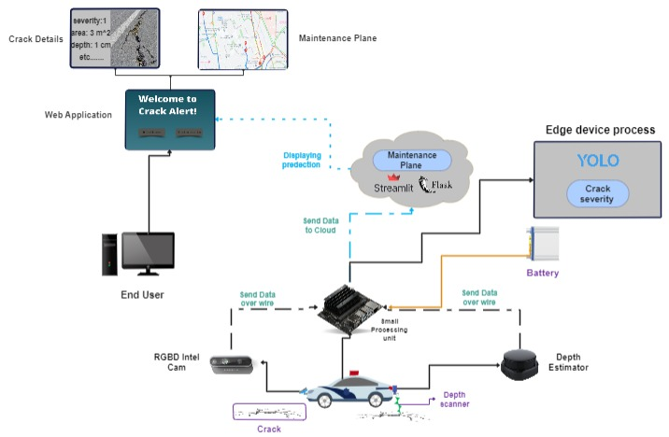
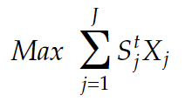
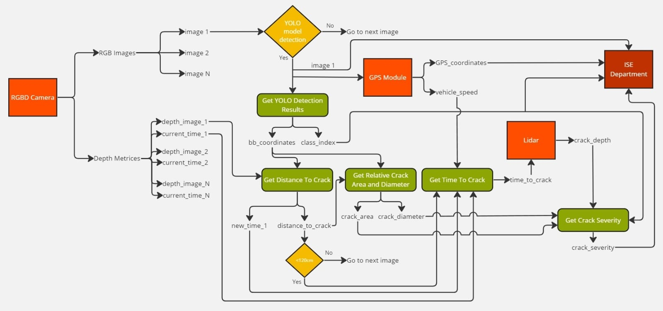
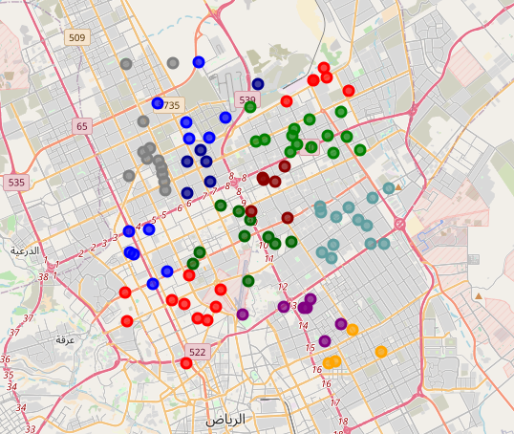
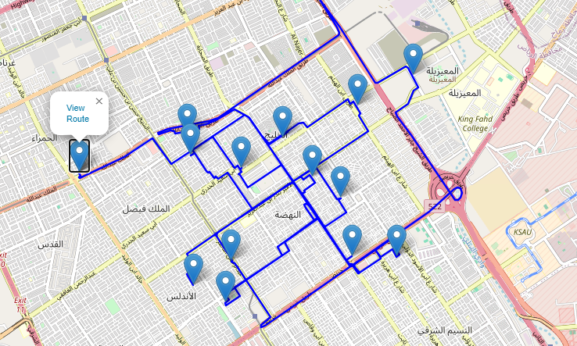
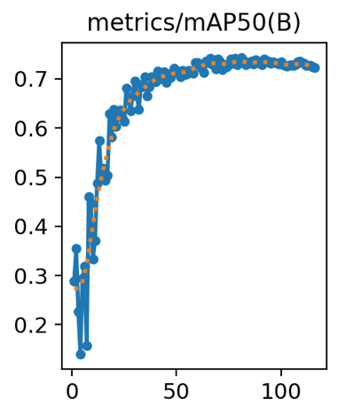
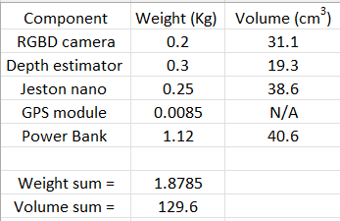
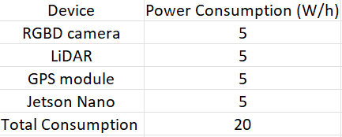
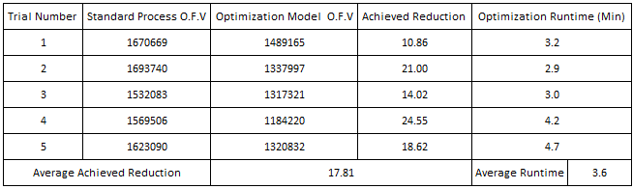
Real-Time Cracks Detection and Severity Classification System
Team 52
Yaman Shullar, Aly Sarhan | Computer Engineering ​
Ali Alloush, Abdulrahman Alahmadi | Industrial and Systems Engineering ​
Ahmad Nayfeh | Electrical Engineering
Problem Statement
System Design
Maintenance Plan Model Formulation
The challenge lies in automating the real-time detection and severity classification of road cracks to enhance safety, reduce maintenance costs, and overcome the inefficiencies of manual inspections.
Phase 1:
Using affinity propagation algorithm to cluster nearby cracks.
See figure 4 below.
Phase 2:
Filtering clusters based on cracks’ severity and allocated budget
Objective function:
Phase 3:
Choosing cracks to be fixed and assigning them to crews to minimize the distances travelled by each crew while maximizing the severity fixed of the chosen cracks taking into consideration several constraints. See figure 5 below.
Constraints:
Linearization constraints
Modified traveling salesperson model constraints
Time constraints
Material constraints
Logical constraints
Clustering constraints
Constraints
• Maintaining high accuracy in different conditions such as different lighting.
• Training data quality.
• Variant vehicle speed.
Target Specifications
Specification | Target
Detection accuracy​ | > 70% mAP
Inference time​ | < 3 sec​
Optimization runtime​ | < 30 min​
Number of clicks​ | < 5 clicks​
Weight​ | < 5 Kg​
Volume​ | <350 Cm³​
Objective function value reduction (minimizing time while maximizing fixed severity) ​ | > 15%​
Power consumption​ | < 24 W
Cost​ | < 6000 SAR​
Figure 5: Clustering
Figure 6: Crew Route Example
Conclusion
This work seeks the possibility of establishing a real-time cost-effective road defect detection and severity classification system that provides an efficient maintenance plan using mostly commercial edge devices. By using an RGB-D camera, a depth estimator, a resource-constrained processing unit supported by a GPS module, and a cloud utility in the experiments, it was shown that the system is effective and can be taken to further stages. Moreover, the maintenance plan has displayed promising results in reducing the objective function value.
Results Validation
Acknowledgments
We extend our sincere thanks to Dr. Yasser Almoghathawi for his continuous supervision throughout this semester. Additionally, we would like to dedicate our appreciation to SDAIA for their significant support throughout this project.
Figure 1: the mean average precision of the model results.
Figure 2: the summation of the weights and volumes of all components constituting the product.
Figure 3: the summation of the power consumption of all components constituting the product.
Figure 4: The optimization runtimes and the mean average reduction achieved by comparing the optimization model built with a standard process using 5 sets of data

