Slide 1

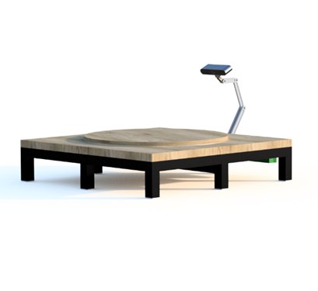
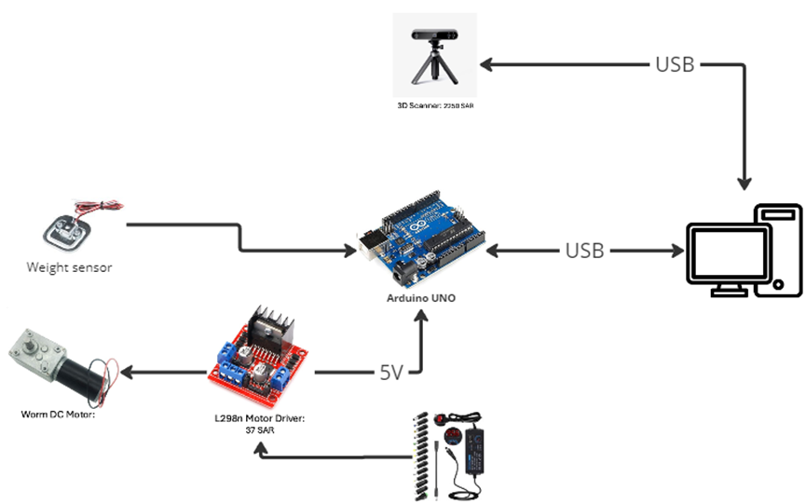
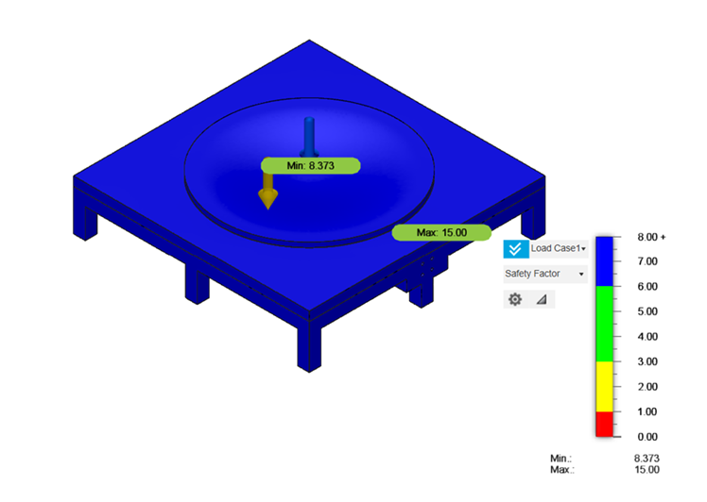
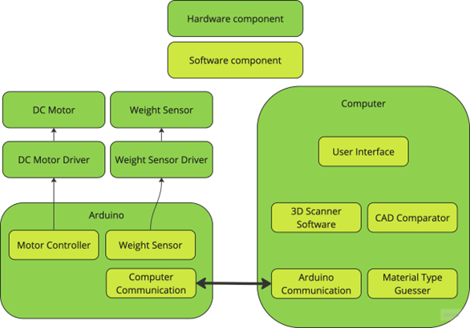
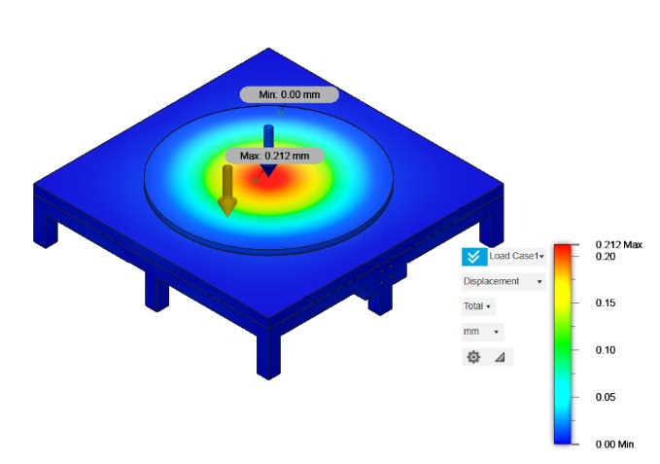




Multi-Purpose Error Detector
Omar Almutairi Wisam Alamri Faisal Alzahrani Ali Aljanahi Hassan Alsaiygh Rayan Al-atiq
COE COE ME ME EE CIE
201917610 201934350 201817260 201854900 201828560​ 201867100​
Introduction
Final Design Details
Validation
A Multi-Purpose Error Detector, Integrating cutting-edge 3D scanning into various applications for precise quality control and error detection.
3D scanner accuracy: ± 0.05mm.
Scanning Process: 3 minutes.
Inspection Area: Covered 600 mm^2 with tables.
Components: Used 9 < 15 maximum.
Problem Statement
Enhancing Manufacturing Efficiency and Product Quality Through Post Error Detection in CNC Machining, Prototyping, and Historical Pieces Modeling.
Project Impact
Economic.
Social
Global.
Environmental.
Constrains
The table must turn 360 degree​​
The scanned object need to be filled inside​​.
The object​ must be 1 material​
Clean the lens of the scanner
Conclusion
The Multi-Purpose Error Detector introduces a new era in error detection technology for CNC machining. With its high accuracy, efficient scanning times, and effective component management, it addresses critical needs in manufacturing quality control. Its diverse applications and adherence to project specifications showcase its potential for revolutionizing industrial processes.
Target Specifications
Accuracy of scanning
0.1-0.3mm
Components <15
Time of process < 6 Minutes
Weight of Device < 20Kg

