Slide 1

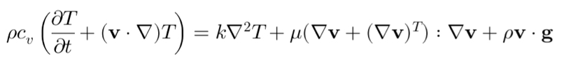
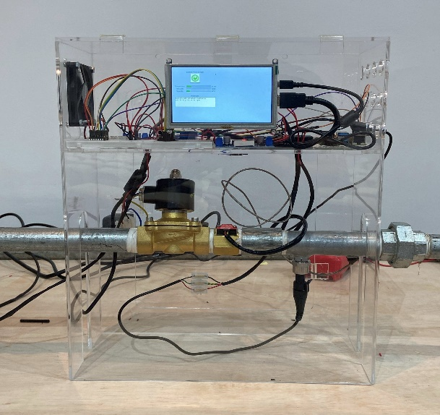
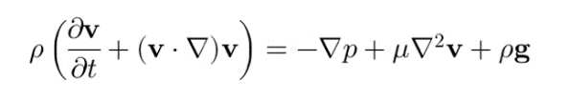
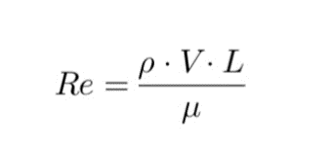
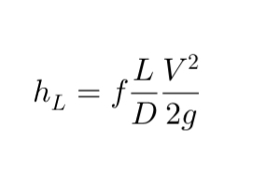
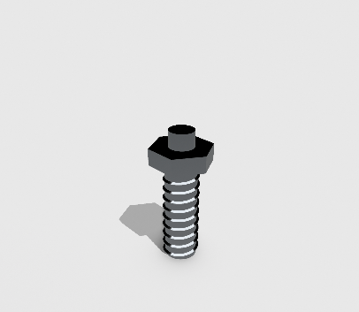
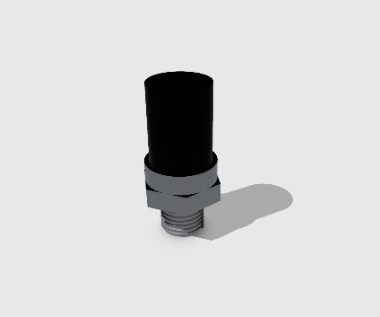
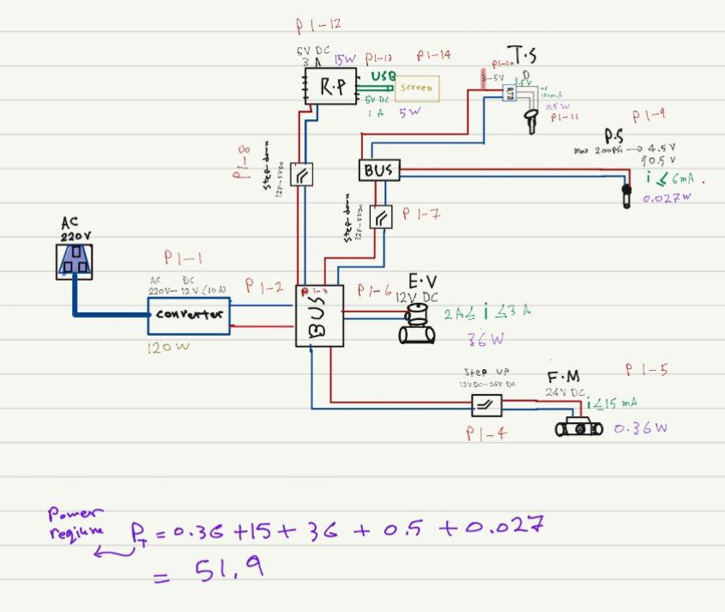
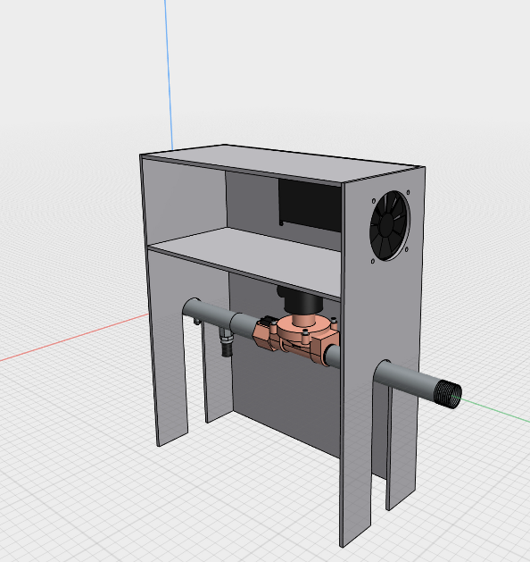
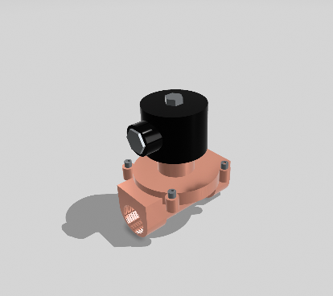
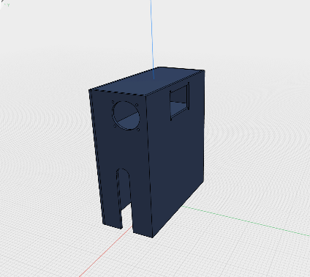
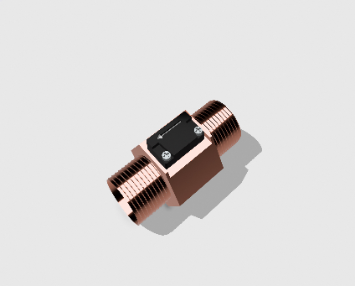
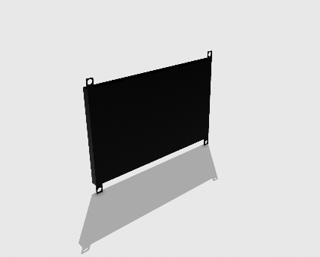
PIPE INSPECTION SYSTEM
EE
ME
COE
CHE
Coach
Dr. Ammar Ayad Alzaydi
Mohammad Alabduulah
Hashim Alabdulmuhsin
Abdulkhaliq Almajhad
Jafar Alolaywi
Mohammed Alsaleh
Ali Alelawi
Team 43
Elevator Pitch
Constraints
Testing and Validation
Introducing our groundbreaking Pipe Inspection System: revolutionizing pipeline monitoring in the oil industry. By seamlessly integrating physical inspections with cutting-edge electronic monitoring, our system offers a comprehensive solution to common challenges like leaks and blockages. Through strategic sensor placement and real-time data analysis, we ensure optimal efficiency, safety, and environmental stewardship. With strict adherence to industry standards and a focus on cost-effectiveness, our system promises actionable insights to optimize pipeline operations. Join us on the forefront of innovation and efficiency with our Pipe Inspection System.
Cost constraints
4000 SAR
Safety constraints
ASME B31.1
Power constraints
Availability
Data management constraints
Clearly in screen
Installation constraints
Easy to install and remove
Reliability constraints
Sensors Calibration
Mathematical Analysis
(1)
(1)
(2)
(3)
Objective
(4)
Our goal is to engineer and deploy an innovative Pipe Inspection System that transforms pipeline monitoring in the oil industry. Through the seamless integration of physical inspections and advanced electronic monitoring, our system targets to elevate operational efficiency, bolster safety measures, and champion environmental responsibility By strategically positioning sensors and analyzing real-time data, our aim is to provide actionable insights for optimizing pipeline operations while effectively managing risks. Grounded in adherence to industry standards and a commitment to cost-effectiveness.
Prototype Design
Figure 8 : Testing process of sensors
Electrical Circuit Design and Readings
Figure 1: Temperature Sensor
Figure 2: Pressure Sensor
Problem Statement
Current oil industry practices face issues of pipeline leakage and ineffective monitoring. Our innovative project integrates physical inspections with real-time electronic monitoring, aiming to provide a consolidated, efficient solution.
Conclusion
Figure 3: Electrical Valve
Figure 4: Housing
In closing, our Pipe Inspection System marks a significant leap forward in pipeline monitoring technology. By seamlessly merging physical inspections with real-time electronic monitoring, our system delivers unparalleled efficiency, accuracy, and reliability. With a commitment to industry standards and rigorous maintenance Our system protocols ensure enhanced safety, operational optimization, and environmental responsibility. Our project heralds a new era of pipeline monitoring excellence, poised to redefine standards and drive innovation in the oil industry.
Target Specifications
Time efficient
Easy to install and use
Accurate data capture
Allowing remote valve control
Reliable system
Figure 7: The designed prototype
> 1 sec
Confidence level > 90%
Figure 5: Flowmeter sensor
Figure 6: Reading Screen
KFUPM DESIGN EXPO - 232
TEAM 43
KFUPM DESIGN EXPO - 232

