Slide 1

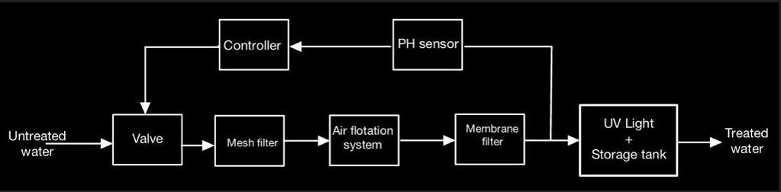
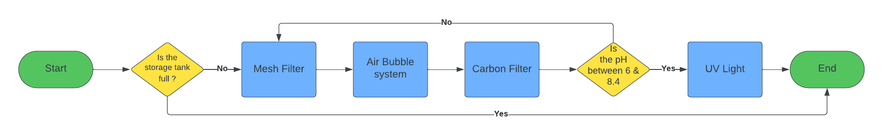
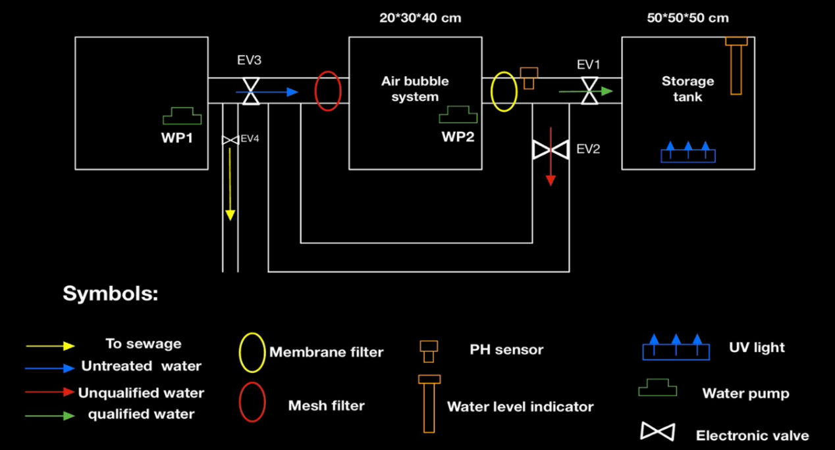
Title
King Fahd University Of Petroleum & Minerals
Team 40: Ali Alneami – ISE
Abdullah Afif – ISE
Saleh Alquraishi – EE
Yaqoub Hakami – CHE
Capstone 2.0
Aqua Revive (Recycling greywater)
Background
Specification
Names
Our target specification is shown in the table below:
Validation
Many homeowners aren't fully leveraging the potential of their wastewater. For those looking to both maximize the benefits of wastewater and cut down on their water consumption costs, Aqua Revive is the answer. This product treats greywater, making it suitable for various non-potable uses. Unlike traditional methods, Aqua Revive can reduce water usage by approximately 45%.
Constituent | Target Level
Total Suspended Solids (TSS) | 5 - 30 mg/L
Total Coliform Bacteria | < 2-10 CFU/100 mL
Turbidity | < 5 NTU
Voltage requirement | 12V DC
Power consumption | < 35W
Our greywater treatment project focuses on meeting and surpassing pH standards set by the Ministry of Environment & Water and Agriculture. Rigorous testing, including untreated and treated samples from diverse sources, ensures adherence to specified pH ranges.
Initial pH Values (Before Treatment):
• Kitchen Greywater:
o Initial pH: 6.42
• Laundry Greywater:
o Initial pH: 9.71
• Shower Greywater:
o Initial pH: 9.37
Post-Treatment pH Values:
Introduction
This project aims to develop an integrated recycling system that efficiently treats water containing simple impurities, enabling its practical and sustainable reuse through the incorporation of four distinct filtration methodologies within a single product which is a Mesh filter, air bubble system, Carbon filter, and UV light offering an innovative solution for responsible water management.
Constraint:
Cost constraint: Our project adheres to a budget of less than 6,000 Saudi Riyals.
Time constraint: Completion within 15 weeks to meet the university deadline
Water Quality Constraint: Guarantees pH within 6-8.4, employing testing and quality control.
Temperature Constraint: Precision monitoring and proactive cooling to prevent temperatures over 60°C, emphasizing safety and longevity.
Objectives
Efficiency Improvement: Develop a water treatment system that significantly improves the efficiency of removing simple impurities from water, ensuring a high-quality output for potential reuse.
Integration of Filtration Methodologies: Integrate multiple filtration methods into one system for convenient and efficient cleaning.
Practical Reusability: Ensure the treated water meets the required standards for practical and sustainable reuse in various applications, such as irrigation, laundry, or other relevant areas.
Prototype Design
Below the block diagram to show the full Process
Our treatment system successfully achieves and maintains post-treatment pH levels within the Ministry's standards, validating its effectiveness in producing environmentally sound greywater suitable for diverse non-potable applications and meeting regulatory requirements.
Power Consumption met since We have 4 main loads in this project and the power consumption of each load will be:
Two Water pumps: it will consume approximately 4.5W each.
Air pump: it will consume approximately 8W.
UV light: it will consume approximately 14W.
The total power consumption of this circuit will be about 31W.
Voltage could not meet, due to the unavailability of UV light and an Air pump that meets both voltage and power consumption specifications.
Below the flow chart to show what happens in the process
Below the final design:
Conclusion
Greywater recycling is a promising technology for water conservation, but challenges like affordability and public awareness persist. Industrial, chemical, and electrical engineers can collectively address these issues by optimizing system design, and treatment processes, and implementing efficient, sustainable systems. This interdisciplinary approach promotes a water-abundant future and addresses global water scarcity concerns.
Notes:
1`

