Slide 1

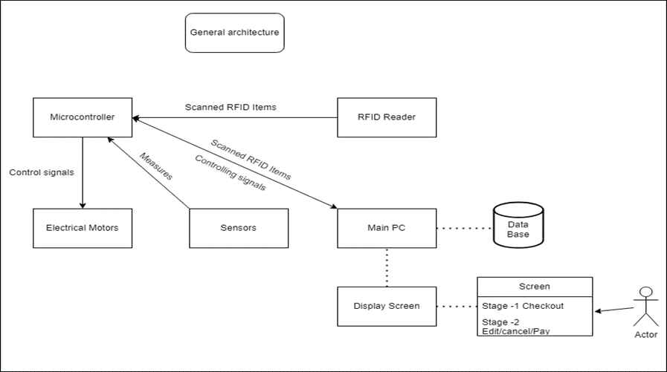
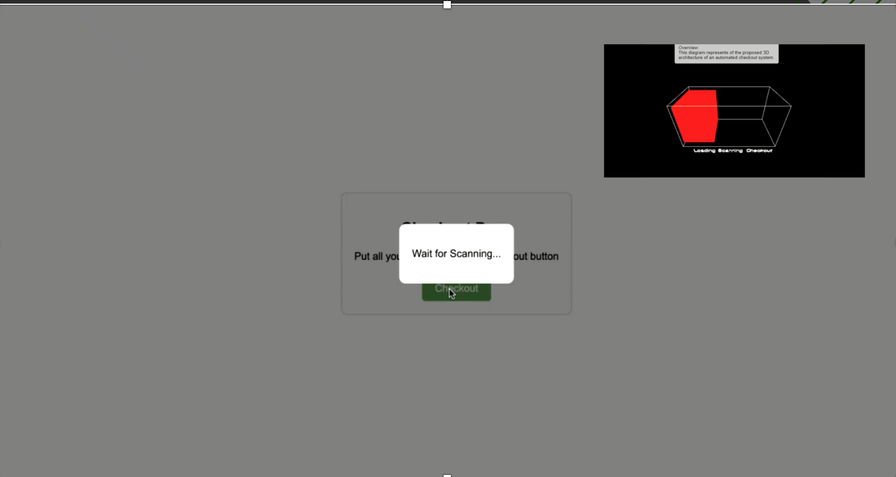
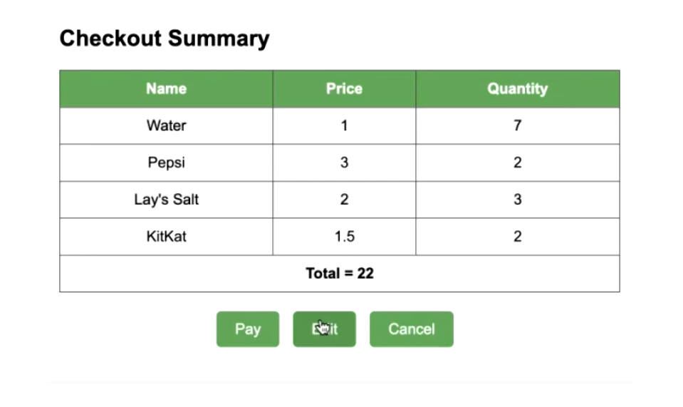

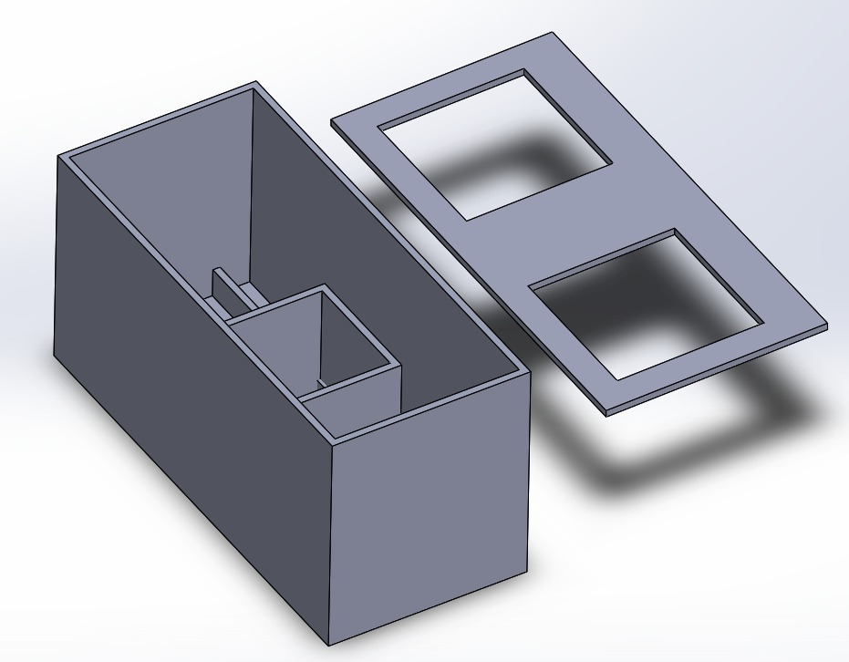
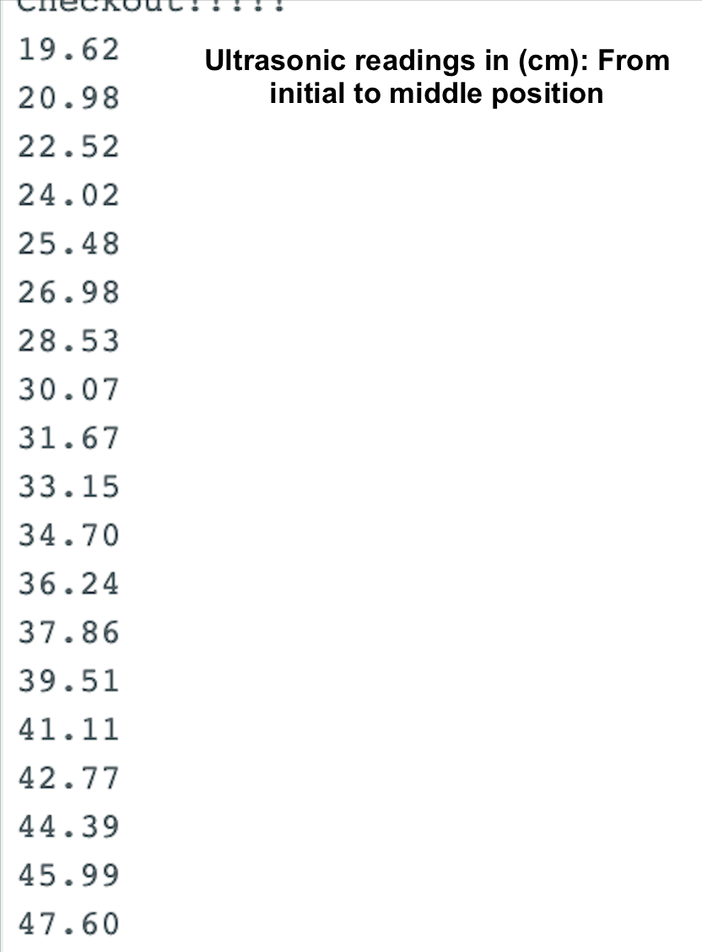
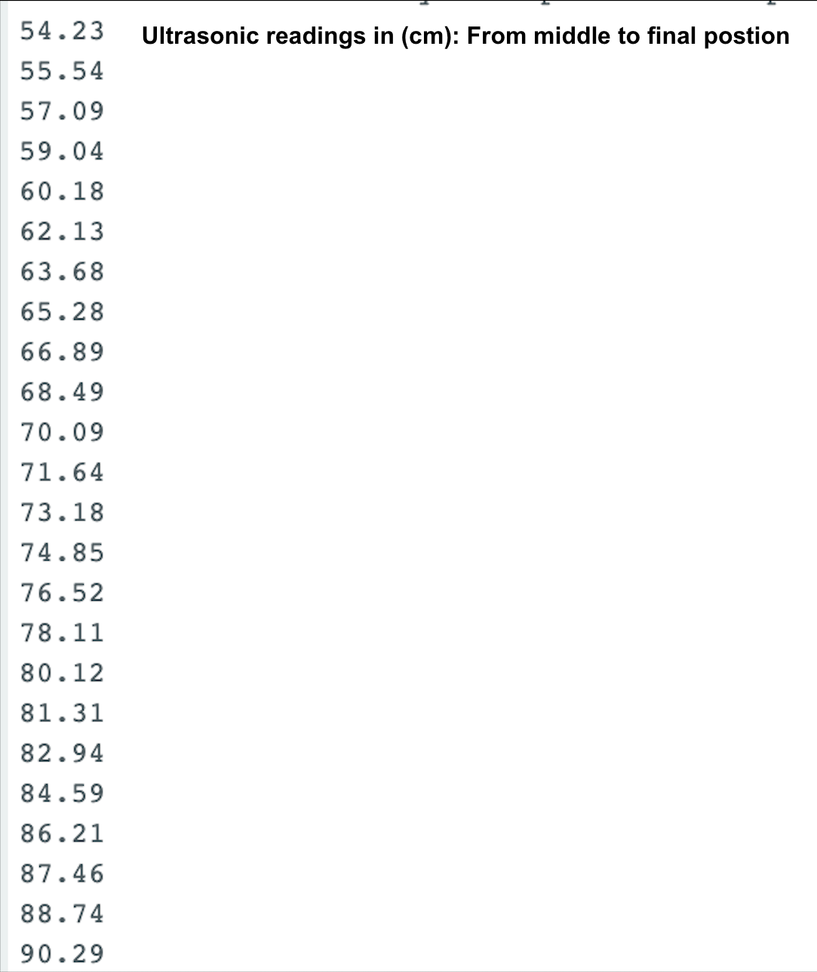
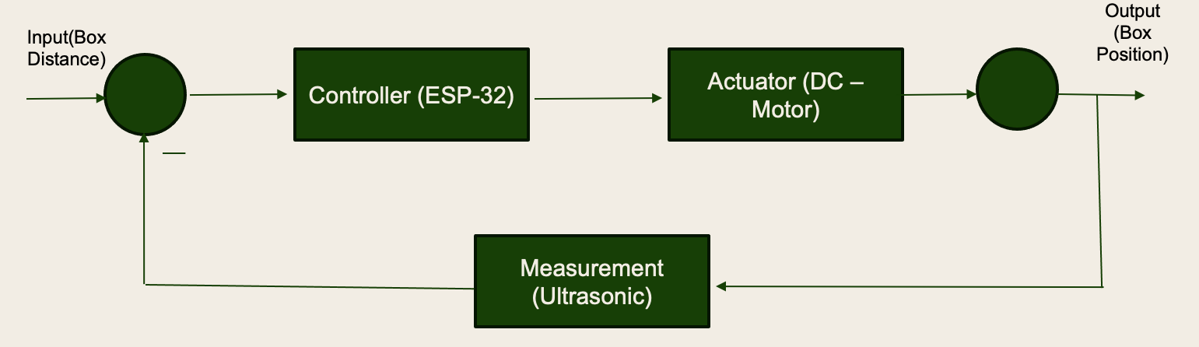
Self-checkout System
Omar Allehyani(CIE) – Abdulaziz Balhareth(EE) – Saad Alghazal(EE) - Fahad Alrajhi(COE) – Sultan Alghamdi (COE)
Introduction
Process Design & Analysis
Testing / Validation
Project Statement: Introducing a self-checkout system, RFID powered to overcome inefficiencies in cost and queue time.
This project aims to enhance the self-checkout experience in existing market through (RFID) to scan items for purchase all at once. The process starts with defining three critical positions (Items placement, Scanning and payment, Collection). These box positions are controlled through a control loop with ultrasonic to provide a feed-back of the box position. Motion of the box is powered by two synchronized DC motors for forward and backward motion.
Specifications and Constraints
Target Specifications:
Payment process completion in less than 2 mins. (excluding edit option)
99% Item detection accuracy rate .
Scanning time lesser than 1 second.
Five steps process.
Constraints:
Security from theft.
Operator Interface.
Ultrasonic Equation:
Distance = c * t/2
c : Speed of sound at normal temperature
t: Duration time
Conclusion
In conclusion, this system is an attempt to transform the shopping experience, by providing a quick self-checkout process that is convenient, easy to use and cost effective. Relying on RFID for quick scanning time, and DC two motors for a smooth process.

