Slide 1

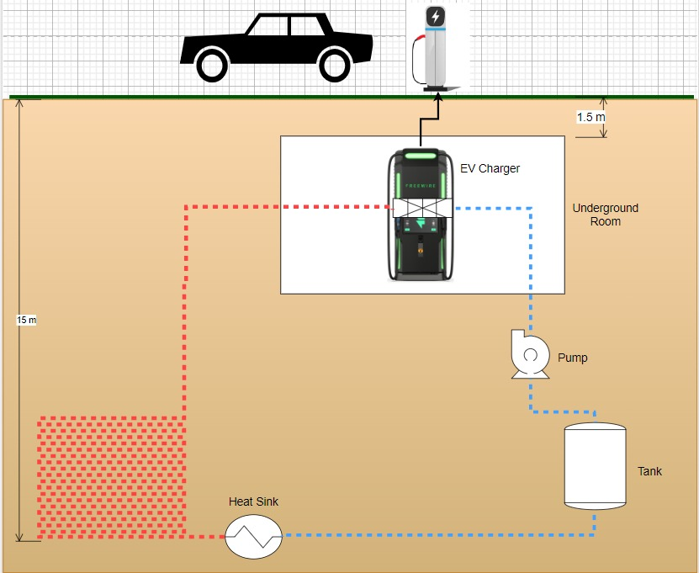
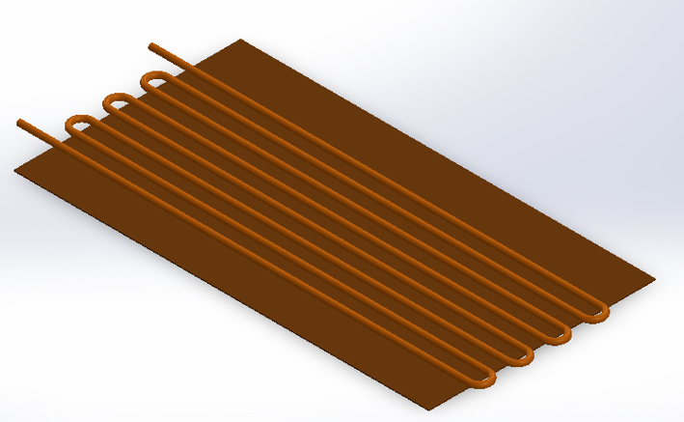
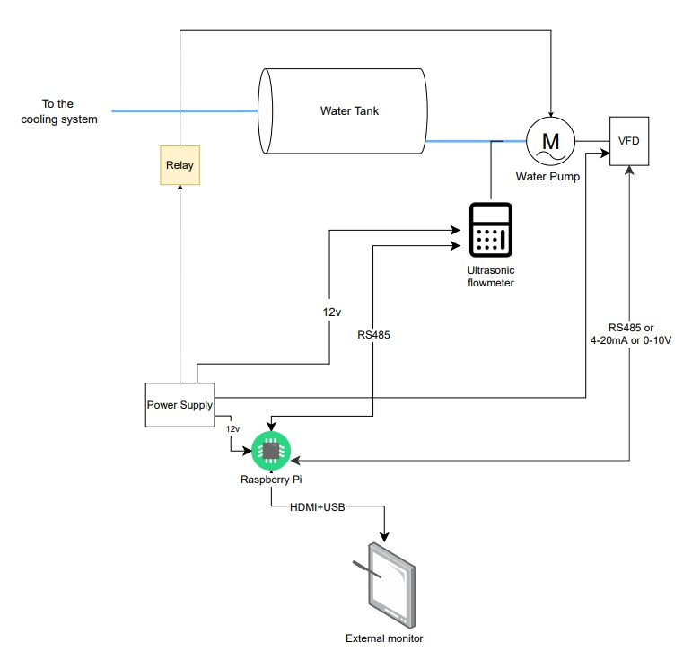
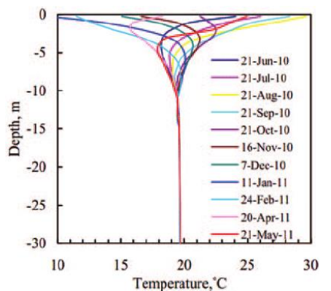
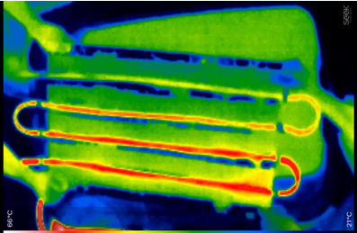
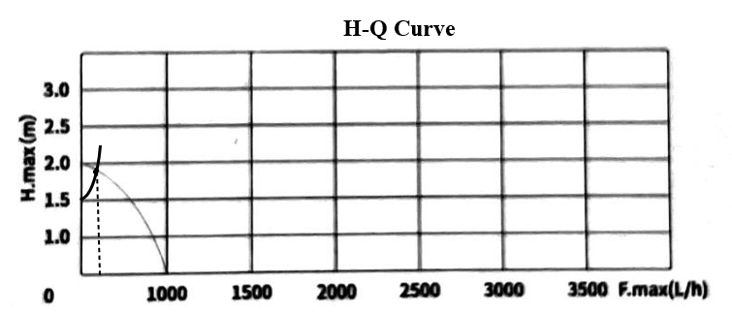
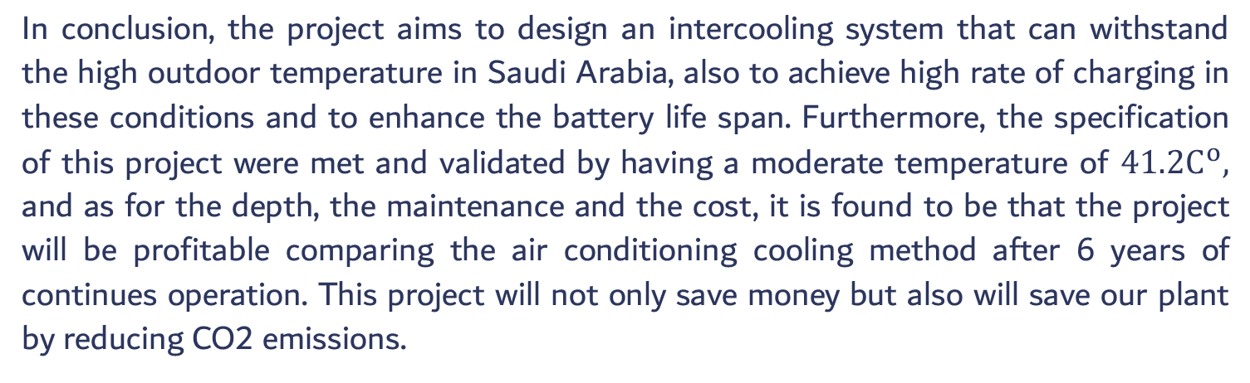
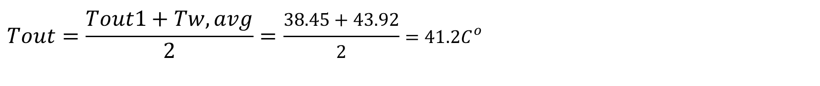

Intercooling System for EV’S charging Stations
Abdullah Almalki(CHE) - Abdullah Aljihani(CHE) - Fahad Altowairqi(EE) - Suhayb Budukhi(ME) - Abdulaziz Alnami(ME)
Advisor: Dr. Ammar Alzaiydi
Introduction
Prototype Design
Aligning with global emission reduction goals.
Rising demand for EVs necessitates efficient charging infrastructure.
EV charging stations are vital for convenient and fast charging.
Saudi Arabia aims for 30% EVs in Riyadh by 2030.
Heat Sink
Pump design and control
The PFD of the entire design
Problem Statement
The outdoor temperature in Saudi Arabia can reach up to 40 c – 50 c during the summer. Hence, the high temperature can affect the efficiency of the EV charger. Consequently, building and designing suitable EV charger station that can withstand the high temperature in Saudi Arabia is preferable.
Final Target Specification
Moderate Temperature
Rate of charge
Depth
The temperature should be varying between 30C to 50C.
The car should be charged in 10 minutes.
Cooling system at depth of 10m, while the station room at depth of 2.5m underground.
Cost
Maintenance
Minimizing the cost of conditioning a station for a year compared by the normal air conditioning systems.
Equipment should be easily maintainable in terms of access and annual time required.
Testing / Validation
Moderate Temperature
Project Constraints
 | q=10KW |  | q= 20KW |  | q= 30KW
m(kg/s) | Tout |  | Tout |  | Tout |  | Re | NuD | Heat transfer Coefficient | Rconvection | Tw,avg
0.4 | 308.95 | 35.800 | 314.75 | 41.6009 | 320.55139 | 47.401 | 4255.31 | 20.96 | 2096.30 | 0.00848 | 10.84
0.45 | 308.30 | 35.155 | 313.46 | 40.3119 | 318.61790 | 45.467 | 4787.23 | 23.03 | 2303.44 | 0.00777 | 20.86
0.5 | 307.79 | 34.640 | 312.43 | 39.2807 | 317.07111 | 43.921 | 5319.14 | 25.06 | 2506.01 | 0.00718 | 38.41
Safety
Integration
Maintenance requirement
The cooling system must meet safety standards for user protection and equipment safety.
The cooling system should seamlessly fit into the EV charging station's design, improving user experience and convenience.
The cooling system must meet safety standards for user protection and equipment safety.
$$Tout=\frac{Tout1+Tw,avg}{2}=\frac{38.45+43.92}{2}=41.2C^{o}$$
Cost
Rate of charge
Air Conditional of 2.9kW
$ 1,226.40 | 1 Year
$ 2,452.80 | 2 Years
$ 3,679.20 | 3 Years
$ 4,905.60 | 4 Years
$ 6,132.00 | 5 Years
$ 7,358.40 | 6 Years
$ 8,584.80 | 7 Years
$ 9,811.20 | 8 Years
$ 11,037.60 | 9 Years
$ 12,264.00 | 10 Years
The cost, the depth and the maintenance were reviewed by a first-degree company in the construction field and as we can see coiling the charger with an intercooling system will only have a capital cost, whereas cooling the room with an air conditioner will have a yearly cost. Moreover, after 6 years from starting the project, both cooling will have the same cost. However, for further years the intercooling system will show a profitable project.
Pump selection analysis
According to the manufacturer at these calculated conditions the charger is successfully charged within 10 minutes
Based on the flowrate that we are trying to reach we selected our pump. The flowrate
required in our project is quite small, which is $Q=\frac{m}{ρ}=\frac{0.05}{1000}=0.05\frac{l}{s}=180\frac{l}{h}$
Items | Cost ($)
pump | 200
Tank (polyeithylene 2000L) | 277
drilling (15meter-a room - man holes - space for tank and pump ) | 6150
tubes (50 meters /copper) | 160
sensor | 100
VFD | 533
raspberry pi | 100
flowmeter | 138.2
Total | 7658.2
Conclusion
In conclusion, the project aims to design an intercooling system that can withstand the high outdoor temperature in Saudi Arabia, also to achieve high rate of charging in these conditions and to enhance the battery life span. Furthermore, the specification of this project were met and validated by having a moderate temperature of $41.2C^{o},$ and as for the depth, the maintenance and the cost, it is found to be that the project will be profitable comparing the air conditioning cooling method after 6 years of continues operation. This project will not only save money but also will save our plant by reducing CO2 emissions.
Here is the operating point for our water pump selection.

