Slide 1
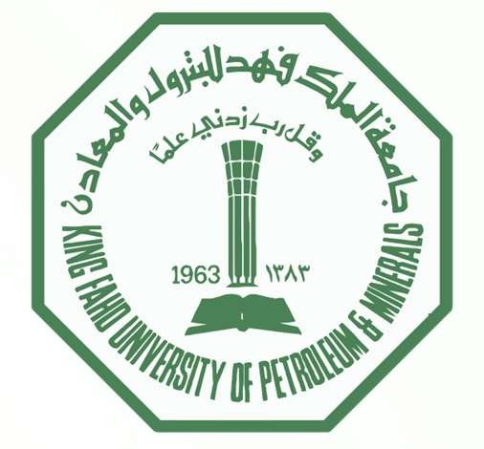


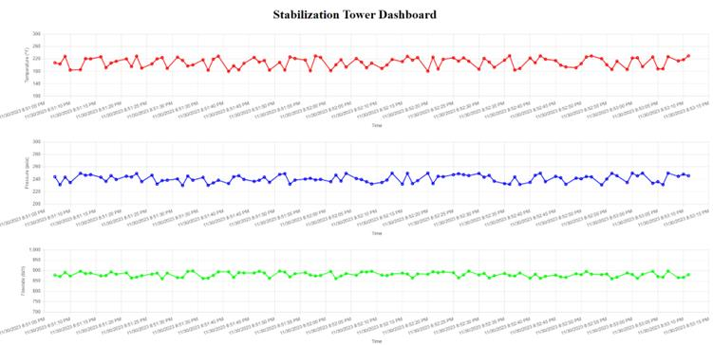
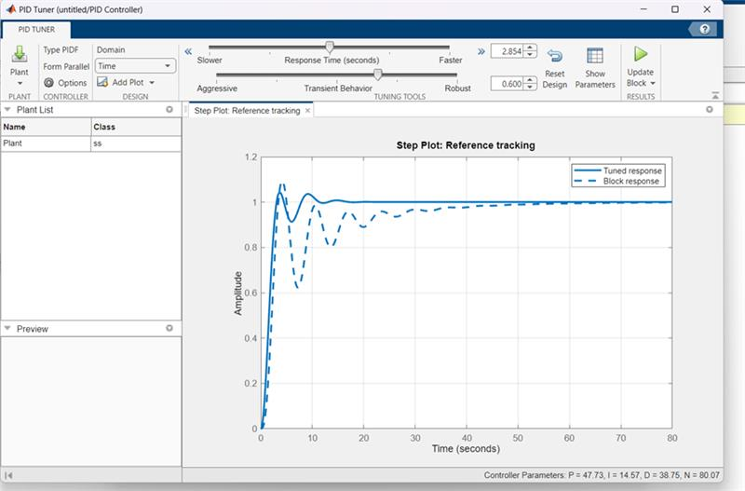
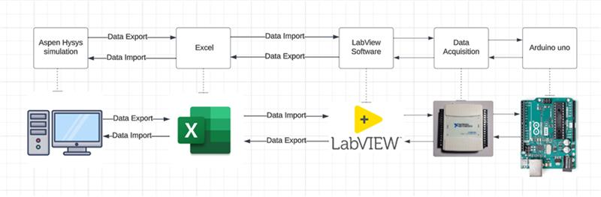
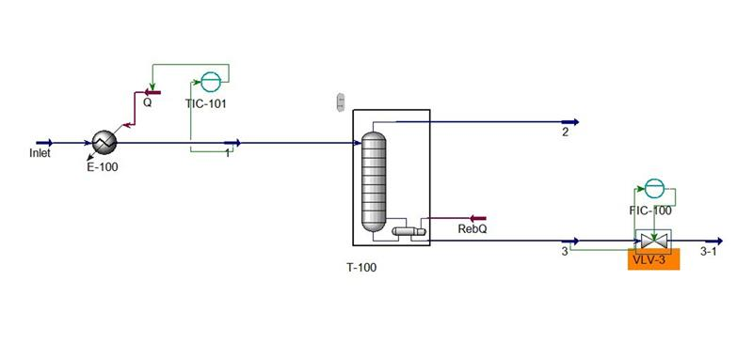
ENHANCING OIL STABILIZER BY OPTIMIZING THE PROCESS WITH PID
Team: Komosany Y(COE), Alghamdi S(CHE), Shameri A(COE), Al-Masoud B(EE), Kutbi A(CHE), Al-Ahmad A(EE)
King Fahad University of Petroleum and Minerals
INTRODUCTION
Testing and Validation
This project explores automating crude oil stabilization, highlighting the limitations of current manual methods. It emphasizes the need for more efficient, accurate solutions in oil production, setting the stage for our investigation into advanced automated systems like the PID controller.
1
Regularly data readings every 6 hours
1
Constraints:
-Limited project time and budget.
-Challenges in data availability and integration of automated systems.
Problem Statement:
Our project targets the inefficiencies in manual oil stabilization, aiming to improve accuracy and reduce costs through the adoption of an automated PID controller in the oil industry.
$36.78
Millions after 15 years.
2
System tolerance ≤ 10%
Target Specifications:
-System tolerance ≤ 10%.
-Process Time ≤ 12 hours.
-Undesired Output Gases ≤ 10%.
-Regularly data readings every 6 hours.
OBJECTIVE
3
Undesired Output Gases ≤ 10%
to enhance the accuracy and efficiency of oil stabilization processes by implementing an automated Proportional-Integral-Derivative (PID) controller. This aims to overcome the limitations of manual methods, reducing operational costs and improving overall process effectiveness in the oil industry.
Before Controlling
After Controlling
Component | Mole Fraction
H2O | 2.20E-03
H2S | 4.40E-03
CO2 | 1.30E-03
Methane | 9.00E-03
Propane | 5.63E-02
C7+* | 0.6206
n-Hexane | 9.51E-02
n-Pentane | 4.62E-02
i-Pentane | 4.60E-02
n-Butane | 6.69E-02
i-Butane | 2.50E-02
Ethane | 2.70E-02
Total | 1
Component | Mole Fraction
H2O | 0.00E+00
H2S | 0.00E+00
CO2 | 0.00E+00
Methane | 0.00E+00
Propane | 3.80E-03
C7+* | 0.8454
n-Hexane | 8.65E-02
n-Pentane | 2.40E-02
i-Pentane | 2.03E-02
n-Butane | 1.55E-02
i-Butane | 4.40E-03
Ethane | 0.00E+00
Total | 1
Prototype Design
CONCLUSION
In conclusion, our project demonstrates the successful implementation of a PID controller in oil stabilization, revealing marked improvements in process efficiency and accuracy. These enhancements suggest promising applications in the oil industry, pointing towards a significant shift from manual to automated processes. This advancement not only aligns with industry trends but also offers a practical, cost-effective solution to existing challenges in oil production.
PROCESS FLOW DIAGRAM

