Slide 1

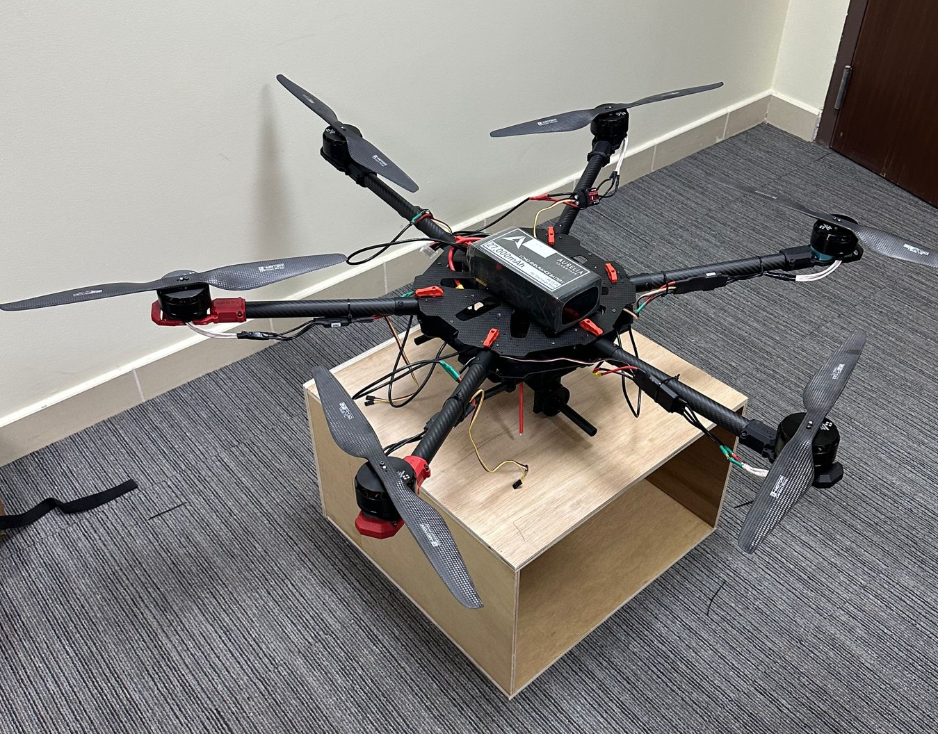
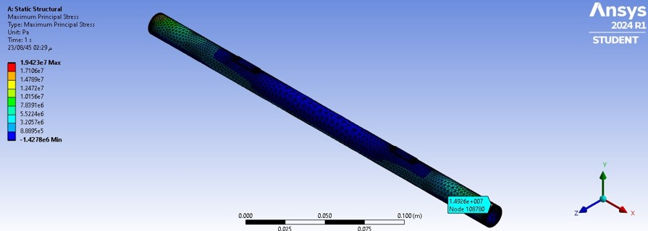
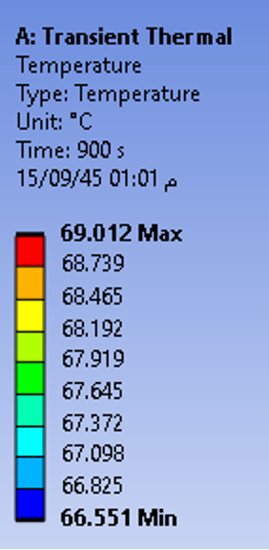
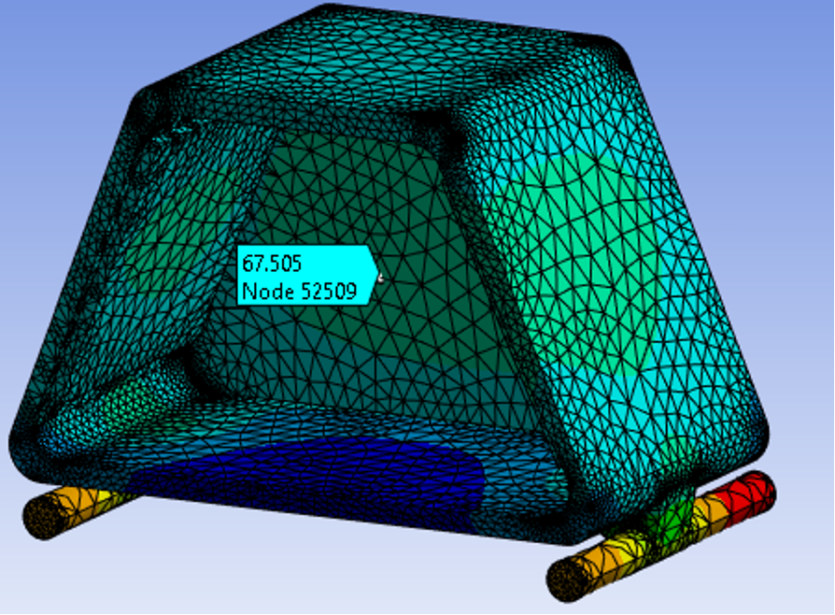
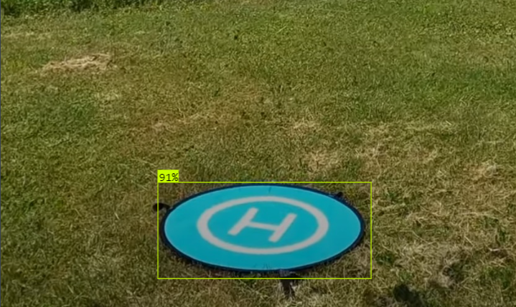
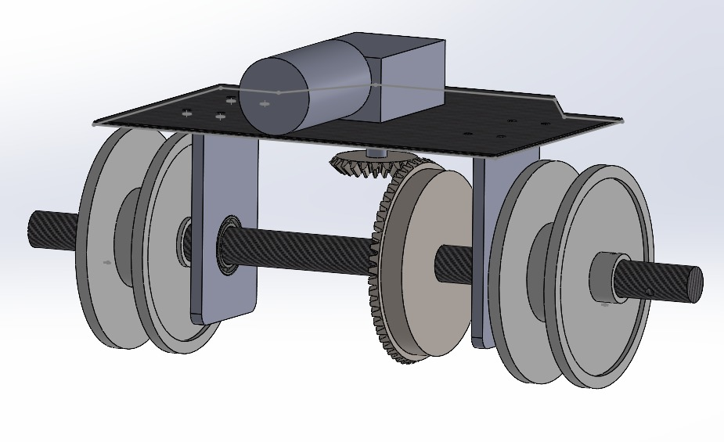
FlightBite
Students Names:
Mohamemd Alramadan (CS) Abdullah Aljraisi (ME)
Abdulaziz Alismail (EE) Albaraa Aleyouni (AE)
Abdullah Alwehaibi (EE) Omer Haydar (AE)
Senior Design Project
Coach:
Dr. Naef Qasem
  INTRODUCTION
PROJECT IMPACT
FlightBite is the first drone delivery service in the Middle East. FlightBite will deliver food packages to customers cheaper and 3x faster than the usual vehicles whilst maintaining the temperature of the meal.
Economic Impact: Drones improve food delivery speed and cost, expanding business opportunities and prompting shifts from traditional to tech-based employment.
Societal Impact: Drones enhance delivery efficiency and safety, fostering community technological interest.
Environmental Impact: Drones reduce traffic and pollution by using cleaner energy.
PROBLEM STATEMENT
Traditional delivery methods are slow, costly, and contribute to traffic and pollution. This project introduces autonomous drones to reduce delivery times, reduce operating costs by more than 90%, and minimize environmental impact.
Figure 2: Drone Prototype
PROTOTYPE DESIGN
TESTING
Drone Frame: Carbon fiber frame is lightweight and durable . It weighs 16kg and has 960mm span size.
Propulsion System: Brushless motors paired with lightweight propellers made from carbon fiber that can lift the necessary payload weight of 5kg.
Drop Mechanism: We are using a motor to control the operation of the drop mechanism system after the landing pad detection.
Container: We modeled our own container design that preserves heat and meets the specified size.
Flight Controller: We used a Pixhawk controller that has a communication range of more than 10km.
Raspberry Pi 4: For landing pad detection and precision auto-landing.
Thermal Finite Element Analysis was conducted to test the container’s heat insulation.
First iteration of the AI model took 10s per frame for detection, while the final took an average of 600ms.
Also, Structural Finite Element Analysis was done to the shaft, pulleys, gears to ensure the total deformation and principal stresses
TECHNICAL CONSTRAINTS
BUSINESS CONSTRAINTS
Payload Capacity
Flight Range
Battery Life
Communication Reliability
Financial Capabilities
Regulations
Infrastructure
Insurance & Liability
TARGET SPECIFICATIONS
Delivery Range (Range up to 10km)
Payload Capacity (5 kg)
Payload dimensions (0.4 * 0.3 * 0.3 m)
Flight Time (Lasts 10 minutes)
Speed: 57 km/h
Frame Design (MTOW less than 25 kg and 960mm span size)
Landing pad detection using computer vision
Communication > 10km range
Container heat insulation
Figure 3: Structural Finite Element Analysis (Maximum Principle Stress)
Figure 1: Drop Mechanism
Figure 4: Container Thermal Analysis (Initial Heat: 70°C)
Figure 5: Landing Pad Detection
CONCLUSION
The project showcases a significant leap in drone delivery within the Middle East, utilizing advanced materials and technology to enhance efficiency and reduce environmental impact. With the integration of a Raspberry Pi 4 for precise landing capabilities, FlightBite aims to reduce delivery times, cut costs, and set a new standard for delivery services.

