Slide 1
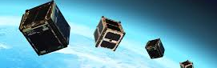

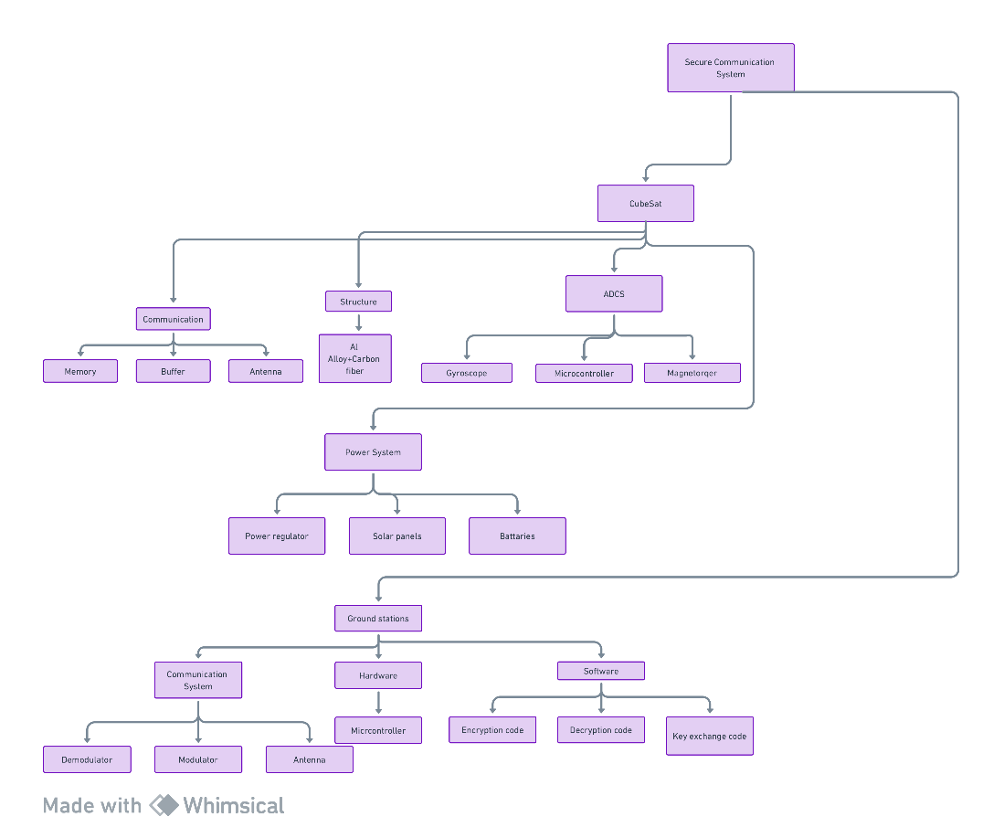
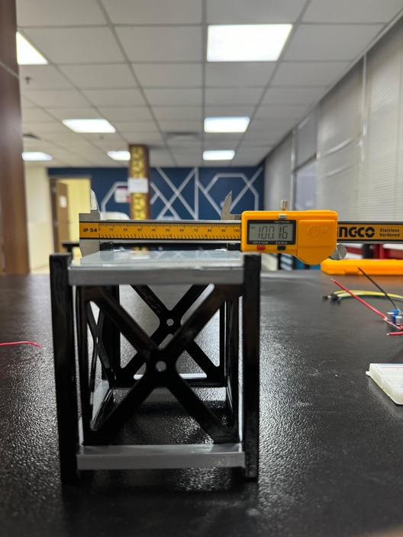
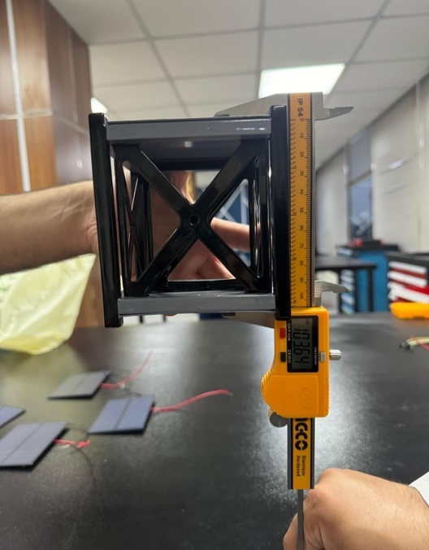
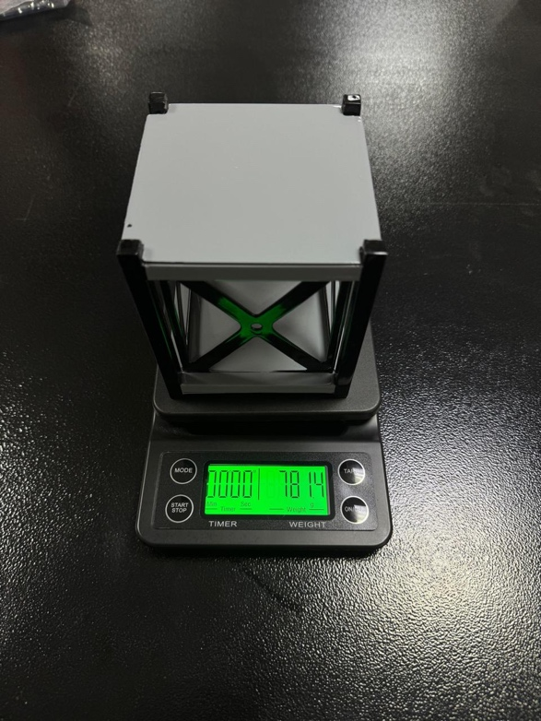
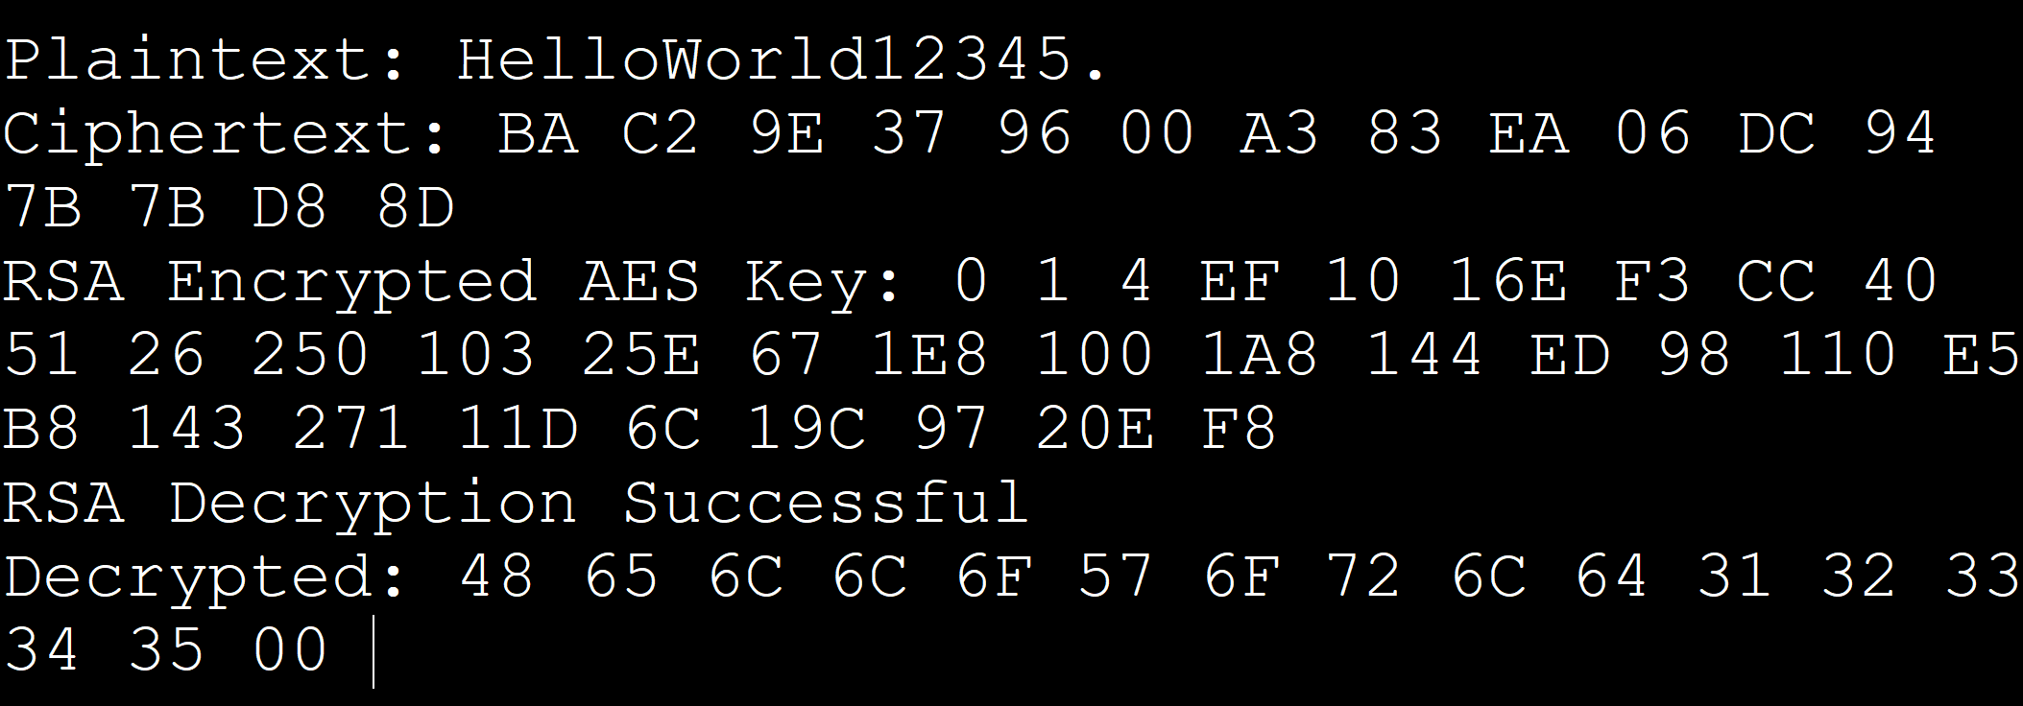
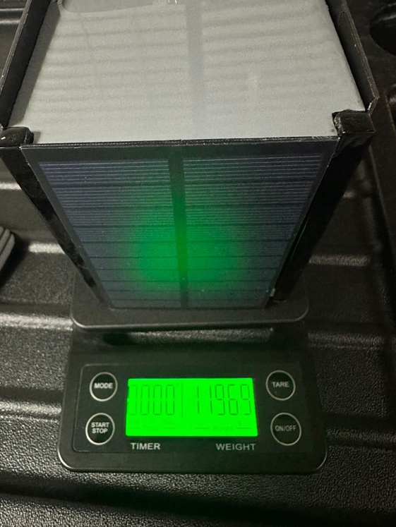
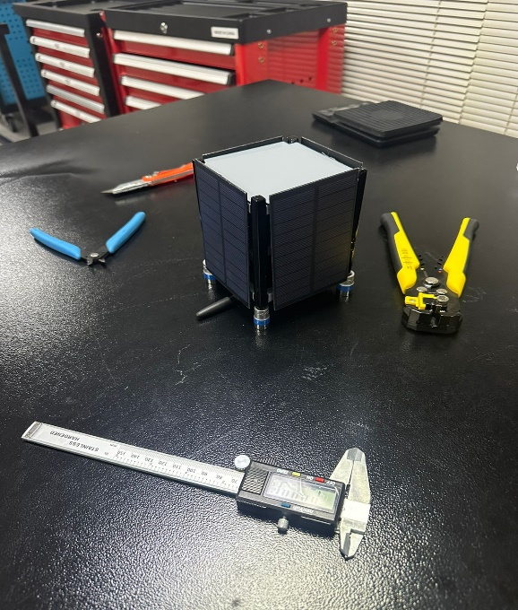
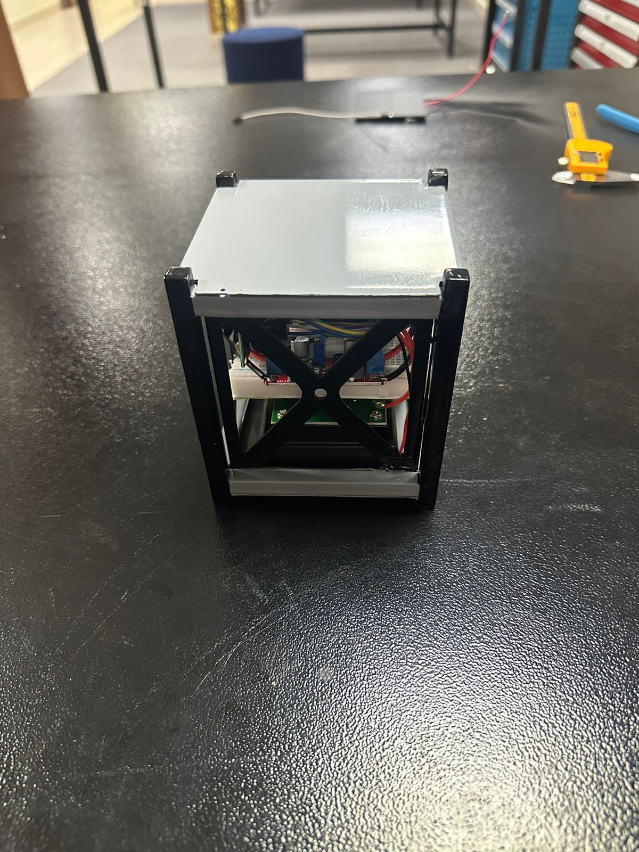
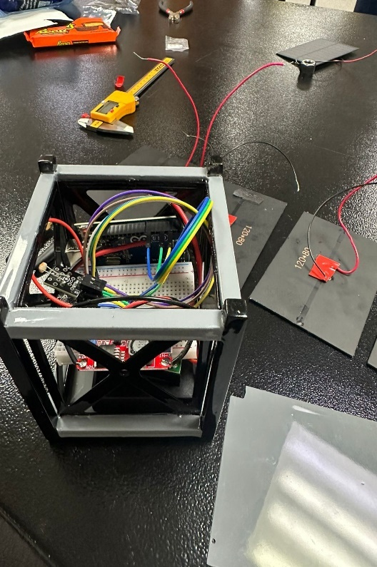

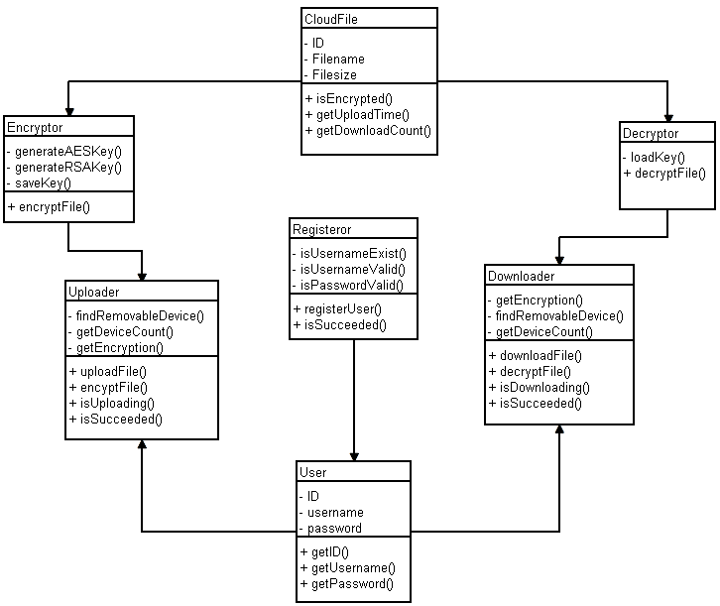
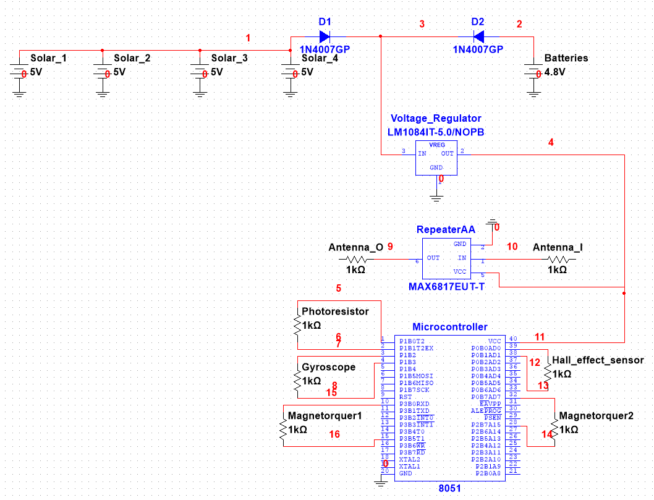
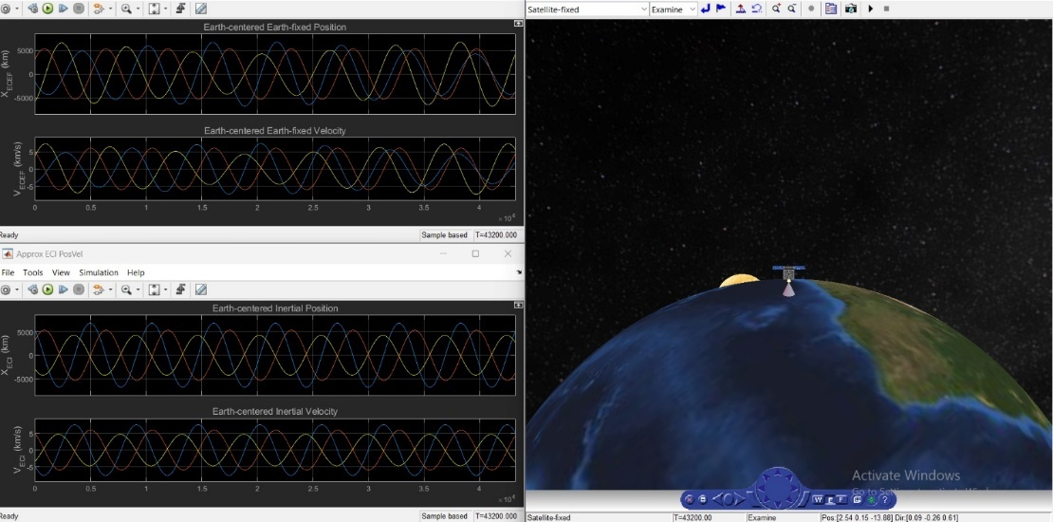
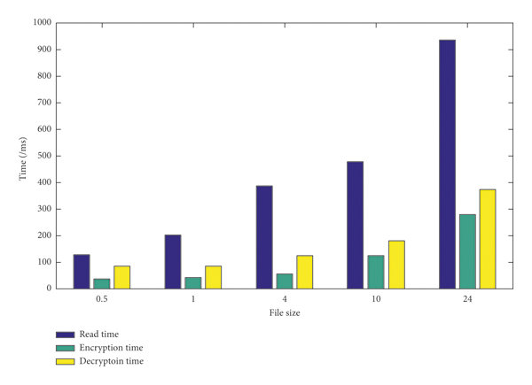
Senior Design Project “End to End Secure Communication CubeSat”
| Instructor : Dr. Abdelmalek Zidouri | TEAM Design department | King Fahd university of Petroleum and Minerals
Background
Prototype Conceptual Design
Testing
This project leverages CubeSat technology to enhance global communication security, addressing the vulnerability of terrestrial networks to disruptions and threats. It focuses on using state-of-the-art encryption within a small-scale satellite to ensure data integrity and confidentiality.
Problem Statement
Traditional satellite systems often lack comprehensive security, exposing data to risks of interception and tampering. This CubeSat project aims to integrate robust encryption protocols within the constraints of a miniature satellite, adhering to strict regulatory standards.
Constraints & Target Specifications
Constraints | Target Specifications
Frequency and Latency under specific Saudi conditions | key length is 256-bits for AES
Computing in a Confined Space | bit error rate less than 10^-5
Keeping Security and Speed in Check | latency is less than 700ms
The Size Dilemma | SNR higher than 10dB
 | CubeSat Mass not exceeding 2 kg
 | CubeSat Size is 1 Unit (10*10*10) cm^3
Prototype Final Design
Scan the QR code to see the video explanation of our project
Conclusion
Project Impact
This project exemplifies the potential of CubeSats in advancing global communication security. By merging cutting-edge cryptographic techniques with innovative satellite engineering, it not only addresses existing limitations in satellite communications but also propels the development of more secure, efficient, and resilient satellite communication networks. This initiative marks a significant step toward redefining the capabilities of satellite technology in the modern era.
Implementing this secure communication CubeSat could revolutionize data transfer security, particularly in remote areas and sensitive operations, setting new benchmarks in satellite communication and inspiring further aerospace innovations.
Cost analysis
Team Members
Item | Description | Cost (SAR) | Cumulative Total Cost (SAR)
1 | Pack of 2 Antennas | 88.88 | 88.88
2 | 2 Pcs LoRa Module | 100.68 | 189.56
3 | 433Hz Power Amplifier | 47.55 | 237.11
4 | Frame Manufacturing | 172.5 | 409.61
5 | Frame Coating | 150 | 559.61
6 | 5 Pcs 6V Solar Panel | 94.28 | 653.89
7 | XL6019 Voltage Regulator | 64.7955 | 718.6855
8 | Solder | 86.25 | 804.9355
9 | Solar 5V | 287.5 | 1092.4355
10 | Arduino Uno CH | 69 | 1161.4355
11 | Hall Effect Sensor | 28.75 | 1190.1855
12 | LDR Module | 23 | 1213.1855
13 | MPU6050 | 40.25 | 1253.4355
14 | 1N4007 Silicon Diode | 2.3 | 1255.7355
15 | 4-AA Battery Holder W/H SWI | 11.5 | 1267.2355
16 | Solder (Second Instance) | 86.25 | 1353.4855
Simulations
Names | IDs | Departments
Abdulkhliq Alasmri | 201972090 | COE
Saeed Alqahtani | 201928830 | COE
Osama Alhaqbani | 201971730 | AE
Rayan Alshahrani | 201971810 | AE
Nawaf Almoiegl | 201960130 | EE
Abdulrhaman Altuwaigri | 201925110 | ISE
Notes:
To change this poster, replace our sample content with your own. Or, if you'd rather start from a clean slate, press the New Slide button on the Home tab to insert a new page. Now enter your text and pictures in the empty placeholders. If you need more placeholders for titles, subtitles or body text, copy any of the existing placeholders, then drag the new one into place.

