Slide 1

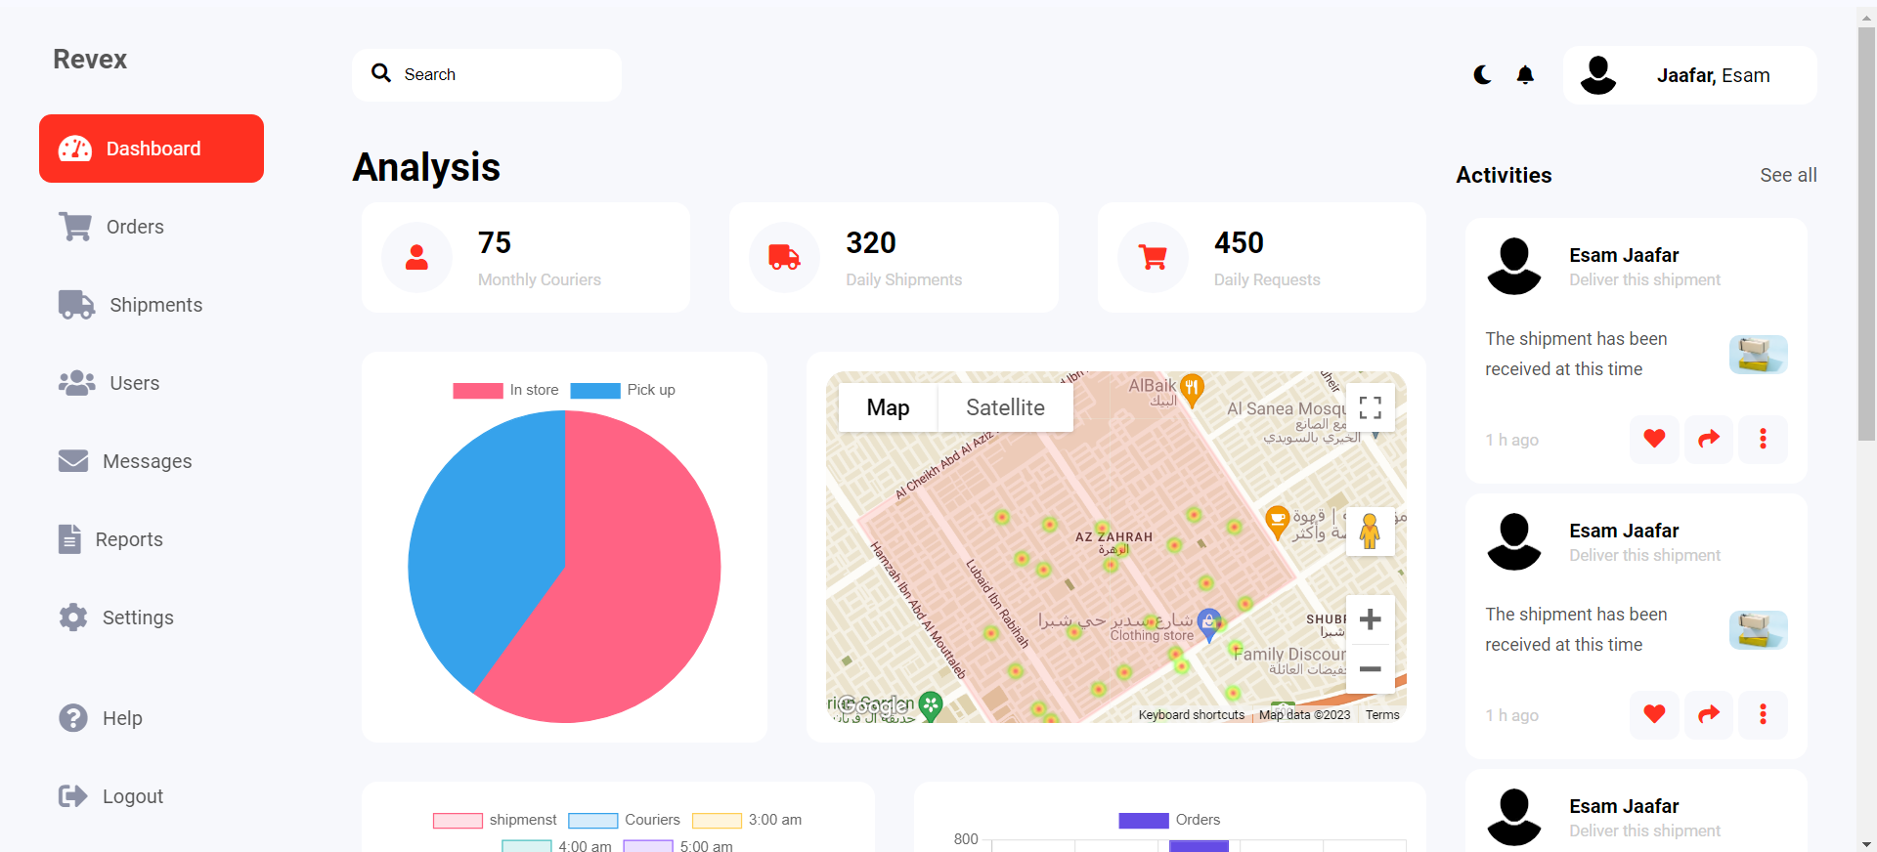
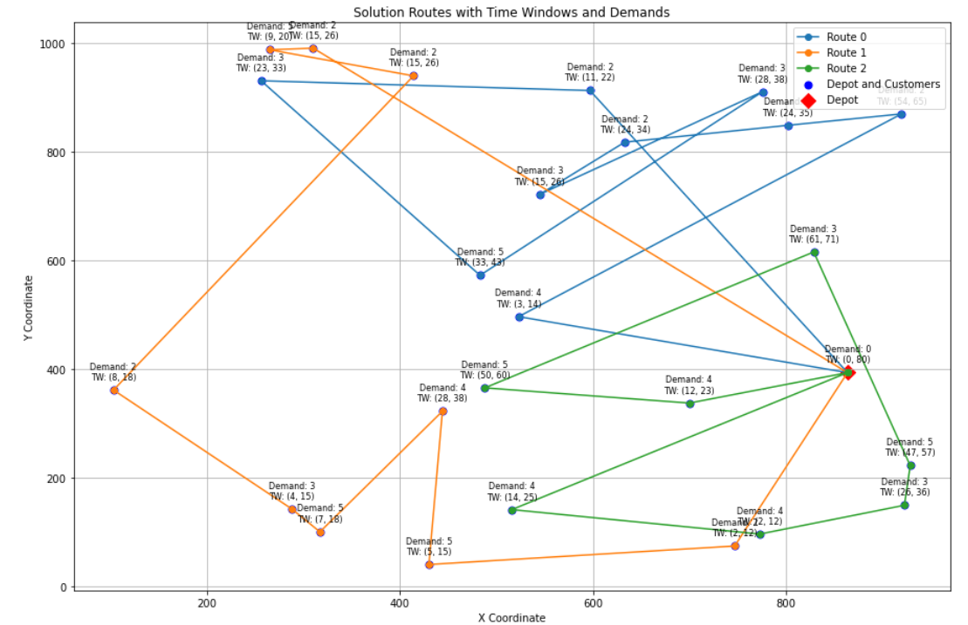
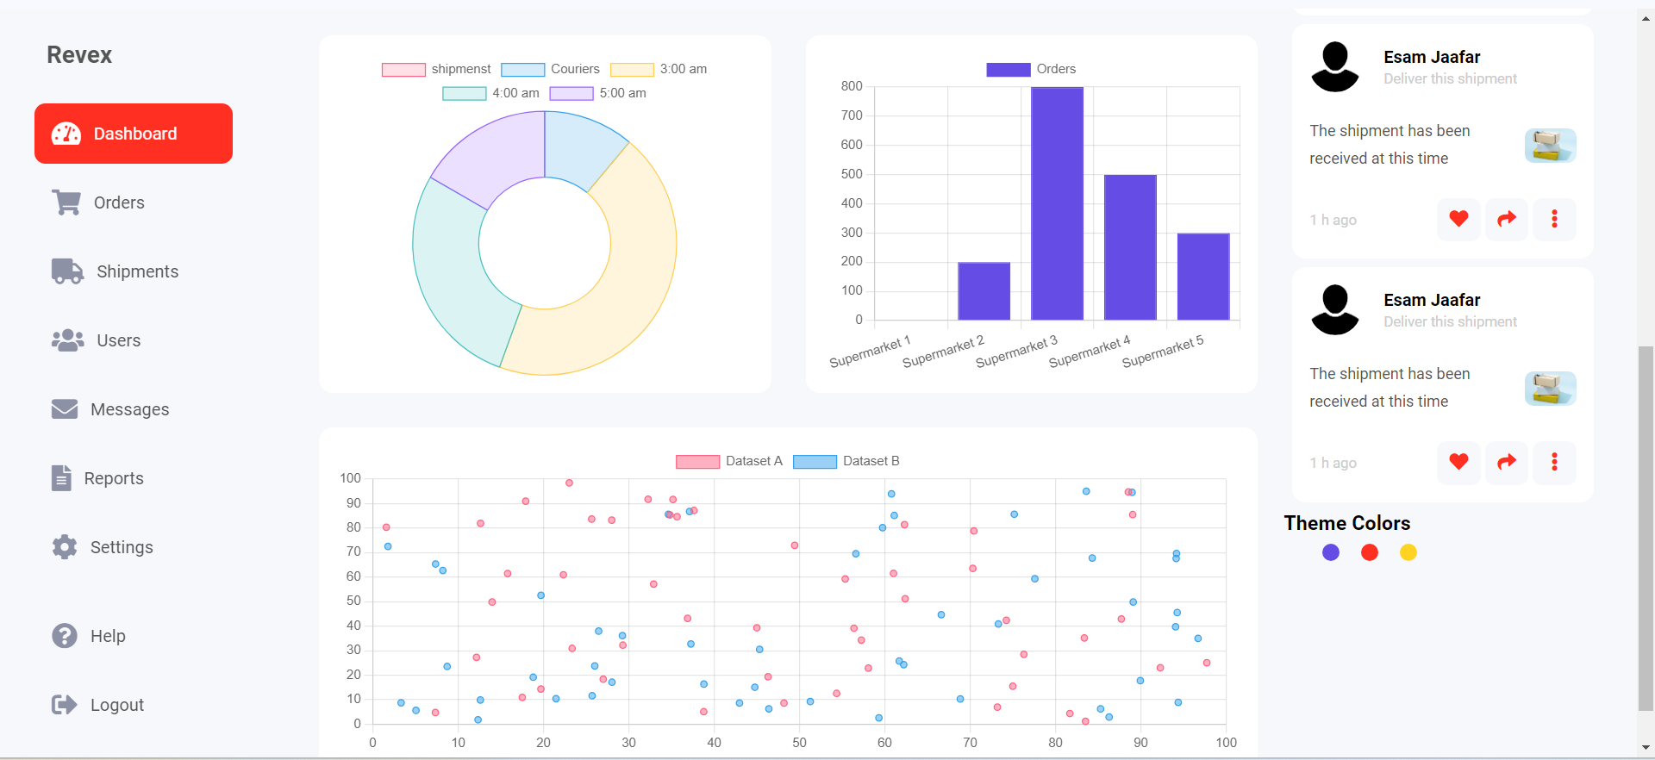
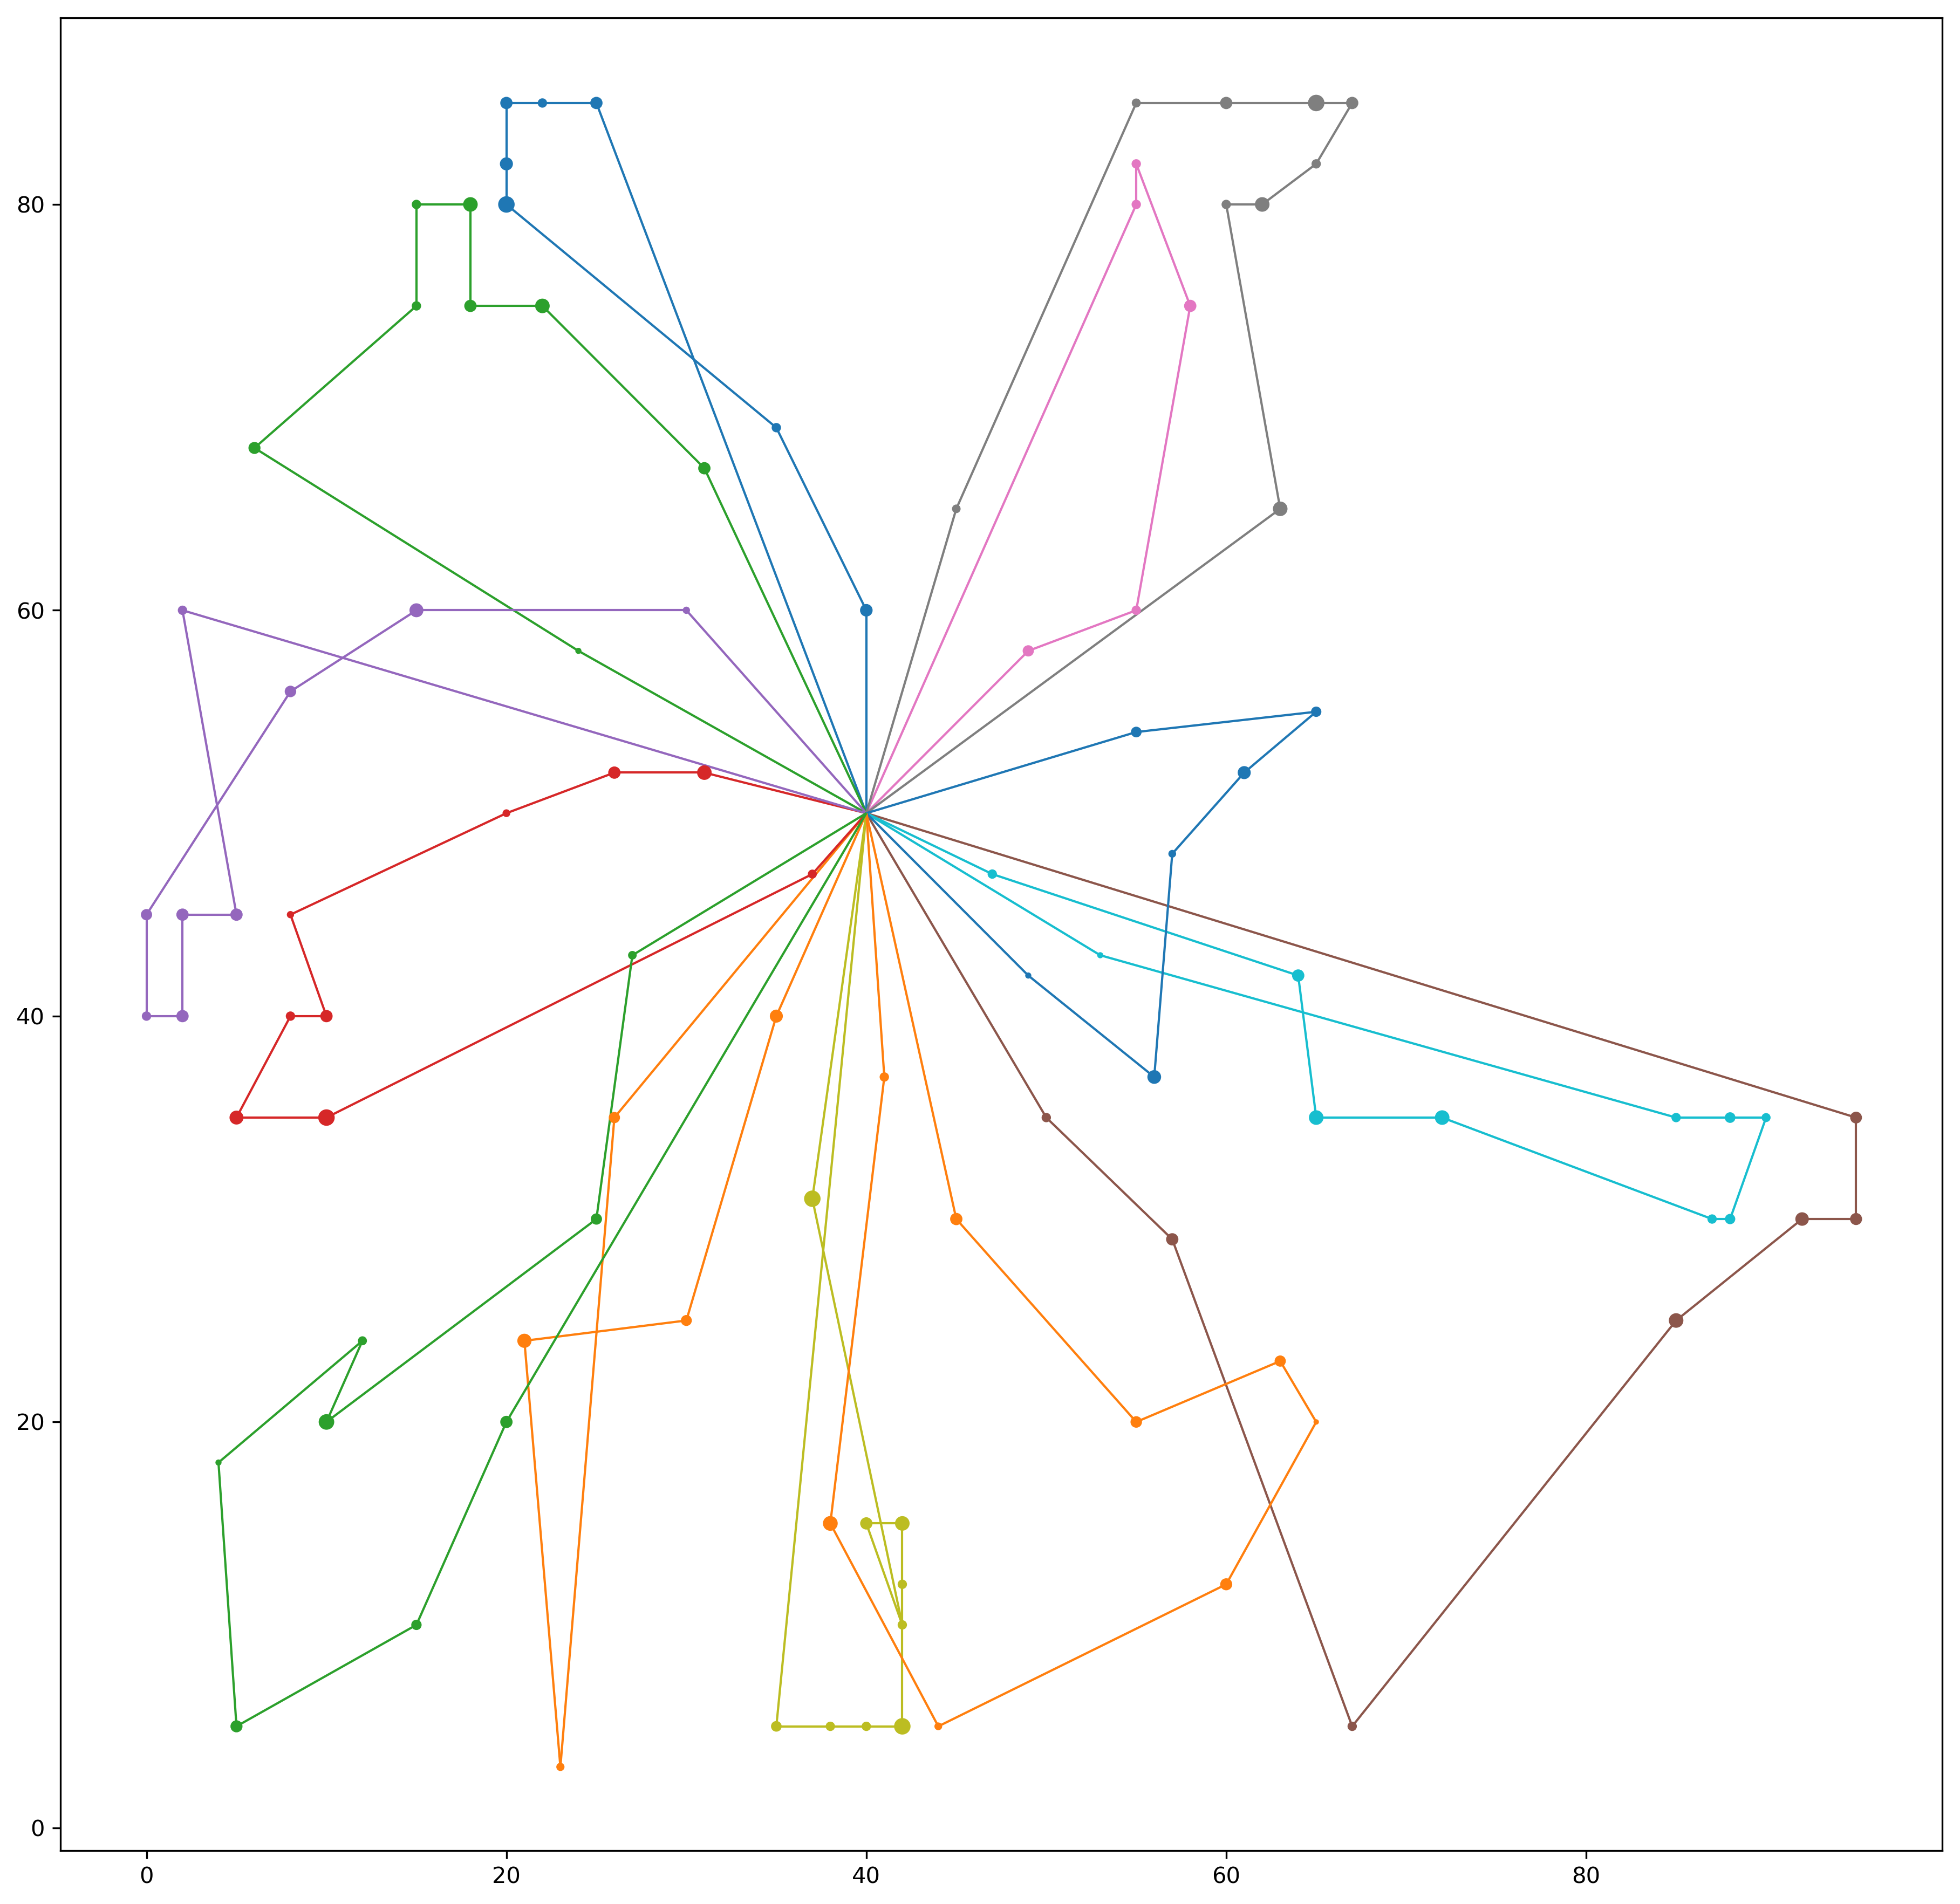


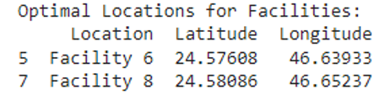
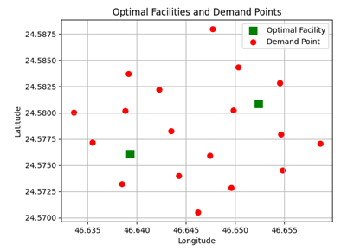
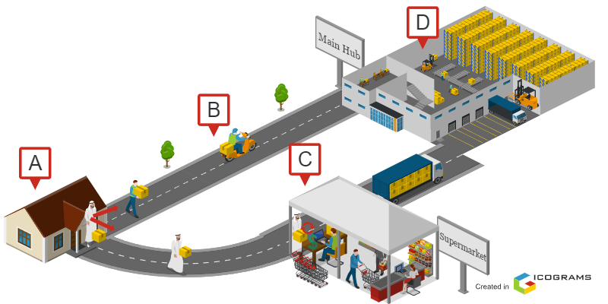
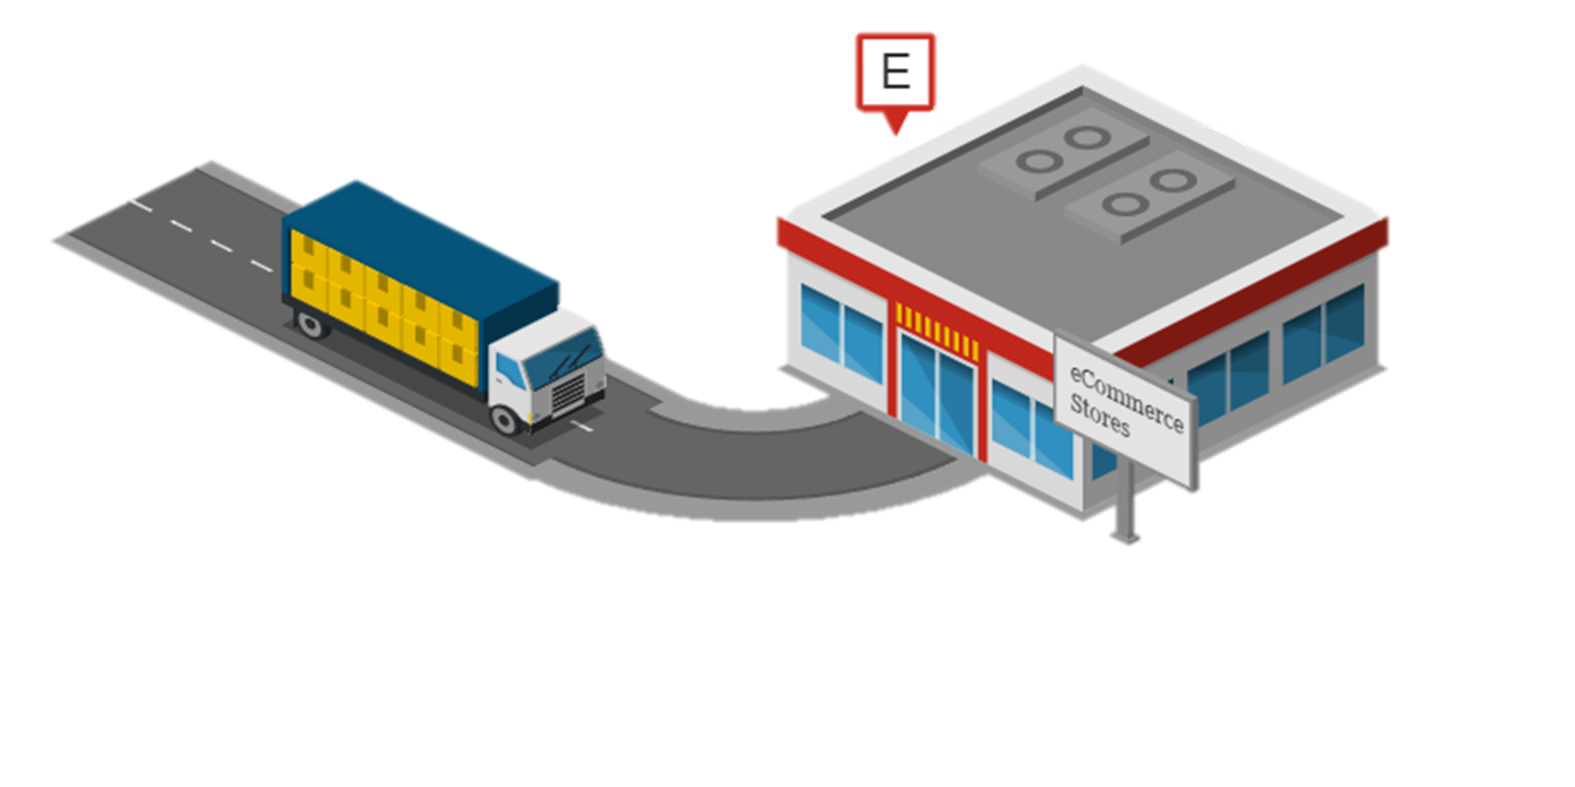










Redefining Shipments Returns: A Comprehensive Approach to Mitigate Logistical Costs and Enhance Customer Satisfaction
Esam Jaafar (CS) Abdullah Bawazir (CS) Abdulkarem Alghamdi (ISE) Monwer Almajnouni (ISE)
Introduction
Mathematical Model
Prototype Design
PROBLEM
E-commerce and logistics companies are facing challenges in managing return shipments, a crucial aspect of customer satisfaction. These challenges include high costs associated with return shipments, difficulties in tracking these shipments, quality control issues, and overall negative customer experiences.
OBJECTIVE The project's objective is to enhance the efficiency and customer satisfaction in e-commerce returns by reducing operational costs, improving customer satisfaction, and smoothing the return process through diverse and flexible return options. CONSTRAINS
Challenges in integrating existing systems with our service.
Facing too many return requests in a short timeframe.
Difficulty in designing solutions suitable for varied customer behavior.
DELIVERABLES
Analyzing high return cost absorption without consumer impact.
Automated return system implementation strategies.
Developing cost-effective reverse logistics models.
Developing scalable solutions for varying return volumes.
Route Optimization with Time Windows Constraint Model
D.V:
$X_{ijk}=\left\{\begin{aligned}1 if driver k goes from node i to j \\ O other wise\end{aligned}\right.$
$S_{ki}=the time driver k reaches node i$
Minimizing the total distance
$$Min Z=\sum_{k}^{D}{\sum_{i}^{N}{\sum_{j}^{N}{D_{ij}∗X_{ijk}}}}$$
Subject to:
$\sum_{k}^{D}{\sum_{j}^{N}{X_{ijk}=1}} ∀i ∈N (≠node o)$
$\sum_{i}^{N}{Di \sum_{j}^{N}{X_{ijk}≤q ∀K∈D }}$
$\sum_{j}^{N}{X_{0jk}=1 ∀k ∈D}$
$\sum_{i}^{N}{X_{ihk}}−\sum_{j}^{N}{X_{hjk}=0 ∀h∈N \left(≠0\right), ∀k∈D}$
$\sum_{i}^{N}{X_{ifk}}=1 ∀k ∈D$
$S_{ik}+T_{ij}−M_{ij}\left(1−X_{ijk}\right)≤S_{jk}$
$a_{i} ≤S_{ik}≤bi ∀i and j ∈N, ∀k∈V$
$X_{ijk}∈$ $\left(0,1\right) ∀i,j$, k
$S_{ik}$ ≥ 0
Optimal Routes Result
Results for Real Case Study with 25 customers
Heading
Results with 100 customers using Tabu search
How It Works
CONCLUSION
Decentralized Courier ​
Different logistics and e-commerce companies use the same courier to return shipments​
Return store​​
Consumers go to the nearest supermarket or store to their houses to drop their shipments​
Select the potential facility location
D.V:
$y_{ij}=\left\{\begin{aligned}1 if demand point j is covered by facility i \\ O other wise\end{aligned}\right.$
$x_{i}=\left\{\begin{aligned}1 if facility is placed at location i \\ O other wise\end{aligned}\right.$
Minimizing number of facilities
$$Min Z= \sum_{i∈F}{x_{i}}$$
$y_{ij} ≤x_{i} ∀i,j$
$\sum_{i∈f}{y_{ij}}≥ 1 ∀i,j$
$if d_{ij}>M, then y_{ij}=0 ∀i,j$
$x_{i}∈\left(0,1\right) ∀ i$
$y_{ij}∈\left(0,1\right) ∀i,j$
Optimal Locations Result
In this project, we were able to create an integrated system for managing and organizing returns that serves online stores and logistics companies that do not support returns. We were able to reduce the total cost of the returns process by up to 65% by using innovative methods and methodologies. This project is characterized by the fact that it can be expanded over time. Larger scopes to serve the largest possible number of customers around the world
Technology

