Slide 1

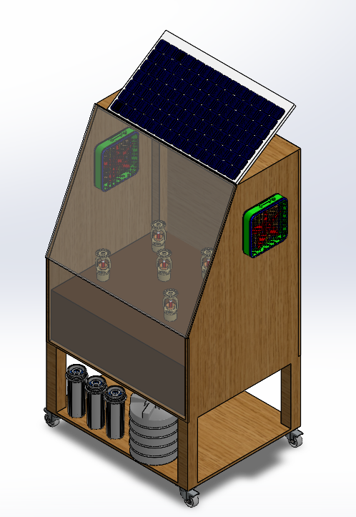
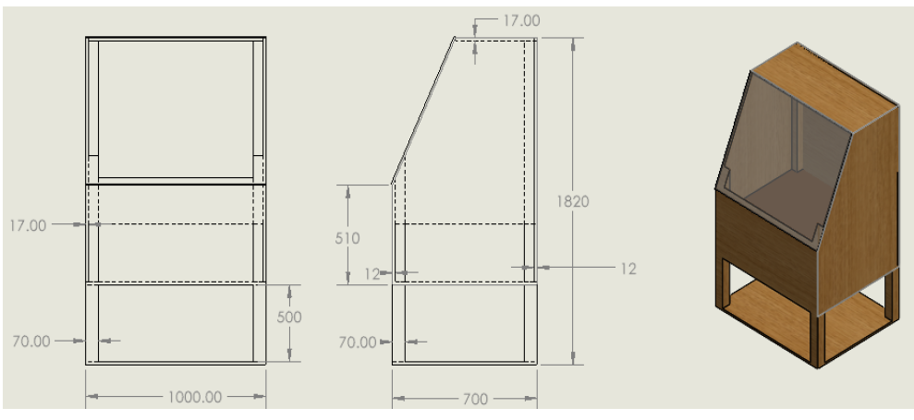
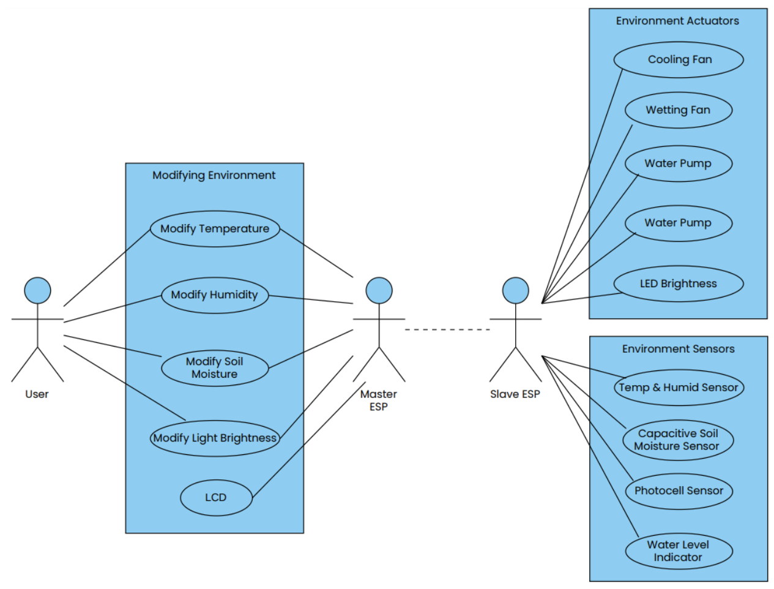
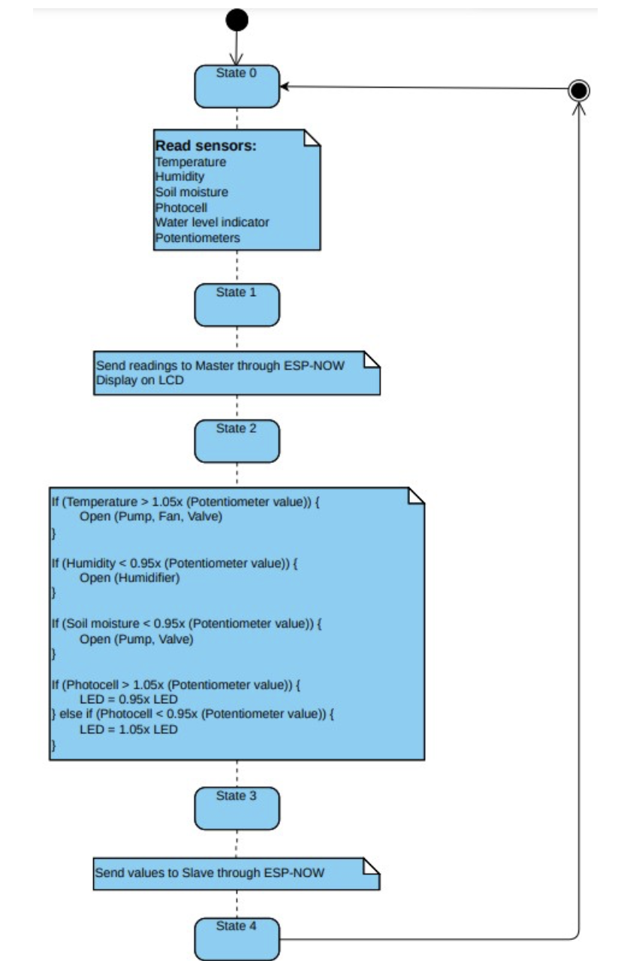
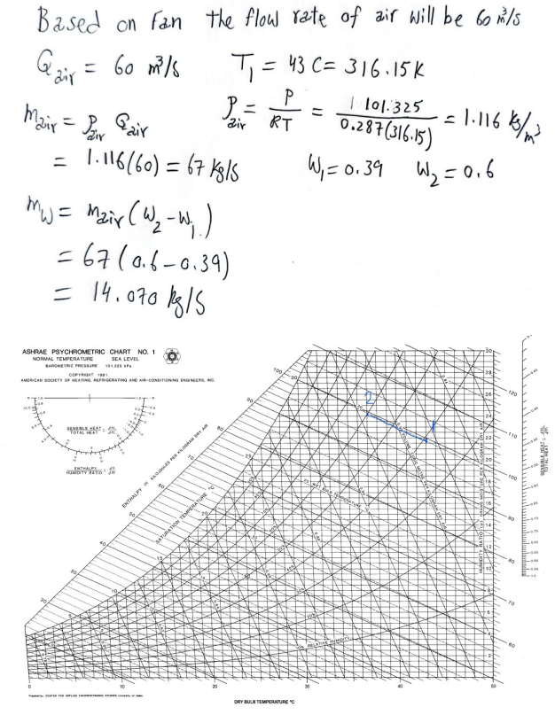
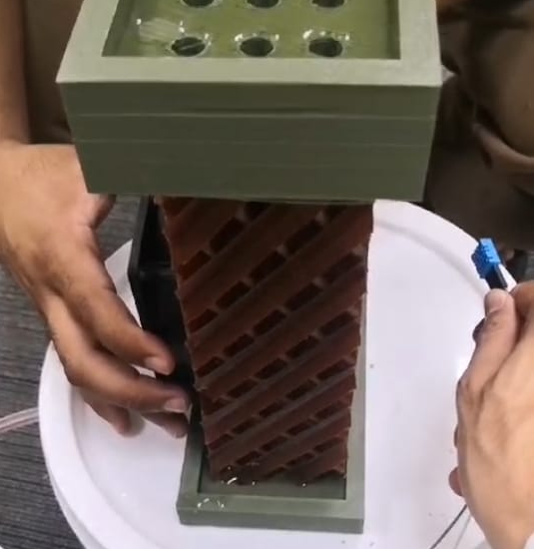
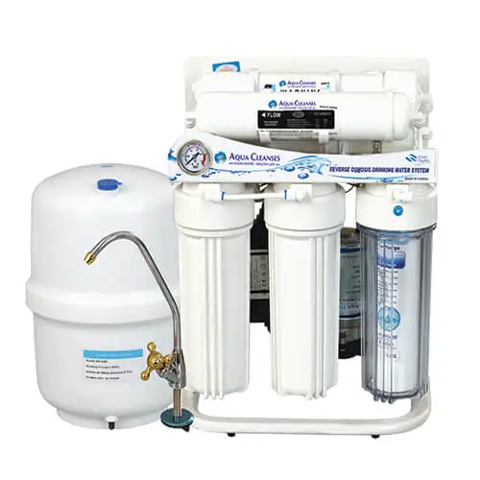
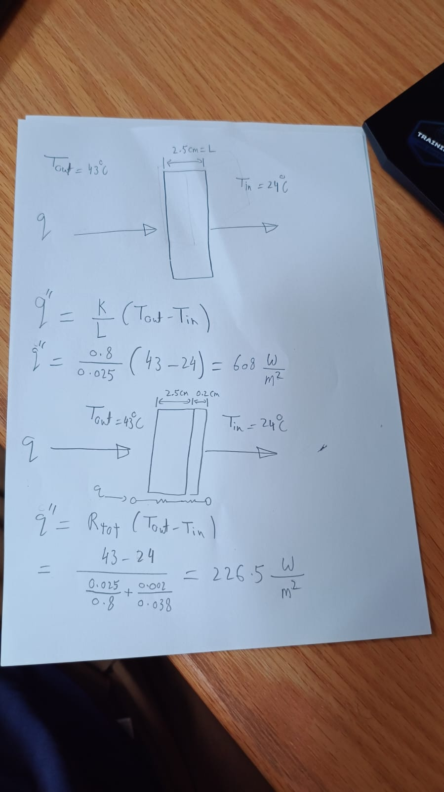


Smart Greenhouse box
`Team Member 1- HUSSAIN ALI ALAESH – 201928370 (ME) 2- ALI MOHAMMED AL-KHALEFA – 201917430 (ME) 3- MOHAMMED ABDULKAREEM ALASWAD – 20184226 (CHE)
4- MUATH ABDULLAH ALSHAHRANI – 201783710 (COE) 5- ZAHER FAREED ALSHAYEB – 201917430 (CHE) 6- FIRAS IBRAHIM HAREES – 20184226 (ISE)
Team 28
Introduction
Design & Testing
Prototype Details
Project Statement: Providing a remote control movable greenhouse box that helps to maintain growth of plant at ritual area with ability of mentoring it and delivering needed nutrients for plant and manage water consumption with avoiding labor cost and climate change.
Untitled
Specifications:
1. Dimensions & Weight
Max Volume : 200 $cm$ x 100 $cm$x 70 $cm$ Weight : less than 150 kg overall
2. TDS
Less than 2000
3. Humidity Control
40% to 80% with ±5% tolerance
4. Energy Efficiency
battery 100 W average usage
5. Temperature Control
20°C to 27°C with ±2°C tolerance
6. pH of water
maintain 6 – 7 pH
Constraints
1. Space
The box is limited to housing 10 plants with specific soil depth and
2. Portability
The design should not exceed weight and size constraints to ensure ease of movement.
3. Energy Efficiency
The system needs to function effectively on solar power
Control coding
Innovation & Creativity
Use case
Software Architecture
1
2
3
Water treatment for agricultural waste
Temperture and humidty synchronization
Movable
Mathematical Model
pH control
$$CH_{3}COOH ↔H^{+}+CH_{3}COO^{−}$$
$$\left[H^{+}\right]=x+b$$
$$pH=−\log\left[H^{+}\right]=−log⁡(x+b)$$
Humidification Design Test
Objective: To evaluate the functionality of the humidification design, specifically its ability to modify the humidity and temperature of air passing through evaporative cooling pads.
Results:
Parameter | Before Cooling Pad | After Cooling Pad
Temperature (°C) | 29 | 23
Relative Humidity (%) | 55 | 71
Conclusion
Water Treatment
Objective: to ensure high-quality water for plant growth by controlling the pH and TDS.
Results:
The calculations without insulation.
The calculations with insulation.
Tech Integration: Demonstrated effective integration of technology with traditional farming.
Environmental Control: Achieved precise control overgrowth conditions, optimizing plant health and resource use.
Solar Efficiency: Powered sustainably by solar energy, reducing costs and environmental impact.
Scalable Design: Showcases potential for adaptation across different climates, enhancing sustainable agriculture prospects.
Reverse osmosis
Symbols | Values
MF1(L/d) | 7200
XF (ppm) | 4000
MD (L/d) | 20
XD (ppm) | 120
MB (L/d) | 7180
XB (ppm) | 4010.808
Total MD (L/d) | 20.0
Total XD (ppm) | 120.0
Total recovery% | 0.003

