Slide 1

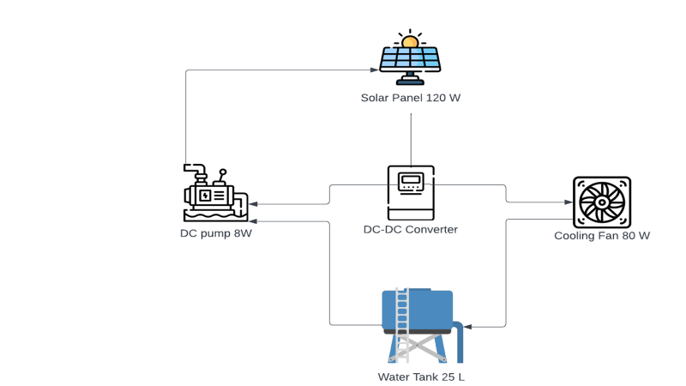
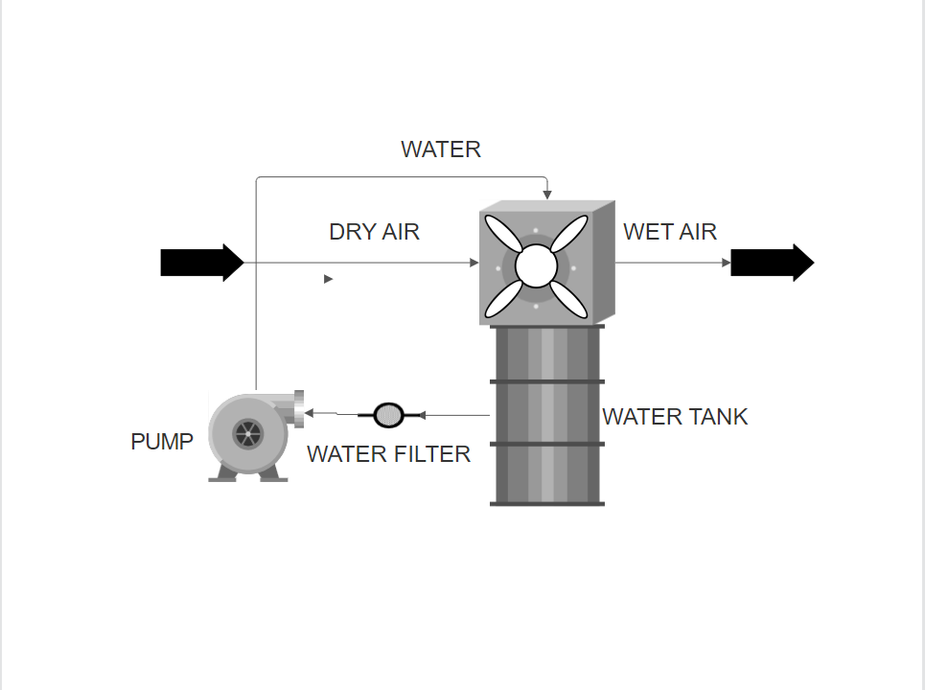
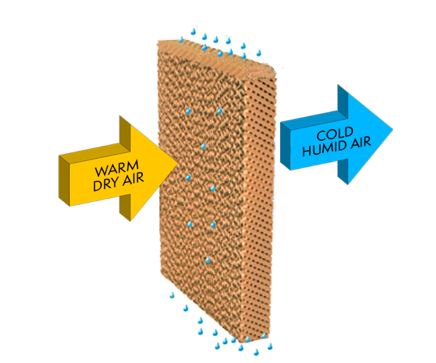
Team 25
Faisal Alssuwiyyan (EE)
Faisal Alahmri (EE)
Abdulelah Alqahtani (CHE)
Hamza Al-Ismail (CHE)
Fahd Al Mohaimeed (ISE)
Ahmed Al Shuwaikhat (ISE)
Water Tank Cooler
Introduction
Concept Design
Testing
Our project focuses on developing a Sustainable Water Tank Cooler that aims to regulate water temperature in exposed tanks with minimal human intervention. Our goal is to create a solution that can be installed and operated with ease, while having minimal environmental impact and long-term economic benefits for clients.
The system utilizes solar power to supply a heatsink with a fan, effectively reducing the temperature of the water tank. The solar panel is automated and equipped with two features: cooling and cleaning. This project enables homeowners to maintain cool water tanks, preventing overheating using a heatsink. The heatsink is powered by a solar panel that incorporates self-cleaning and cooling functionalities.
When the tank in the water is 45 C, it dropped to 28C (the outside temperature was 33C.
*Dependent on the environment temperature
Conclusion
The main function of our product is to cool the water in the water tank, by using a renewable energy source, to save cost and benefit from the established infrastructure that the customer has, most water tanks are in the roof to save water pump cost and benefit from the gravity pull downward. The functions are mainly three, energy source which is the solar panel, secondly the fan the pull cold air inside and drive hot air outside, lastly the air conditioning chamber/filter.
Constraints
Tackles one source of heat (heated tanks).
Hot weather regions .
Dependent on weather (solar powered).
Specifications
Power efficient: The system will be supplied by a solar panel integrated with cleaning and cooling system.
Economy: The idea is to benefit the client of a long-term product.
Cooling Effectiveness: cools fast and the specified temperature drop.
Product Life Cycle. Long life cycle.
The idea here is to use directly a buck DC-DC step down converter to supply the fan connected to chamber that vaporize the water inside the tank (evaporative cooling).

