Slide 1
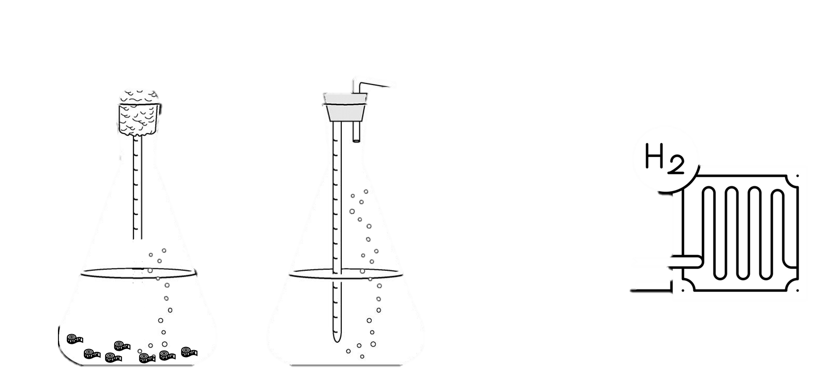
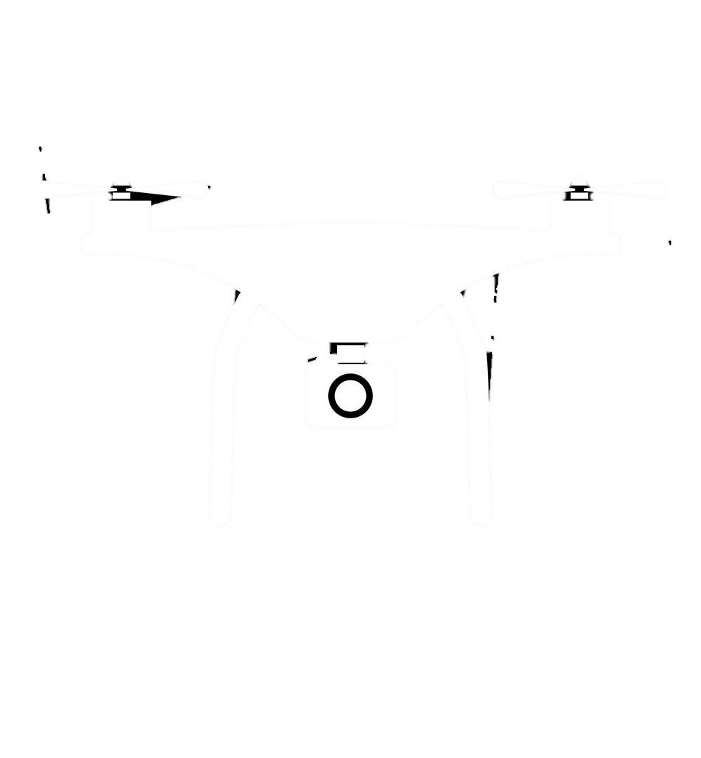

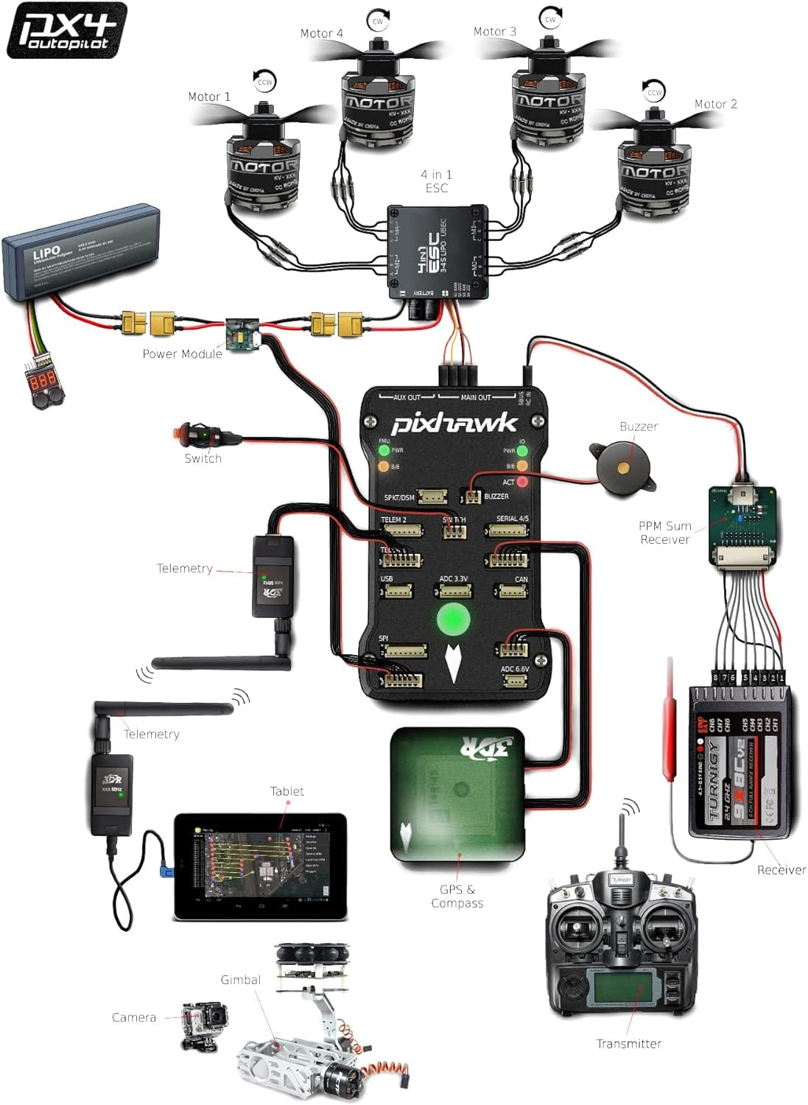
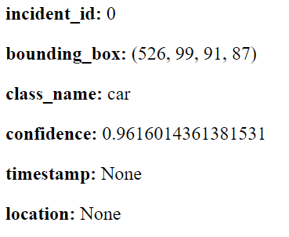

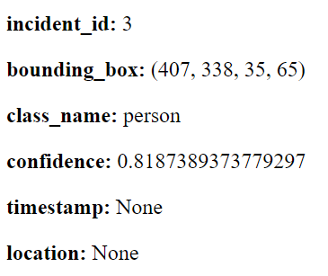
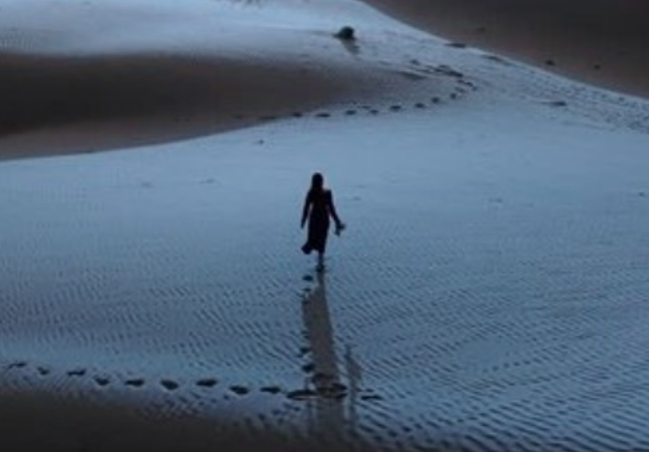
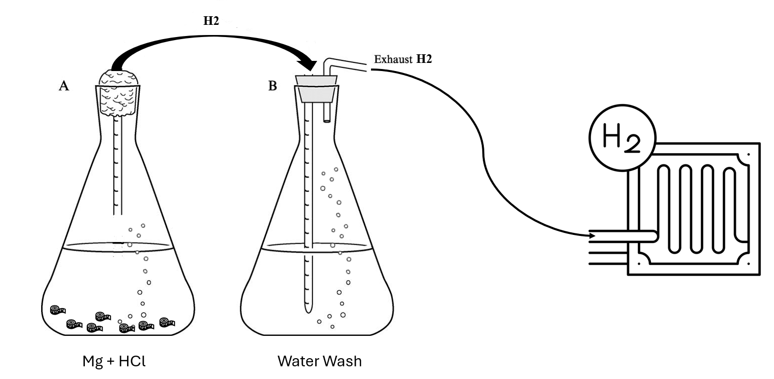
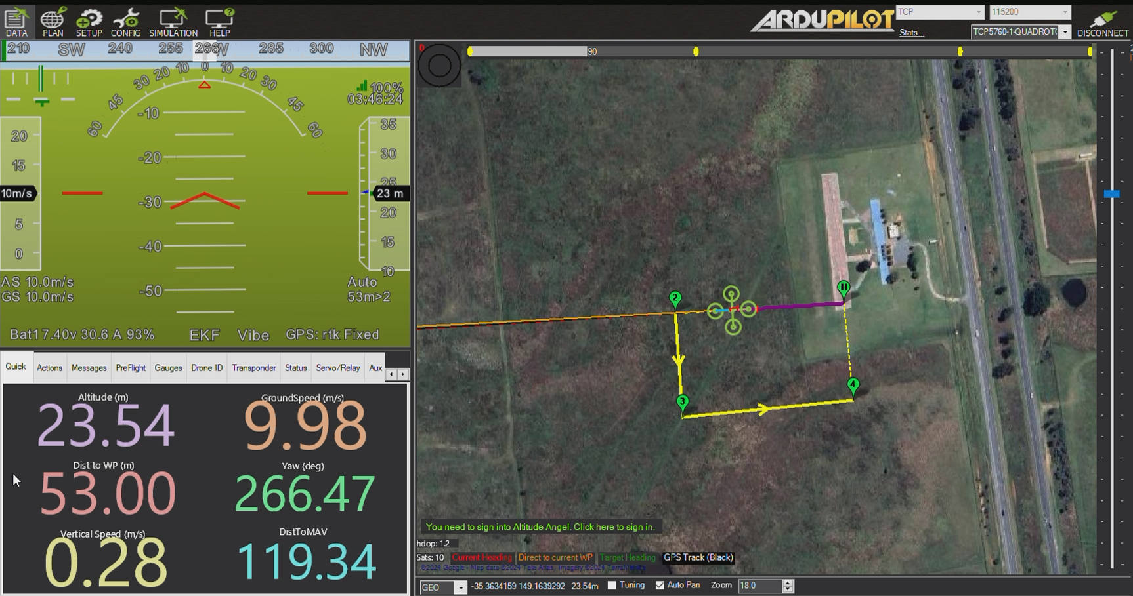
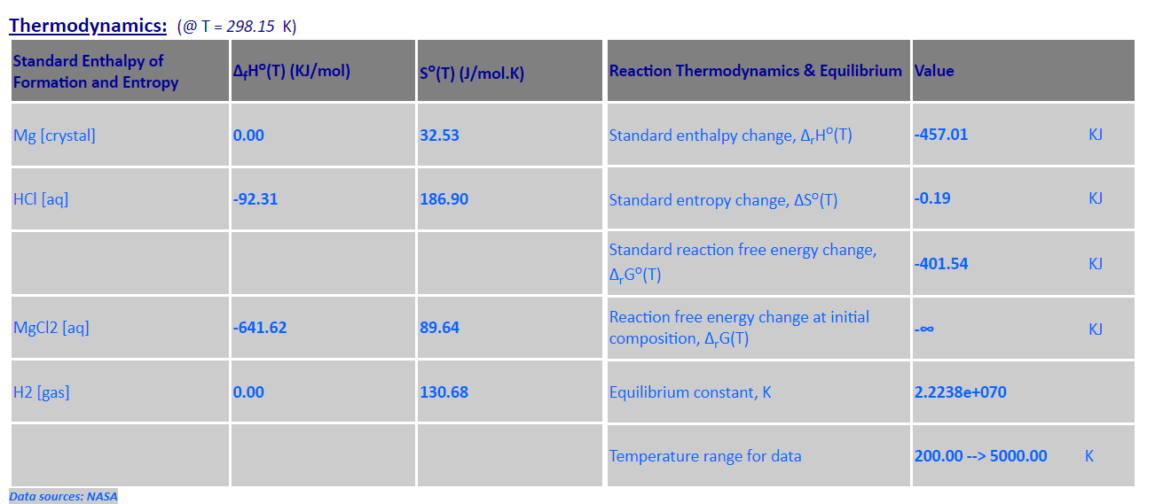
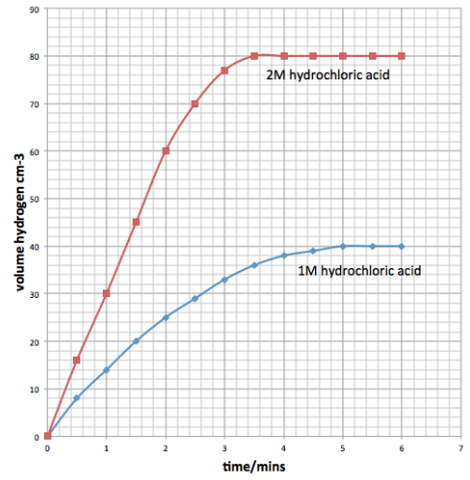
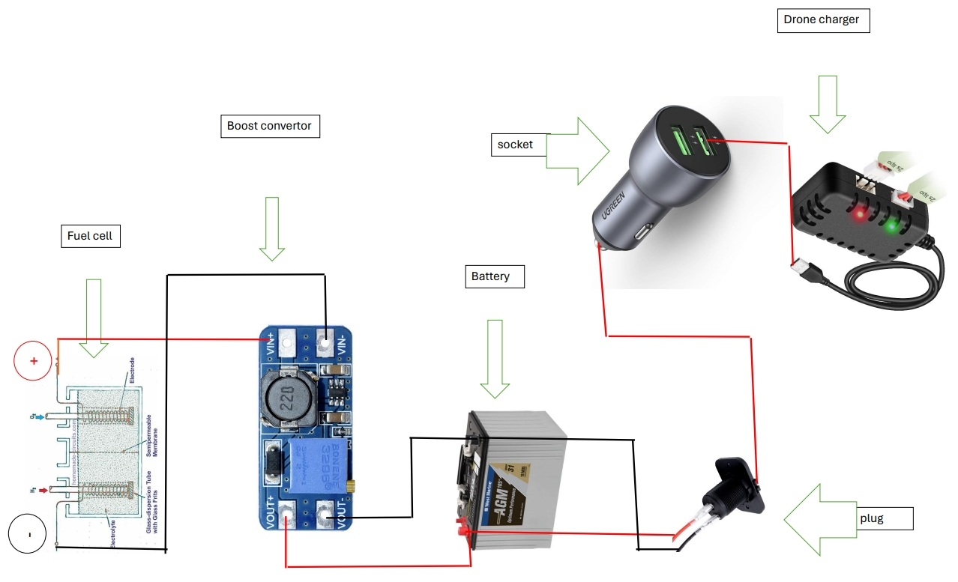
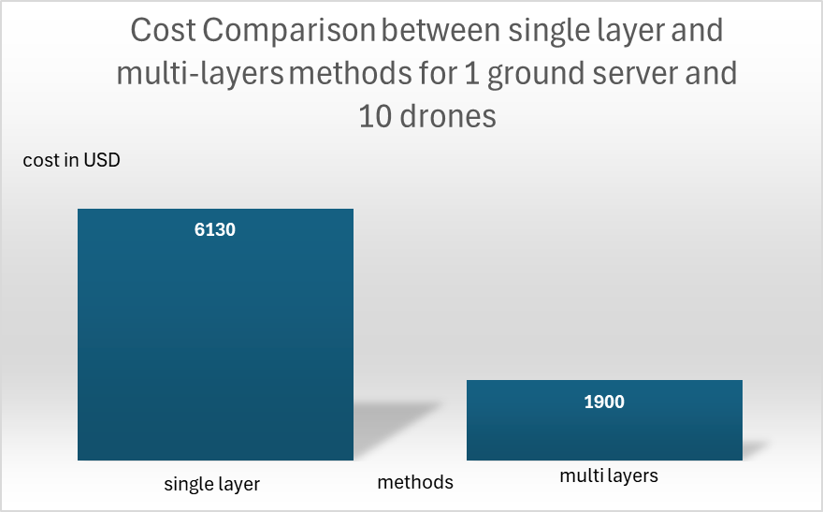
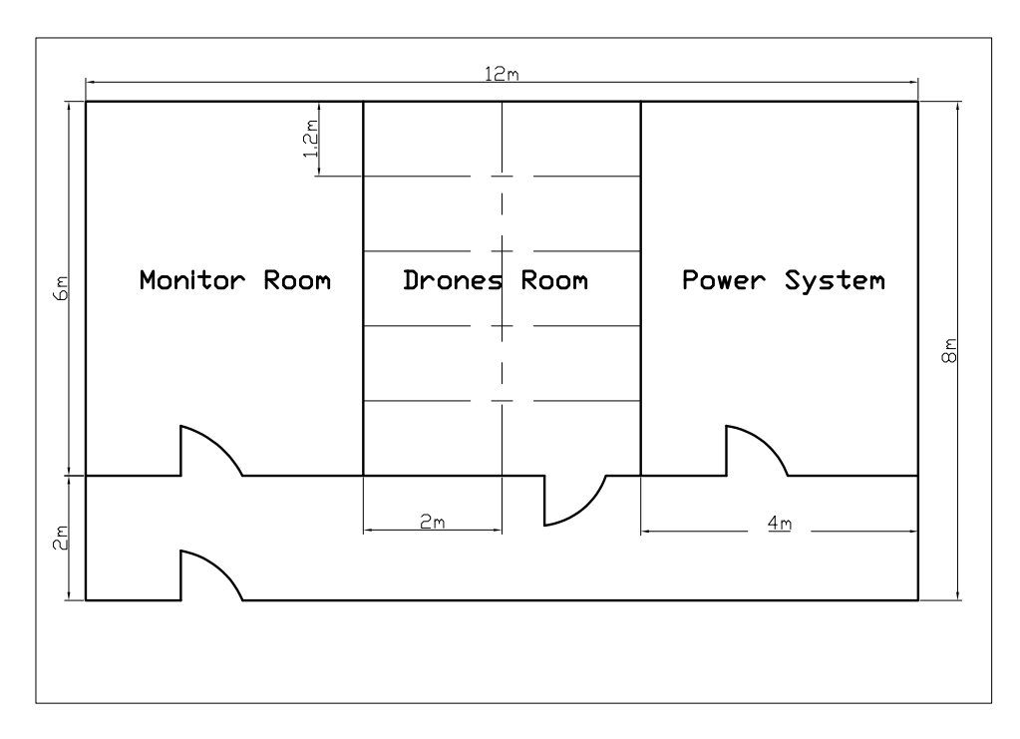
Drone-Based Surveillance Security System
`
Drone-Based Surveillance Security System
TEAM Design Term 232 - Team 021
Abdulrahman Alothman (COE) Abdulkarim Alghaith (COE) Ahmed Alghumgham (EE)
Fahad Alobaydah (CHE) Hussain Almubarak (CE) Yazeed Alharbi (AE)
Introduction
Drone Design
Material Testing
Prototype Software Testing
This project deals with the problem of security surveillance in large-area environments. More specifically, the system should be able to classify illegal human activities by using an autonomous computing system. The idea is to monitor the security violations from the air instead of the ground by employing Drones to survey the desired area. Currently, the practical solution for monitoring large area environments of any kind; natural reserves, and huge area parks, is by manual human patrols. However, by employing an intelligent Drone system, traveling through a given region, our system will capture and classify human activities using state-of-the-art AI technologies and report this information back to the
central monitoring base.
Problem Statement
In large-area environments such as natural reserves and vast parks, traditional security surveillance methods primarily rely on manual human patrols. This approach is labor-intensive, costly, and often inefficient due to the extensive area coverage required and the potential for human error. This project proposes the development of an autonomous aerial surveillance system using drones equipped with advanced AI technologies. The system aims to revolutionize security monitoring in large-area environments by automating the detection and classification of illegal human activities.
Power System
Prototype Drone Testing
Specifications / Constraints
Here are the drone simulation where the team set a mission to do it with the attention of the constrains.
Target Specifications | Constraints
Accuracy should be at least 70% | Maximum hight is 100m
Transmission time should be less than 800msec | Minimum hight is 20m
Average operation cycle time should be 5mins | Tilted camera angle is 60 degrees
The coverage area should be at least 1.5 Km² | Hydrogen LFL is less than 4%
The drone weight should not exceed 5Kg | Day light operations
The camera should be 8M pixels at leas
Prototype Reaction Testing
Project Impact
Conclusion
Impact Type | Justification
Environmental | Using green hydrogen fuel cell to generate electricity using which is a renewable source that contributes to reduce the carbon emission.
Economical | Saving labor cost in security applications where the drone can replace the labors salary with its fixed operating and maintenance cost
Health and Safety | Improving surveillance of natural reserves can contribute to safer public spaces by promptly identifying and mitigating potential threats.
Operating Center
Selected Design
In conclusion, the project is aimed to solve the issue that is related to surveillance and security system. Implementing an intelligent drone-based system reduces reliance on manual labor, leading to significant cost savings in operational expenses, minimizing carbon emissions associated with traditional surveillance methods, contributing to environmental sustainability, and integrating AI-driven drone surveillance with centralized data processing which ensure the security effectiveness.

