Slide 1

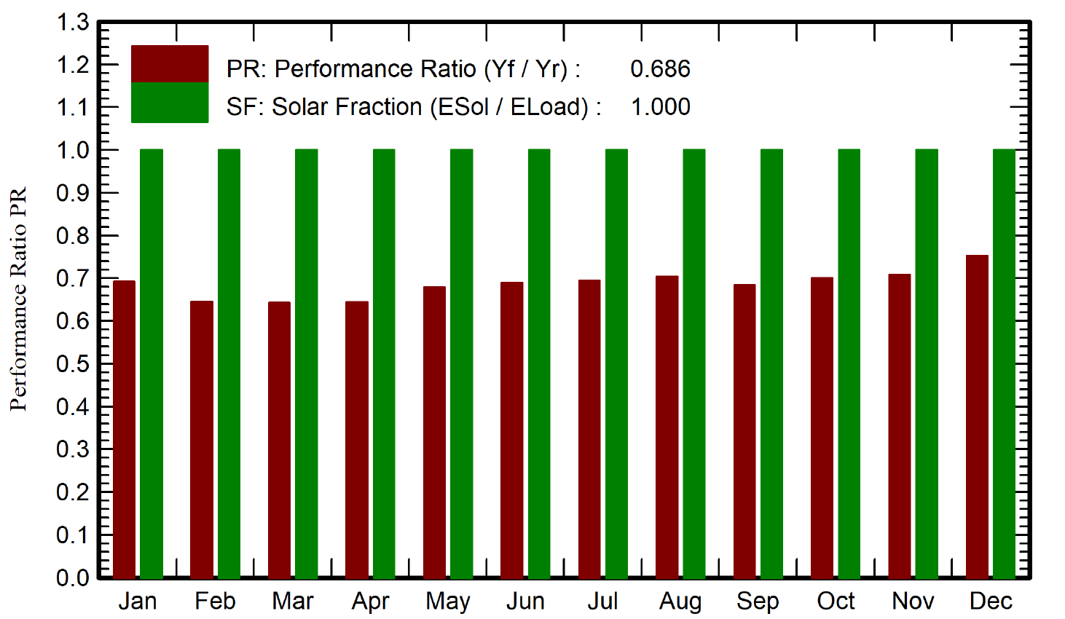
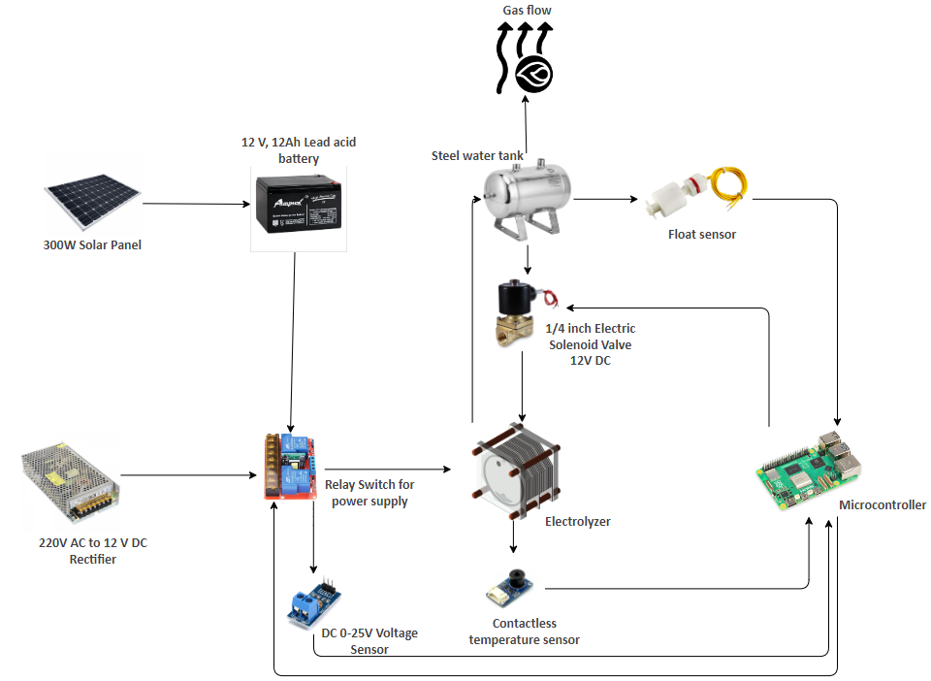
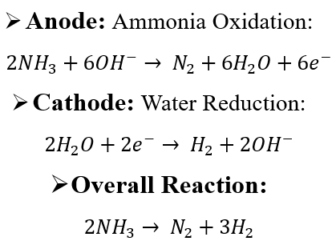
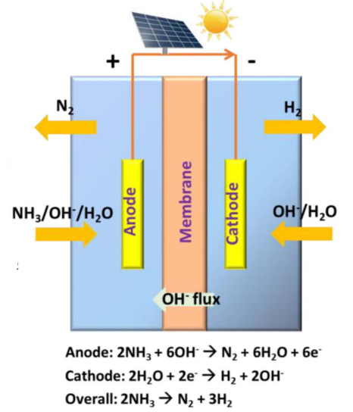
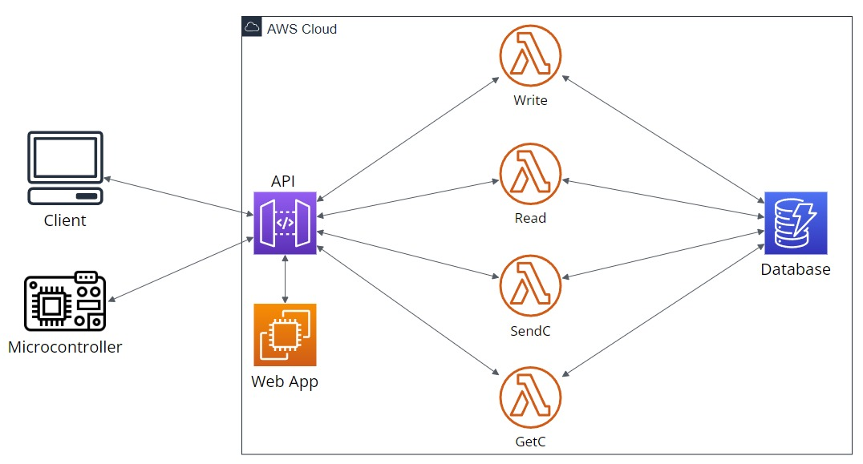
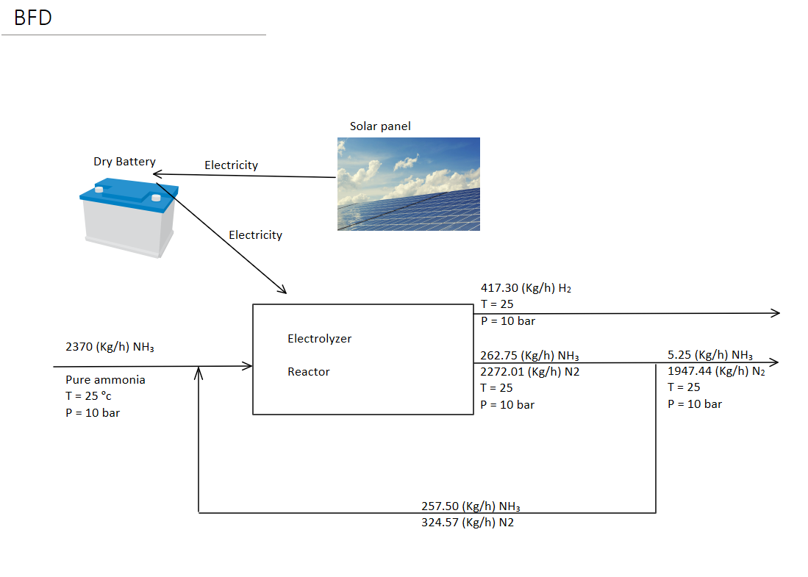
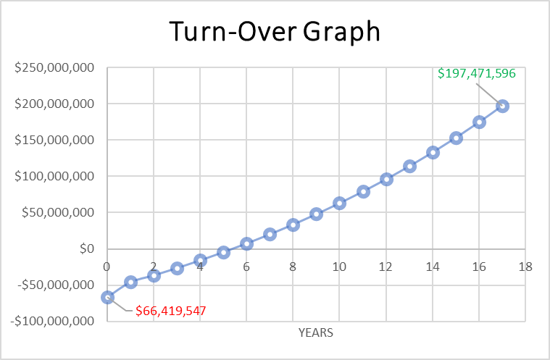
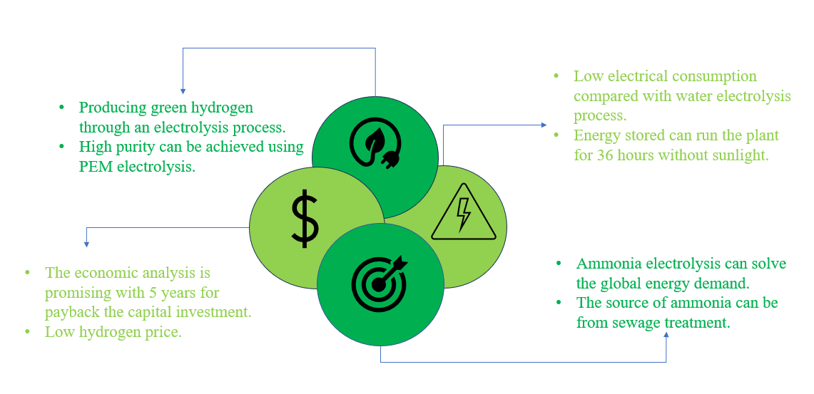
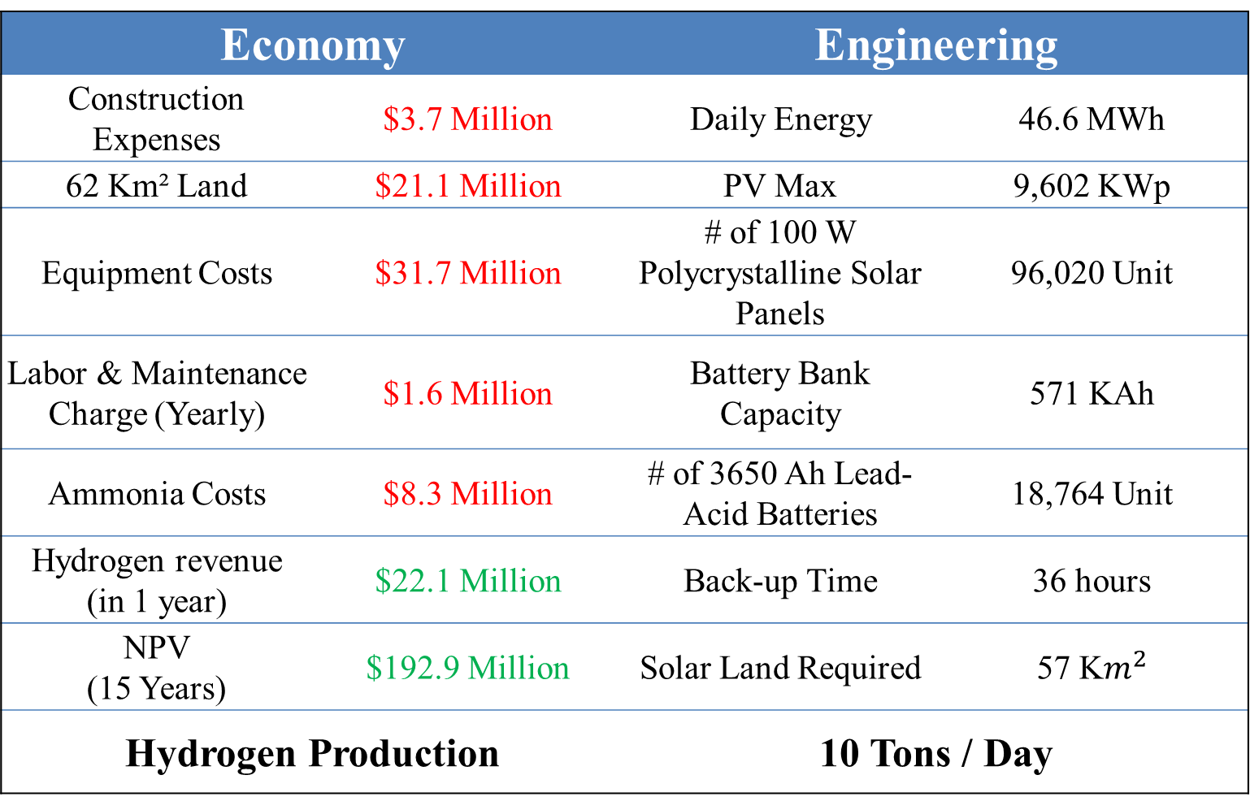
EcoSplit: Harnessing Electrolyzer by Solar Power for
Hydrogen Generation from Ammonia (TEAM 17)
Hussain Alhussain, EE | Nader Alharbi, CHE | Faisal Alwaily, ISE | Abdulrahman Osailan, ISE | Hyder Almir, CHE | Ahmed Alhaiti, COE
Introduction
Large-Scale Analysis
Prototype
As electricity demand increases, it has become crucial to prioritize research and development of new technologies to find sustainable, efficient and eco-friendly energy solutions for future generations.
Project statement is to develop a more sustainable and efficient method for producing hydrogen from ammonia using solar power.
Performance Ratio
Soler panel with acid battery as primary power source
Electrolyzer for generating hydrogen gas
Solenoid valve to control liquid flow
Relay switch to switch between power sources
Embedded system for controlling and monitoring
Web app for data visualization and controlling remotely
Constraints:
Using appropriate material to handle the ammonia
Solar Resource Availability
Electrolyzer Efficiency and Capacity
Ammonia Availability and Purity
Economic Viability and Cost Constraints
Specification:
Elеctrolyzеr Efficiеncy more than 85%.
H₂ production ratе of 10 tons/day
Modular dеsign allows for еasy scalability up to 1 MW.
Zеro еmissions of harmful byproducts
An energy management system enhances optimization.
Chemical Reaction & BFD
Economy |  | Engineering
Construction Expenses | $3.7 Million | Daily Energy | 46.6 MWh
62 Km² Land | $21.1 Million | PV Max | 9,602 KWp
Equipment Costs | $31.7 Million | # of 100 W Polycrystalline Solar Panels | 96,020 Unit
Labor & Maintenance Charge (Yearly) | $1.6 Million | Battery Bank Capacity | 571 KAh
Ammonia Costs | $8.3 Million | # of 3650 Ah Lead-Acid Batteries | 18,764 Unit
Hydrogen revenue (in 1 year) | $22.1 Million | Back-up Time | 36 hours
NPV (15 Years) | $192.9 Million | Solar Land Required | 57 K$m^{2}$
Hydrogen Production |  | 10 Tons / Day
Web App Cloud Architecture:
Conclusion
Supervised by: Dr. Wasif Farooq

