Slide 1

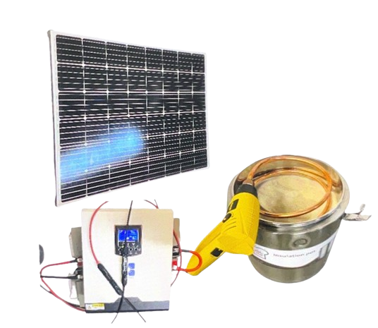
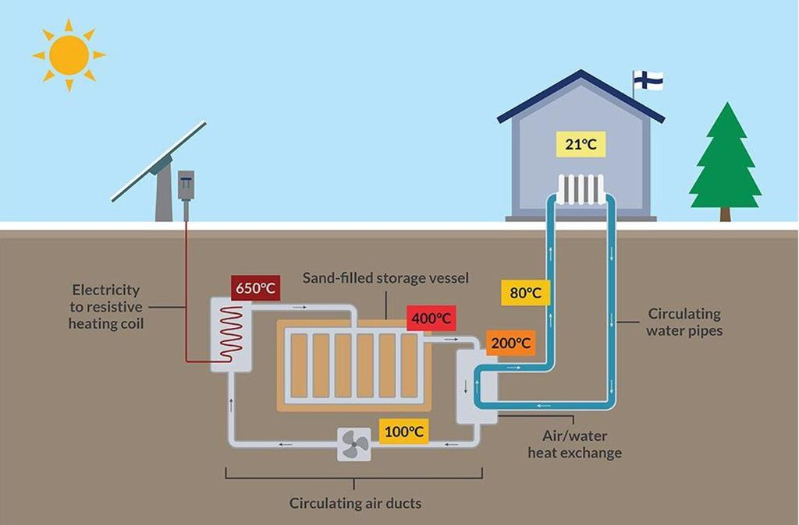
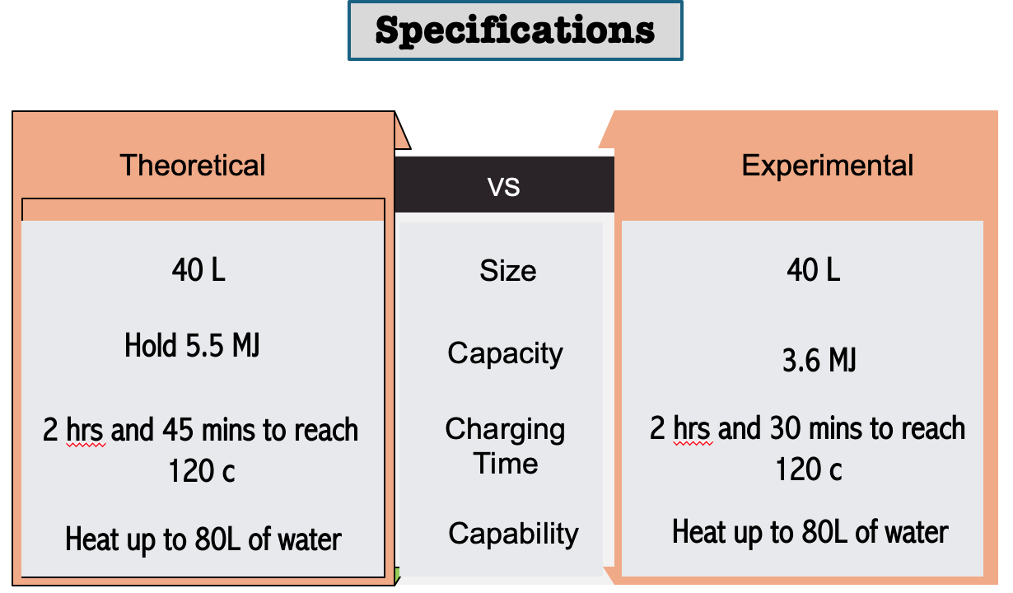
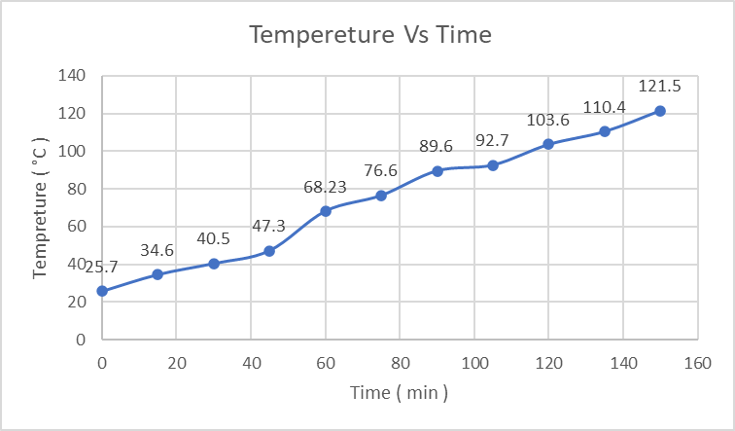
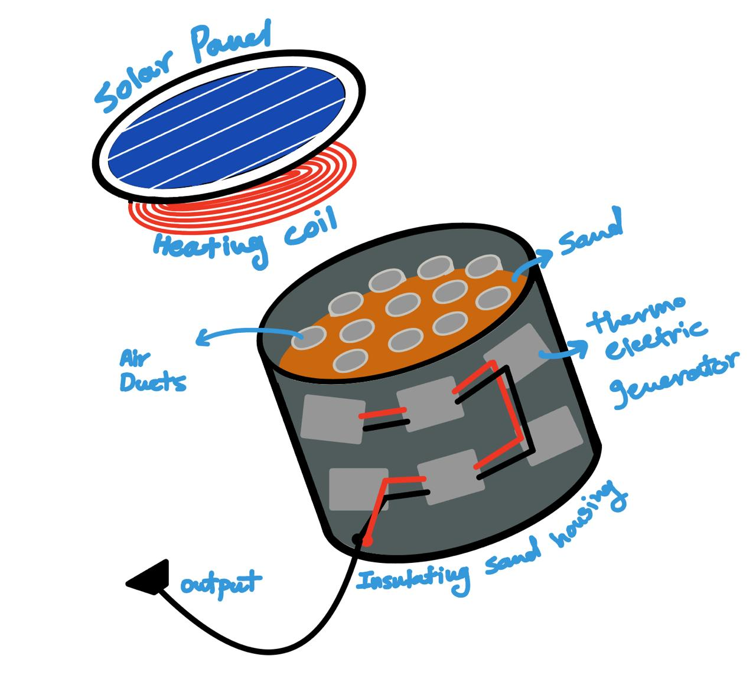
Design A Sand Heat Storage for Residential Heating
Team 17
FARIS SAMARGANDI -CHE
MAHMOUD ALSHENGITI -CHE
KHALID ALHARBI -ISE
MUAAZ ALANDEJANI- ME
ABULLAH MASHAT-ME
HAMZA MOSAWA-CE
Introduction/Background
Prototype and Application
Problem Statement:
Develop a sand heat storage system optimized for efficient thermal energy storage, integration with renewable energy sources, maximizing energy storage capacity, and minimizing environmental impacts.
Elevator Pitch:
Energy companies face a problem with storing intermittent solar energy. Therefore, for energy companies, Who want sustainable energy storage, Sand Battery is a green energy storage that is completely sustainable. Unlike lithium-ion batteries, Sand batteries store energy in the form of heat.
Constraints:
three constraints must be considered in the project.
1- Energy Source: The require energy to charge the sand. And its type.
2- Weight: The total storage weight is about 50kg.
3- Heat Loss: Subjected to heat loss through time.
Target Specifications:
The specifications for the projects are:
1- Size: 40 L of sand.
2- Capacity: Can hold 5.5 MJ or 1.52 kWh.
3-Charging time: Require 2 hours and 45 minutes to fully heat to 120 degrees.
4-Capability: Can heat up to 80 L of water per charge.
Project Impact:
Sand battery offers environmental benefits by reducing greenhouse gas emissions, conserving natural resources, minimizing pollution, and contributing to the preservation of ecosystems. As such, they play an important role in advancing sustainable and environmentally friendly solutions for residential energy use. In addition, while the initial investment in the Sand Battery may be higher, the potential long-term energy savings, reduced maintenance costs, and environmental benefits can make it a financially attractive option for lower energy bills and reduce environmental impact.
Materials: : 1- 40 Kg of Silica Sand
2- 1 Solar Panel
3- 2 Heat Exchangers
4- Copper Coil
Application:
1- Solar panel heats the resistive coils.
2- Coils heat the air with convection
3- Hot air heats the sand to reach to required temperature.
4- Sand acts as a heat storage container
5- Air exchanges heat with water
6- Hot water is utilized.
2.5 h of testing the prototype
Figure , Tempereture vs Ti,e for the first test
Additional solar panels are required.
Small heat loss and slight errors were observed during the initial test.
Further testing is necessary to achieve optimal results.
The prototype functionally meets the specifications.
Results and Conclusion
Results and discussion
Results and Conclusion
Prototype Design
Conclusion
References
Poulose, T., Kumar, S., & Torell, G. (2022). Power storage using sand and engineered materials as an alternative for existing energy storage technologies. Journal of Energy Storage, 51, 104381. https://doi.org/10.1016/j.est.2022.104381
Kiwan, S., & Soud, Q. R. (2019). Numerical investigation of sand-basalt heat storage system for beam-down solar concentrators. Case Studies in Thermal Engineering, 13, 100372. https://doi.org/10.1016/j.csite.2018.100372
Poulose, T., Kumar, S., & Torell, G. (2022). Power storage using sand and engineered materials as an alternative for existing energy storage technologies. Journal of Energy Storage, 51, 104381. https://doi.org/10.1016/j.est.2022.104381

