Slide 1
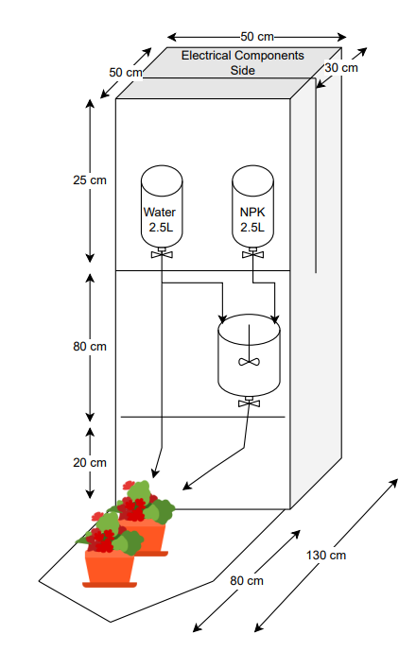

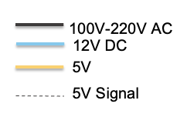
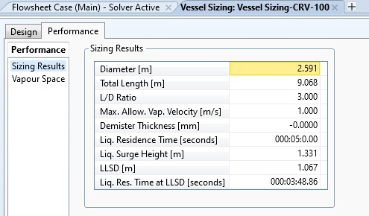
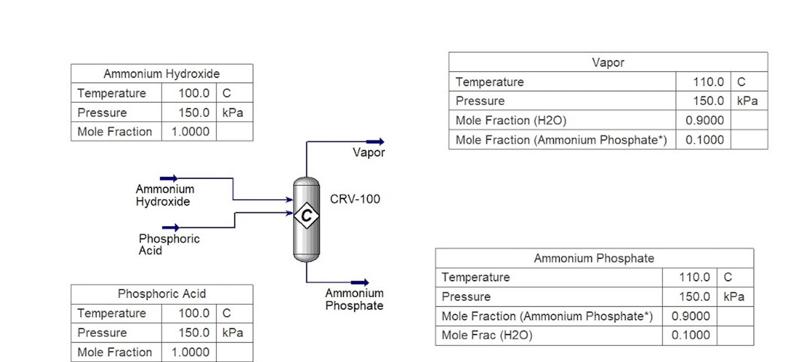
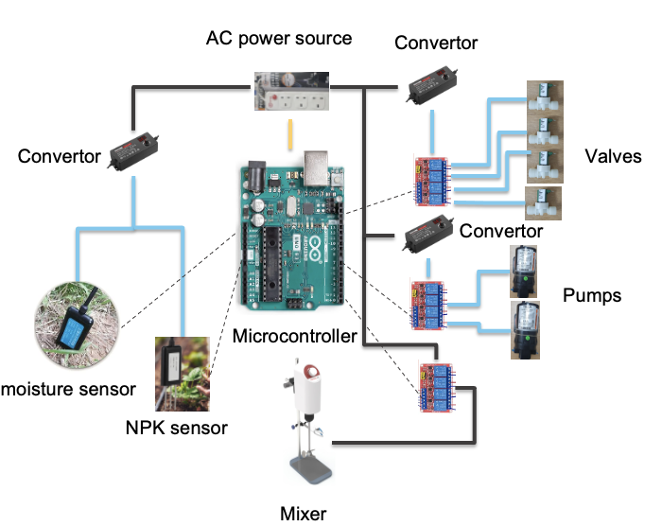
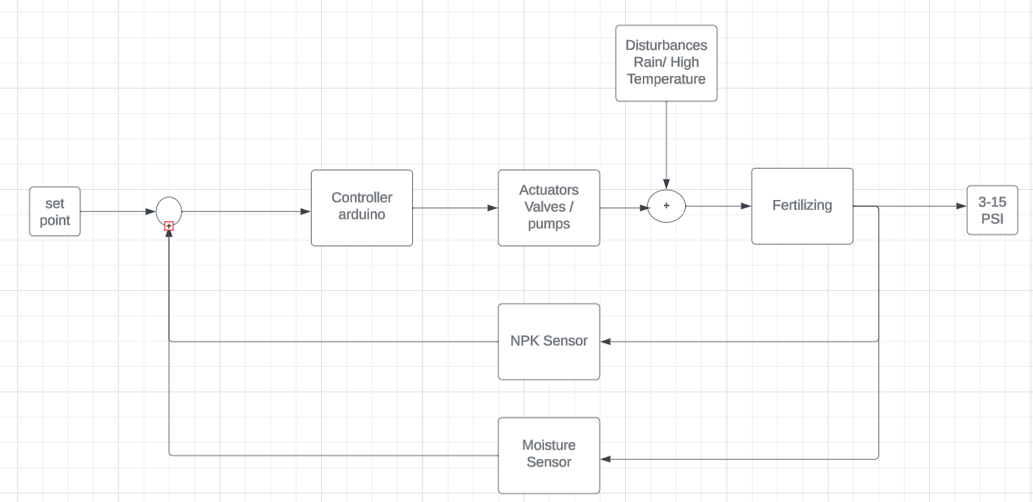
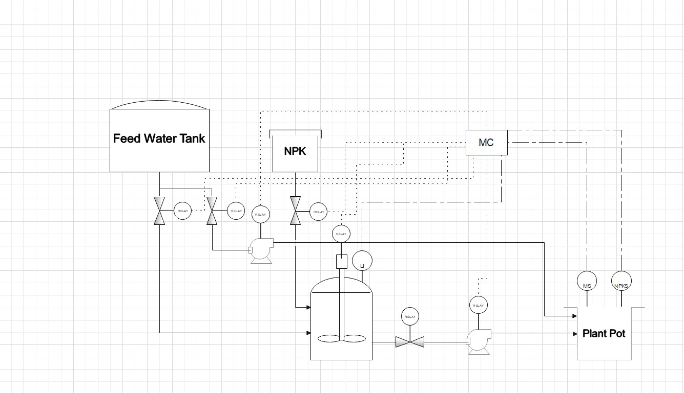
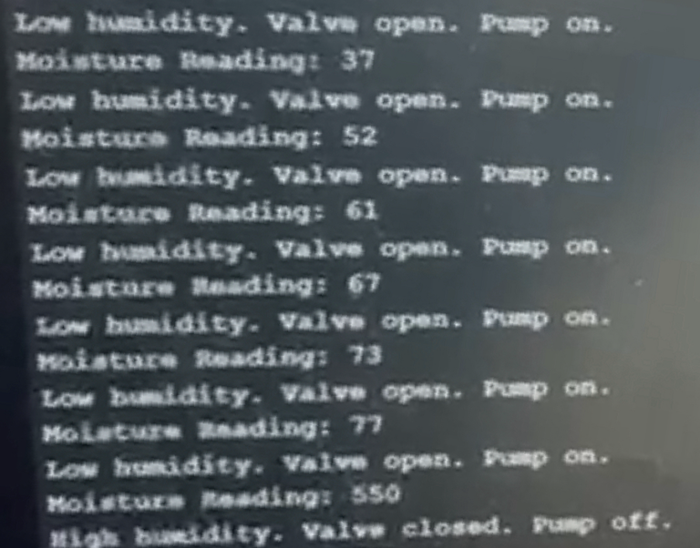
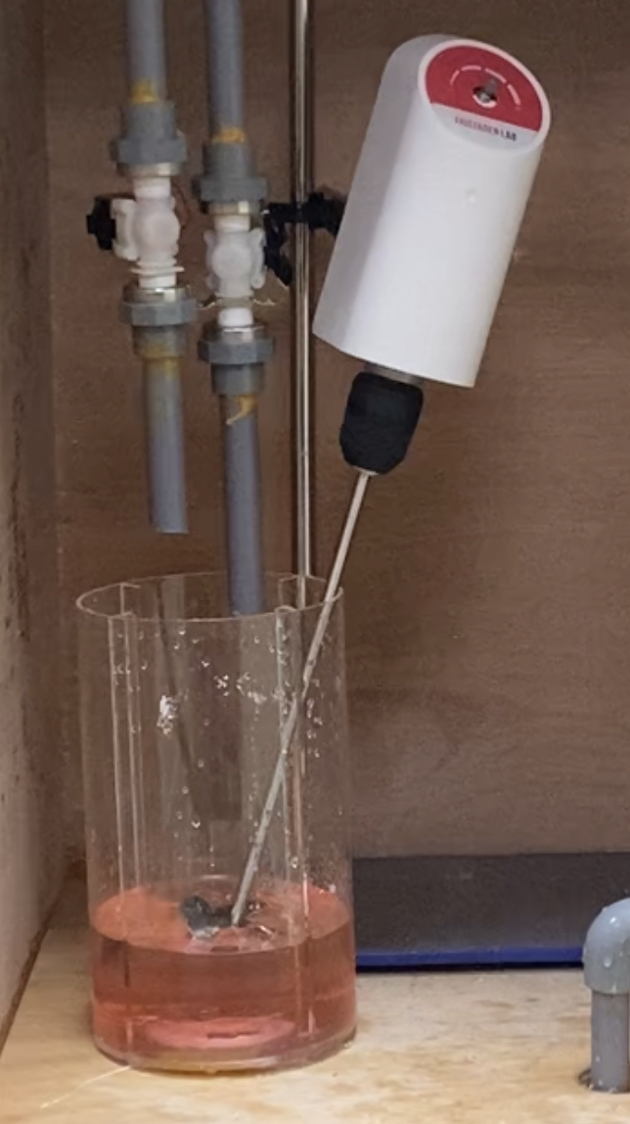
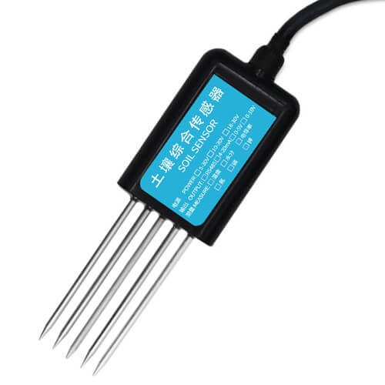
Automated Fertilization System for Irrigation
CHE: Mohammed Alhassan | Aaser Abudegen
CIE: Ali Alqallaf | Sadiq Al Qassim
EE: Abdullateef Weldaba
Advisor: Dr. Muhammad Emzir
Background
Engineering Design
Problem Statement: The objective of this project is to develop a comprehensive automated system that integrates real-time sensor measurements, microcontroller-based control, and automated processes to regulate nitrogen and moisture levels in the soil.
Constraints
1. Sensor Readings: NPK/Moisture sensors should give accurate readings (<90%)
2. Relays’ Switch: Signal 5V DC, NC and com 220V AC
3. Toxicity: Ammonia is a toxic gas, so
it was replaced, in the prototype, with an NPK Fertilizer.
The system has three levels of voltages, which are 5VDC, 12VDC,.
Arduino is using relays to control the power of pumps, mixer and valves.
Specification:
The System Works with 450 W
Nutrients in the soil: maintain Nitrogen (0.024kg/m2), Phosphorus (0.009161kg/m2), and Potassium (0.038547kg/m2).
Water in the Soil Maintain moisture levels in the soil between 21-40%
Handling ammonia as a fertilizer might impact health because of its toxic nature. Consequently, a simulation was performed using Aspen Hysys to generate ammonium phosphate and determine the appropriate reactor size.
Testing
Our automatic drip irrigation fertilizer system successfully achieves several specifications, which are made possible through the thoughtful design and integration of various tools:
Humidity Control Well-Mixed Solution
Inefficient NPK Sensors
Elevator Pitch: Agricultural companies and farmers face a problem with inefficient nitrogen and moisture management. Our product is an advanced system that automates soil nutrient and moisture control. Unlike traditional methods utilized by MEAC and SADRIC, our product utilizes real time sensors and microcontroller-based control to optimize crop growth and minimize resource wastage.
Conclusion
This Project aims to create a system that maintain 21-40 % of water in a soil which equals 4.2-5.5 inch/ft and maintain Nitrogen (0.024kg/m2), Phosphorus (0.009161kg/m2), and Potassium (0.038547kg/m2) in the soil due to the toxicity of the Ammonia. The required reactor is designed using Aspen Hysys to produce ammonium phosphate to be introduced to the soil.

