Slide 1


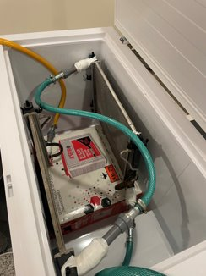
SunChill – A Revolutionary Energy Saving Cooling System
_{Ibrahim Majrabi (EE)}
_{Mohammed Aldawsari (ME)}
_{Abdulrahman Tumayhi (EE)}
_{Abdullah Aloraini (ISE)}
_{Mohanned Bawaked (ISE)}
_{Moshari Alshiban (ME)}
Elevator Pitch
Testing / Validation
Would you like to reduce your electricity bill by over 90% ? SunChill is an innovative, solar-powered air conditioner delivers efficient, cost-effective cooling with significantly lower energy use than traditional ACs, revolutionizing your cooling experience.
Specifications Validation
Exceeding expectations, we achieved an impressive -37.1°C
A minimum temperature of 18°C in the AC unit has been established.
The system can be fed by batteries and works for almost 1 day without power loss.
Power consumption of SunChill is about 147W while the regular AC is at least 1000 W.
We met this specification since the main individual components of the system can work properly for a long time.
Our system consists of two parts AC part, and a Solar System part. The total of those parts is less than 6000 SAR.
Introduction/Background
Project Statement: Make use of solar energy to supply electrical power for a new version of cooling systems designed to be environmentally friendly and save more energy.
Objective: To develop and implement a revolutionary cooling system powered by solar energy, aiming to significantly enhance energy efficiency and environmental sustainability, while providing cost-effective and reliable cooling solutions.
Constraints
Safety Regulation
Cost
Building Time
Space Limitation
Product Availability
Project Interior
Specifications:
Cooling to a minimum temperature of freezer –5C.
Minimum cooling temperature reached by AC unit >20 C.
Have an energy storage system that can provide energy for at least two hours as backup in case of power loss.
Power consumption is less than 1000 W.
Work properly for more than 5 years.
Cost to be less than 6000 SAR.
Cost Analysis
Conclusion
After 4 months of the continuous work, we were able to launch the final prototype. All constraints were met, and the product has successfully exceeded the target specifications. Finally, we would like to thank KFUPM for giving us the opportunity to perform this outstanding project. Also, special thanks to Dr. Ammar Alzaydi and Dr. Zayd Leseman for the continuous support and assistance throughout the project period.

