Slide 1

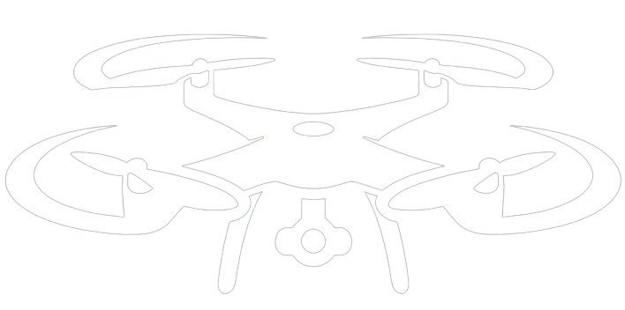

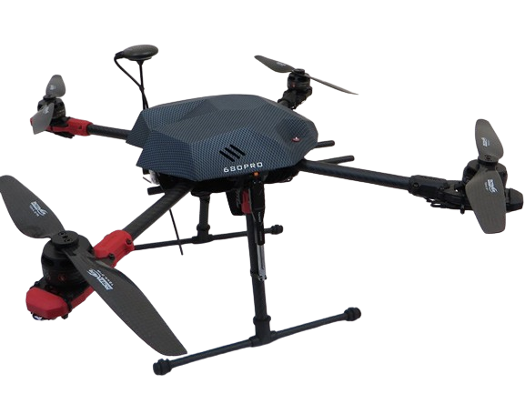
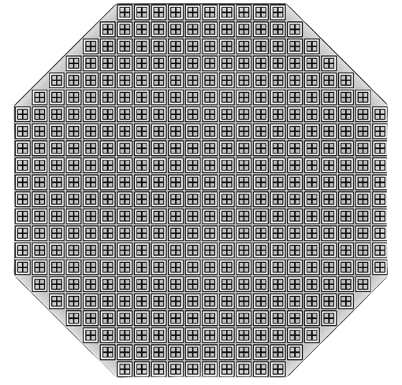
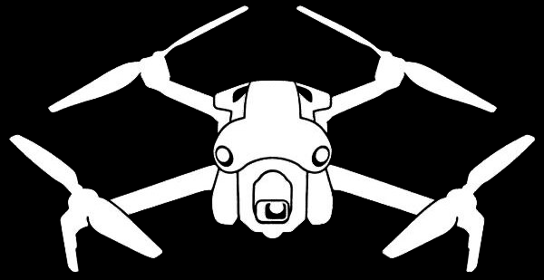

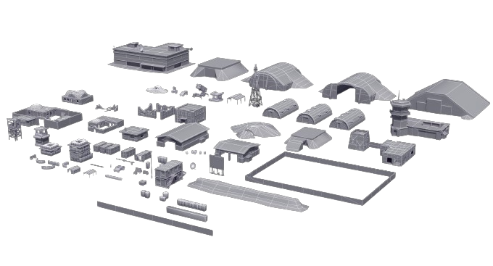
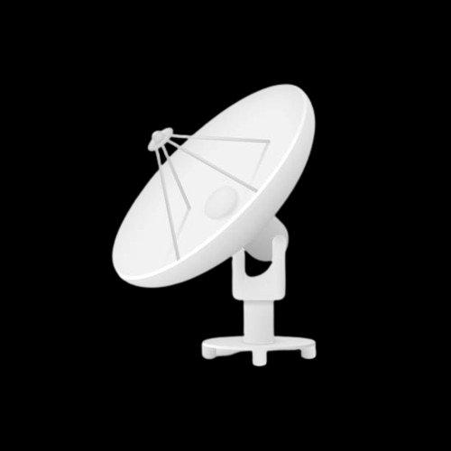
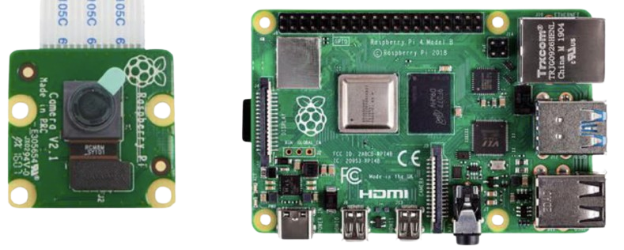
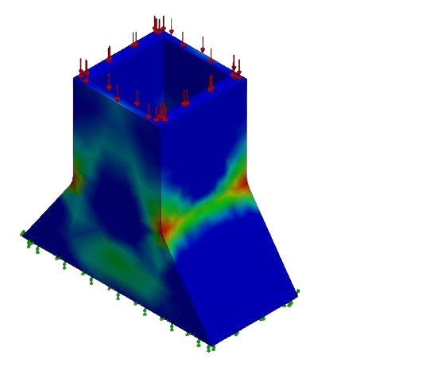

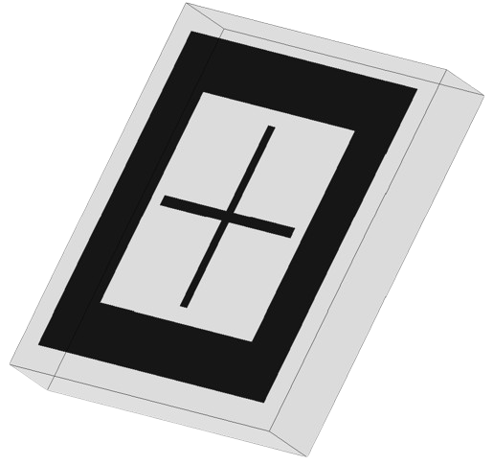
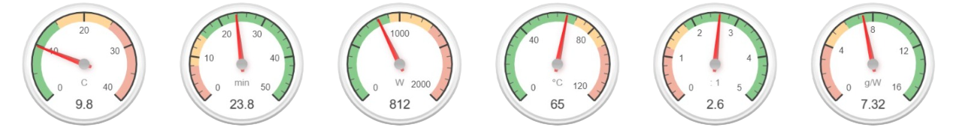

Stealth Reconnaissance AI-Enhanced UAV for Precise Military Location Identification
Introduction
Problem Statement
The Stealth UAV project is an Innovative advancement in military technology, merging stealth capabilities with AI-enhanced detection systems. Designed to avoid sophisticated radar detection, particularly in the Ku-Band frequencies, the drone features microwave absorbers that minimize its radar visibility. It also boasts an AI-powered camera system for precise autonomous identification & tracking of enemy assets.
Current reconnaissance UAVs are detectable by advanced Ku-Band radar, risking mission success and safety. This project will develop a Stealth Reconnaissance Drone with superior radar evasion through specialized materials and design, reducing its visibility against Ku-Band radar. AI technology will also be integrated, enabling the drone to autonomously identify military targets for effective and covert operations in modern warfare.
Constraints
UAV’s Absorber Array
Not exceeding total weight of 8 kg to prevent failure.
At least 20 mins of hover flight time to cover large area.
Using customized landing gear to free up space for the stealth material beneath the drone.
The absorber needs to cover the KU-band (11-17)GHz. to stealth the UAV from the enemy radar.
Using a transparent absorber under the drone to keep the vision of the camera.
UAV
Stealth UAV
AI System & Camera
Military Location
Radar
MTOW 8kg
Covere-d Area $3{km}^{2}$
Covere-d Area 𝟑〖𝒌𝒎〗^𝟐
5e+00
Fabrication and Validations
Absorber Ku-band
Camera Resolution
3280 x 2464
3.502e+00
Frame size 96cm
Specifi-cations
Max Flight Speed
$63$ $km/h$
2.005e+00
Landing gear FOS
Absorber Unit Cell
Thrust weight 2.6
Conclusion
The project has successfully demonstrated a significant advancement in military surveillance technologies. Integrating stealth capabilities with AI-enhanced detection, this UAV meets strict performance and design specifications while maintaining minimal radar visibility in Ku-Band frequencies.
Load
Hover Flight Time
Electric Power
Est. Temp
Thrust-Weight
Specific Thrust
Further Work
Applying the same microwave absorber to a fixed wing & VTOL drones.
Utilizing the energy stored in the absorber to power the drone partly.
Team: 003
Saleh Bazuhair, Ahmed Khadrawy, Ahmed Ali, Abdulmohsen Alanazi, Ahmed Sarawi, Talal Alomari.

