Slide 1

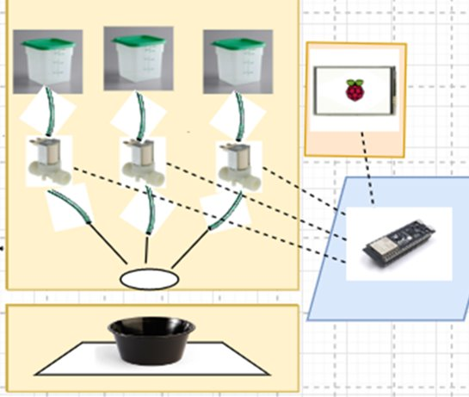
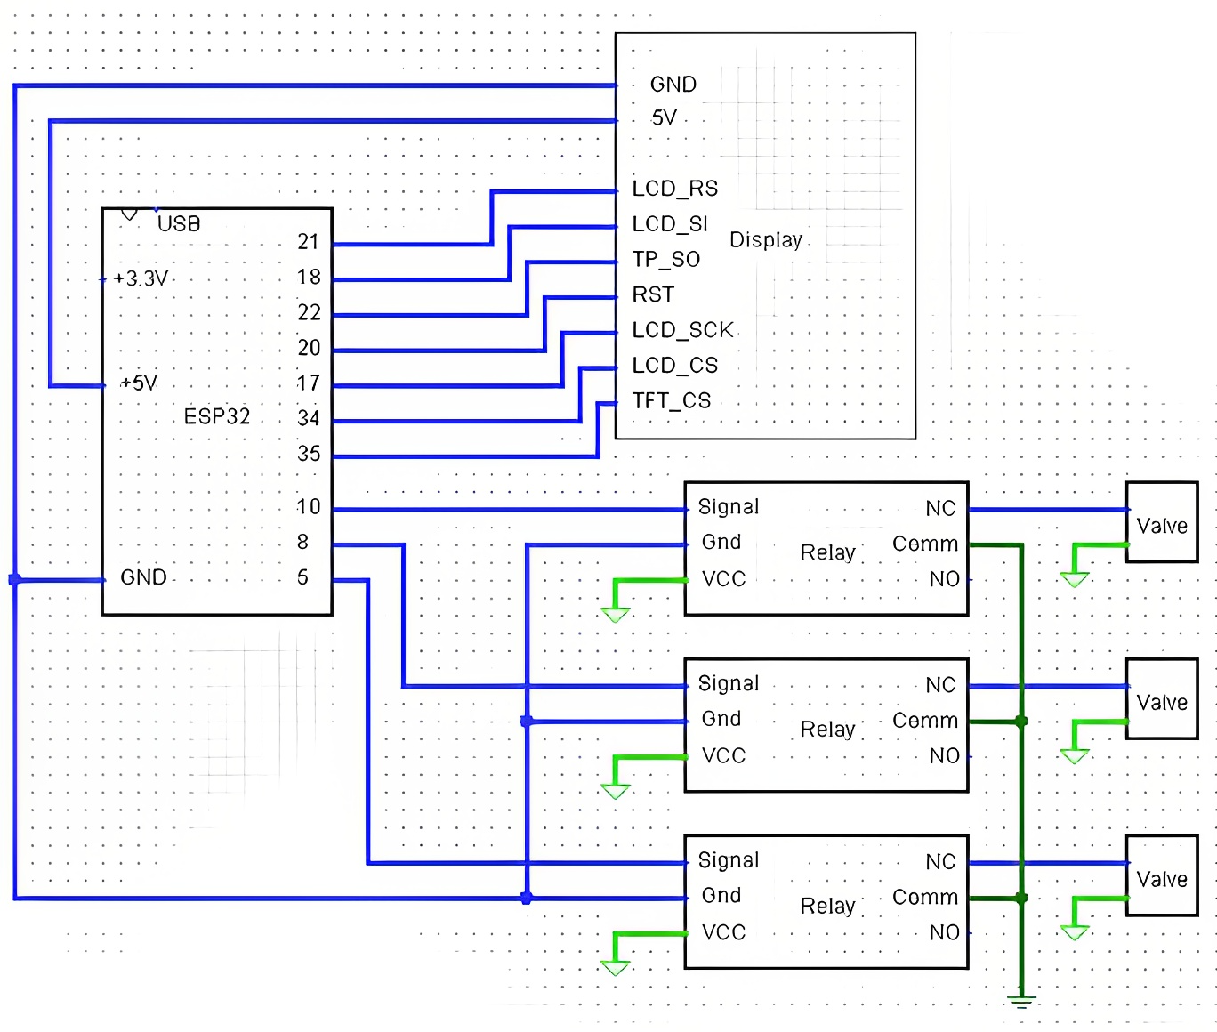
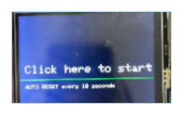
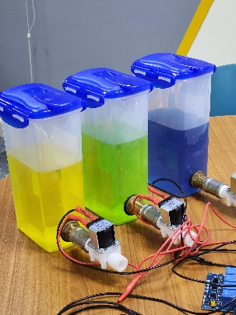
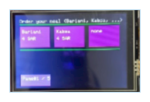
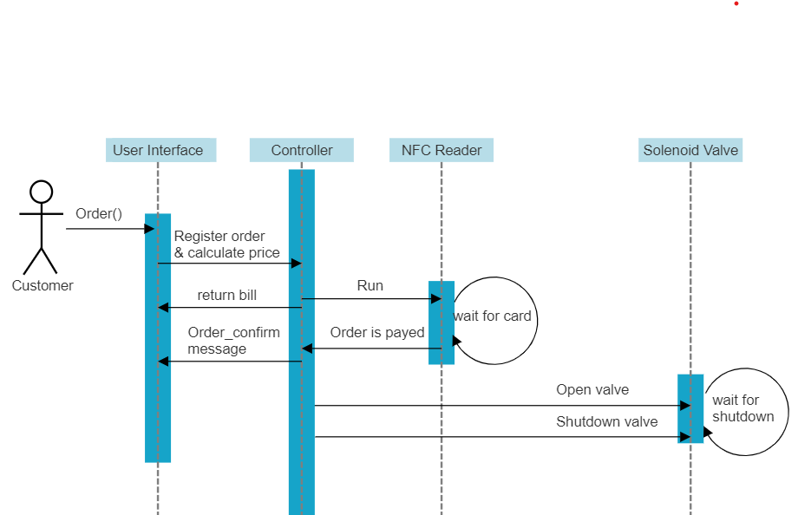
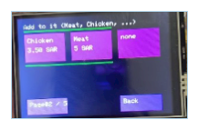
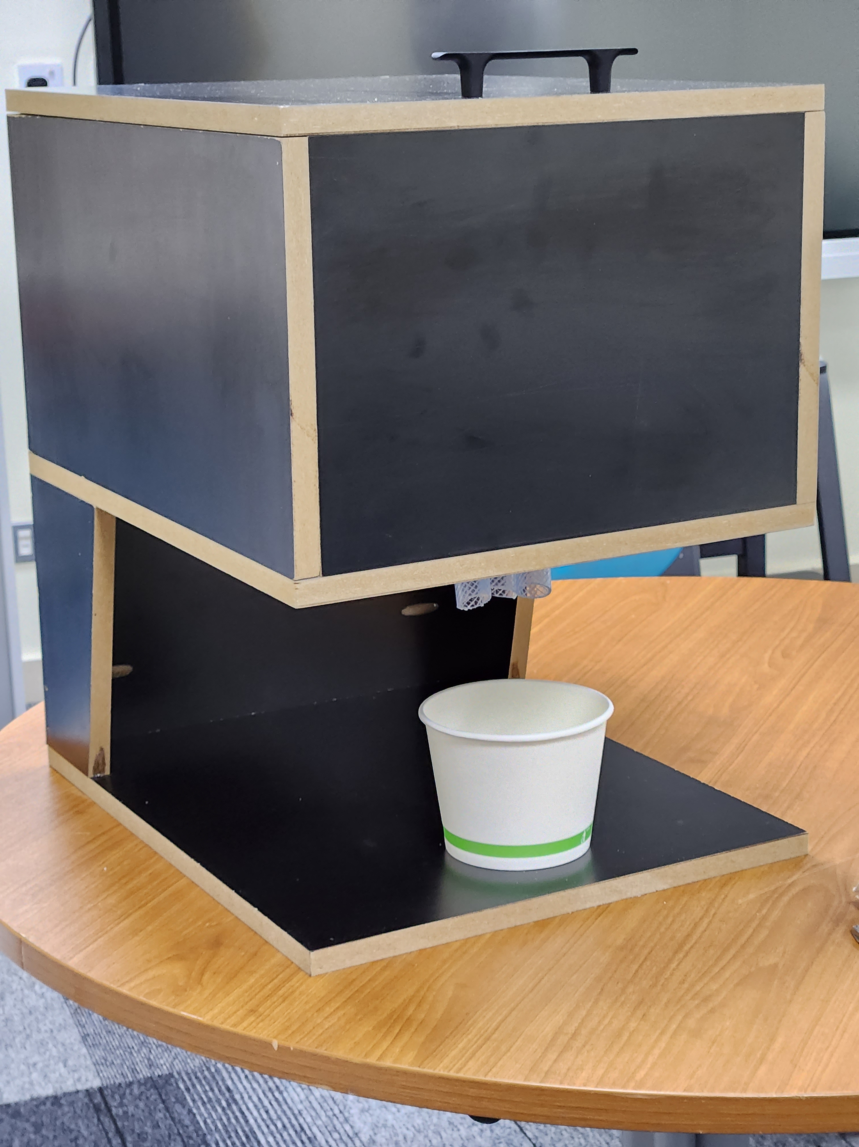
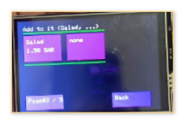
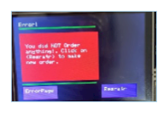
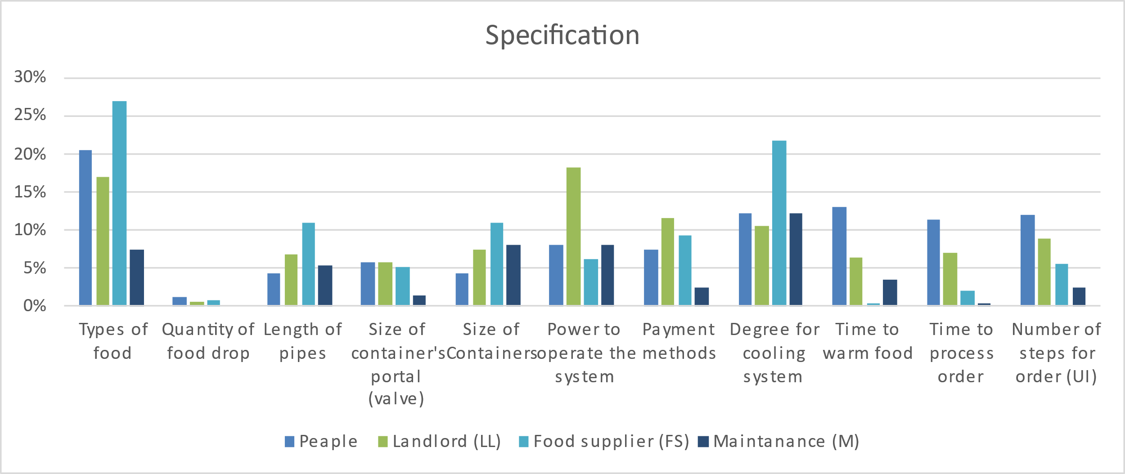

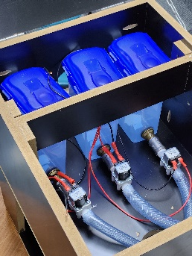
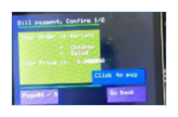
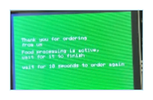
Make your meal vending machine
Team members & departments
Abdullah Alhajri ID: 201687840 [COE] Ahmed Alarfaj ID: 201757350 [EE]
Ishaq Alahmed ID: 201839720 [COE] Qassem Almutawa ID: 201817960 [COE]
Introduction
Customer’s pain
Food is a necessity in life. However, you do not always get to have a healthy meal customized to your liking in such a short time and in places where there are no restaurants. Vending machines often offer unhealthy snacks high in sugar and fat. However, with technology, we can develop healthier options by incorporating nutrient-dense foods to promote better eating habits and improve health.
Project Statement
Building a machine to provide a healthy customized meal, by having different types of food options. i.e., rice, macaroni, meat, chicken, and a salad.
Constraints
  The size of the machine shouldn’t exceed the length of 0.8-meter, width of 1.2-meter, and height of 1.8-meter since this is the common size of vending machines.
  Power consumption shouldn’t go over 60 kWh.
  The cost shouldn’t exceed 6000 Saudi Riyals.
  This project should be done in sixteen weeks.
Target Specification
  To serve 3 Different kinds of food.
  Serving time would be less than 2 minutes.
  The customer can order in 5 steps (pages).
  Provide complete isolation and protection to the food inside.
Prototype design
User Interface
Validation
Sleep page
Menu1 page
Figure 1. Product form
Figure 2. Hardware Connection
Menu2 page
3 Sealed containers (Isolation)
Each container has a different kind of liquid that represent a type of food (3 types).
Menu3 page
Error page
5 screens for completing the order.
Figure 3. Sequence diagram of the project
Figure 4. Our vending machine
Bill & payment page
Successful msg page
Conclusion
In this project we have achieved our specifications. In addition of utilizing the knowledge from our majors by working in a multidisciplinary team
Figure 5. Customers and their requirements
Figure 6. Food containers with solenoid valves inside the box

