Slide 1








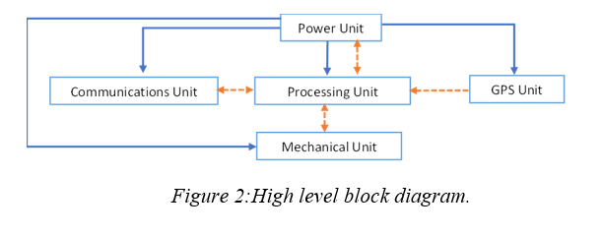
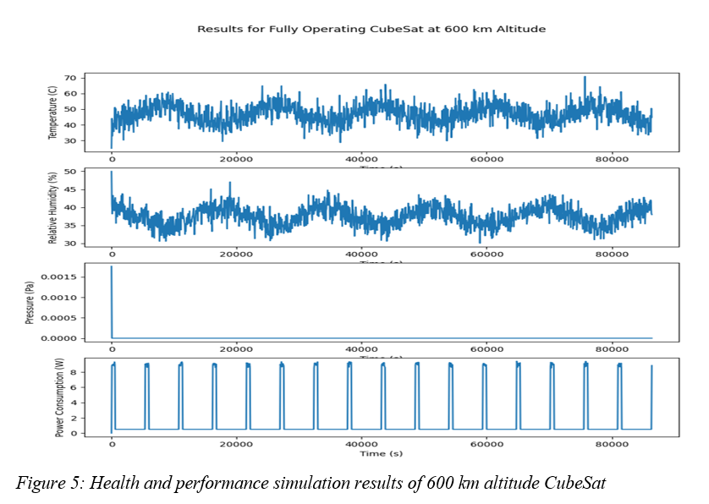

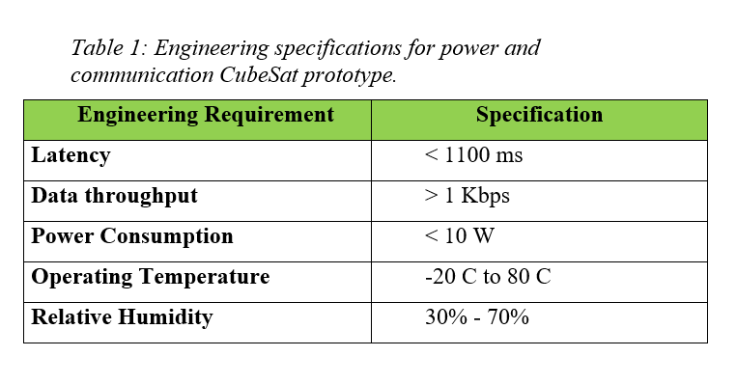
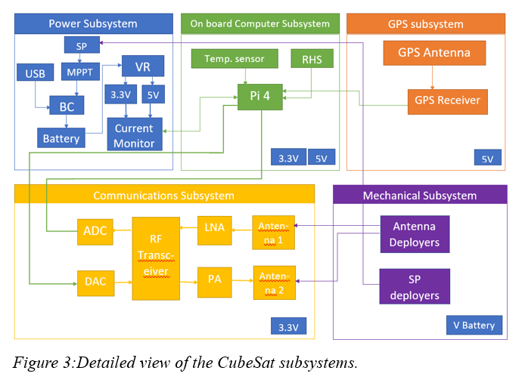
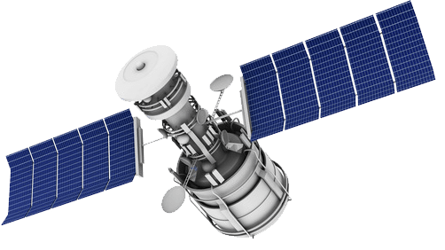
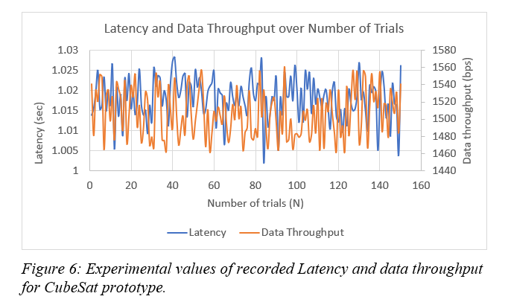
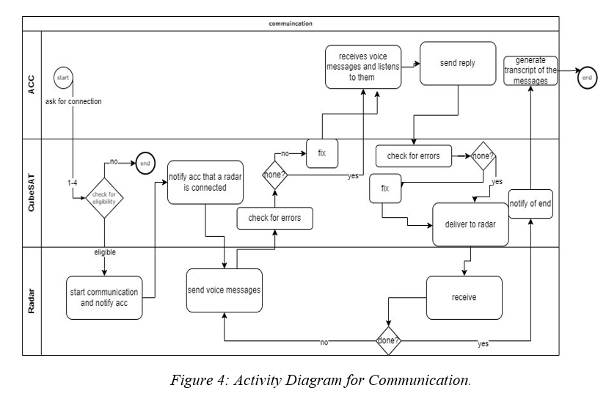
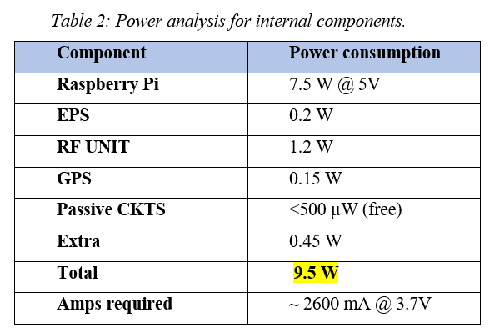
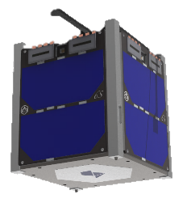

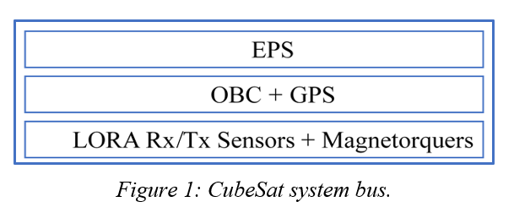
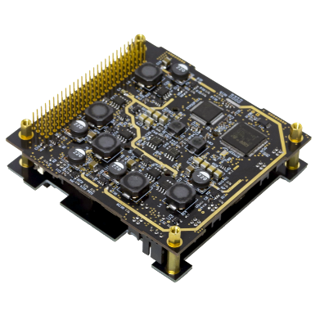
CubeSat
Power and Communication
Cluster 2 – Team 9
Coach: Dr. Alaa El Din Houssin
Mohammed Khalil
201850880
CS
Essam Al Moghairi
201739370
EE
Yousef Al Fadhli
201746310
EE
Abdulrahman Salahuddin
201836800
COE
Abdulaziz Bu Jubarah
201831380
COE
INTRODUCTION
SPECIFICATIONS
VALIDATIONS
BACKGROUND
The specifications for the communications and power subsystems of a CubeSat outline the requirements that must be met for the subsystems to function effectively and efficiently.
The aviation industry's growth has created a demand for reliable communication and power subsystems between aircraft and air traffic control (ACC). Air traffic control was first established in 1935 using telephones and radio operators. The introduction of radar has increased efficiency, but CubeSats offer a cost-effective solution to maintain air traffic control with minimal congestion by serving as a secondary communication line between the ACC and aircraft.
PROBLEM STATEMENT
This project aims to develop a CubeSat prototype as a cost-effective and efficient solution to meet the communication and power requirements of the aviation industry.
OBJECTIVES
OVERALL DESIGN
The objective of the project is to:
Design and implement a CubeSat prototype for communication between ACC and ground radar.
Minimize latency in processing signals and maintain efficient communication using minimal power and frequency.
Develop an environmentally friendly CubeSat with a long operational life and the ability to perform multiple tasks.
Create simple and efficient software to operate the CubeSat prototype.
Ensure that the CubeSat prototype provides reliable communication with reduced costs and improved performance.
DESIGN SUMMARY
CubeSat prototype design has 3 layers:
EPS
OBC + GPS
Sensors/magnetorquers + RF Module
Power subsystem uses solar cells to convert sunlight to electricity and store it in batteries.
Communication subsystem includes converters, transceiver, amplifier, and antennas.
Activity diagram shows communication flow from ACC to CubeSat and back to ACC.
DESIGN DIAGRAMS
CONCLUSION
CONSTRAINTS
ANALYSES AND VALIDATIONS
In conclusion, the CubeSat prototype's power and communication subsystems have been designed and tested to meet the desired specifications. The power consumption has been proven to be within the absolute max conditions and power safety margins. The temperature and humidity have been simulated under specific conditions and optimized to ensure they meet the desired specifications. latency and data throughput were tested indoor and were found to meet the specification.. Overall, the CubeSat prototype's power and communication subsystems have been found to operate efficiently within the desired specifications.
The Communication and Power Subsystem Prototype of a CubeSat is subject to the following constraints:
Time limited to 12 weeks
Budget limited to 6000 SAR
10 cm3 CubeSat size
Weight does not exceed 1.33 kg
Center of Mass must be of ± 2 cm acceptable deviation from center of the CubeSat.
ANALYSIS STATEMENT
Simulation of temperature and humidity at an altitude of 600 km was performed illustrating operation over fluctuation.
Experimental testing was conducted for Data throughput and Latency of communication subsystem.
The theoretical power consumption was verified under absolute maximum conditions and with power safety margins.

