Slide 1

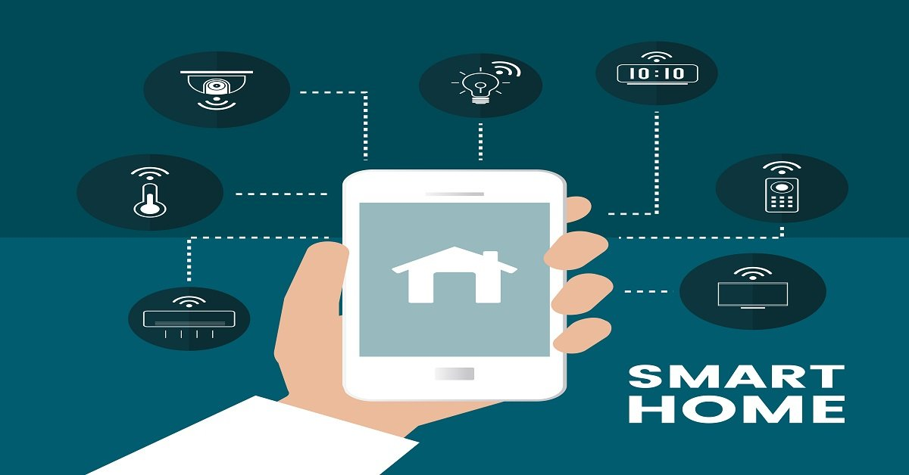
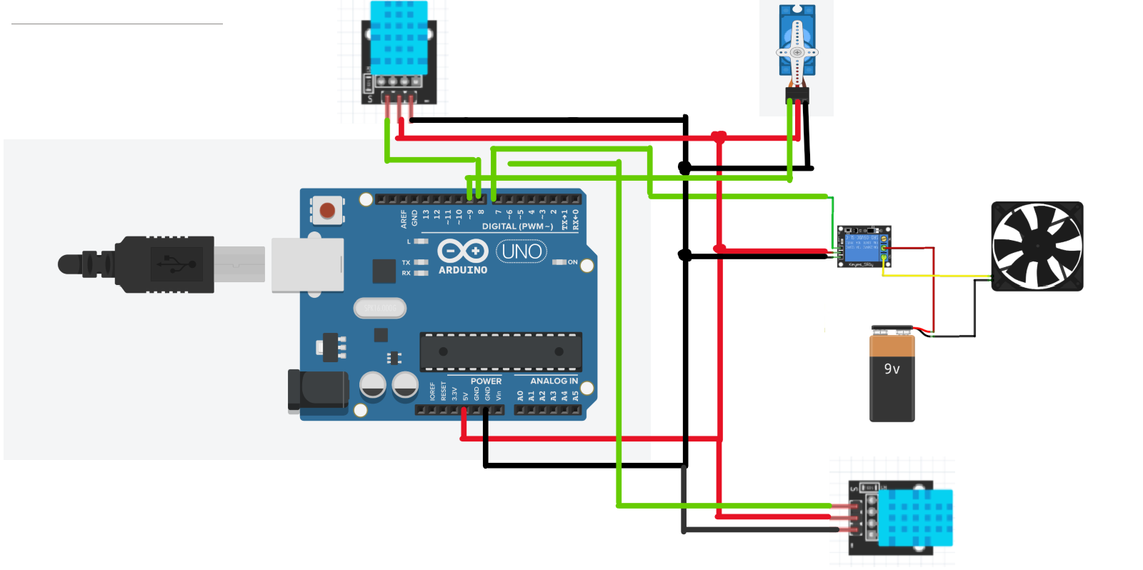
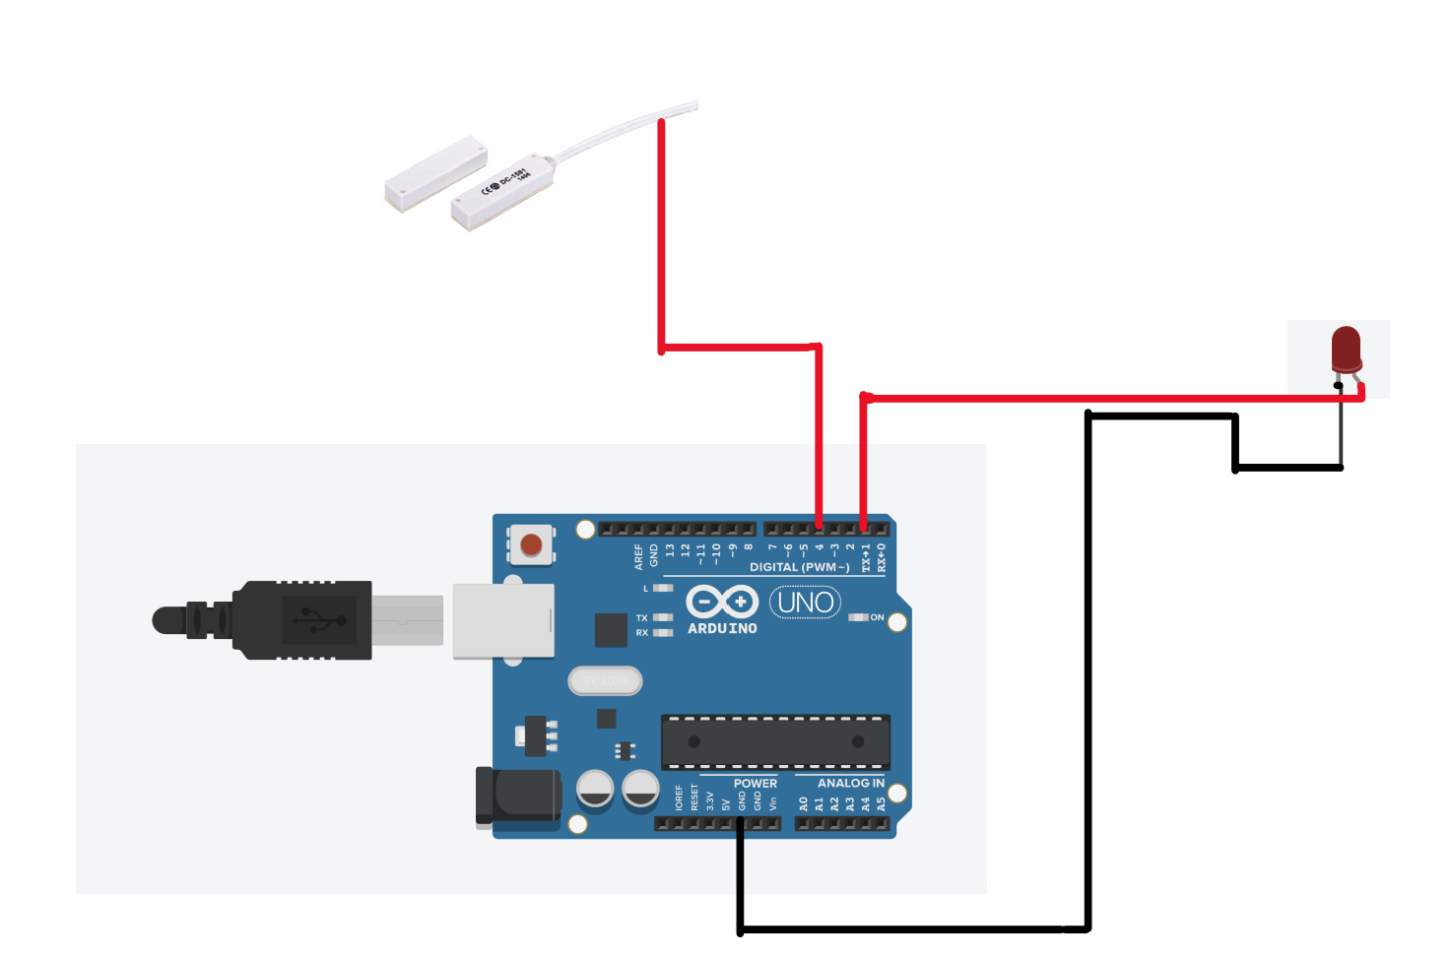

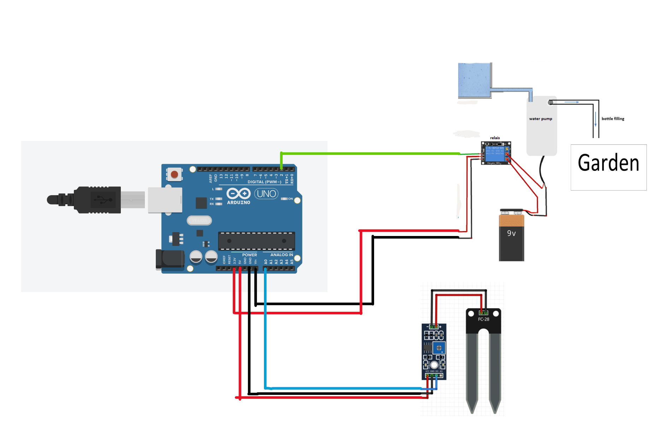
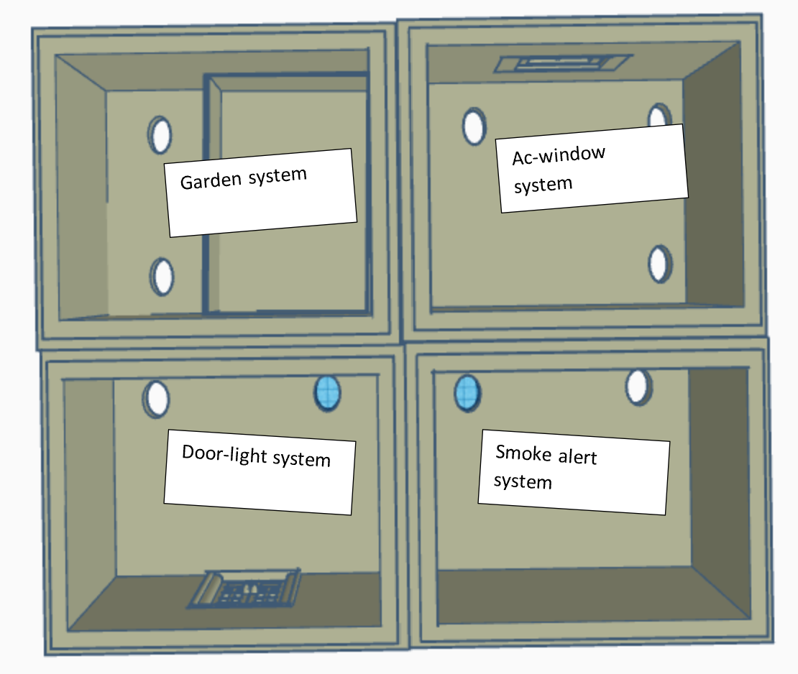
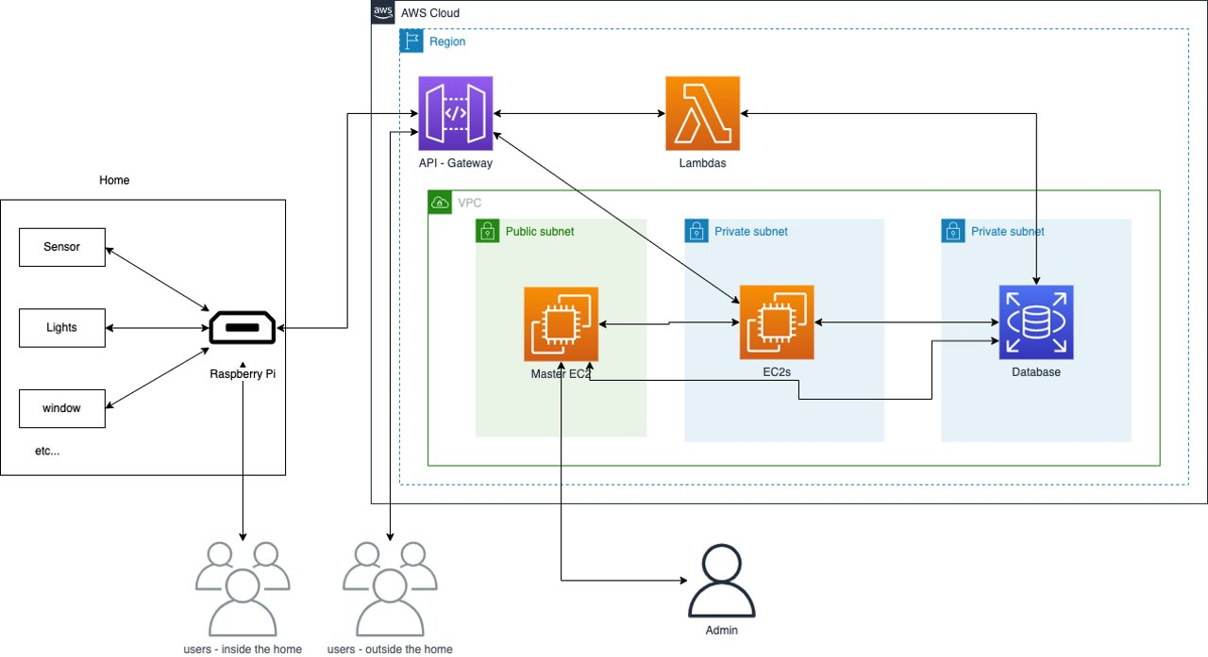
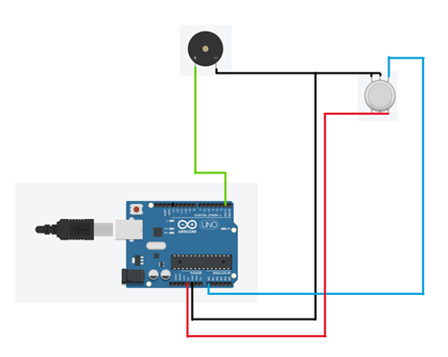
King Fahad University of Petroleum and Minerals SENIOR DESING PROJECT - Cluster 2 HOME ASSTANCE
Prepared by :
Ali Alsaif -EE, Faisal Al-Harbi -EE, Omar Al-Thubyani -EE, Mohammed Al-Shellatie -COE, Faisal Al-Otaibi –ICS Coach : Alaa El Din Houssin
Introduction
Ac-window system:
In this circuit design, the following components are used Two DHT 11 sensor, motor, fan, relay, battery, and Arduino. To illustrate, the DHT sensor checks humidity and temperature and act upon them.
- Light-door system:
In this circuit design, the following components are used magnetic reed switch sensor, led, and Arduino. To illustrate, the system will check the situation of the door using the reed switch sensor and act upon it
- Garden system:
In this circuit design, the following components are used water pump, relay, battery, soil moisture sensor, and Arduino. To illustrate, the sensor will check the moisture of the sand and act upon it.
-Cloud infrastructure:
For users outside, the home their
Connection will be with the cloud to
initiate the commands to the edge
device (the raspberry pi). The cloud
will be responsible for log, auto-
initiation, direct connection and
marinating the information into a
postgres database. For user inside the
home, their connection will be directly to the raspberry pi. And the raspberry pi will communicate to the cloud for the log and the state for each system. by differentiating the users outside and inside, the inside users will have nearly instantaneous access to each system, and is case of networking going down, there are still can manage, access and control each system.
-App:
a. Platform compatibility: The app should be compatible with both iOS and Android platforms, thanks to the use of Flutter.
b. Connectivity: The app must connect to the home automation system using the system's DNS, supporting Wi-Fi and/or Ethernet connections.
c. User authentication: Implement secure user authentication, such as OAuth 2.0 or Firebase Authentication, to ensure only authorized users can access the system.
d. User interface: The app should have an intuitive, user-friendly interface, including clear icons, labels, and a well-organized layout. Provide support for multiple languages and accessibility features.
e. Notifications: Implement real-time notifications to inform users about the status of their home automation system, such as task completion or security alerts.
f. Customizable scenes: Allow users to create and customize scenes, a combination of actions performed by the home automation system.
g. Device management: Enable users to add, remove, and manage devices within the app.
.
– Problem Statement:
To design a smart home system that is capable of react and execute daily routines activities via an app at economical cost.
– Constraints :
The Budget: The budget is small relative to other solutions.
Time Constraints: less than three months to complete the backend, the frontend and the electrical aspect of the design.
Performance constraints: the impact of user bandwidth or Internet connectivity and product servers.
Dependencies: one task relies on the status of another task.
– Target Specifications:
The system can be controlled by more than one device at same time.
The start-up time of the system must not exceed 5 seconds.
response time (request to the cloud) must take less than 5 seconds.
System can be learnt fully under 25 minutes.
Accuracy of data about the house must have an error of less than 5%.
Testing / Validation
Prototype Design
By testing all the following targets have been reached:
The system can be controlled by more than one device at same time.
The start-up time of the system must not exceed 5 seconds.
response time (request to the cloud) must take less than 5 seconds.
Also, all sensors in the house has accuracy better than 5%. Therefor the following targe has been reached:
Accuracy of data about the house must have an error of less than 5%.
-House building:
The building is designed To be
built using a3d printer, and there
are four rooms in the building. To illustrate,
each room has different systems to be
implemented in it. Moreover, the four
systems are the Garden system, Light-Door
system, Window-Ac system, and Smoke
alarm system.
-Electrical systems:
- Smoke alarm system:
In this circuit design, the following components
are used MQ2 Gas sensor, Buzzer (Piezo
Speaker), and Arduino. To illustrate, the
smoke sensor will check if there is any fire
(smoke), and act upon it.
Conclusion
In conclusion, the smart home system can do different daily activities using the app. Also, the system will have the ability to be controlled by more than one device at the same time. Moreover, the app will provide different data with high accuracy about the house such as temperature, humidity, moisture of sand, and the status of the door (open or close). Furthermore, the system will have the ability to react to different cases automatically.

