Slide 1


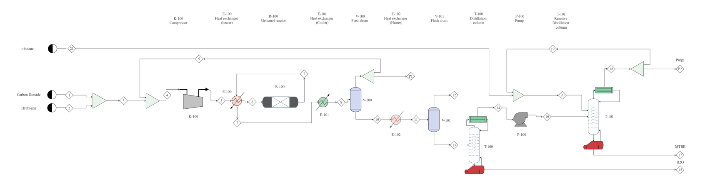
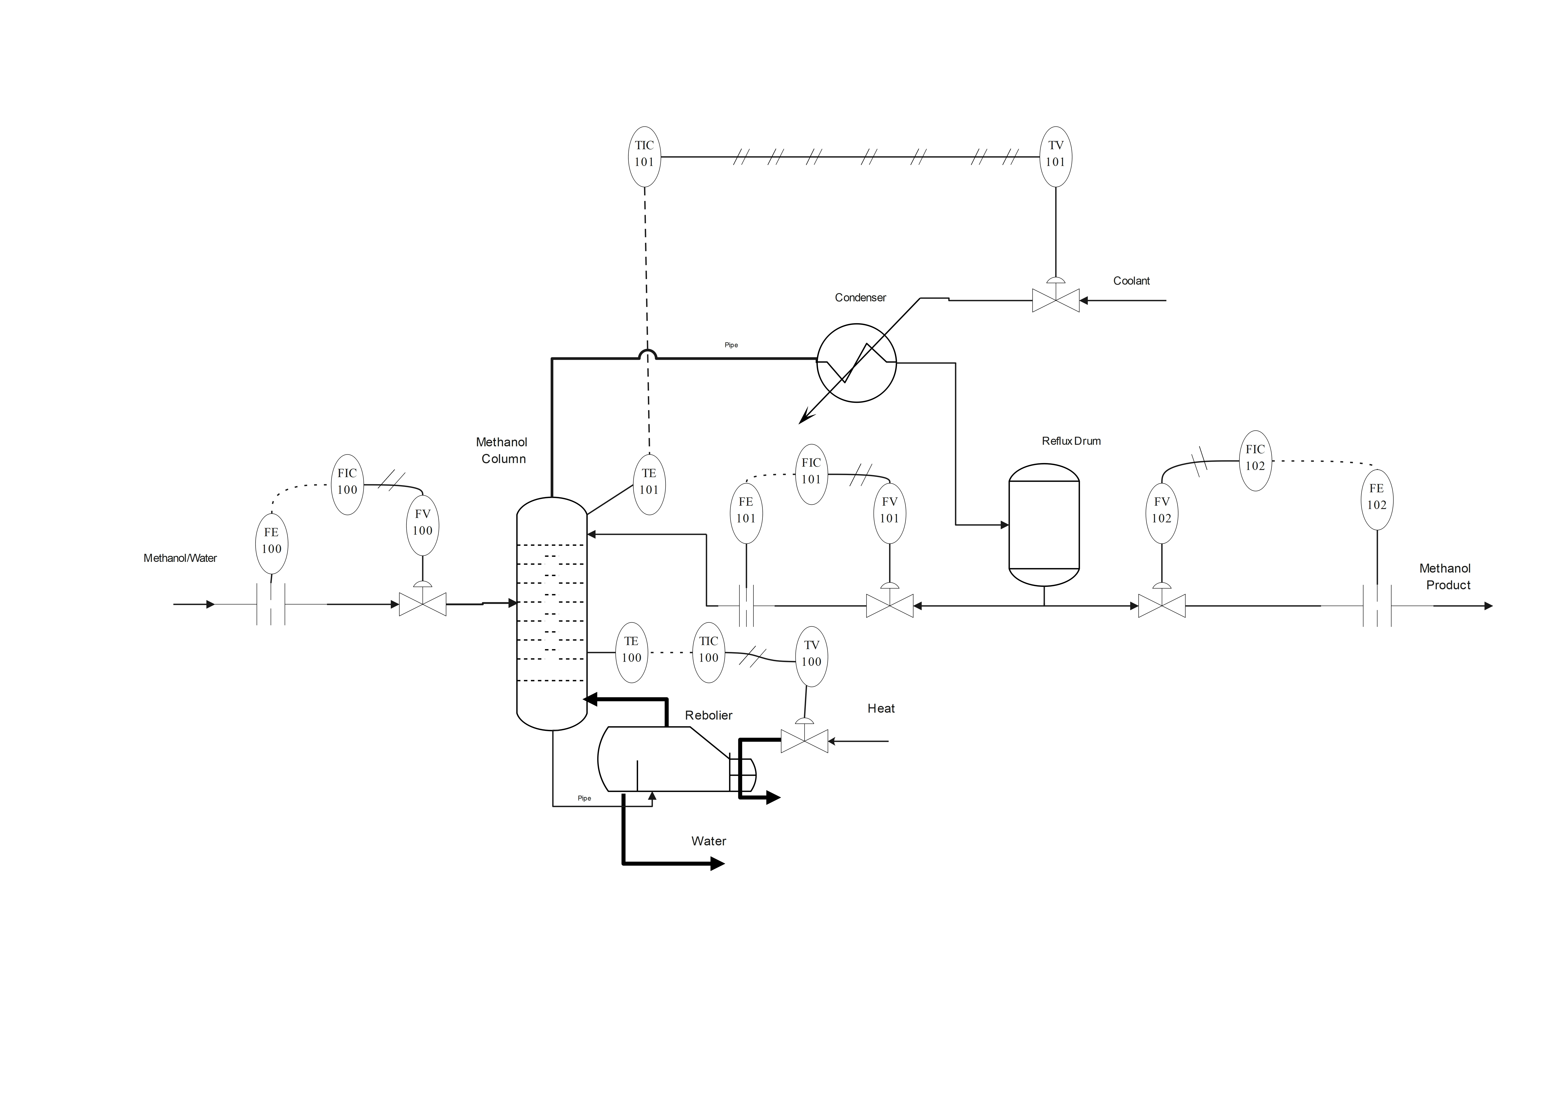
Process Design And Control Of MTBE Production From CO2 Driven Methanol
TAHER AL HAJJIAHMED - HUSSAIN AL HUSSAIN - BASSAM BO MOZAH - AMMAR AL BOSAAD
Background
Diagrams
Results
Abstract :
The objective of this project is to design an MTBE process and control system based on CO2-driven methanol production, in order to meet the growing demand for MTBE. In order to do so, we first had to study market needs and implement Quality Function Deployment (QFD) techniques, which lead us to focusing on four key specifications: purity, plant reliability, production rate and yield. After comparing and ranking multiple alternative solutions, we ultimately decided that using the hydrogenation process would be most suitable; this process uses captured carbon dioxide as a raw material in order to produce environment-friendly methanol and subsequently use this methanol with isobutylene in order to produce MTBE. Additionally, when investing in an MTBE production project, it is important to calculate the estimated profit margin to ensure profitability and minimal costs. All this will be achieved through a complete convergence flowsheet for detailed economic analysis of the process as well as P&I diagram design. The outcomes of this project are therefore centered around presenting a fully detailed report combining all factors from automated main equipment of the plant up to economic feasibility analyses.
Process flow Diagram
Equipment Summary
Methanol Reactor (R-100):
  Packed bed reactor
  Stainless steel
  Volume = 6.64 m^3
  Diameter = 1.55 m
  Length = 10.82 m
Methanol column (T-100):
  Stainless steel
  Bubble cap trays
  Actual number of trays = 22
  Diameter = 3.13 m
  Height = 13.2 m
MTBE reactive Distillation (T-101):
  Stainless steel
  Bubble cap trays
  Actual number of trays = 17
  Packing material = Ion-Exchange Resins
Heat Exchanger (E-101):
  Stainless steel
  Area = 100.26 m^2
  Duty = 501 kW
Economic Analysis
Taxation Rate | 42 %
Annual interest rate | 10%
Working capital | 4,360,000 $
Fixed capital investment | 15,200,000 $
Raw material cost | 28,064,901 $
Utility cost | 4,760,000 $
Operating labor | 332,800 $
Cost of manufacturing | 44,029,156 $
Net present value | 35,620,000 $
P&ID for Methanol Reactor (R-100)
Problem statement :
An efficient process design to produce 120 (Kt/yr) of 98 (mol.%) MTBE from green methanol and mixed Butenes, with negative carbon emissions.
Specifications
Yield​ | MTBE Purity​ | Production Rate​ | Plant Reliability​
99%​ | 98%​ | 120 kT/Yr​ | >90%​
Conclusions
The process of MTBE production from CO2 driven methanol was design taken in consideration the project duration to be 15 years, with annual interest rate of 10%.
The desired production rate of 120 Ktons per year of 98% Mole MTBE was achieved.
The design was visualized using 3D software to analyze the equipment accessibility and operability.
Alternative designs were performed to enhance the process overall energy efficiency and to minimized waste material.
Material of construction and instrumentation selection was performed to increase the equipment reliability and insure safe operations all the time.
The MTBE reactor was selected to be Reactive Distillation ‘RD’ column over the conventional approach of PFR and distillation in series to minimize the number of equipment, which lowers the operating and maintenance expenses.
Introduction:
MTBE can be produced from methanol through a simple etherification reaction, making it an attractive option for utilizing methanol produced from CO2 hydrogenation
Methanol Reactions :
CO₂ + H₂ → CO + H₂O (water gas shift)
CO₂ + 3H₂ → CH₃OH + H₂O (CO2 Hydrogenation)
MTBE Reaction :
CH₃OH + (CH₃)₂C=CH2 → (CH3)₃COCH₃
P&ID for methanol column (T-100)

