Slide 1

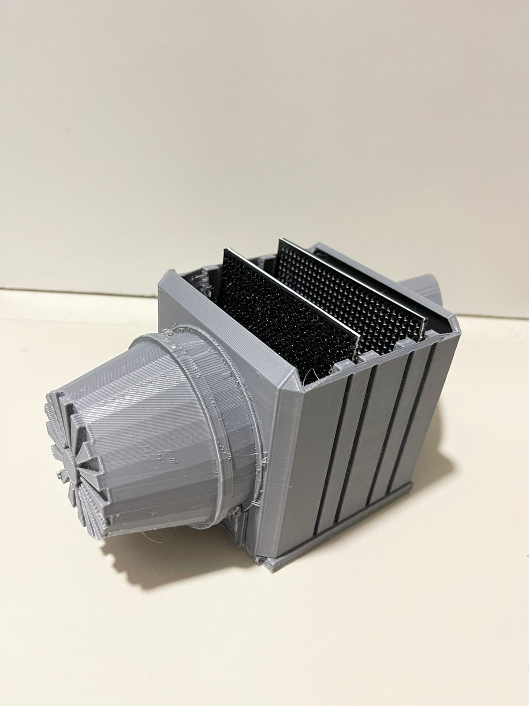
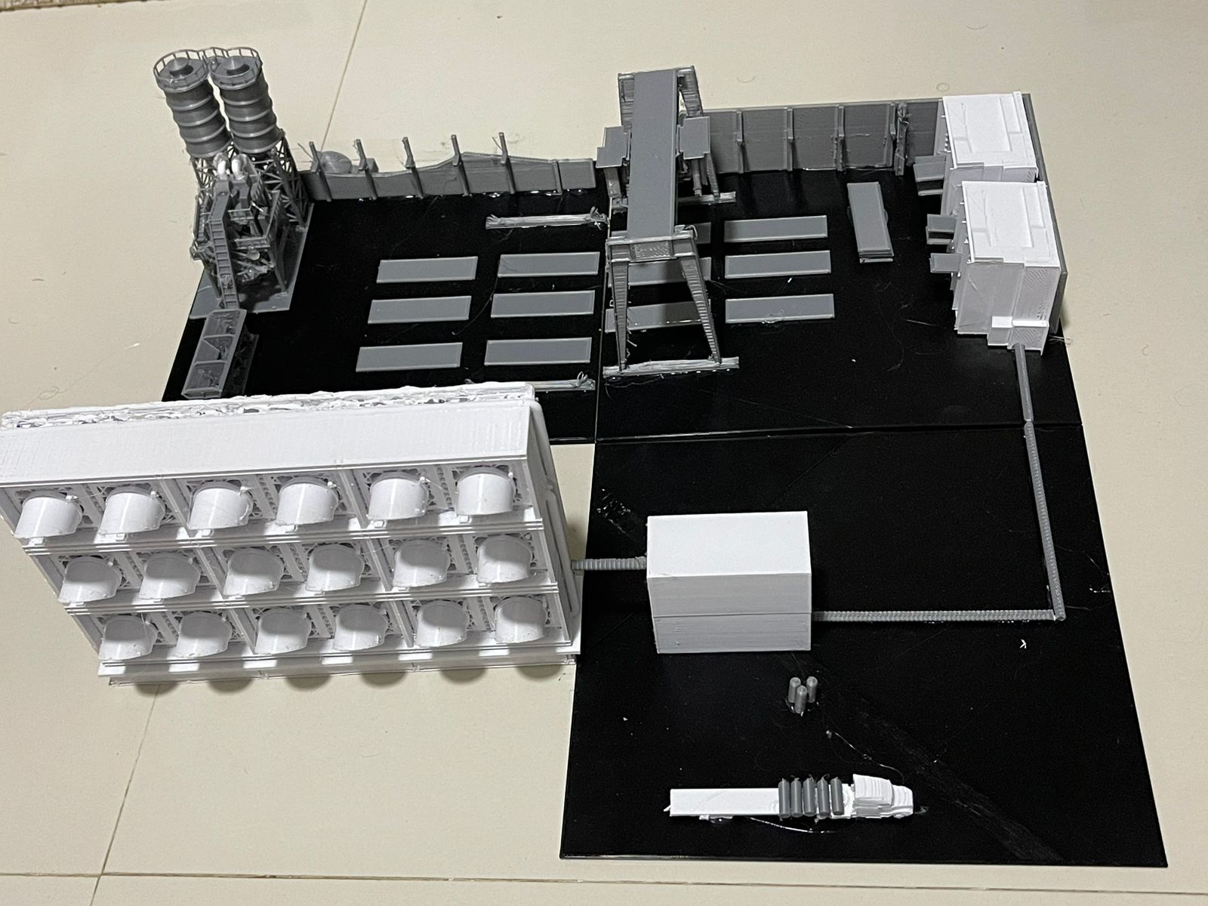
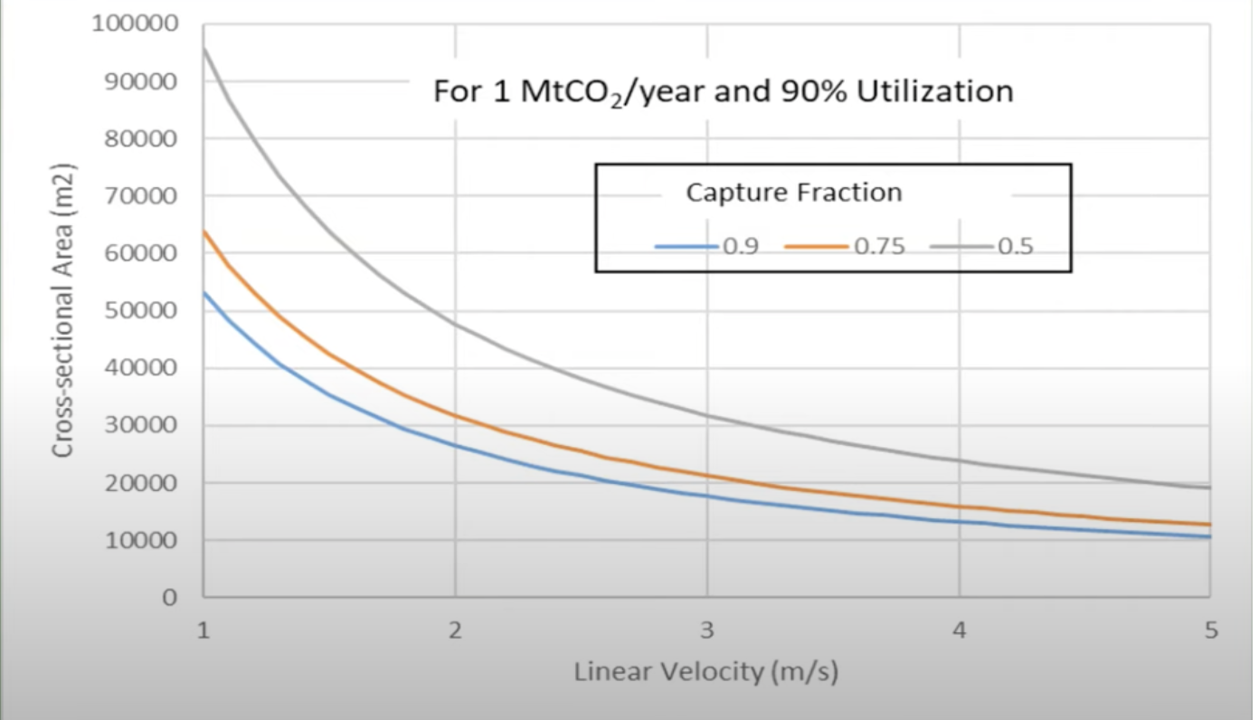
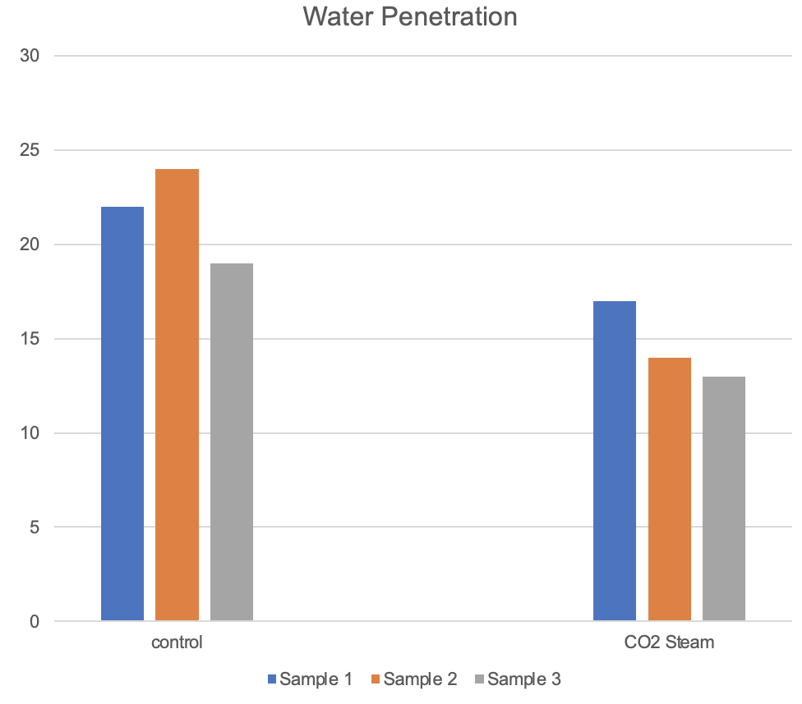
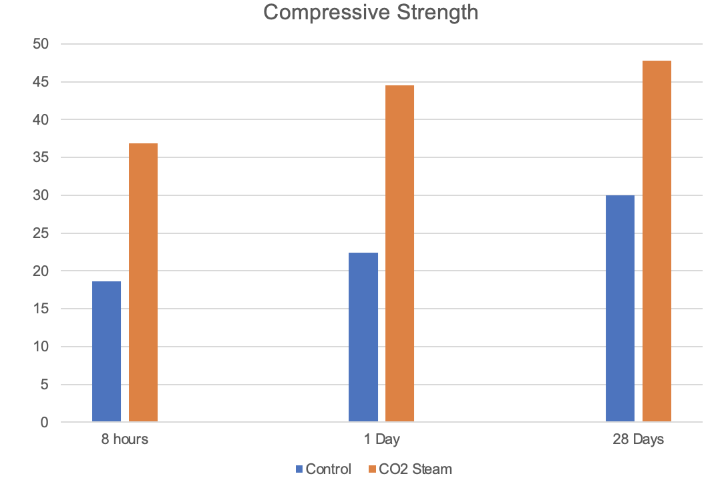
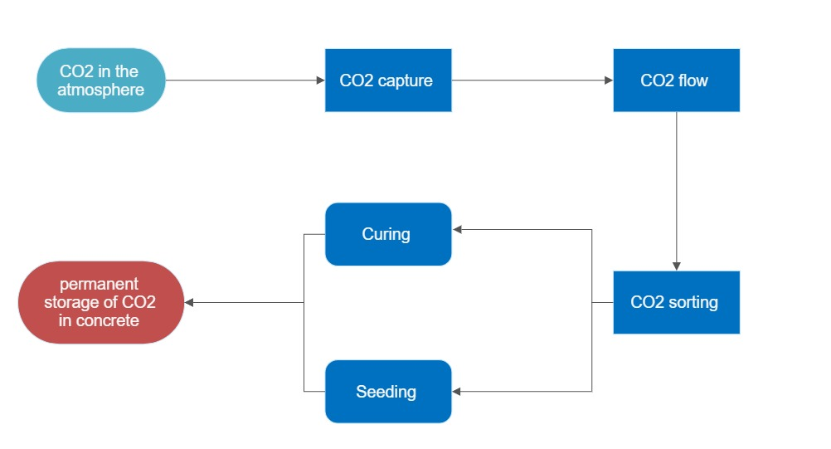
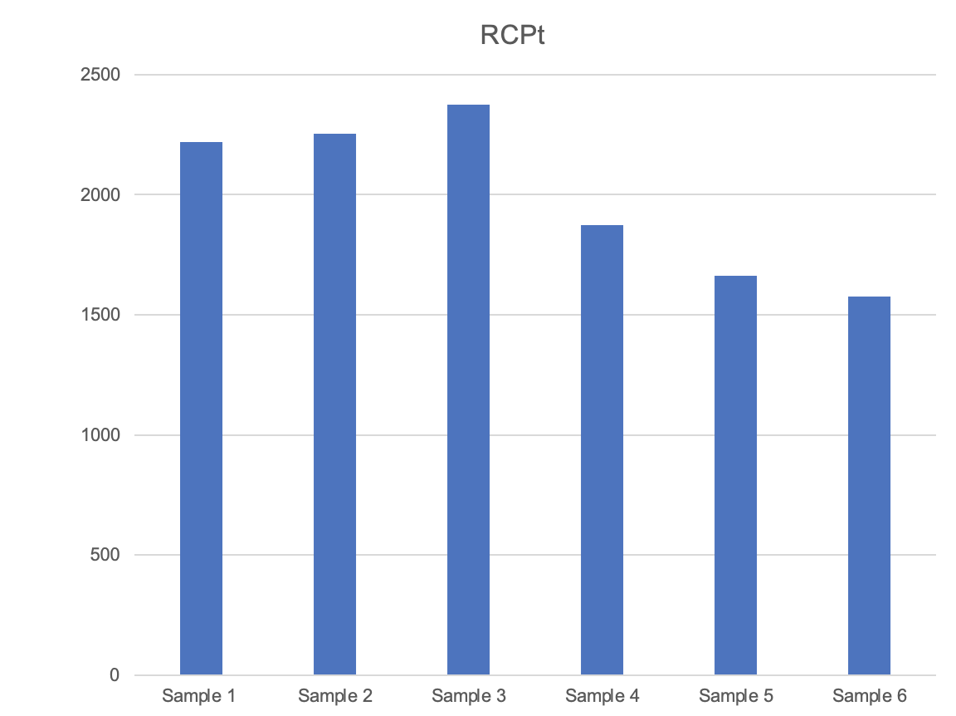
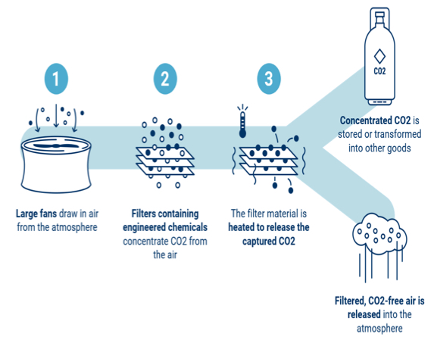
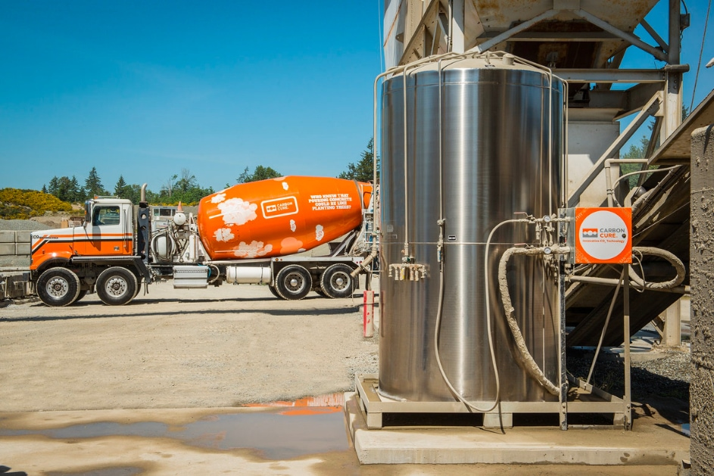
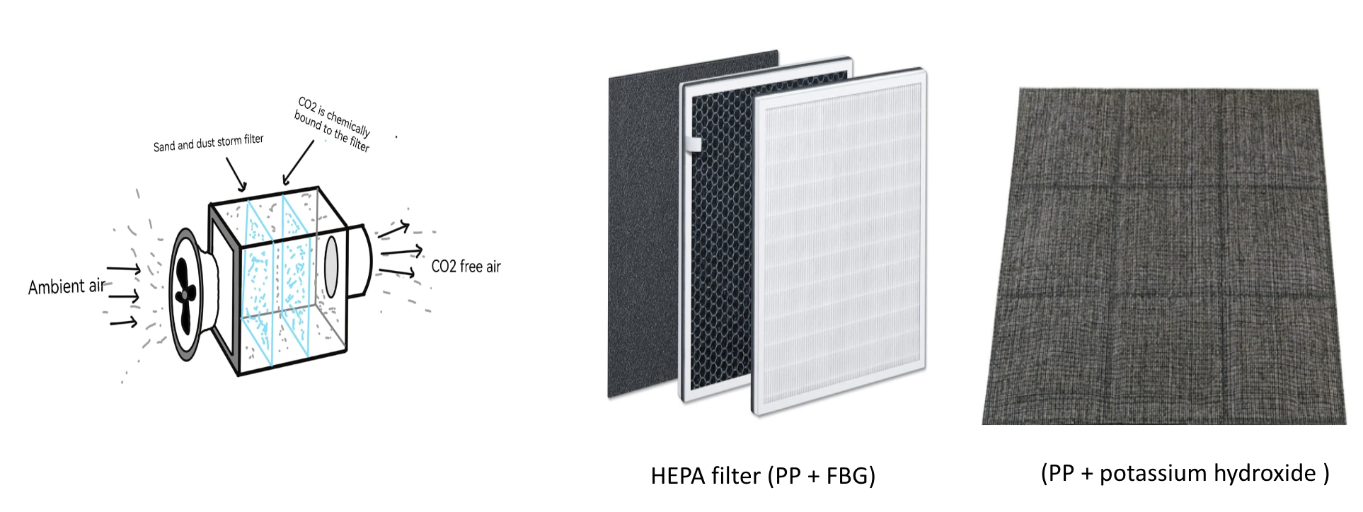
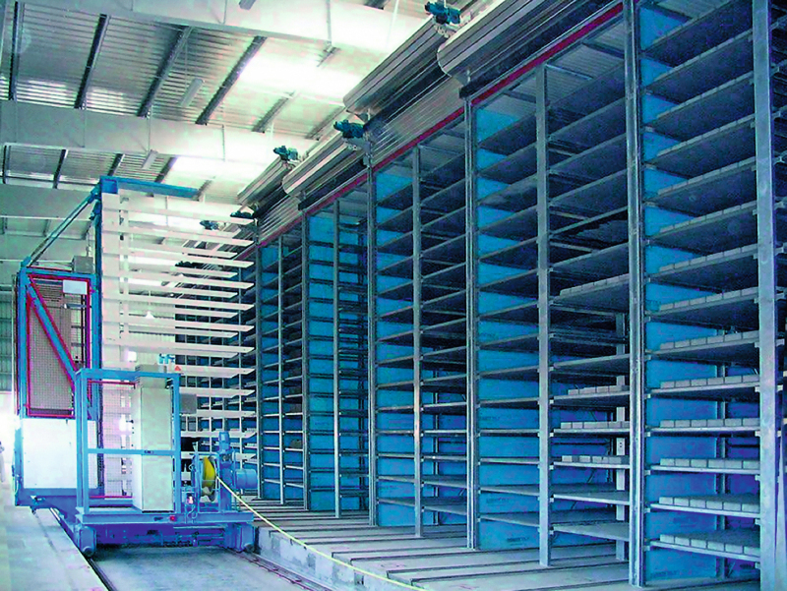
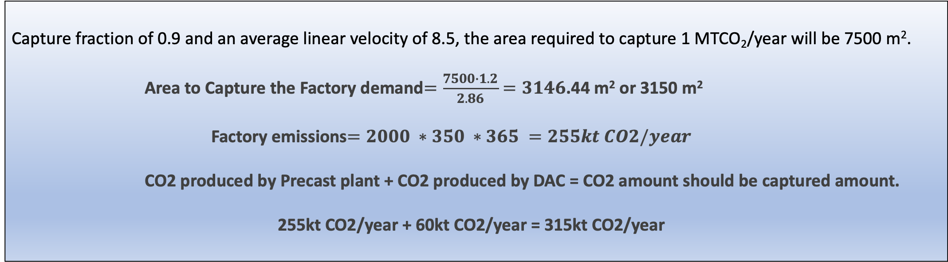
Net Zero Precast Concrete Factory
`
Musatfa Al-Jalal (CE) – Abdullah Almagabi (CE) – Ali Almaani (CE) – Sadun Alesawi (CE)
Introduction
Design Process
Final Prototype
Project Statement: Contributing to the Saudi Arabia 2060 vision of achieving net zero by capturing CO2 and storing it in concrete.
Area selection:-
Deliverables:
A Direct air capture unit printed in 3D
A scaled down view of the entire project
Concrete sample injected and cured with CO2.
Constraints:
The machine will not be operating..
It will not show how the process is simulated
Limited budget
Final Target Specifications:
Compressive strength (28d) : 35 MPa
Curing time : 8 hrs
Water permeability : 15-20 cm
Target Area: 3150 m²
Rapid Chloride penetration : 1500-2000 Col
amount of CO2 Captured: 315 kt CO₂
Testing
Function of Product
Capture fraction of 0.9 and an average linear velocity of 8.5, the area required to capture 1 MTCO₂/year will be 7500 m².
Area to Capture the Factory demand$=\frac{7500∙1.2}{2.86}=3146$.44 m² or 3150 m²
Factory emissions$=2000 ∗350 ∗365 =255kt CO2/year$
CO2 produced by Precast plant + CO2 produced by DAC = CO2 amount should be captured amount.
255kt CO2/year + 60kt CO2/year = 315kt CO2/year
In this Flowchart the team explained the process from capturing CO₂ in the atmosphere to storing it in concrete permanently
DAC functionality & development:-
Concrete injection and Curing
CO₂ is injected using CarbonCure technology that injects CO₂ at a rate of 3.15% per 1 m³ to increase the uptake of CO₂ by 12.6%.
Carbonation Curing is done in a curing chamber and concrete will take up to 24% of CO₂
****Red line indicates range of targeted specification****
Test Results
Compressive strength
Rapid Chloride Penetration
Sample 1 (Control) | 2221 Col
Sample 2 (Control) | 2255 Col
Sample 3 (Control) | 2374 Col
Sample 4 (CO2 Steam) | 1872 Col
Sample 5 (CO2 Steam) | 1663 Col
Sample 6 (CO2 Steam) | 1576 Col
Water Penetration
8 Hours | 1 Day | 28 Days
18.6667 | 22.44 | 30
36.88 | 44.5 | 47.4
Control | CO2 Steam
22 mm | 17 mm
24 mm | 14 mm
19 mm | 13 mm

