Slide 1

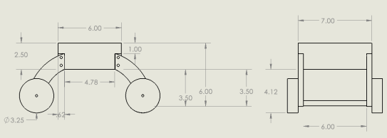
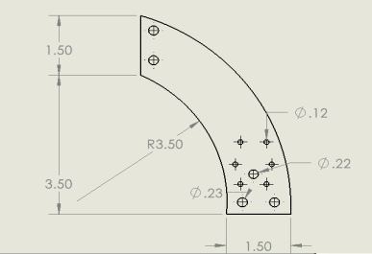
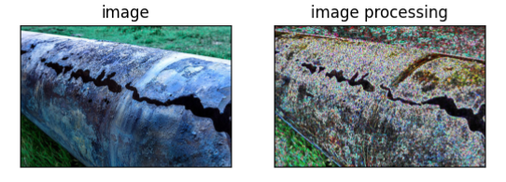
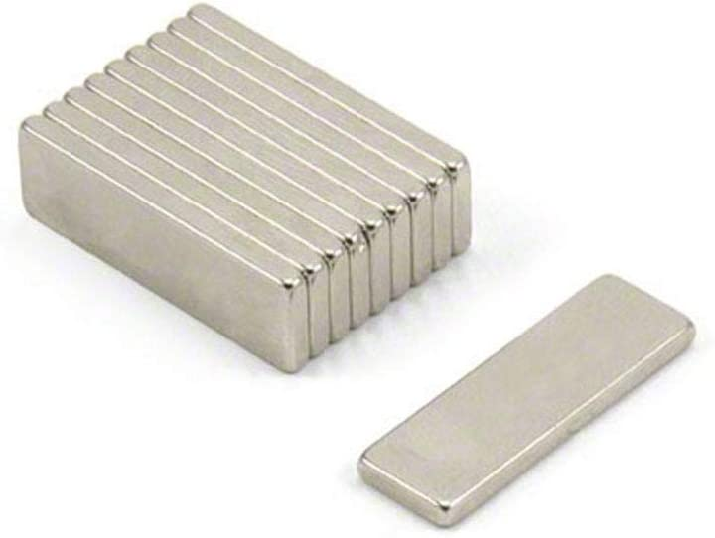
Pipeline Inspection Robot Capstone2.0 CLUSTER#1 Team# 7 Coaches: Dr. Hammad & Mr. Abdurahman
Pipeline Inspection Robot Capstone2.0 CLUSTER#1 Team# 7 Coaches: Dr. Hammad & Mr. Abdurahman
Marwan Alamri -ME Ali Alshabeeb -CIE Bassem Alahmed -CIE Hassan Abo Aziz -CE
Project Statement
Function of Product
Final Prototype Design
The pipeline inspection process is a costly procedure in money and manpower perspectives, especially in remote areas where it is hard to be reached and the environment is not safe!
Pipeline Inspection
Programming
Sensing
Control
Mobility
Covering the whole pipeline
Stability
Data transmission
Power
Speed
Visual camera
4 12V lithium batteries
GPS Sensor
ESP32 is the controller of the robot
The lithium batteries are rechargeable
Ultrasonic sensor
ESP32 Controller
Fan
Design Requirements
Thermal camera
Motor Module
Runs on above-ground pipeline.
Inspecting the whole Pipeline.
Inspecting corrosion, leaks, and visual cracks.
Specifications & Constraints
1) Set up time less than 10 minutes.
2) OVERCOME OBSTACLES Up to 4 inches in height
3) Robot weight less than 10 KG
4) magnetic force up to 150 N
Pipe size: less than 10 inches diameter.
Flange types: The robot can only overcome slip-on flange types.
Sensors for the robot & the magnetic selected
ESP32 CAM
MLX 90640
Ultrasonic Sensor
GPS sensor
Visual camera
Thermal Camera
Distance Sensor
Location Sensor
Image Processing
The prototype of the Robot is fabricated through the utilization of 3D printing technology.
The legs of the robot is 4.5 inches high, allowing it to traverse obstacles
Applicable Standards
Validation & conclusion
OSHA Occupational Safety and Health Admin and EPA
ASTM Testing Materials Code
ANSI/ASME B16.5 Class 150 Forged Flanges
The weight of the robot is less than 5 kilograms.
To ensure its stability, a magnet has been selected that can provide a capability of over 150 newtons.
The robot is equipped with four DC motors that run at 100 RPM and provide high torque,
Assuming the lithium batteries are fully charged, the setup time of the robot will be less than one minute.
In summary, The Robot is controlled by a control panel where the operator could see the visual camera, the image processing, and the thermal camera image to detect any corrosion, leaks, or visual cracks. Having this technology will help companies to detect problems on the pipe in a cheap and safe manner.
The edge detection technique Sobel combined is used for the image processing
The programming was done for the image processing by Python OpenCV.
Ultra High Performance N52 Neodymium - 25mm x 8mm x 2mm Thick - 3kg Pull
Notes:
Replaced prototype concept graph because it is air-to-air design with fans

