Slide 1

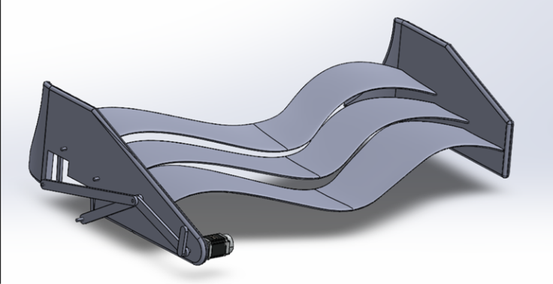
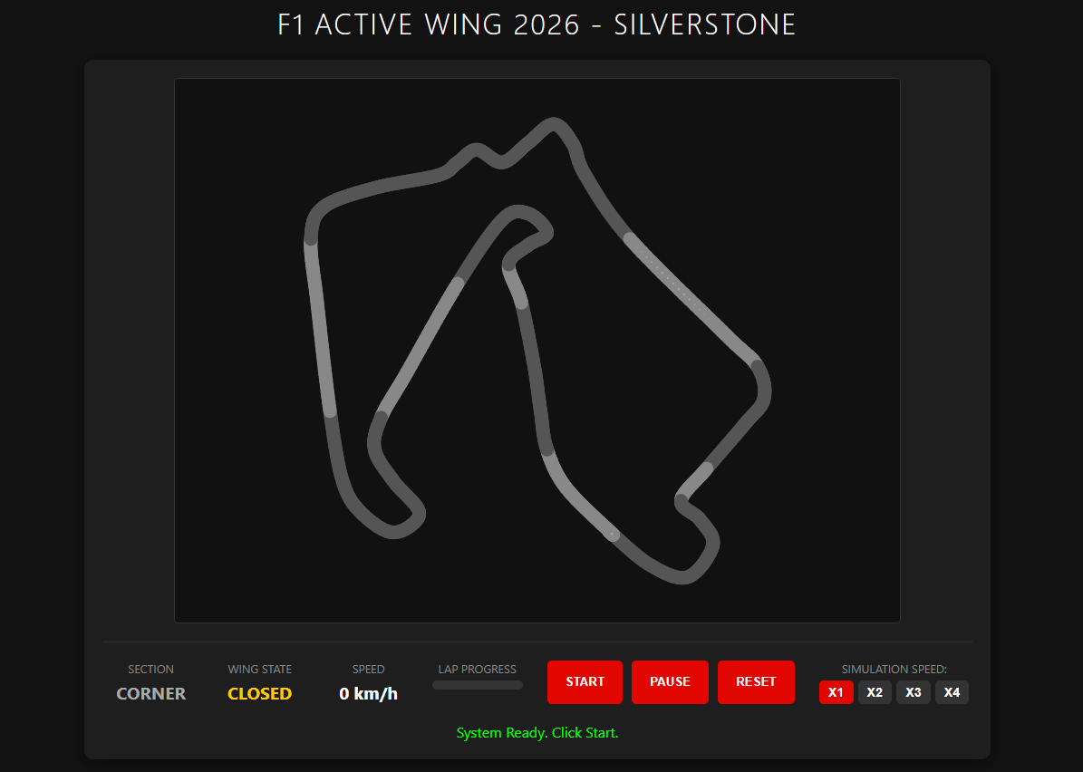
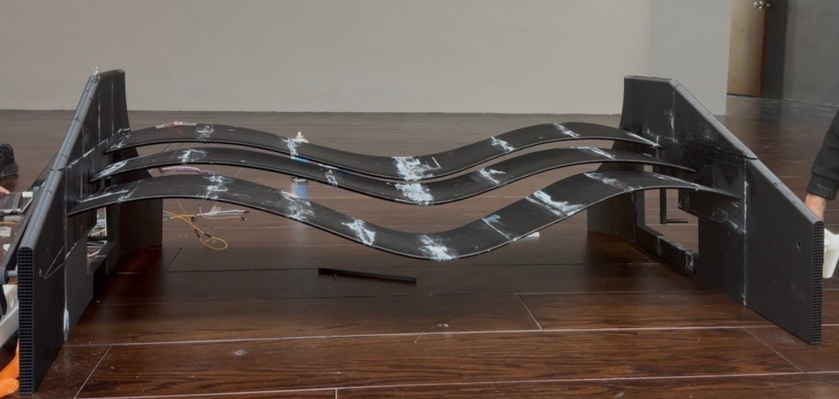
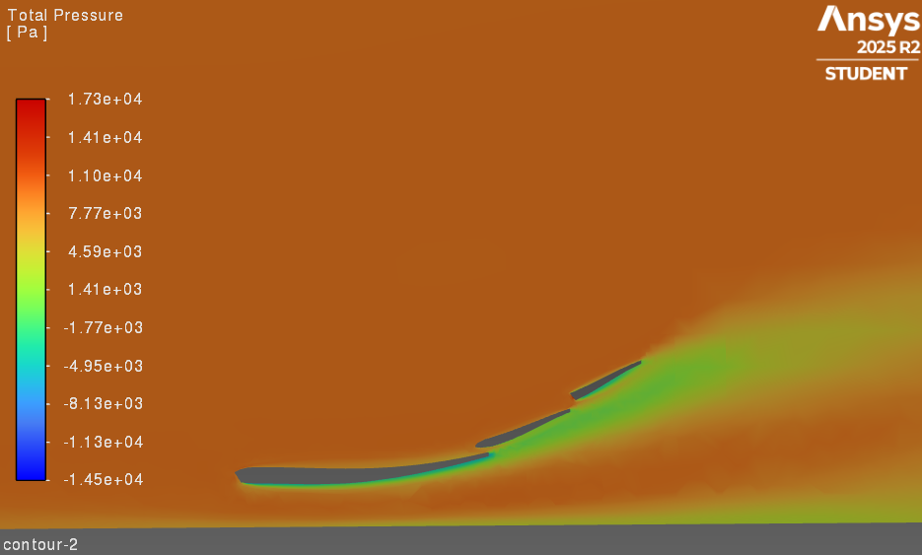
Active Front Wing for F1 Cars
TEAM
48
Nasser Alfehaid – Omar AlAzmi – Mohammed Alzaharni– Musaed – Sahal - Mohammed
Coach: Dr. Bilal Qurashi
Introduction
Constraints
Prototype Design
Lap-Time Simulation
Problem Statement:
Conventional Formula 1 front wings are designed with fixed geometries that cannot adapt to changing driving conditions such as speed variations, cornering, and braking. This limitation leads to a trade-off between maximizing downforce for grip and minimizing drag for straight-line speed. As a result, overall aerodynamic efficiency and vehicle performance are compromised.
Solution:
This project proposes an active front wing system that dynamically adjusts the flap angle in real time. A servo-driven mechanism is used to control the wing angle within a range of 0° to 25°, based on vehicle conditions such as speed. This adaptive system aims to optimize aerodynamic performance by increasing downforce when needed and reducing drag during high-speed conditions.
Front wing dimensions must not exceed 2000 mm × 600 mm
Effective operating speed range: 150 km/h to 370 km/h
Maximum transition time between positions: ≤ 400 ms
Specifications
Front wing downforce: 2 kN ± 10% at 230 km/h
Achieve 2%–5% improvement in time-averaged lift performance compared to a fixed wing
2D Lap-time simulation and rely on physics equations
Fixed vs Active Results
CFD
Fixed | Active | Total Down Force
14132.54 N | 14605.29 | In whole lap
10738.77 | 11213.44 | In corners Only
Using the simulation results, this corresponds to an improvement of approximately 4.4% in cornering conditions..
CFD Results :
Inlet Velocity | Downforce | Percentage of Total Weight
150 km/h | 400.39 N | 11%
200 km/h | 866.02 N | 22%
330 km/h | 1959.0 N | 53%

