Slide 1
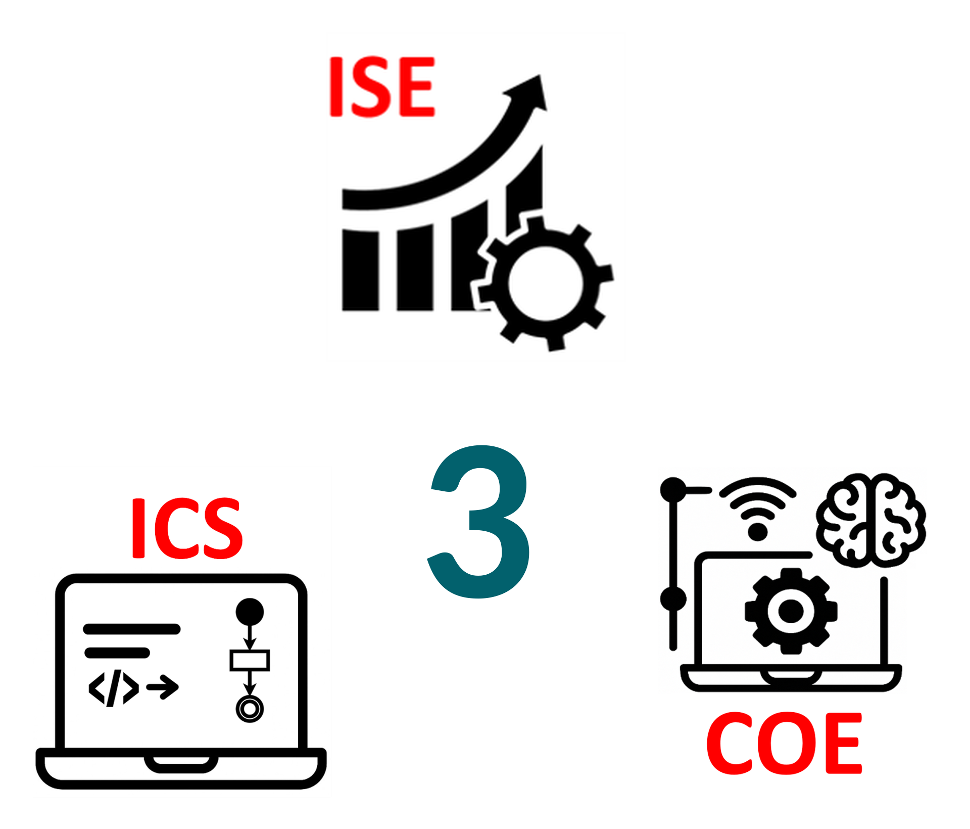
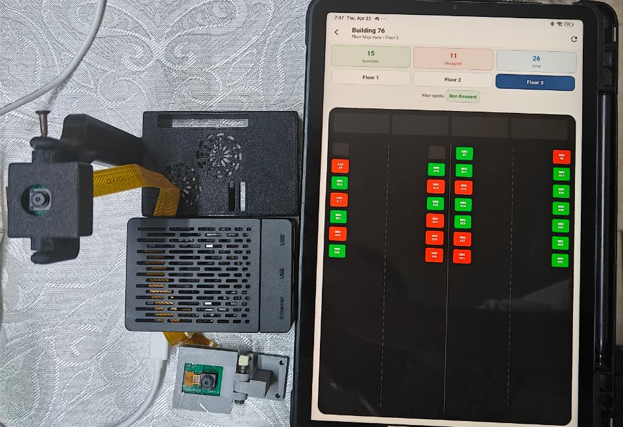
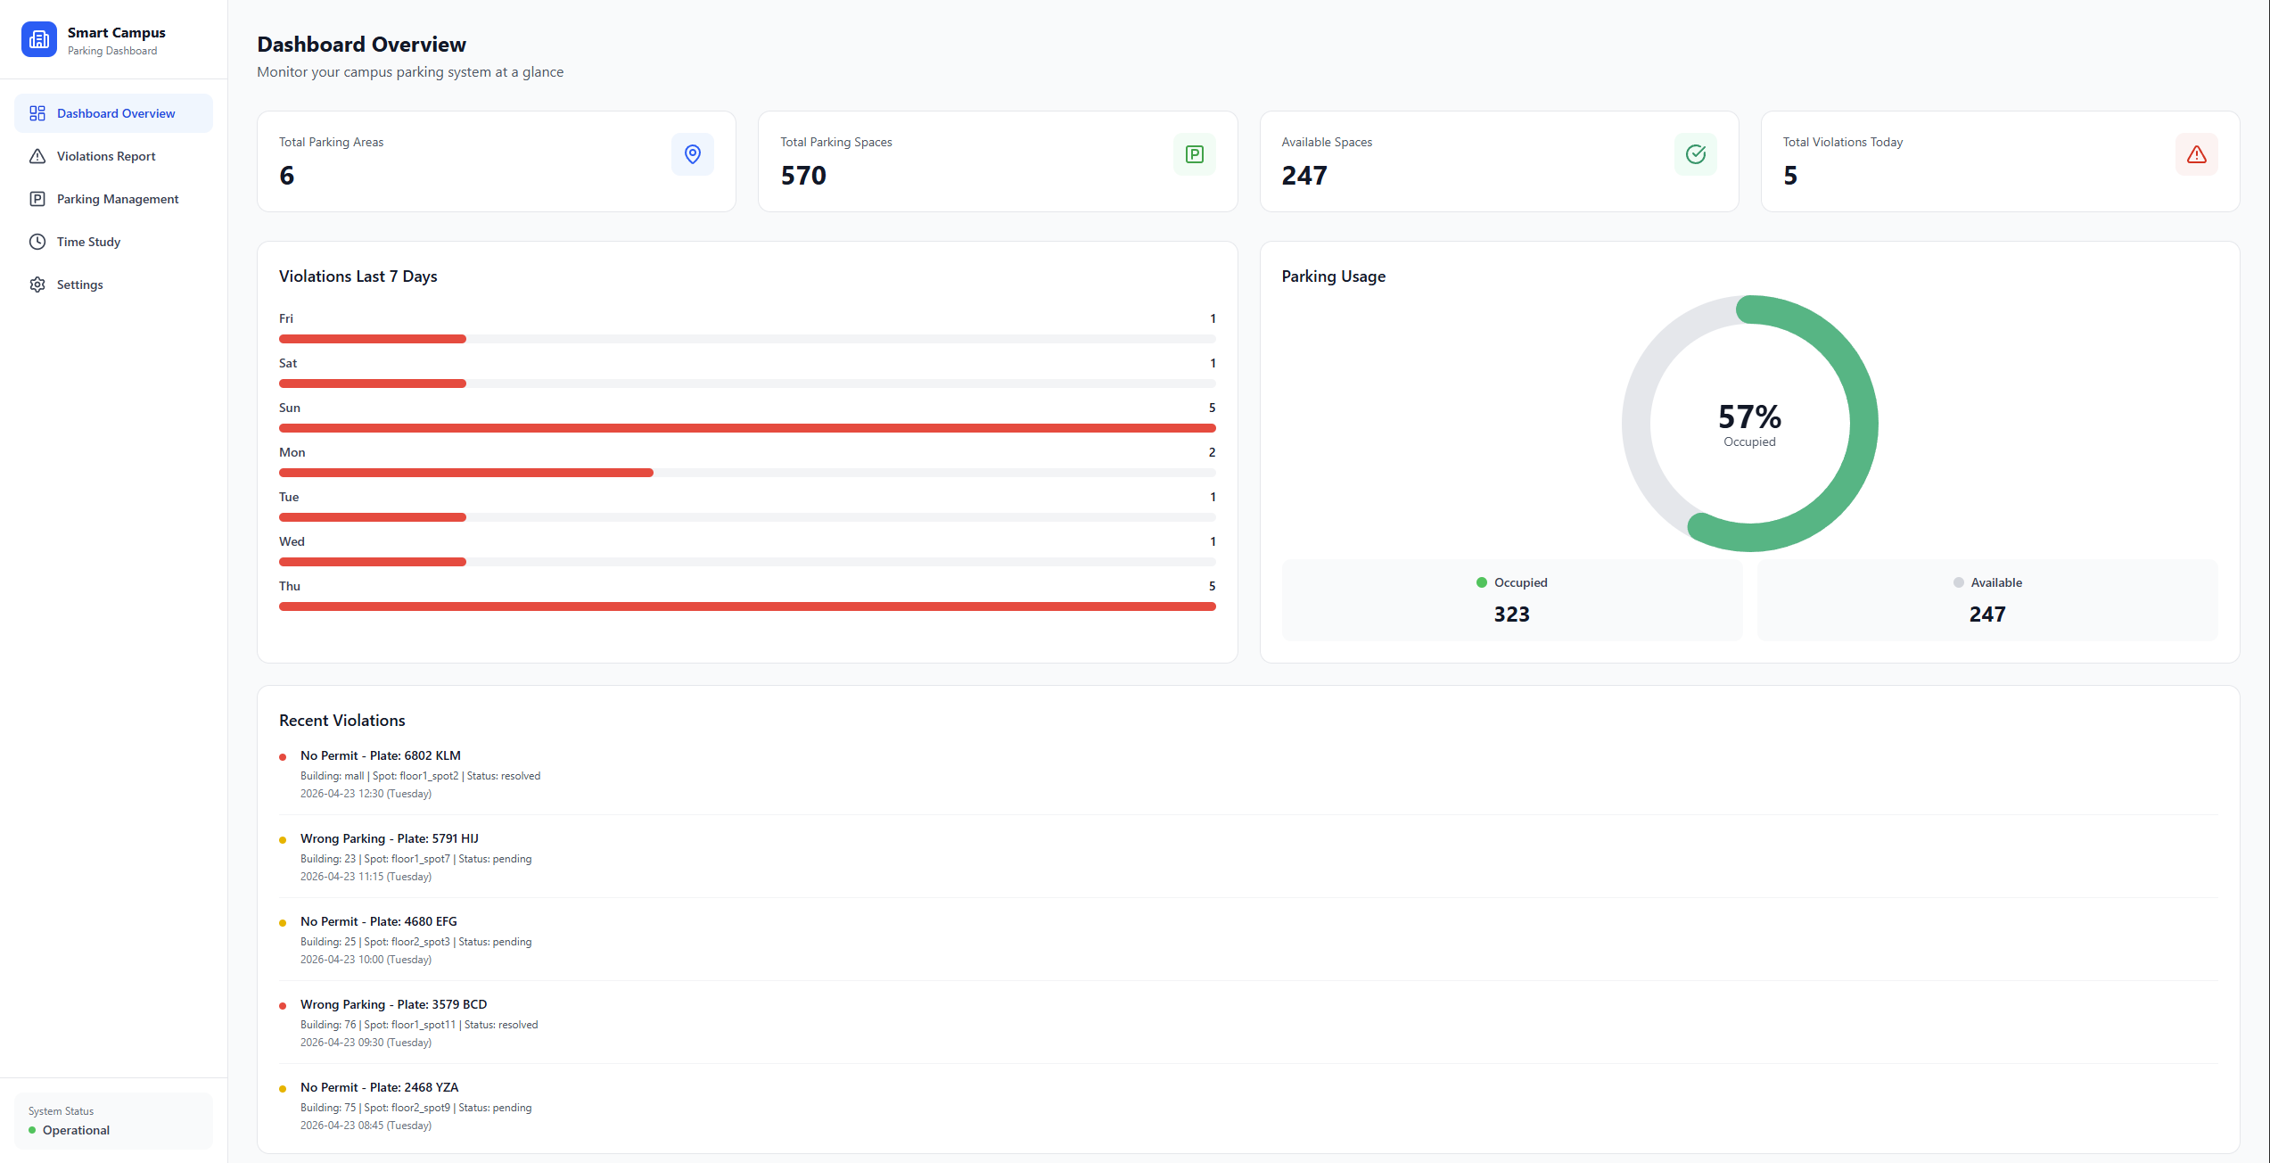
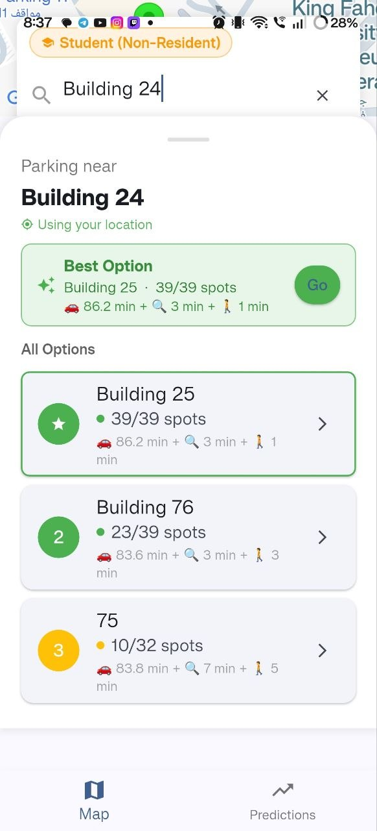
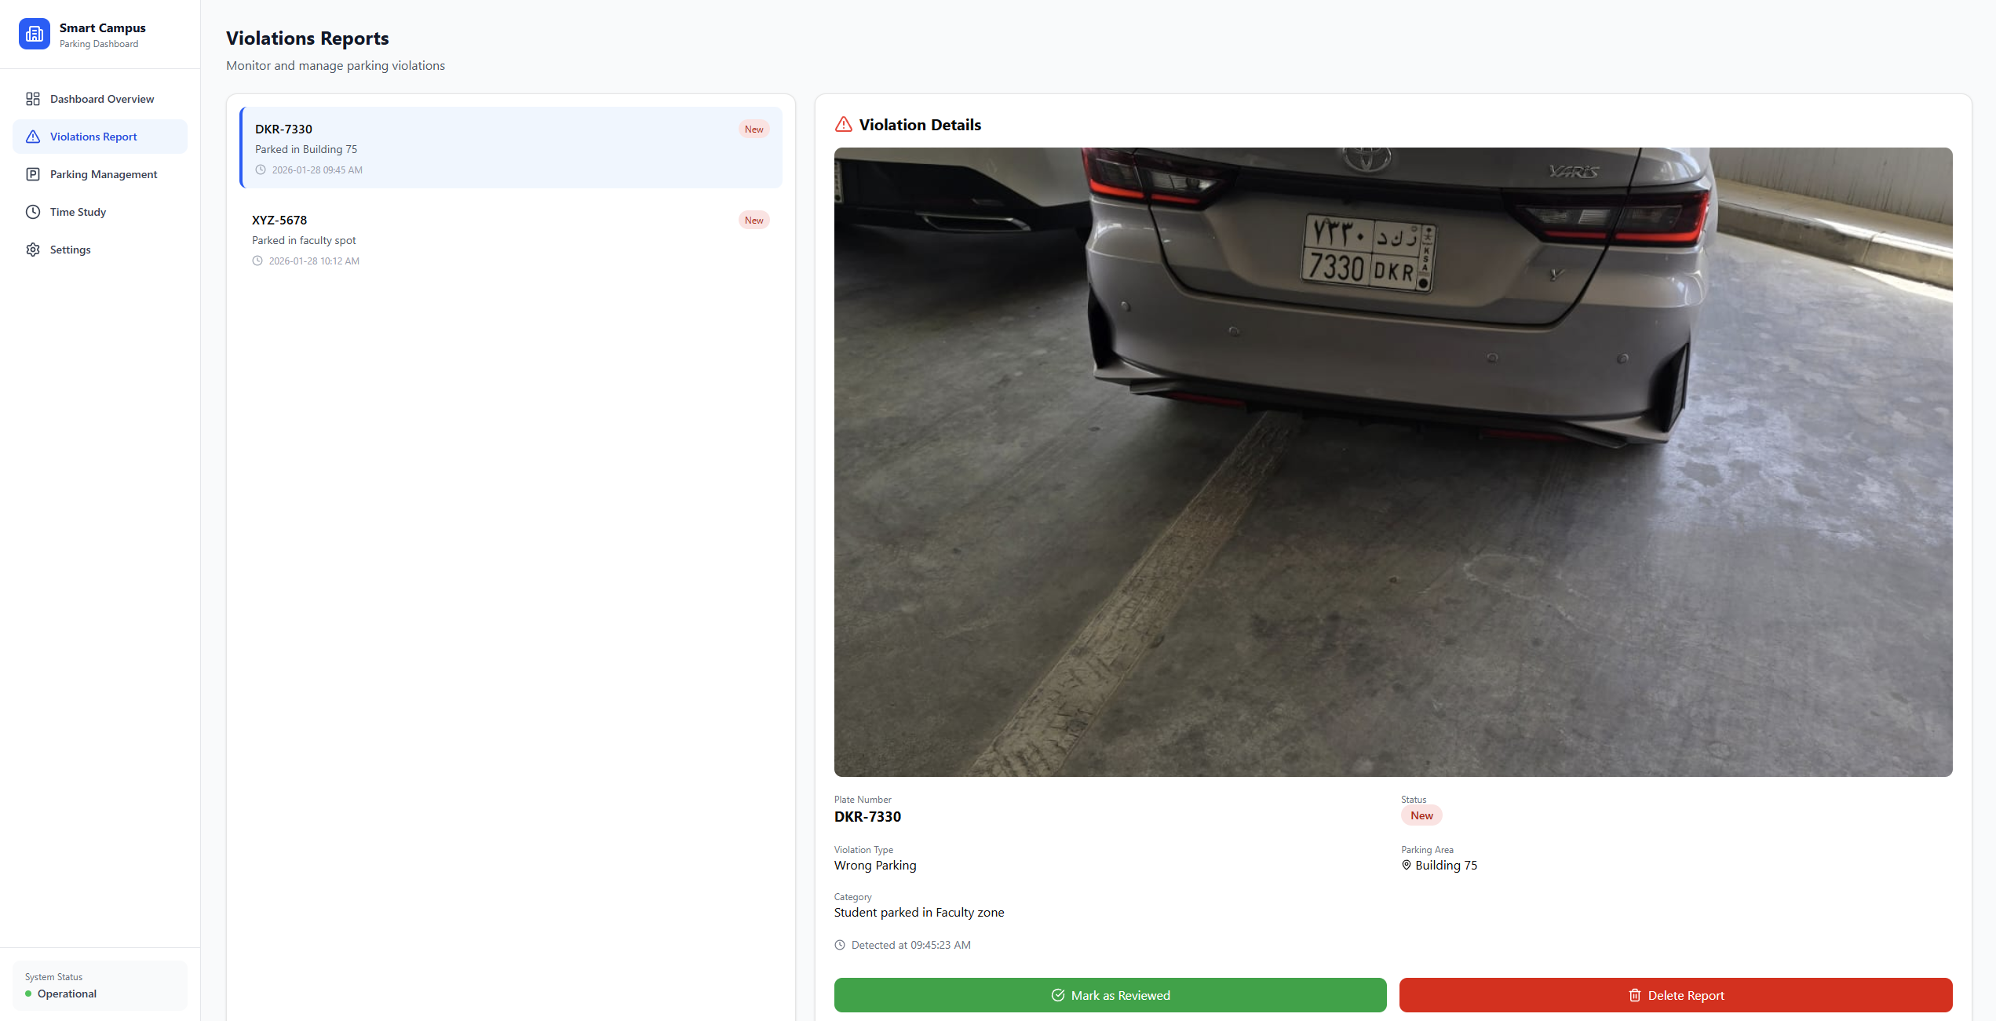
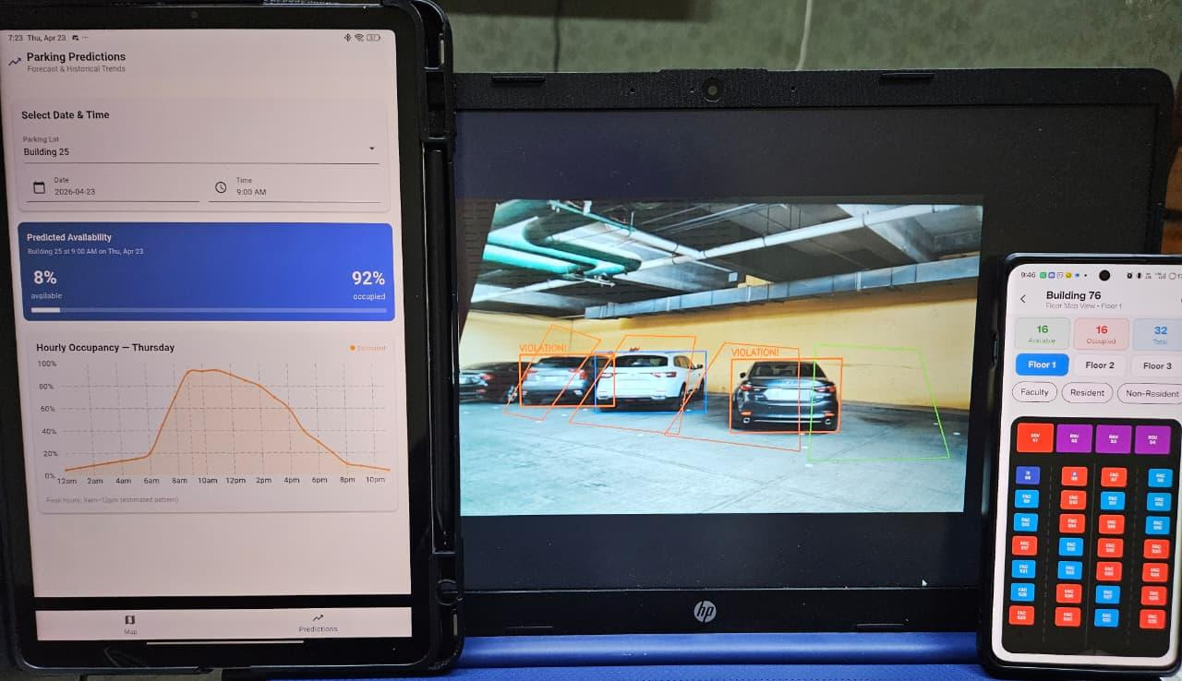
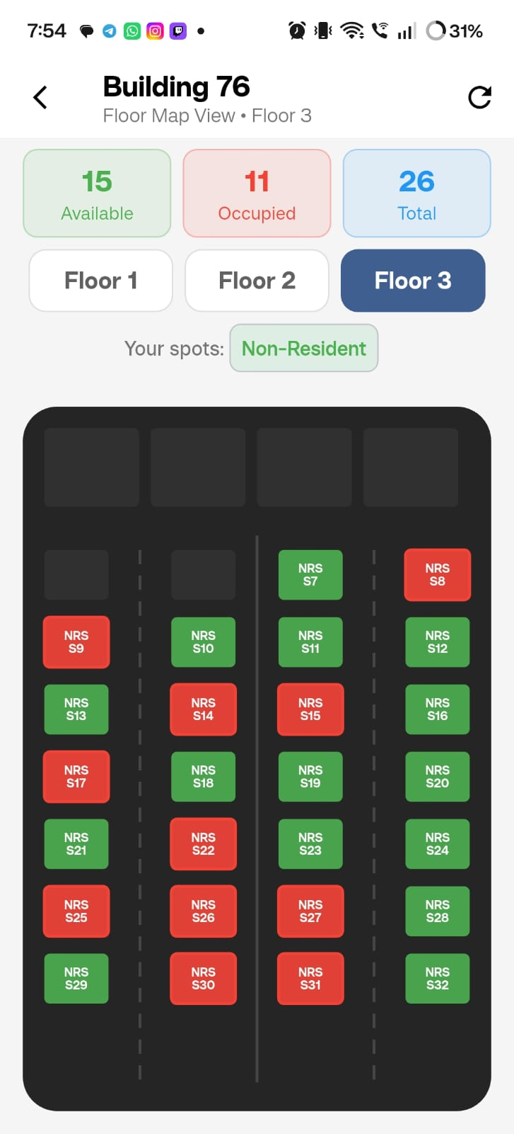
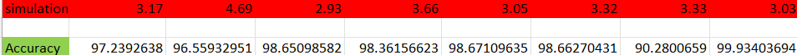
SMART PARKING AVAILABILITY
& PREDICTION FOR CAMPUS
TEAM
M018
Hassan Al-salam, Hassan Al-Sadah , Abdulhamid Al-Jawad , Ahmad Al-Ghumgham, Sajjad Arafat, Haider Al-Faraj
Coach: Omar Eldalgamouny
Objective
Specifications
Testing / Validation
Prototype Design
Develop a smart parking system that provides real-time availability and predictive insights to reduce parking search time, congestion, and user frustration on campus.
Reaching parking status within 3 taps
Updating parking availability every 5–10 seconds.
The app must support iOS 14+ and Android 10+
Maximum detection latency ≤ 1 second
The optimization model should select the nearest parking area to the building
Map view must load all parking lots within 2 seconds.
Admin dashboard: ≤2-click violation review (images <3s), real-time monitoring (≤5s), instant updates, and stats load ≤5s.
Users see only permitted parking lots by category.
Simulation parking demand with ≥ 85% accuracy.
System classifies parked vehicles as Allowed or Violation based on zone and parking rules.
month Historical data retention and have prediction accuracy of ≥ 80%.
User can identify parking status within 2s.
parking availability detection Having an accuracy ≥95%
system uptime >= 99%
Some tests were done to validate the specifications especially time related ones
Problem Statement
Parking at KFUPM is inefficient and time-consuming. Many users spend 5–15 minutes searching for spaces, with nearly half arriving late due to parking difficulties. This results in traffic congestion, increased fuel consumption, stress, and reduced productivity.
Conclusion
The Smart Parking System addresses parking challenges at KFUPM by integrating computer vision, real-time data, and predictive analytics to provide accurate availability and recommendations. The system demonstrates a functional prototype and meets key performance requirements. It has strong potential to reduce search time, congestion, and emissions while improving overall campus experience.
Constraints
Forecast Models Must Be Periodically Retrained
Maximum ongoing operational cost of SR 350 per month
Maximum initial investment of SR <15,000
Limited server resources (CPU,memory, bandwidth) for handling 500+ users
Requiring Wi-Fi connection availability in the parking lot for the
Sensors must operate in 0 –55°C and withstand dust and humidity

