Slide 1

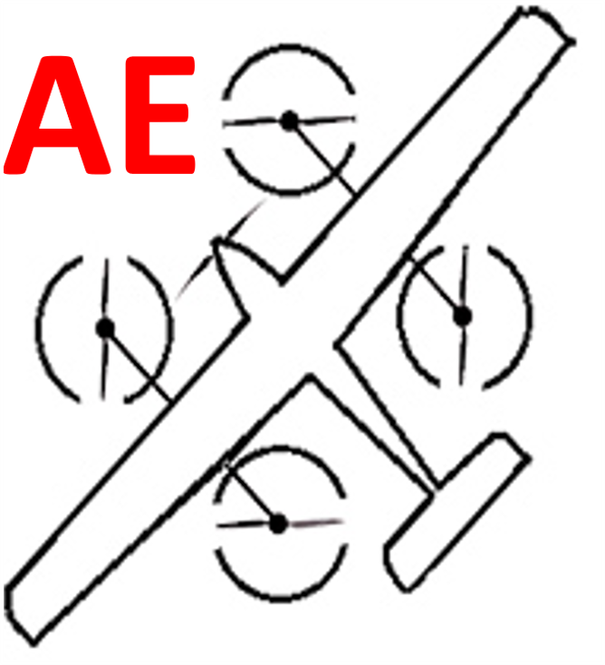


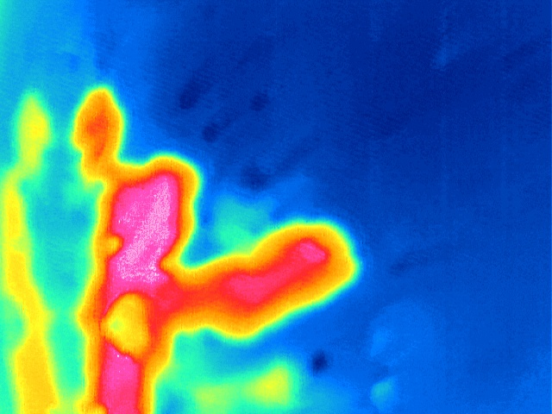
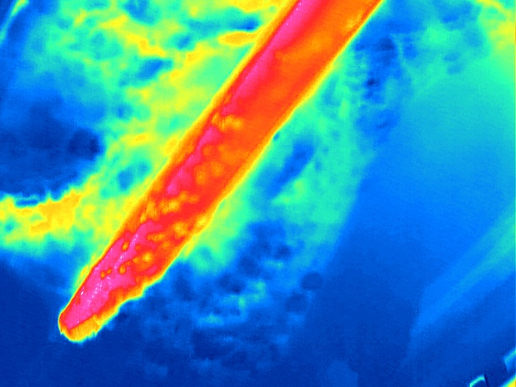
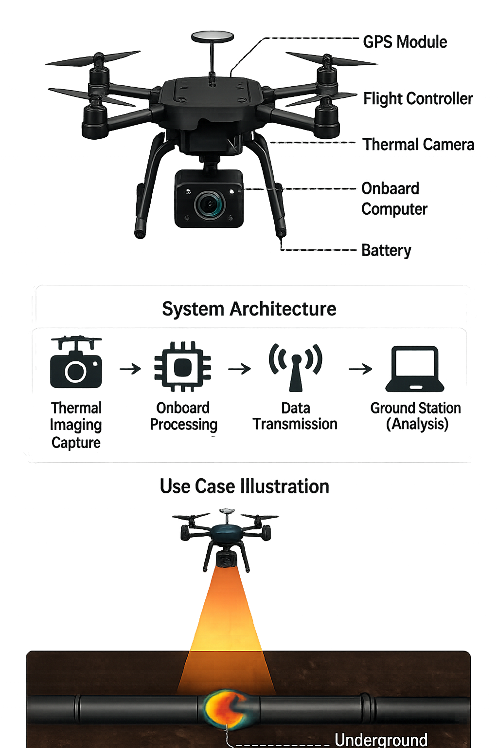
Manual ultrasonic inspection is too slow and costly for extensive underground pipelines. This inefficiency delays leak detection, risking environmental damage and high operational expenses. Using thermal drones to identify surface temperature anomalies provides a rapid, cost-effective screening solution. This targeted approach minimizes manual effort and significantly accelerates the inspection process.
Drone With Thermal Imaging System for Detecting Remote Underground Damaged Pipelines (SHAHM)
Manual ultrasonic inspection is too slow and costly for extensive underground pipelines. This inefficiency delays leak detection, risking environmental damage and high operational expenses. Using thermal drones to identify surface temperature anomalies provides a rapid, cost-effective screening solution. This targeted approach minimizes manual effort and significantly accelerates the inspection process.
TEAM
M013
5
Hassan Alobaidan, Hussain Alabdullah, Sajjad Alahmed, Ali Ethowani, Mohammed Alatafi
Coach: Dr. Abdulaziz Mohammed Al-Qwbaiban
Introduction / Background
Constraints
Prototype Design
Testing / Validation
Underground Pipe inspection needs manual inspection using ultrasonic devices, which is accurate but slow and costly for long underground pipelines since it requires close scanning and long times. Our project proposes using a drone with thermal imaging to detect surface temp anomalies from leaks which helps quickly identify suspicious areas. This will reduce time, effort and costs.
Constraints | Met? | Constraints | Met?
The maximum weight load of the drone should be less than 5 Kg |  | Finance: Budget for building the prototype shouldn’t exceed the university’s limit budget.
The system should endure temperature ≤ 30 C and dust resistance. |  | The visualization application shall run on Windows
The autonomous program and the visualization app should be compatible with each other for data transmission |  | The machine learning model should be compatible with 640 x 512 JPEG or R -JEPG
The system should comply with Saudi Laws and Regulations.
A thermal image showing a racked pipeline compared to a normal pipeline.
A 98% Accurate AI model.
Problem Statement
Specifications
Conclusion
Manual ultrasonic inspection is too expensive and unreliable for vast underground pipeline networks. This inefficiency delays leak detection, leading to high costs and environmental risks. Our project uses thermal drones to rapidly pinpoint surface temperature anomalies for targeted repair. This shift from manual scanning to aerial screening significantly reduces time, effort, and operational expenses.
Specifications | Met? | Specifications | Met?
Reducing total assessment time and cost by at least 50% compared to manual inspection methods |  | The maximum distance between the drone and the ground station shall not exceed 6 km.
The operating system should not exceed 30% of total memory. |  | Wi -Fi operating band for image transmission should support 2.4 GHz
100% automated system with minimum distance of 1 Km in a single operation without battery recharging. |  | The system should show the coordinates of the detected leakages relative to a reference point (0,0) on the visualization app.
The image processing time must be ≤ 60ms |  | The battery must yield a power of ≥ 700 W
Battery endurance of at least 20 minutes per flight. |  | The ability to detect underground pipeline defects up to a depth of 0.5 m.
Inspection coverage rate of 0.8 m²/s. |  | The AI classification model confidence should be ≥ 85%
A complete drone-based system was designed and developed, including the drone platform, power distribution system, thermal imaging integration, and an AI model for leak detection. A visualization application was also created to present the results to the user. All components were successfully integrated and tested as a unified system.

