Slide 1




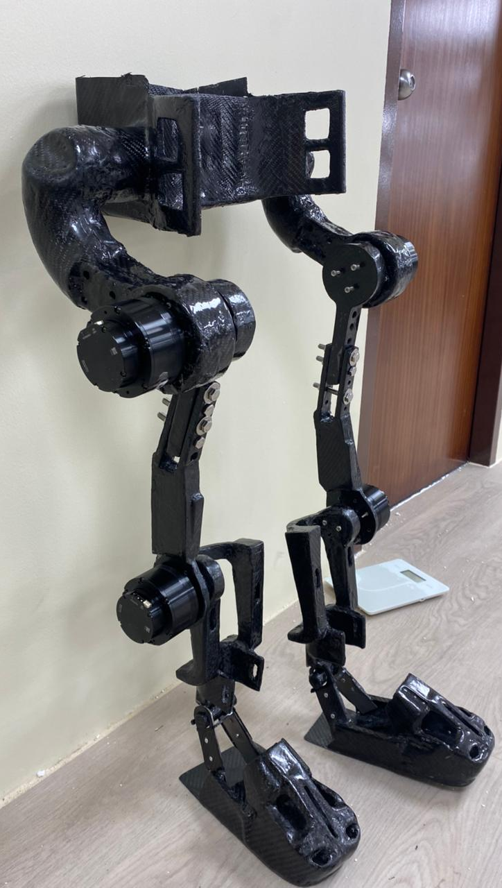
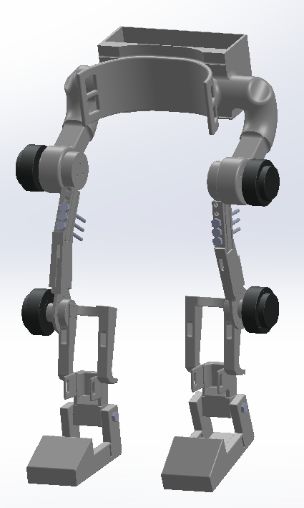
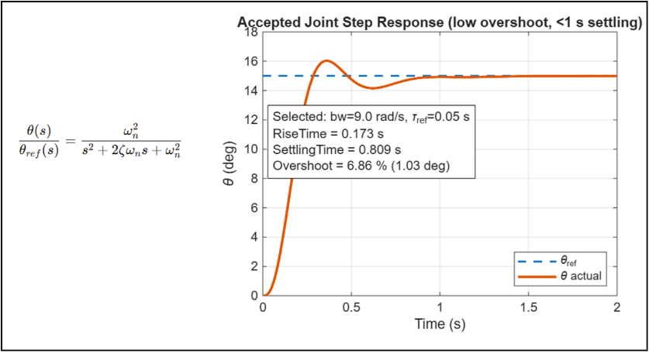
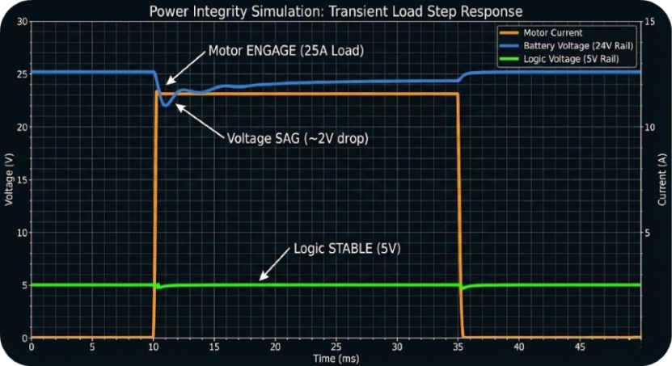
Self-Balanced Pediatric Lower-Limb Exoskeleton
for Children’s Gait Rehabilitation
TEAM
007
4
Khaled Mahmoud, Sameer Alsaba, AlMoayad Alsadi, Jehad Alsulami, Saad Alshami, Khalid Alsaeed
Coach: Dr. Mohamed Faten Zhani
Introduction & Problem
Key Constraints & Specifications
Prototype Design
Results & Conclusions
Problem Statement
Design a child-specific lower-limb exoskeleton for supervised rehabilitation outside clinics.
Children with gait impairments need frequent rehabilitation.
Current therapy is manual and clinic dependent.
Most existing exoskeletons are designed for adults.
Goal: safe and lightweight gait assistance for children.
Total mass ≤ 18 kg. Lightweight, high strength structure.
Operates at 0–40 °C.
Sized for pediatric users.
Carbon fiber mechanical frame.
Hip and knee geared motors.
IMU, encoders, and foot sensors.
STM32 based control with safety features.
Operating Modes
Standing support.
Assisted walking.
Rehabilitation / training.
Emergency stop.
Manual height adjustment with locking pins.
Inline motor mounting to reduce bending moments.
Structural safety factor > 2.
Stable control response achieved.
System is technically feasible for pediatric rehabilitation.
Future work: clinical testing and control refinement.
Conclusion
Final design is technically feasible, child-specific, and safety-focused.
Future work: hardware identification, clinical testing, adaptive control refinement.

