Slide 1
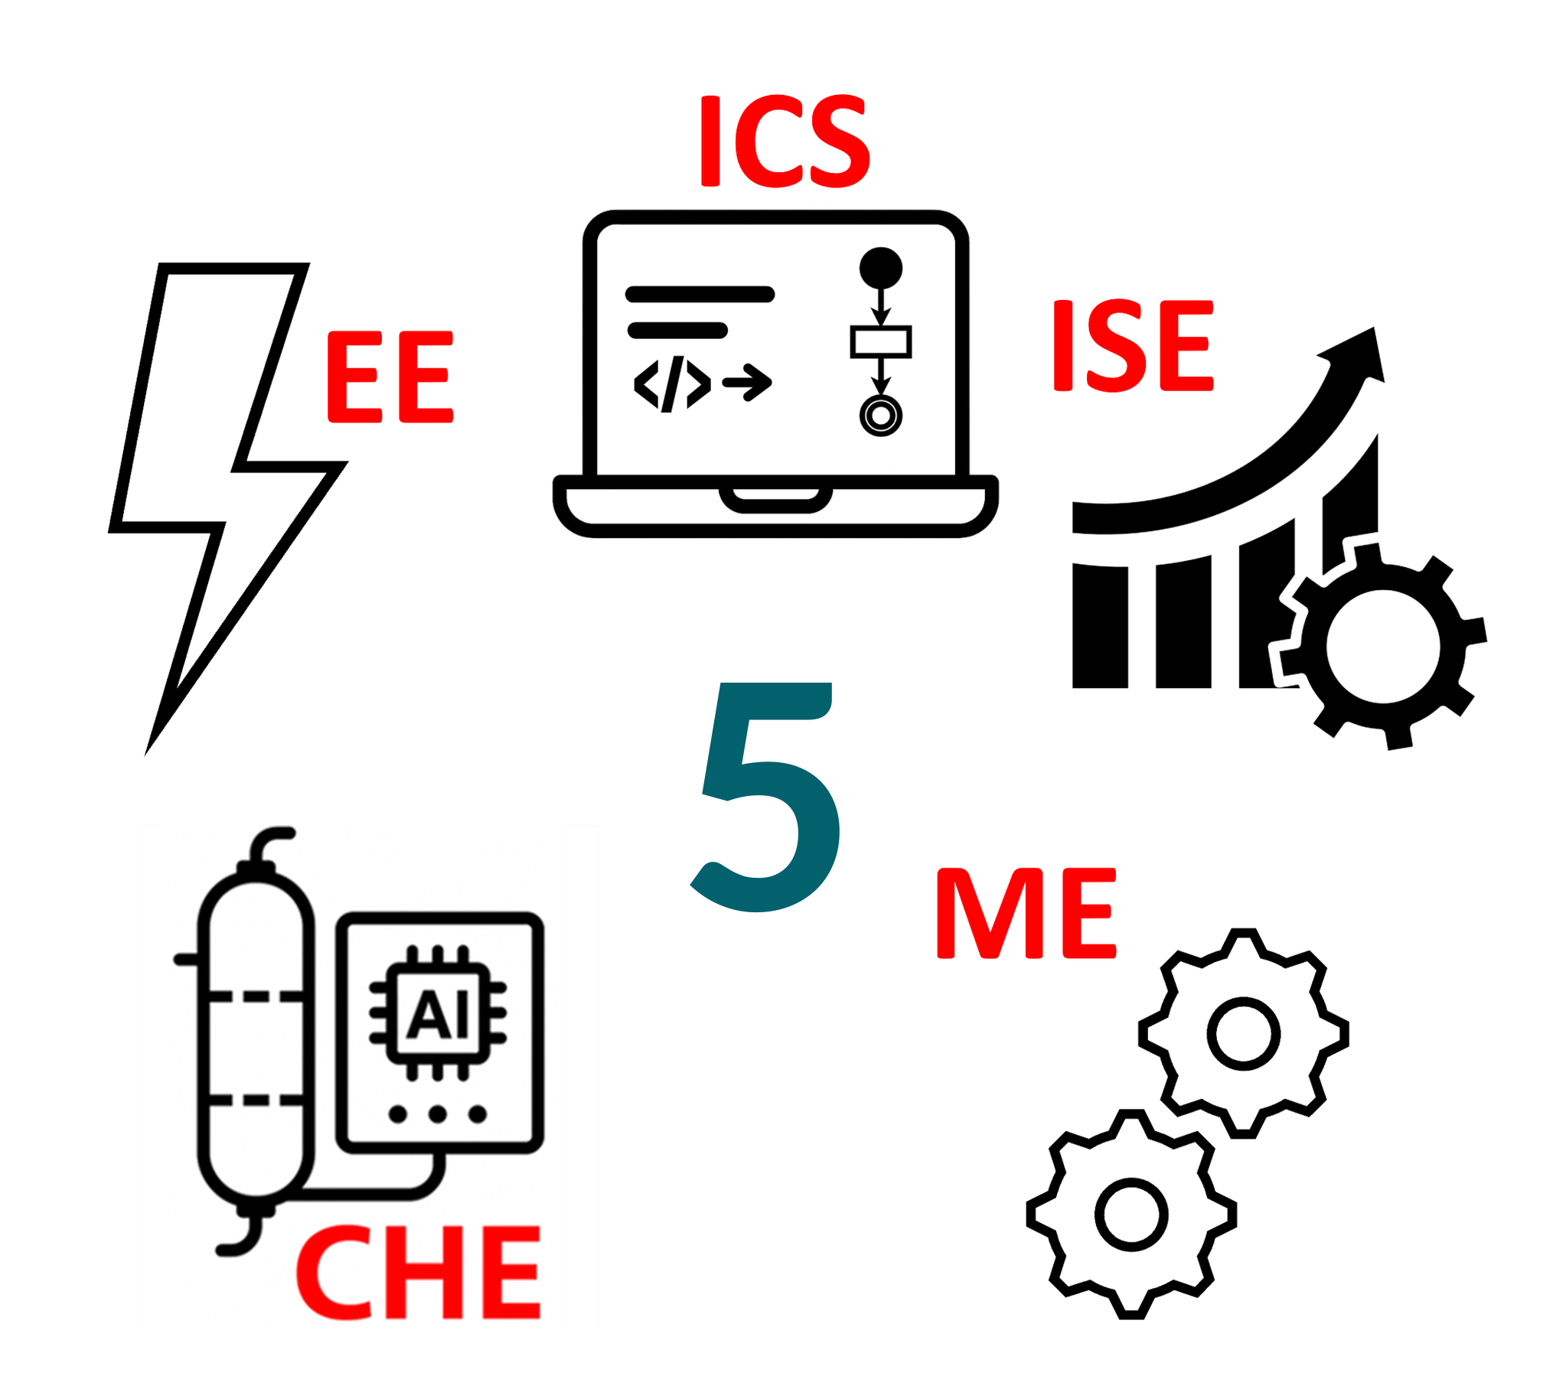
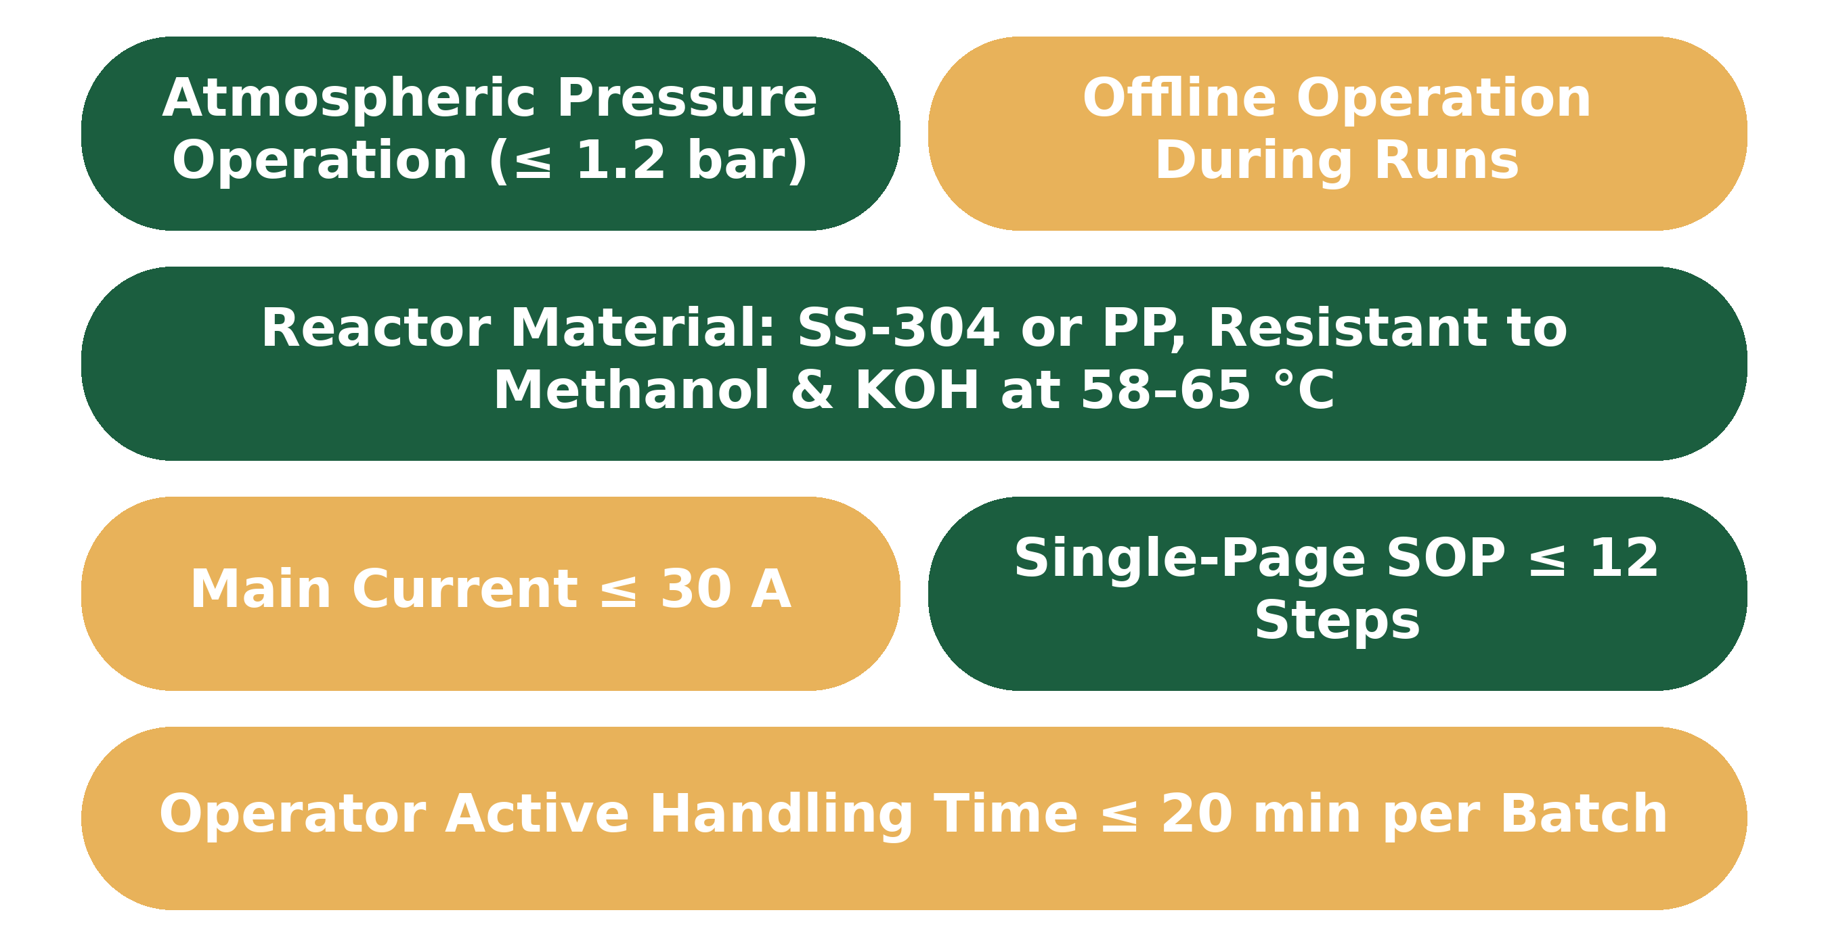
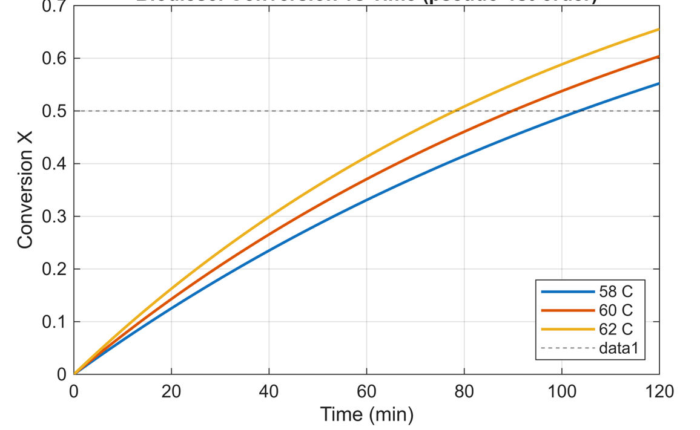
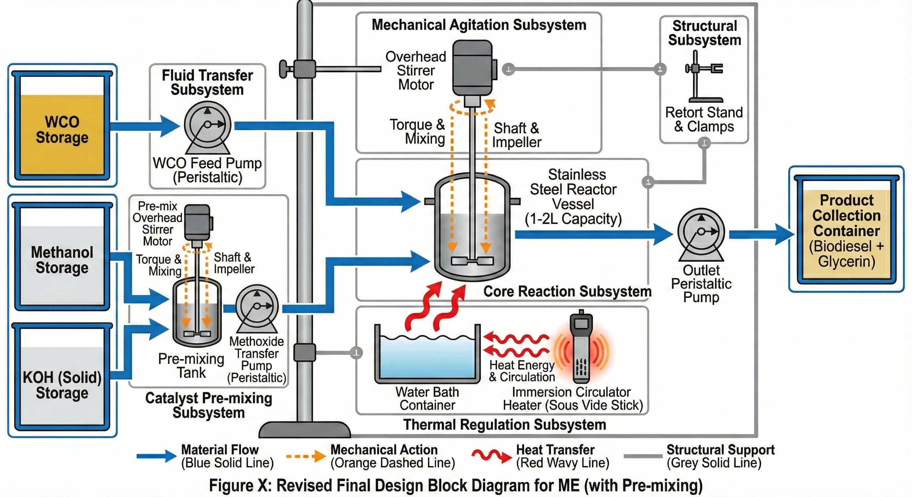
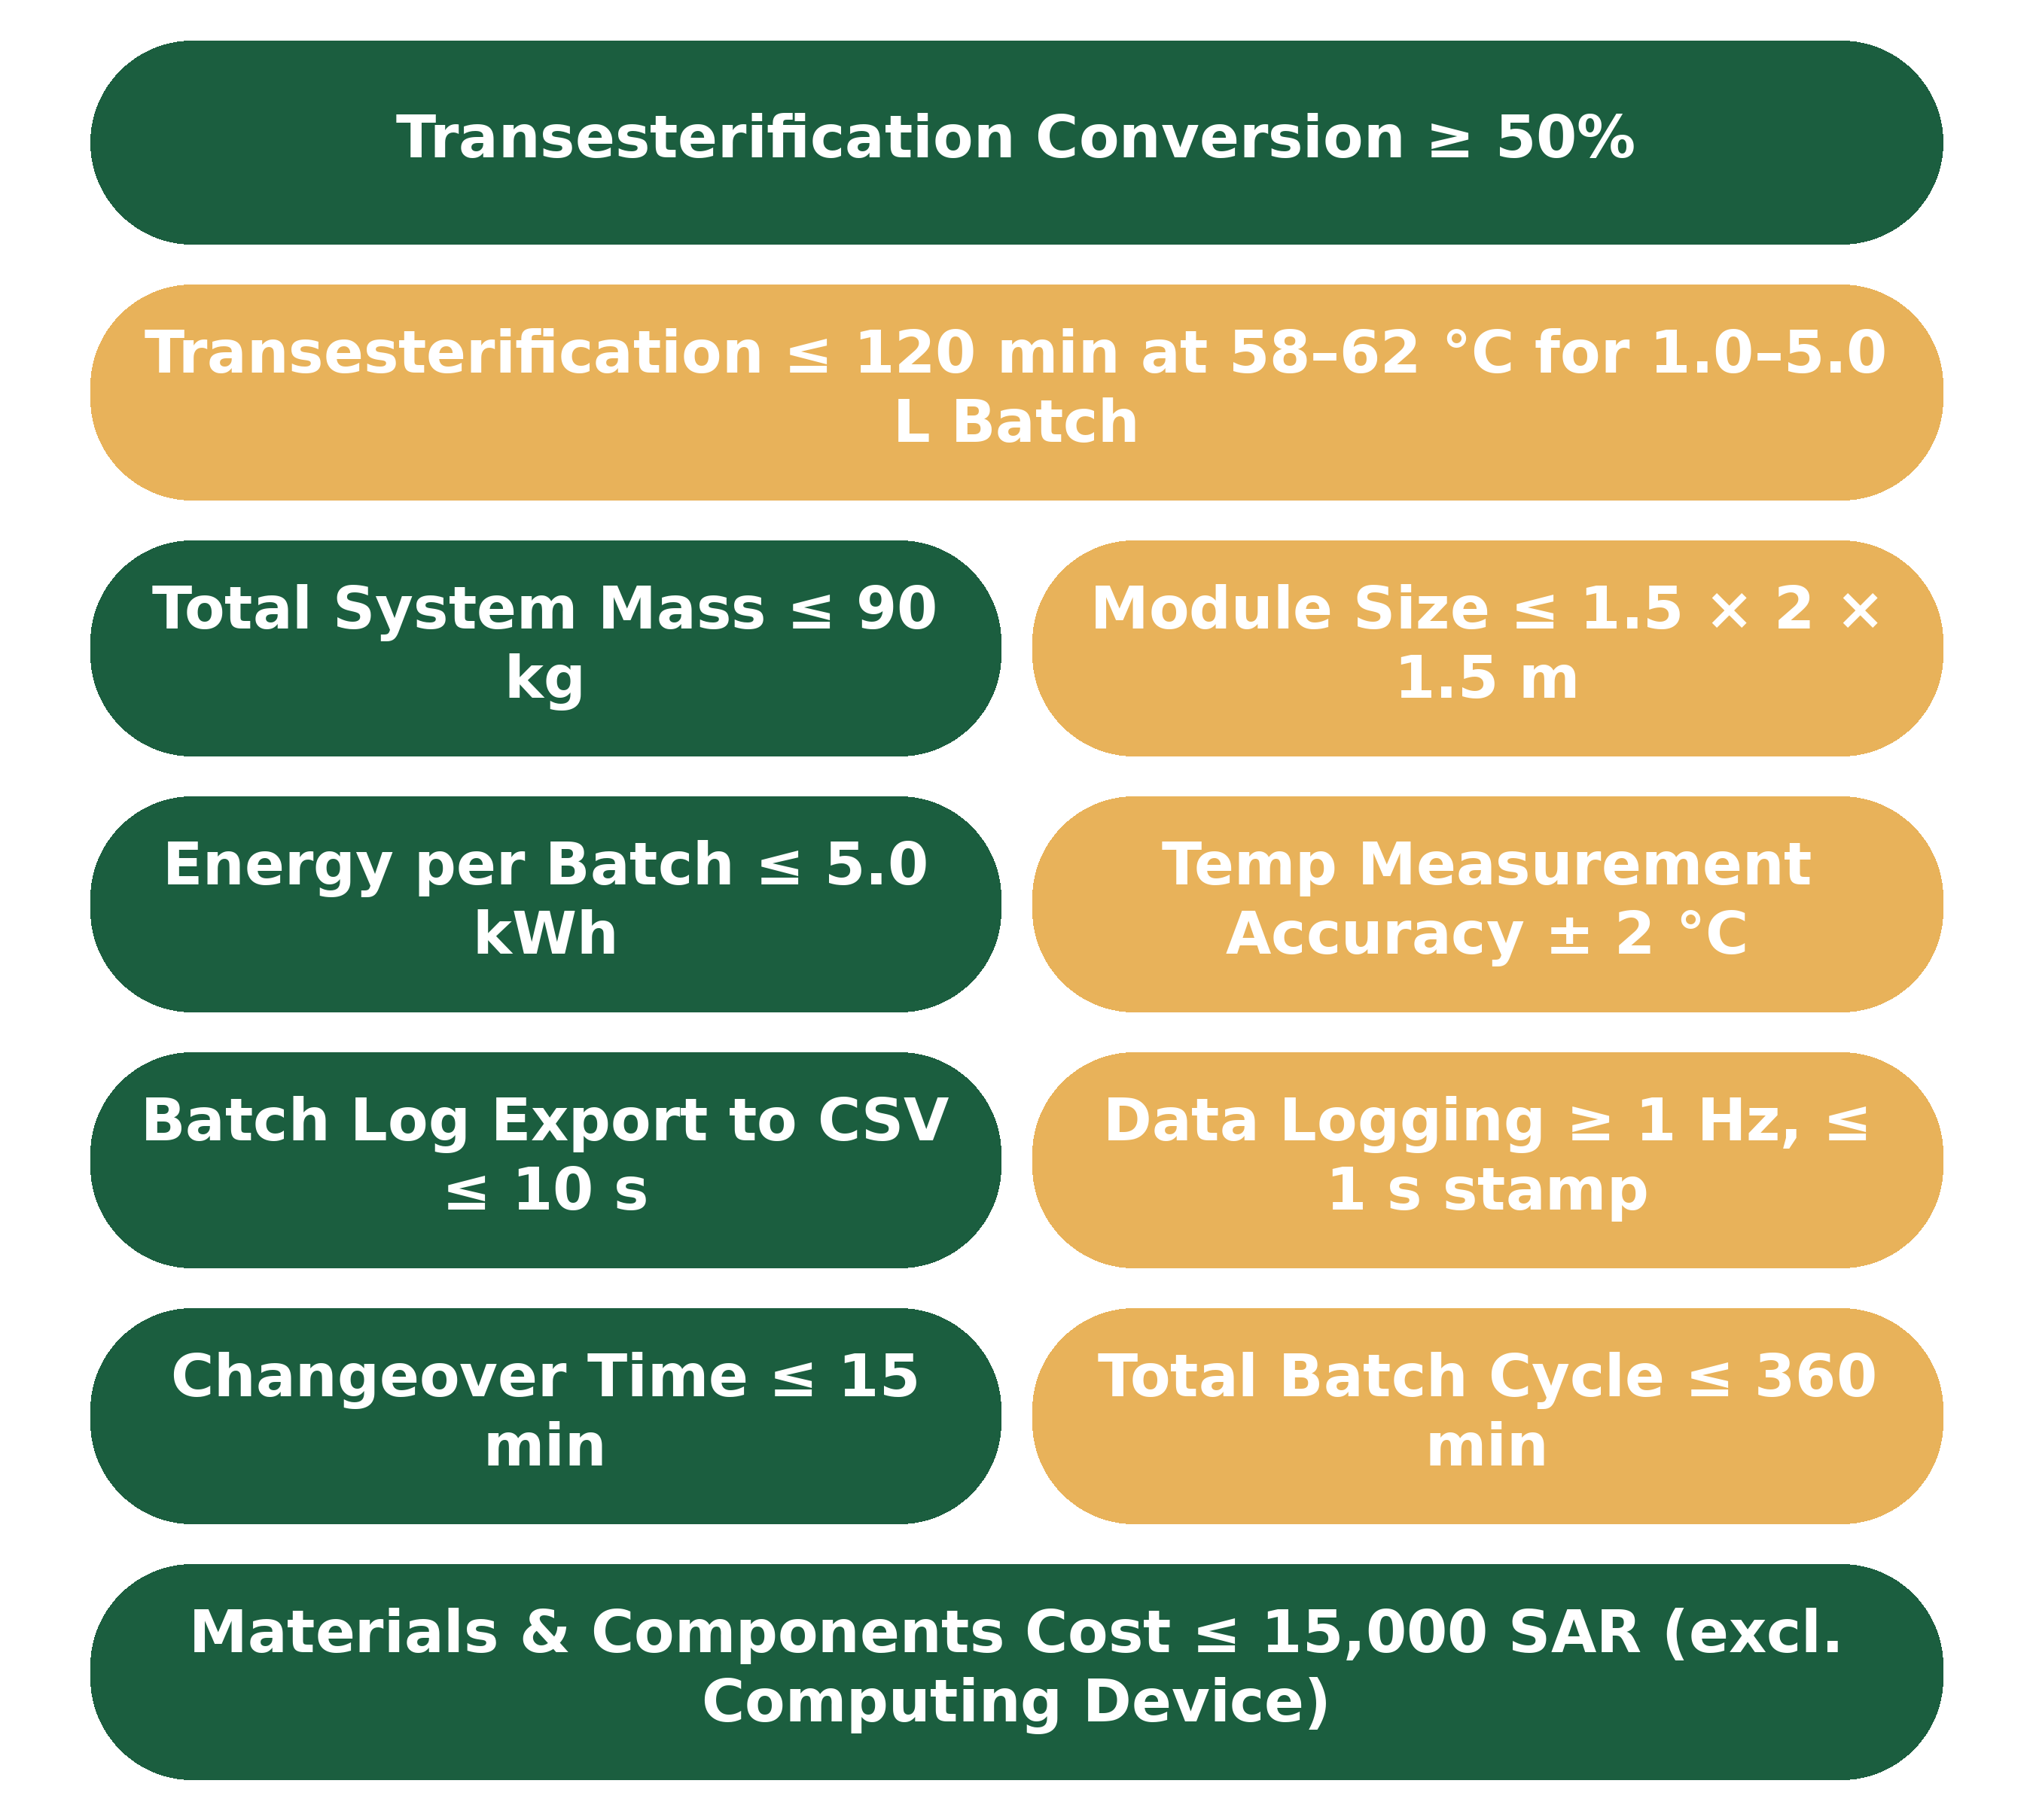
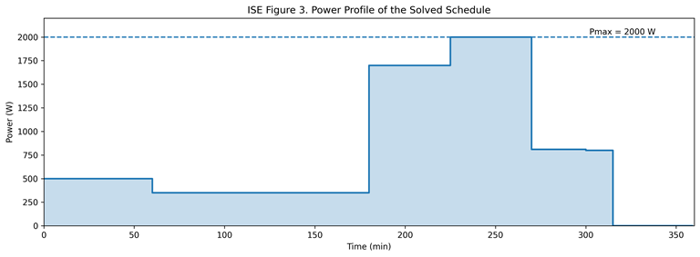
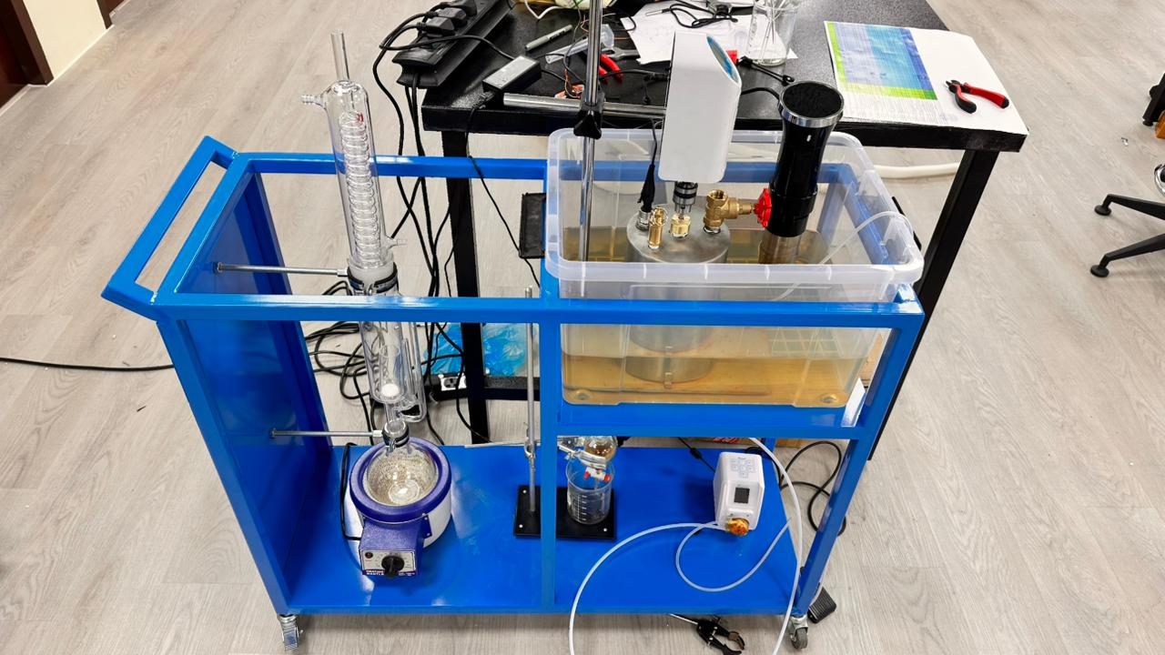
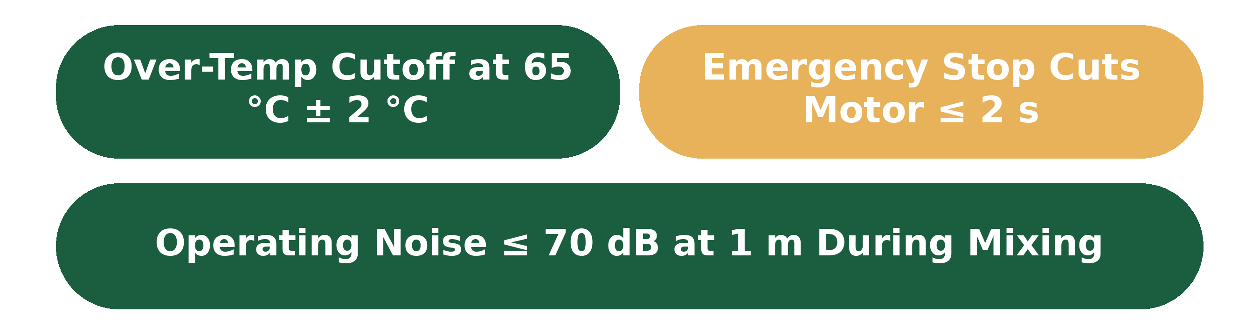
Modular Portable Biorefinery for Waste Coffee Conversion
TEAM
M061
Aseel Brbaa, Fahad Alqahtani, Suad Majed Alsubhi, Hassan Majed Alhulays, Abdulaziz Alhaimi, Abdulrahman Almufadhi
Coach: Dr. Muhammad Niazi
Background
Constrains
Testing & Validation
Spent coffee grounds are generated in large quantities and are often discarded despite their value as a feedstock. They contain oil and residual solids that can be converted into biodiesel and biochar. However, small-scale conversion systems often lack portability, integration, and clear performance verification.
Problem Statement
Specifications
Conventional spent-coffee conversion systems are often non-portable, loosely integrated, and weakly verified, limiting practical operation, safe control, and reliable performance assessment.
Objective
Design, build, and validate a modular portable biorefinery that converts spent coffee grounds into biodiesel and biochar while meeting key safety, operational, and performance requirements.
Prototype Design
Conclusion
The project delivered a five-discipline integrated modular biorefinery for waste coffee conversion, combining extraction, reaction, monitoring, and control in one portable system. The final design met major safety, operational, and performance requirements, demonstrated feasible biodiesel conversion, and validated the biochar pathway through simulation.
Integrated Specifications

