Slide 1
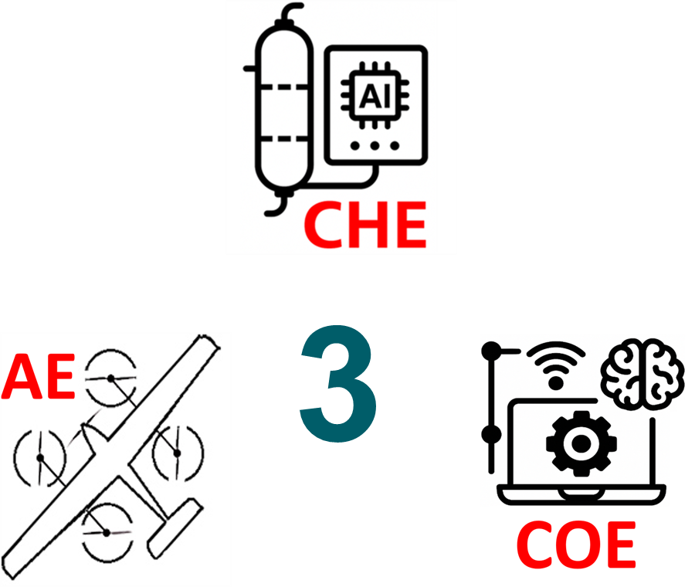
Emergency Capsule Ejection System for Commercial Aircraft
TEAM
055
FERAS AL-GHAMDI, ABADI ABADI, RAYAN AL-ADALAH, RASHED AL-BENSAAD
Coach: Dr. Uthman Baroudi
The Big Idea
How the System Works
Building the Prototype
What Comes Next ?
The Emergency Capsule Ejection System (CES) reimagines commercial aviation safety by combining two powerful aerospace concepts: the ejection seat mechanism used in fighter jets and the stage-separation architecture of orbital rockets. Inspired by these proven systems, CES transforms the passenger cabin into a detachable rescue capsule capable of separating from a failing aircraft, stabilizing aerodynamically, deploying staged parachutes, and landing with controlled impact. To bring this ambitious idea into a practical engineering context, a 3D-printed prototype was built to demonstrate the core mechanical behavior of the full-scale system, allowing the team to explore its feasibility through hands-on testing and visualization.
CES relies on a carefully coordinated sequence modeled after real aerospace technologies. The capsule separates from the aircraft in a manner similar to rocket stage separation, ensuring a clean and balanced release. Once detached, its behavior mirrors the stabilization logic of military ejection systems, achieving aerodynamic balance before deploying multi-stage parachutes for controlled descent. These principles were analyzed through aerodynamic modeling, CG studies, and structural load predictions. The 3D-printed prototype incorporates the same logic through its wing geometry, fuselage design, and solenoid-based release system, enabling a scaled demonstration of how separation alignment, stability, and descent dynamics function in practice.
Developing the prototype required translating the engineering logic of ejection seats and rocket separation mechanisms into a compact, functional model. The aerospace team designed, printed, reinforced, and assembled the entire airframe, including fuselage segmentation, wing installation, and structural mounts that reflect stage-separation interfaces. A solenoid-based mechanism was integrated to emulate the “lock-and-release” behavior found in real aerospace systems. While Computer Engineering provided wiring and activation circuitry, nearly all mechanical, structural, and aerodynamic work was completed by Aerospace Engineering. The result is a scaled model that physically represents how these two high-reliability concepts can be adapted into a civilian-aviation safety design.
Analytical models and prototype observations suggest that a full-scale CES system could replicate the same principles that make fighter-jet ejection and rocket stage separation successful: clean detachment, aerodynamic stability, and staged descent. The prototype validated key mechanical behaviors especially separation feasibility and structural integrity providing confidence in the system’s conceptual foundation. Future development will focus on optimizing parachute deployment, refining structural interfaces inspired by multi-stage rockets, and integrating automated sensing and activation logic. CES ultimately represents a forward-looking approach that adapts proven aerospace technologies to create a new generation of commercial-aviation safety solutions.

