Slide 1
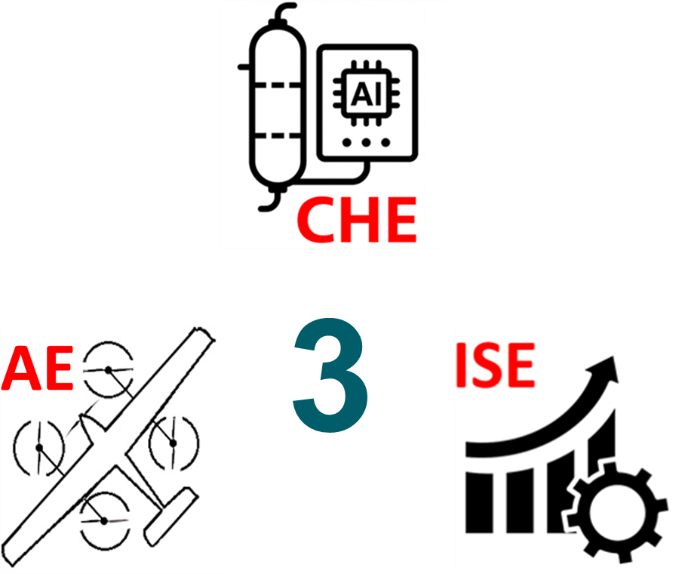
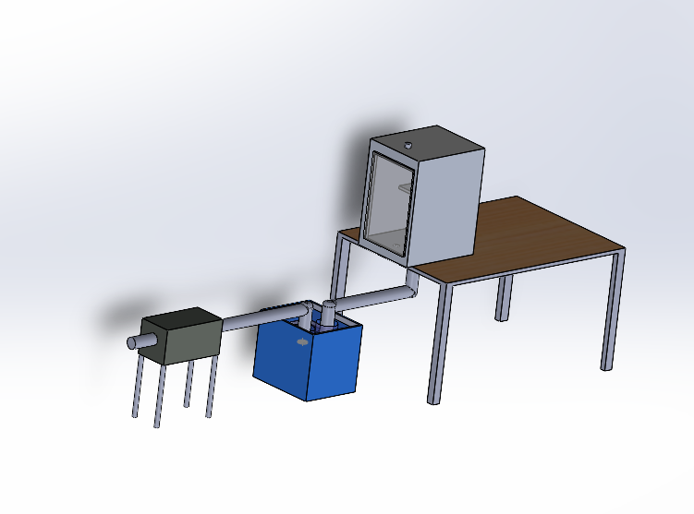
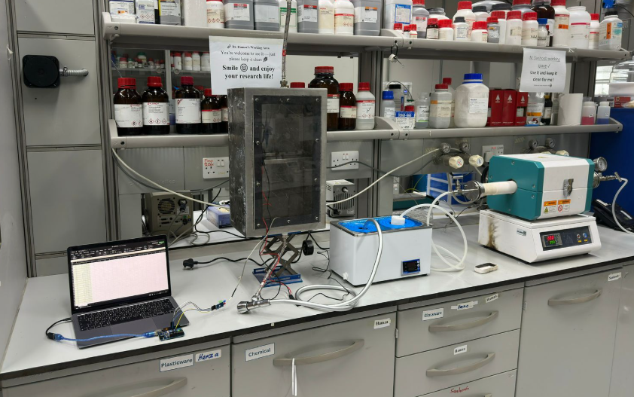
New Sustainable Bio-Ethylene Production Process
TEAM
054
Talal Alharbi, Bader Aljohani, Yousef Alzahrani, Dhari Alotaibi
Coach: Mohammad Alam
Background
Specifications
Simplified Flow
Prototype Design
This project aims to produce ethylene in a more sustainable way by using renewable fruit waste as the feedstock. By converting low-value waste sugars into high-value ethylene, the process reduces emissions, lowers cost, and provides an environmentally friendly alternative to fossil-derived production.
Process Optimization: Operating conditions tuned to minimize cost per kg while maintaining high ethylene purity.
Temperature Control: Variation held within ±3σ of the mean, ensuring 99.73% stability within control limits.
Ethanol Conversion: Minimum 60% conversion during dehydration.
Ethylene Yield: 5–7 L of ethylene per 1 kg of fruit waste.
Gas Flow: gas velocity maintained at ≥ 3 m/s.
Operating Range: Full temperature control across 30–400 °C.
Fruit Waste → Fermentation →
→ Ethanol Purification → Catalytic Dehydration → Ethylene
Engineering Contributions
Chemical Engineering
Fermentation performance
Product Separation & Purification Strategy
Process modeling
Aerospace Engineering
Heating control
Gas flow velocity
System thermal stability
Industrial Engineering
Statistical process control (SPC)
Reliability & cost optimization
Problem Statement
Conventional ethylene production depends on fossil fuels, requires 750–900 °C, and emits 1–1.6 t CO₂ per ton of ethylene.
Test/ Validation
A laboratory experiment was conducted to validate the proposed process.
Constraints
Material used must withstand >400 °C
Only waste fruit can be used as feedstock.
Fruit storage < 24 hours with buffer strategy for inconsistent supply .
Time of the reaction

